Slide 1
ksrecipe
Database

Slide 2
About Ksrecipe
Ks recipe is kind of recipe website which includes details about recipe ingridients,quantity ,stepbystep instruction easy to make recipe
It includes different course details for more they can contact from number given website.

Slide 3
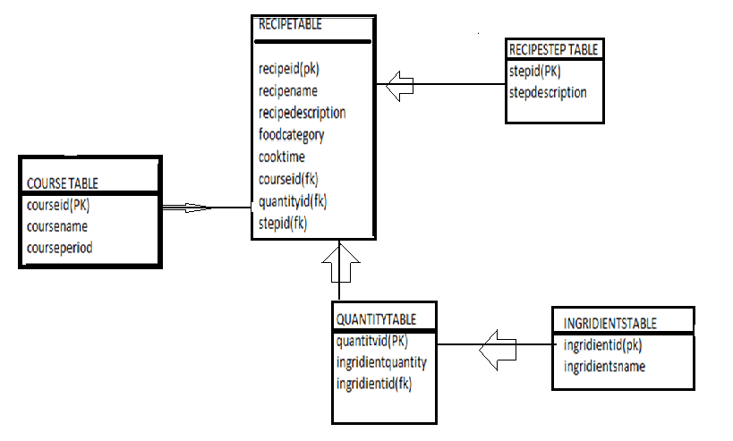
ER DIAGRAM

Slide 4
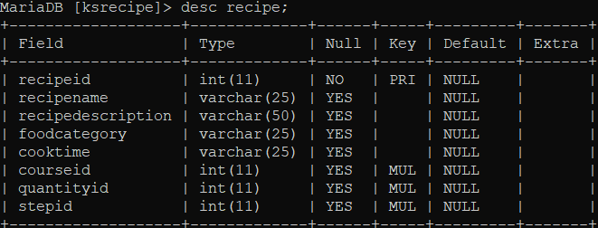
Recipe table

Slide 5
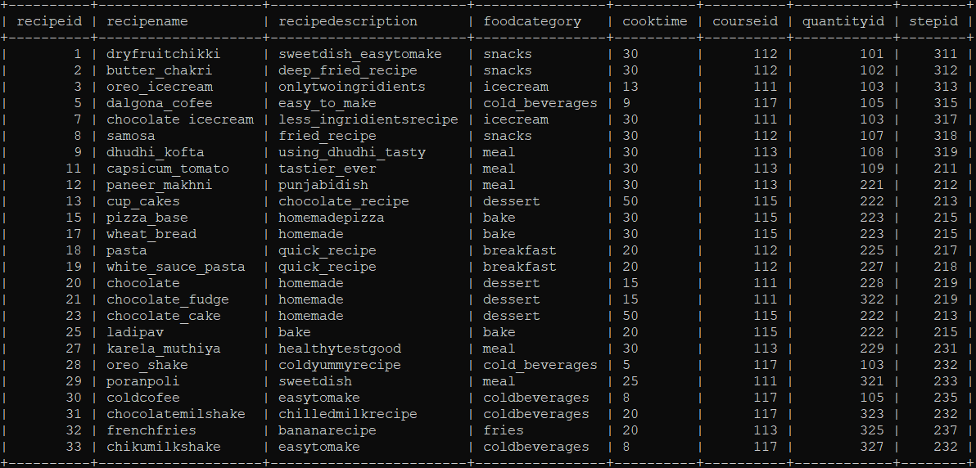
Main recipe table

Slide 6
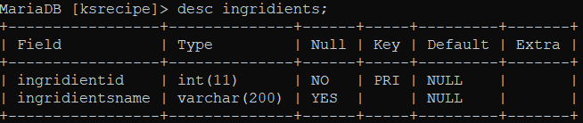
Ingridients

Slide 7
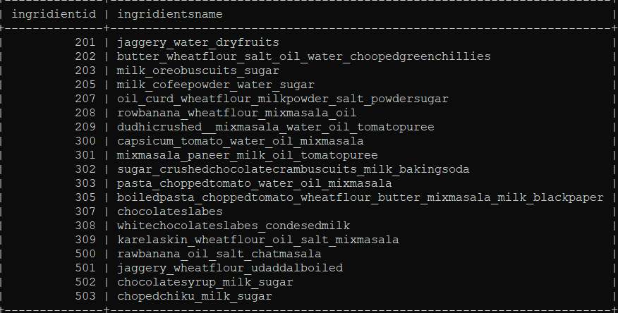
Ingridient table

Slide 8
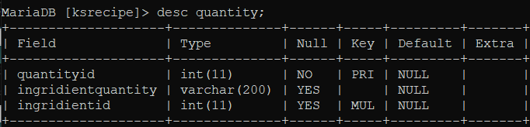
Quantity

Slide 9
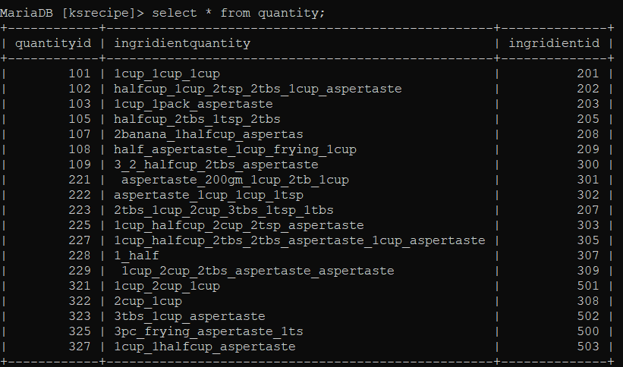
Quantity table

Slide 10
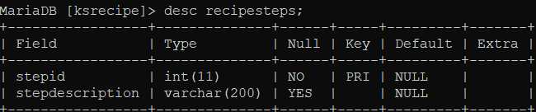
recipesteps

Slide 11
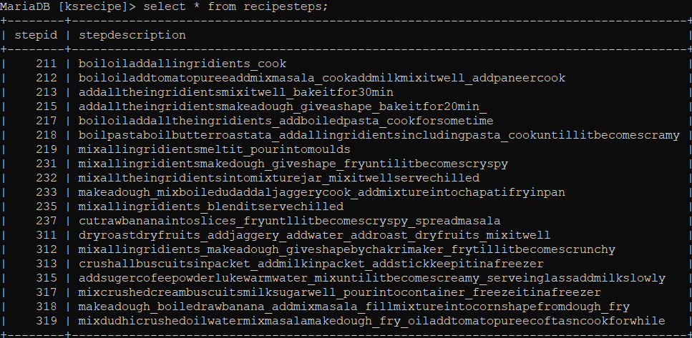
Recipesteps table

Slide 12
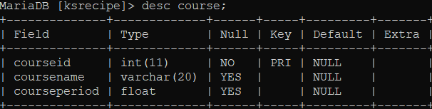
Course table

Slide 13
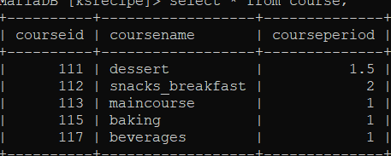
Course table

Slide 14
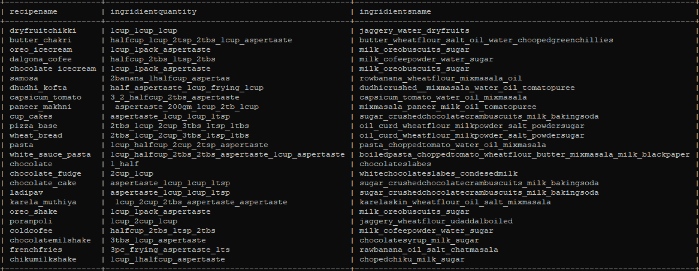
rightjoin
recipename,ingredient quantity,ingridientsname
select recipe.recipename,quantity.ingridientquantity,ingridients.ingridientsname from quantity right join ingridients ON quantity.ingridientid=ingridients.ingridientid right join recipe ON recipe.quantityid=quantity.quantityid;

Slide 15
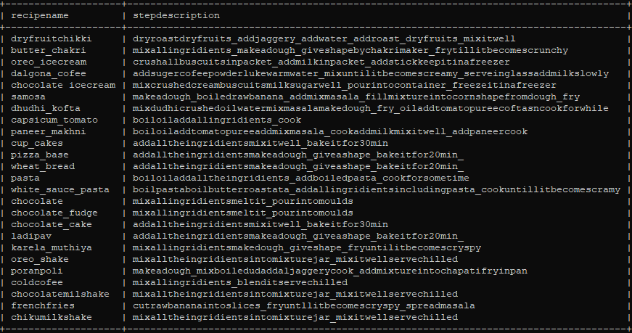
Leftjoin
select recipe.recipename,recipesteps.stepdescription from recipe left join recipesteps ON recipe.stepid=recipesteps.stepid;to show steps with recipename
Recipename,stepescription

Slide 16
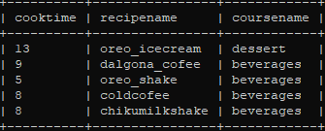
Inner join
Quick recipe courses
select quickrecipe.cooktime,quickrecipe.recipename,coursereview.coursename from quickrecipe inner join coursereview ON coursereview.recipename=quickrecipe.recipename;

Slide 17
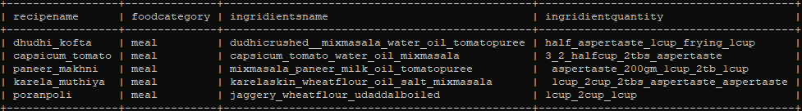
Subquery meal with ingridients
select recipe.recipename ,recipe.foodcategory, ingridients.ingridientsname , quantity.ingridientquantity from recipe,ingridients,quantity where quantity.ingridientid=ingridients.ingridientid and quantity.quantityid=recipe.quantityid and recipe.recipeid in(select recipeid from recipe where foodcategory='meal');

Slide 18
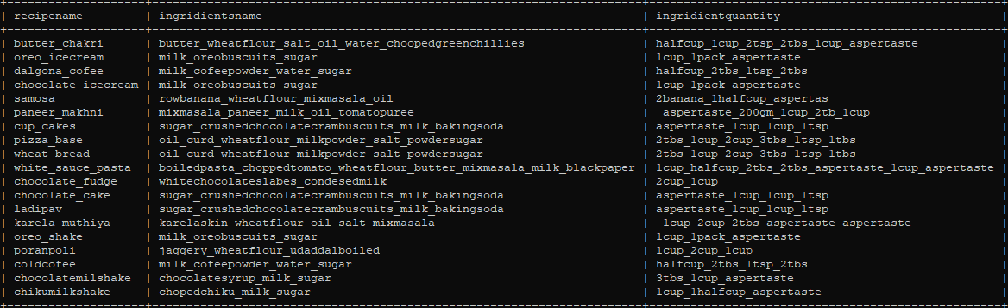
milk ,wheatflour,curd
select recipe.recipename , ingridients.ingridientsname , quantity.ingridientquantity from recipe,ingridients,quantity where quantity.ingridientid=ingridients.ingridientid and quantity.quantityid=recipe.quantityid having ingridients.ingridientsname like '%milk%' or ingridients.ingridientsname like '%curd%' or ingridients.ingridientsname like '%wheatflour%';

Slide 19
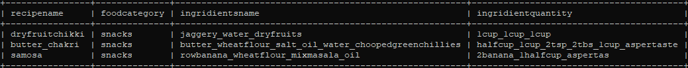
subquery Snacks
select recipe.recipename ,recipe.foodcategory, ingridients.ingridientsname , quantity.ingridientquantity from recipe,ingridients,quantity where quantity.ingridientid=ingridients.ingridientid and quantity.quantityid=recipe.quantityid and recipe.recipeid in(select recipeid from recipe where foodcategory='snacks');

Slide 20
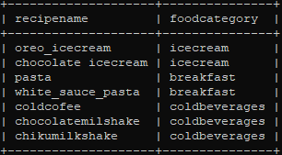
Subquery Breakfast,coldbevrages,icecream
select recipename,foodcategory from recipe where foodcategory in (select foodcategory from recipe where foodcategory IN('coldbeverages','breakfast','icecream'));

Slide 21
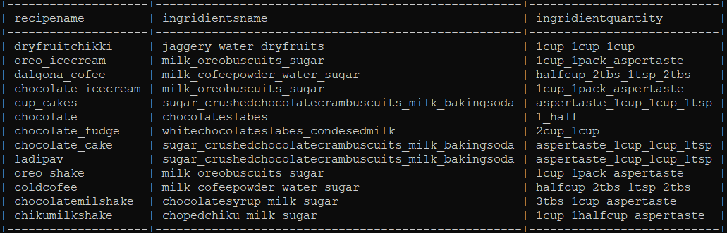
Non oily recipe
select recipe.recipename,ingridients.ingridientsname,quantity.ingridientquantity from recipe,ingridients,quantity where quantity.ingridientid =ingridients.ingridientid and quantity.quantityid=recipe.quantityid and ingridients.ingridientsname NOT LIKE '%oil%';

Slide 22
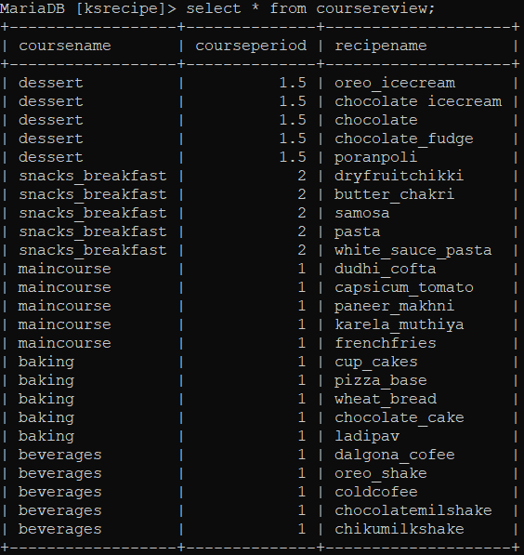
Views shows coursewise recipe
create view coursereview AS select course.coursename,course.courseperiod,recipe.recipename from recipe,course where recipe.courseid=course.courseid;

Slide 23
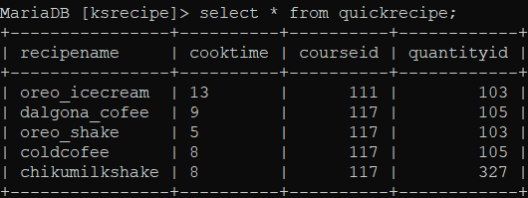
Views quick recipe
create view quickrecipe AS select recipename,cooktime,courseid,quantityid from recipe where cooktime<15;

