Slide 1

Supply–Demand Analysis in Electricity Networks Using Demand Response: A NYISO Case Study
Kinjal Patil
MBA- Business Analytics
Saint Peter’s University
Spring 2026
Time-Series Forecasting • ARIMA Modeling • Peak Load Optimization

Slide 2
Introduction & Problem Statement
Electricity demand varies hourly, daily, and seasonally in NYISO markets.
Peak demand periods increase operational stress, generation costs, and grid risk.
Utilities must maintain real-time supply–demand balance to ensure grid stability.
Project Goal: Develop ARIMA forecasting and simulate Demand Response impact on peak demand reduction..

Slide 3
Project Objectives
Analyze
Analyze historical NYISO hourly electricity demand data.
Identify
Identify peak vs. off-peak load behavior and demand variability.
Simulate
Simulate Demand Response (DR) impact on peak load reduction.
Forecast
Forecast short-term electricity demand using ARIMA modeling.

Slide 4
Data Source & Preparation
Data Source: NYISO hourly electricity demand dataset
Data imported into SQLite database for structured querying
Transformed wide hourly format into long format for analysis
Constructed structured datetime index for time-series modeling.

Slide 5
SQL Data Engineering Pipeline
Created structured relational tables in SQLite for efficient querying
Converted Hr1–Hr24 columns into unified timestamp format
Validated daily 24-hour data completeness and integrity
Prepared modeling-ready dataset for Python time-series forecasting

Slide 6
Exploratory Data Analysis (EDA)
Strong daily cyclical demand patterns observed across the dataset
Significantly higher electricity consumption during business hours (9 AM – 6 PM)
Consistently lower demand during overnight periods
Distinct and recurring peak load intervals identified

Slide 7
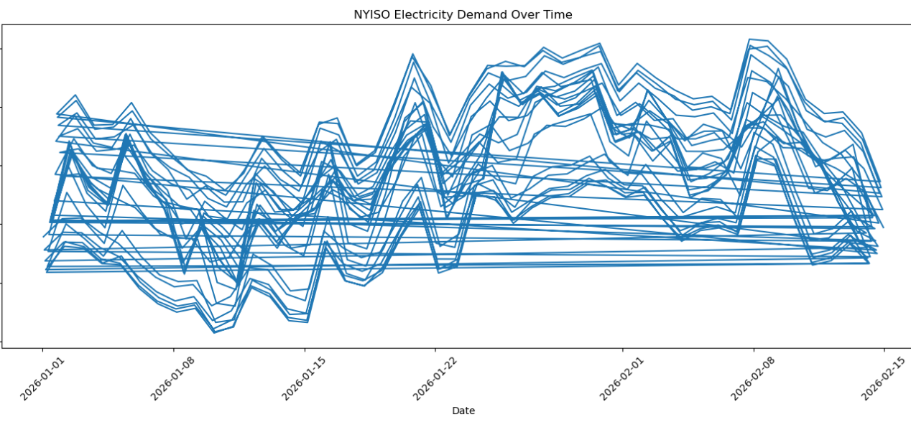
Hourly Electricity Demand Trends in NYISO
• Hourly demand shows clear daily cyclical patterns • Peak loads occur during daytime and early evening hours • Overnight demand remains consistently lower

Slide 8
Peak vs Off-Peak Analysis
Peak period defined as 7:00 AM – 10:00 PM (business activity window)
Extracted hourly values from structured datetime index
Computed average demand during peak and off-peak intervals
Peak demand significantly higher.

Slide 9
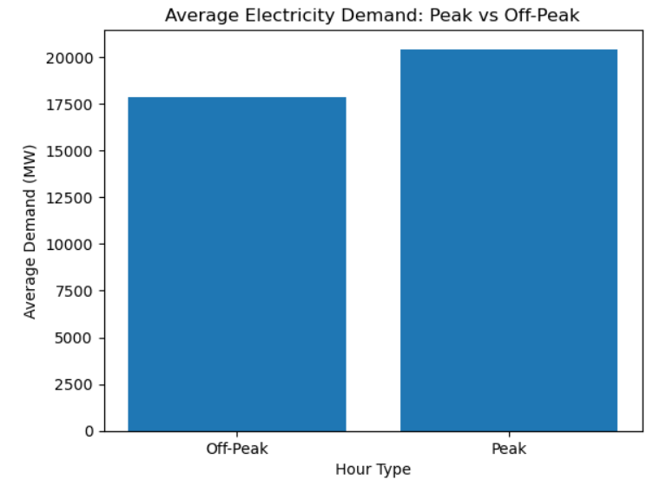
Peak vs Off-Peak Demand Comparison
• Average peak demand is significantly higher than off-peak demand • Peak concentration increases operational and generation costs • Load imbalance during peak periods stresses grid infrastructure

Slide 10
Demand Response Simulation
Simulated 5% reduction in electricity demand during peak hours (7 AM – 10 PM)
Recalculated adjusted peak demand levels
Observed measurable decline in peak load stress.
Results demonstrate operational and cost benefits of Demand Response programs

Slide 11
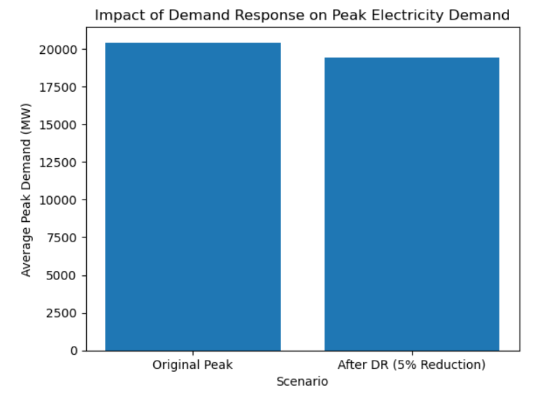
Demand Response Simulation (5% Peak Reduction)
Scenario Assumption
• Simulated a 5% reduction in peak demand • Applied reduction only during defined peak hours
Impact Analysis
• Reduced maximum system load • Lowered peak stress on grid infrastructure • Demonstrates effectiveness of Demand Response programs

Slide 12
ARIMA Forecasting Methodology
Model Specification: ARIMA (2,1,2)
Trained on 1,000 hourly demand observations
First-order differencing applied to achieve stationarity
Implemented for short-term (24-hour) electricity demand forecasting

Slide 13
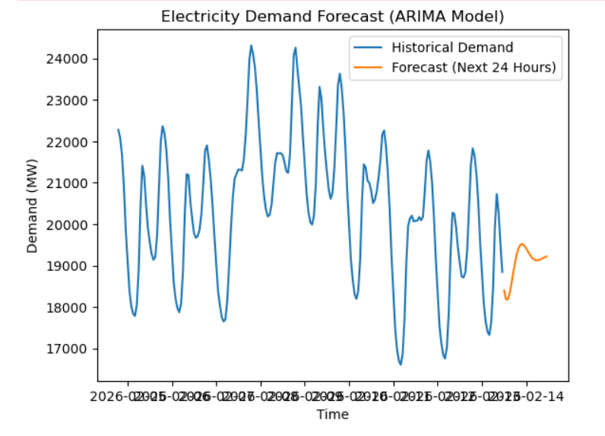
ARIMA-Based Electricity Demand Forecast
Model Specification
• Model Used: ARIMA(2,1,2) • Trained on historical hourly demand data • Captures temporal dependency in electricity load
Forecast Objective
• Generate next 24-hour demand projection • Support short-term operational planning

Slide 14
Forecast Results (Next 24 Hours)
ARIMA model captures cyclical demand behavior effectively
Forecast indicates stable short-term demand trajectory
Projected demand remains within historical peak range
Supports proactive grid management and supply scheduling decisions

Slide 15
Business & Economic Implications
Demand Response reduces peak load stress and grid overload risk.
Supports long-term sustainable energy planning strategies.
Data-driven forecasting enhances cost control and supply optimization
Improves infrastructure utilization and operational efficiency

Slide 16
Key Insights & Conclusion
Electricity demand exhibits strong and predictable daily cycles
Peak-hour demand is the primary driver of grid stress
Even modest (5%) Demand Response adjustments significantly reduce peak pressure
Short-term forecasting improves operational reliability and proactive planning

