Slide 1
Mini Production ML System
90-Day Customer Churn Prediction · Non-Contractual Online Retail
Kinjal Joshi | 2025EM1100339
UCI Online Retail · 541,909 transactions · 4,372 customers · Dec 2010 – Dec 2011
0.792
0.593
11.1 ms
6,324/s
68
validation ROC AUC
(candidate LightGBM)
break-even precision
derived from £ economics
online p95 latency
vs 150 ms SLO
batch throughput
rows per second
tests passing
WHAT WAS BUILT
Micro-batch ingestion — schema-validated, idempotent, audited
23 engineered features in one module shared by training and serving
Purged temporal split (July embargoed) — no entity or label leakage
4 model tiers: prevalence → business rule → linear → GBDT
6 promotion gates derived from campaign economics, not guessed
FastAPI hybrid serving + registry with stage-based rollback
PSI/KS drift, data-quality and schema monitoring
4-signal retraining trigger with hard blocks

Slide 2
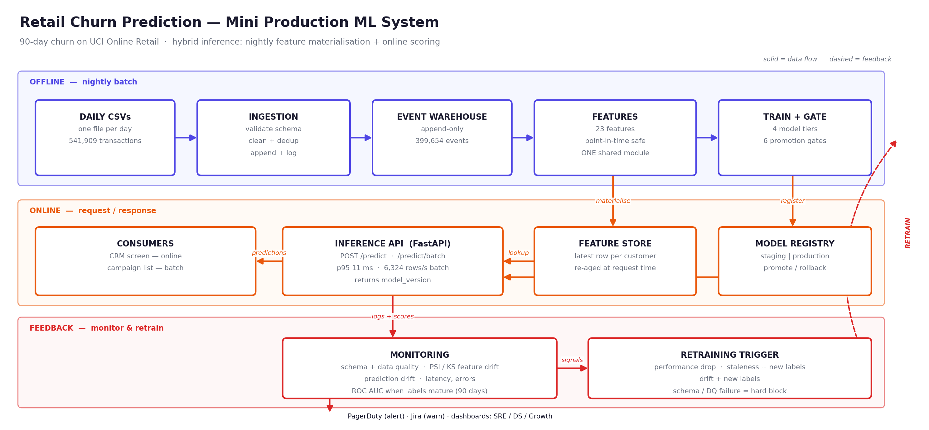
System Architecture
Data sources → ingestion → warehouse → features → training → registry → serving → monitoring → retraining

Slide 3
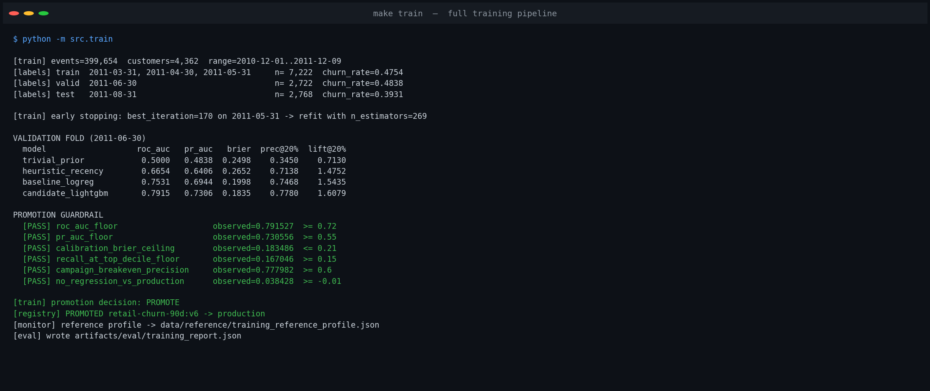
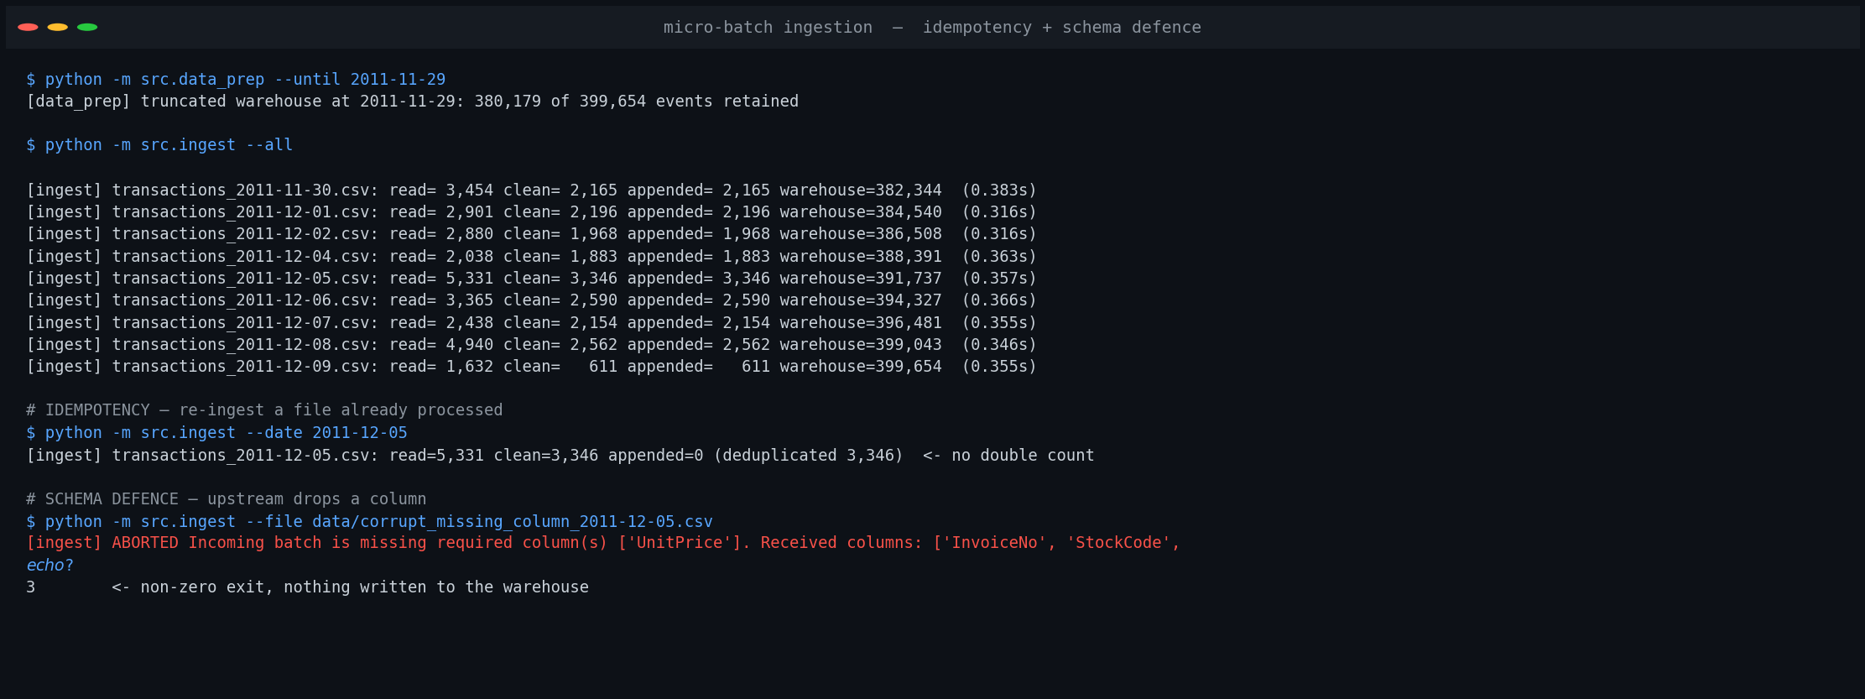
Pipeline Run and Ingestion
Real captured output — 380,179 → 399,654 events; re-run appends 0; corrupt batch exits 3
380,179 → 399,654
0 rows
exit code 3
events retained after cleaning
appended when a batch is re-ingested
corrupt batch rejected, nothing written

Slide 4
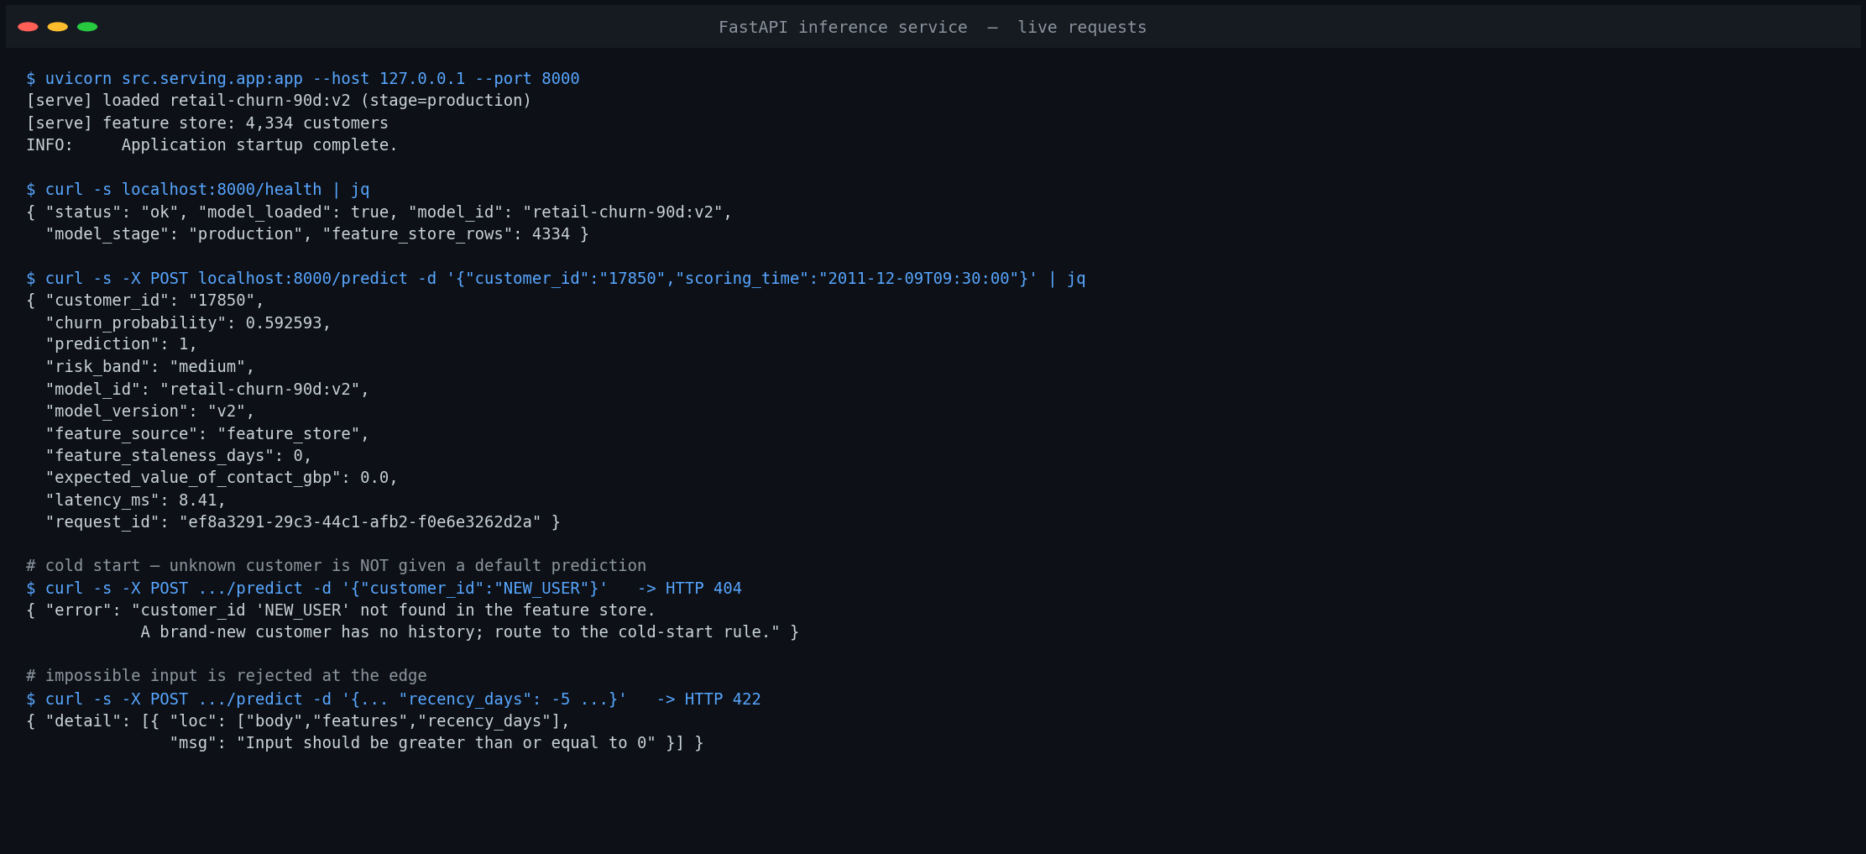
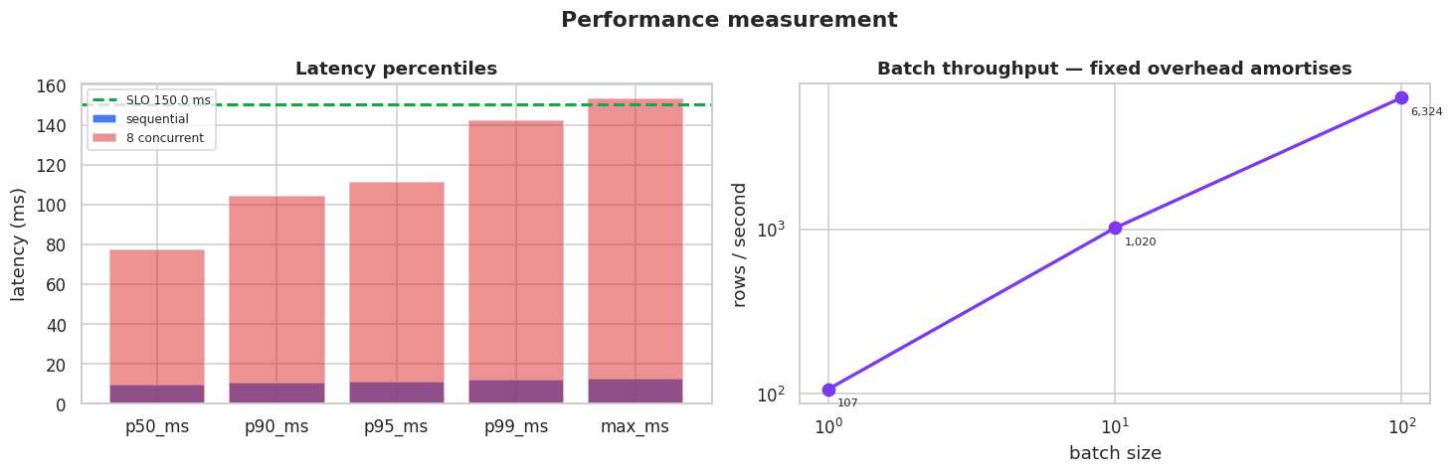
Inference Service — Live Requests
Hybrid pattern: nightly feature materialisation + online scoring; model resolved by registry stage
WHY HYBRID
A CRM agent on the phone needs a score immediately; the nightly campaign list does not.
Pure online would scan 180 days per request. Pure batch can't score on demand. Streaming adds infrastructure for features that only change daily.
Cache staleness is closed by re-aging the 4 time-dependent features, verified equal to offline recomputation to within 1e-6.
8.41 ms
0 days
404 / 422
measured request latency
feature staleness at request time
cold start & bad input both handled

Slide 5
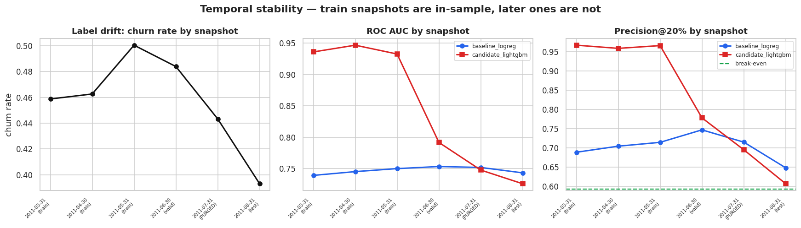
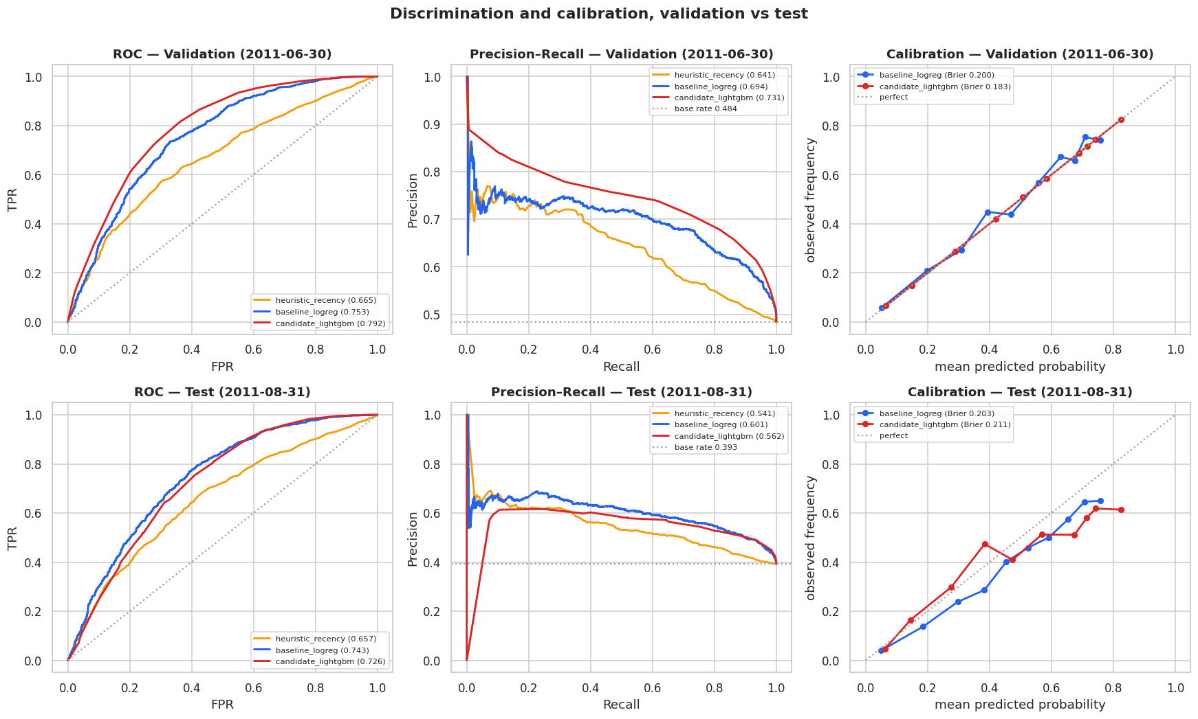
Offline Evaluation
Validation chose the GBDT; the held-out test fold two months later shows the linear model was more robust
MODEL LADDER — ROC AUC
model
valid
test
prevalence
0.500
0.500
recency rule
0.665
0.657
logistic
0.753
0.743
LightGBM
0.792
0.726
THE FINDING
Churn prevalence falls from 0.500 to 0.393 across the folds as the Q4 ramp approaches. The GBDT's in-sample edge far exceeds its out-of-sample edge — it fits March–May structure that doesn't persist into August, while the linear model lacks the capacity to fit it, so it doesn't lose it either.
RESPONSE
Canary, don't cut over
Keep logistic archived — rollback is one metadata write
Add a temporal-robustness gate
Recalibrate on schedule (Brier degrades before AUC)

Slide 6
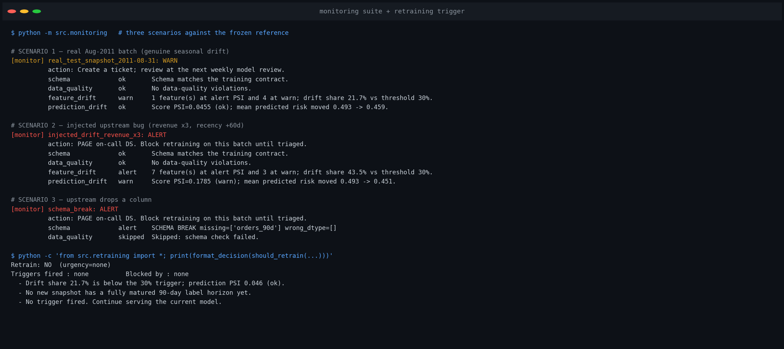
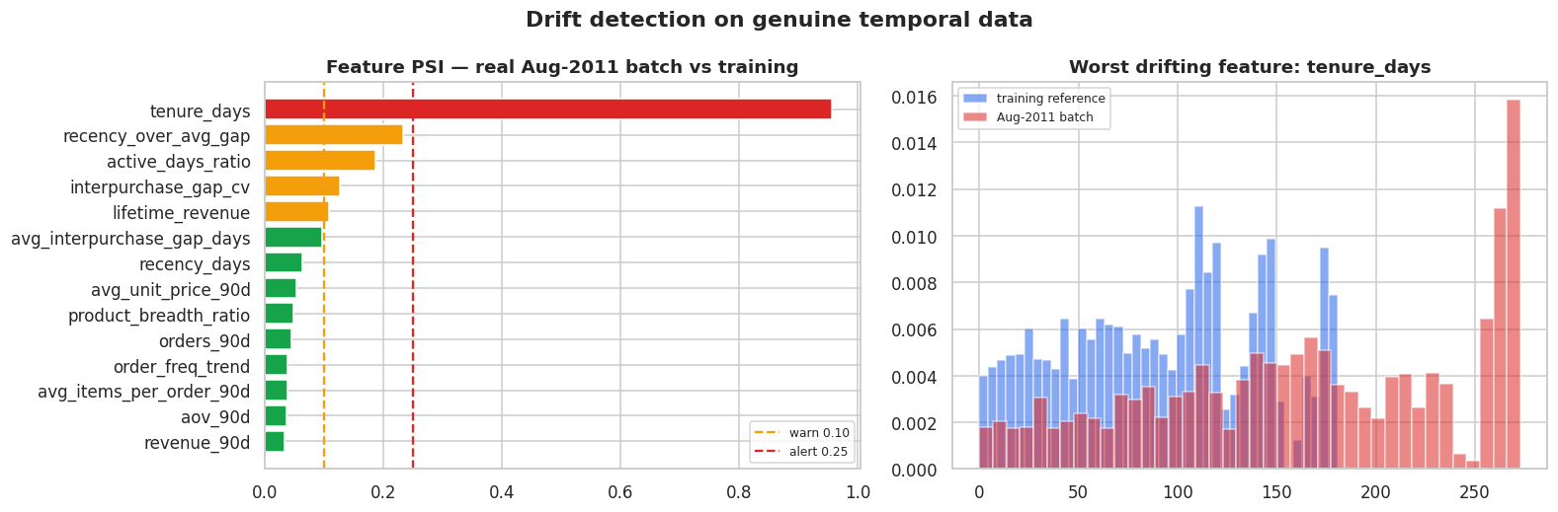
Monitoring, Drift and Retraining
The metric that matters most arrives 90 days late — so the plan is ordered by detection lag
CALIBRATED TO BE TRUSTED
Real Aug-2011 batch → WARN. tenure_days PSI 0.956 because the customer base genuinely ages, but drift share stays at 21.7%, below the 30% threshold.
Injected upstream bug → ALERT. 7 features at alert-level PSI, 43.5% drift share, PSI and KS agreeing.
Dropped column → ALERT, short-circuited; retraining is hard-blocked so the defect never reaches the weights.
Sensitive enough to catch a real failure, specific enough not to page for seasonality , a muted monitor is worse than none.

Slide 7
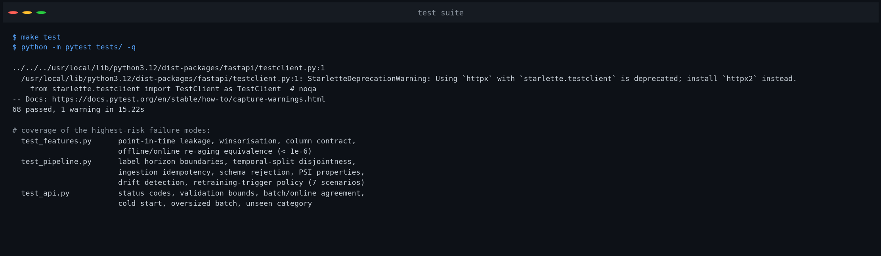
Code Quality, Tests and Reproduction
Config-driven, idempotent, CLI-invocable — a run is described by (git commit, config, environment)
HONEST LIMITATIONS
0.30 campaign uplift is assumed, not measured — a randomised holdout is the highest-value next step
One seasonal cycle across six snapshots
24.9% of transactions lack a customer_id and are excluded
REPRODUCE END TO END
make data → make ingest → make train → make test → make serve → make load
or a single make pipeline for end-to-end reproduction.

