Slide 1

Project 43: Machine Learning Approach for Predicting Hydropower Generation Deficits during El Niño Years using Support Vector Regression.
T.Y. (Division B) B.Tech Project-Based Learning (PBL) Presentation , Batch – T8
Guide Name: Dr. Milind Nemade
Group No. 21
1. Kinjal Joshi – Roll No. 60
2. Garvit Kanani – Roll No. 61
3. Raj Vitmal – Roll No. 71
Department of AI-DS, K.J. Somaiya Institute of Technology, Sion, Mumbai 400022
1

Slide 2

TABLE OF CONTENTS
Sr.No. | Content
1. | Introduction
2. | Literature Review
3. | Motivation
4. | Problem Statement
5. | Objectives
6. | Methodology
7. | Project Workflow
8. | Results and Discussion
9. | Conclusion
10 | References
11. | Thank You & Q&A
2

Slide 3
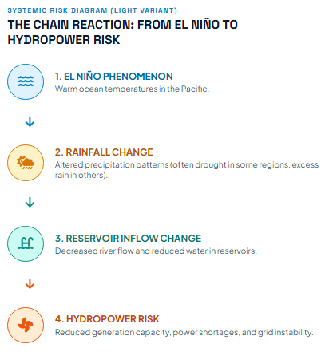
INTRODUCTION
Background
El Niño is a climate phenomenon that can influence rainfall and monsoon conditions.
Changes in rainfall can affect river flow and reservoir inflow.
Changes in reservoir inflow can affect water availability for hydropower generation.
Project Idea
Use ENSO indicators, rainfall and KRS reservoir data to predict next-month reservoir inflow deficit.
Use predicted inflow deficit as an indicator of potential hydropower risk.
Basic Concept:
El Niño → Rainfall Change → Reservoir Inflow Change → Hydropower Risk
3

Slide 4
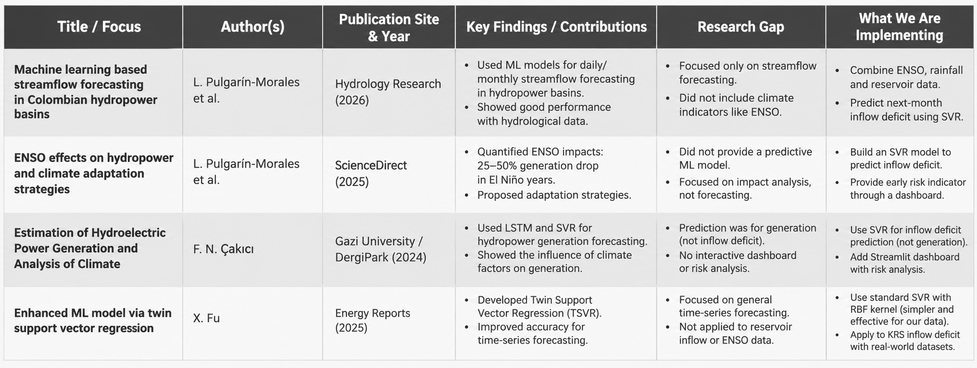
LITERATURE REVIEW & RESEARCH GAP
4

Slide 5
MOTIVATION
To use historical climate and reservoir data to estimate next-month inflow deficit and provide an easy-to-understand hydropower-risk indicator.
Reservoir water availability is strongly influenced by rainfall and climate conditions.
El Niño can affect monsoon and rainfall patterns.
Lower rainfall can result in lower reservoir inflow.
Lower reservoir inflow may indicate increased risk to future hydropower water availability.
Machine Learning can identify relationships between climate and reservoir conditions.
5

Slide 6
PROBLEM STATEMENT
Actual Problem :
Reservoir inflow is difficult to predict because it depends on multiple factors:
El Niño conditions
Rainfall
Previous reservoir inflow
Reservoir storage
Seasonal variations
Problem Statement :
How can historical ENSO, rainfall and KRS reservoir data be used to predict the next-month KRS reservoir inflow deficit percentage?
Proposed Solution :
Develop an SVR-based Machine Learning model that predicts next-month KRS inflow deficit and presents the result through an interactive dashboard.
6

Slide 7
OBJECTIVES
Primary Objective
To develop a Support Vector Regression model for predicting next-month KRS reservoir inflow deficit using El Niño and hydrological information.
Task to be performed to achive objective :
Combine ENSO, rainfall and KRS reservoir data.
Convert the data into a consistent monthly dataset.
Create climate, hydrological and seasonal features.
Train and evaluate an SVR-RBF model.
Compare SVR with other Machine Learning baseline models.
Develop an interactive Streamlit dashboard for visualization and prediction.
Represent predicted inflow deficit as a hydropower-risk indicator.
7

Slide 8
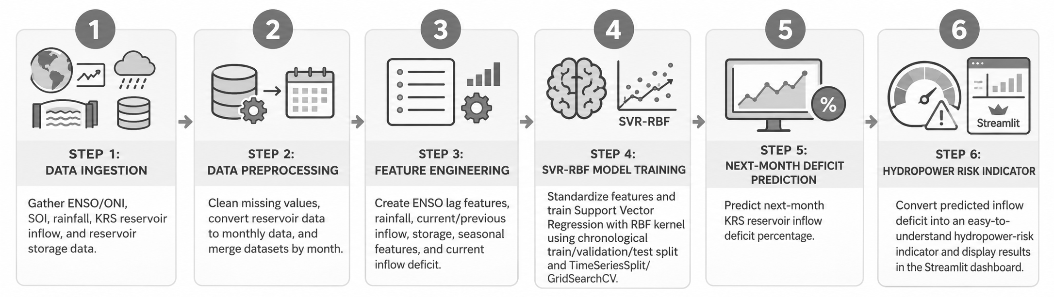
METHODOLOGY
8

Slide 9
PROJECT WORKFLOW
ENSO Data
ONI + SOI
Rainfall Data
KRS Reservoir Data
Inflow + Storage
Data Cleaning
Monthly Data Conversion
Data Merging
Feature Engineering
SVR-RBF Model
StandardScaler
Chronological Train /
Validation / Test Split
Next-Month Inflow Deficit (%)
Hydropower Risk Indicator
Streamlit Dashboard
9

Slide 10
TENTATIVE RESULTS AND DISCUSSION
Single Sample Dataset (KRS) :
Period: 2011–2020
Total months: 120
Usable ML samples: 116
Training samples: 57
Validation samples: 24
Testing samples: 35
Model | RMSE | MAE | R²
SVR-RBF | 65.5 | 53.0 | 0.29
Linear Regression | 60.5 | 49.3 | 0.40
Ridge Regression | 60.6 | 49.5 | 0.39
Random Forest | 69.1 | 57.6 | 0.21
Persistence | 77.5 | 48.7 | 0.01
Discussion
SVR-RBF performed better than Random Forest and the Persistence baseline.
Linear and Ridge Regression performed slightly better than SVR on the test set.
The small dataset limits overall model performance.
ENSO and hydrological features provide useful information for inflow-deficit prediction.
10

Slide 11
CONCLUSION
Conclusion
Developed a complete Machine Learning pipeline for KRS reservoir inflow-deficit prediction.
Combined ENSO, rainfall and reservoir information.
Implemented Support Vector Regression with an RBF kernel.
Compared SVR with multiple baseline models.
Developed an interactive Streamlit dashboard.
Used next-month inflow deficit as an indicator of potential hydropower risk.
Future Scope
Add more reservoirs such as Harangi, Kabini and Hemavathi.
Use a larger historical dataset.
Include actual hydropower generation data.
Predict actual generation in MWh/GWh in future.
Test longer forecasting horizons.
Explore LSTM and other advanced Machine Learning models with larger datasets.
11

Slide 12
REFERENCES
[1] Pulgarín-Morales, L. and Schwenzer, J., “Machine learning-based streamflow forecasting in Colombian hydropower basins at daily and monthly scales,” Hydrology Research, 2026.
[2] Pulgarín-Morales, L. and Krueger, T., “ENSO effects on hydropower and climate adaptation strategies,” Journal of Hydrology: Regional Studies, 2025.
[3] Çakici, F. N., “Estimation of Hydroelectric Power Generation and Analysis of Climate,” Gazi University, 2024.
[4] Fu, X., “Enhanced ML model via Twin Support Vector Regression,” Energy Reports, 2025.
[5] NOAA Climate Prediction Center – Oceanic Niño Index and ENSO information.
[6] World Bank Climate Change Knowledge Portal – Climate and rainfall data.
[7] India Water Resources Information System – Reservoir and hydrological data.
12

Slide 13
QUESTIONS & ANSWERS
HydroPulse-SVR
El Niño-Based Reservoir Inflow Deficit Prediction Using Support Vector Regression
13

Slide 14
THANK YOU !
13

