Slide 1



Analysis Of Usage Pattern Of Mobile Phone And It’s Impact On Human Health In Vadodara City
The Maharaja Sayajirao University of Baroda
Faculty of Science
Department Of Statistics
Guided by :
Prof. R. Srivastava
Presented by :
Kinjal Panara
Reshma Shah
Bansari Bambhaniya
Vishal Harijan

Slide 2
CONTENTS
Introduction
Methodology and Field work
Objectives
Questionnaire
Coding of collected data
Sample size determination
Graphical Visualization
Statistical Analysis
Proportion test
Chi-Square test (AND Cramer’s V test)
Multiple Response Analysis
Multiple Response Chi-square for Independence of attributes
Mann-Whitney U test
Kruskal-Wallis test
Multinomial Logistic Regression
Principal Component Analysis
References

Slide 3
INTRODUCTION
Technology has become a fundamental aspect in our lives and we cannot neglect its contribution in the welfare of human beings.
Mobile phones are being used by each and every one today. Their use without any knowledge of their harmful effects is unsafe and have several downsides, especially on human health.
The highlight of this project include recent scientific facts and Analysis of Mobile phone on Human Health and Life .
And we are discuss about how its impacting on human body, Sleeping pattern and physical stress .

Slide 4
METHODOLOGY
Data Collection
Understand data & Analysis Generating Insights
Presentation of Results Obtained
Sample size
Total Population(of 4 wards)
Sample size( of 4 wards)
Sampling type
Proportional Stratified sampling
Sample Source
Vadodara city
=5,88,922
= 337

Slide 5
OBJECTIVES
Impact on sleeping hours
Effect on humans Upper Limb , Back and Neck
Impact on Eyes
Physical Stress due to mobile phone

Slide 6
To estimate proportion of users of mobile phone after 10 p.m. ward wise of Vadodara City.
To estimate Proportion of users of mobile phone ward wise of Vadodara City.
To check whether there is significant difference among the four wards based on Global score of Usual sleep habits.
To check whether there is difference between the rank of Gender based on Sleep Latency.
To check whether there is association between Usual sleep habits of section-1, Physical health problem (upper limb, neck and back) of section-2, Physical health problem (Eye Problem) of section-3, and Physical health problem (Physical stress) of section-4 based on Gender and Usage of mobile phone.
To gain insight into whether out of 6 purpose which one is major for given Physical health problem (upper limb, neck and back) of section-2, Physical health problem (Eye Problem) of section-3, and Physical health problem (Physical stress) of section-4 to aware of the associated potential risk.
To study the placing pattern of their mobile phone based on Age, Gender and occupation.

Slide 7
QUESTIONNAIRE and CODING OF COLLECTED DATA
In this survey section where asked to investigate the following sensation,
Usual sleep habits (of section 1)
Physical health problem (Upper limb, Neck and Back) (of section 2)
Physical health problem (Eye Problem) (of section 3)
Physical health problem (Physical Stress) (of section 4)
In sleep section of the survey, recall their sleep habits to answer 9 individual questions related to seven main components: sleep quality, sleep latency, sleep duration, habitual sleep efficiency, sleep disturbance, use of sleep medication and daytime dysfunction.
In the second section of the survey questions relate to upper limb, neck and back.
In third section of the survey questions relate to eye problems.
In the fourth section of the survey questions relate to restlessness, tiredness and irritation.
3_Questionnaire AND Coding of collected data.pdf

Slide 8
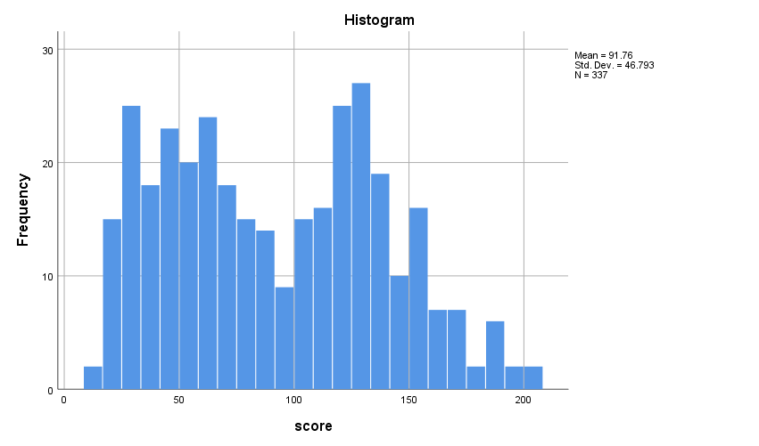
Reliability Of Questionnaire
Cronbach’s alpha is the most common measure of internal consistency (reliability). It is widely used when you have multiple Likert questions in a survey questionnaire. In the research study, the reliability of Cronbach alpha should lie between the value of 0.7 to 0.9 for consistent and reliable
Test for Normality
Ho : The data are Normally distributed.
ag.
H1: The data are Non-Normally distributed.
Conclusion: We can assume that our data are approximately non –normally distributed.
Reliability Statistics
Cronbach's Alpha | Cronbach's Alpha Based on Standardized Items | N of Items
.822 | .965 | 134
Tests of Normality
 | Kolmogorov-Smirnovª |  |  | Shapiro-Wilk
 | Statistic | df | Sig. | Statistic | df | Sig.
score | .099 | 337 | .000 | .962 | 337 | .000
a. Lilliefors Significance Correction

Slide 9
SAMPLE SIZE DETERMINATION
For the collection of samples, we have used three stage sampling.
In first stage we have used cluster sampling, we have divided the Baroda city into different clusters based on the Zone.
In second stage we have used cluster sampling, we have divided the Zone into different clusters based on the ward.
In third stage we have chosen 4 wards randomly form each Zone by simple random sampling.
Then we have used Probability Proportional to size sampling to calculate the sample size of each cluster (ward).
From pilot survey of our study
Sr. no | Zone | Ward number | Ward name | Total Population
1. | North Zone | 7 | Fatehgunj | 1,82,567 (= N1)
2. | West Zone | 11 | Vasna | 1,22,645 (= N2)
3. | South Zone | 4 | Pratapnagar | 1,60,969 (= N3)
4. | East Zone | 2 | Harni | 1,22,741 (= N4)
Sr. no | Ward number | Ward name | Pilot survey sample | Proportion
1. | 7 | Fatehgunj | 20 (= 𝑛∗) 1 | 0.8 (= 𝑝∗)1
2. | 11 | Vasna | 20 (= 𝑛∗ ) 2 | 0.55 (= 𝑝∗) 2
3. | 4 | Pratapnagar | 20 (= 𝑛∗ ) 3 | 0.65 (= 𝑝∗) 3
4. | 2 | Harni | 20 (= 𝑛∗ ) 4 | 0.7 (= 𝑝∗)4

Slide 10
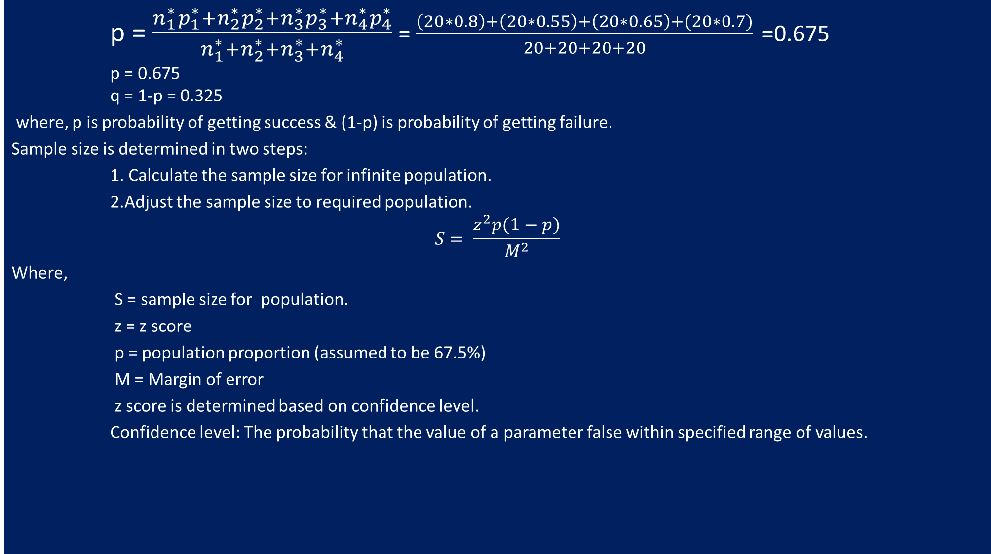
p = $\frac{n_{1}^{∗}p_{1}^{∗}+n_{2}^{∗}p_{2}^{∗}+n_{3}^{∗}p_{3}^{∗}+n_{4}^{∗}p_{4}^{∗}}{n_{1}^{∗}+n_{2}^{∗}+n_{3}^{∗}+n_{4}^{∗}}$ = $\frac{\left(20∗0.8\right)+\left(20∗0.55\right)+\left(20∗0.65\right)+(20∗0.7)}{20+20+20+20}$ =0.675
p = 0.675
q = 1-p = 0.325
where, p is probability of getting success & (1-p) is probability of getting failure.
Sample size is determined in two steps:
1. Calculate the sample size for infinite population.
2.Adjust the sample size to required population.
$$S= \frac{z^{2}p(1−p)}{M^{2}}$$
Where,
S = sample size for population.
z = z score
p = population proportion (assumed to be 67.5%)
M = Margin of error
z score is determined based on confidence level.
Confidence level: The probability that the value of a parameter false within specified range of values.
confidence level | z- value
90% | 1.645
95% | 1.96
99% | 2.576

Slide 11

If we consider 95% confidence level then z-score is 1.96
Margin of error is small amount that is allowed for in case of miscalculation or change of circumstances.
Generally, we take margin of error as 5%.
M =0.05
Z-score =1.96
p= 0.675
s = $\frac{{\left(z−score\right)}^{2}p(1−p)}{{(margin of error)}^{2}}$ =337.1028
So, sample size for population is 337 Now, we must adjust the sample size to the required population.
If we want to adjust the sample size to 5,88,922 population.
Then use the following formula for adjusted sample size,
$$\frac{s}{1+[\frac{\left(s−1\right)}{N}]}$$
Adjusted S = 336.9105
Finally, we have determined the sample size for 5,88,922 population as 337.
So fixed n is 337.

Slide 12
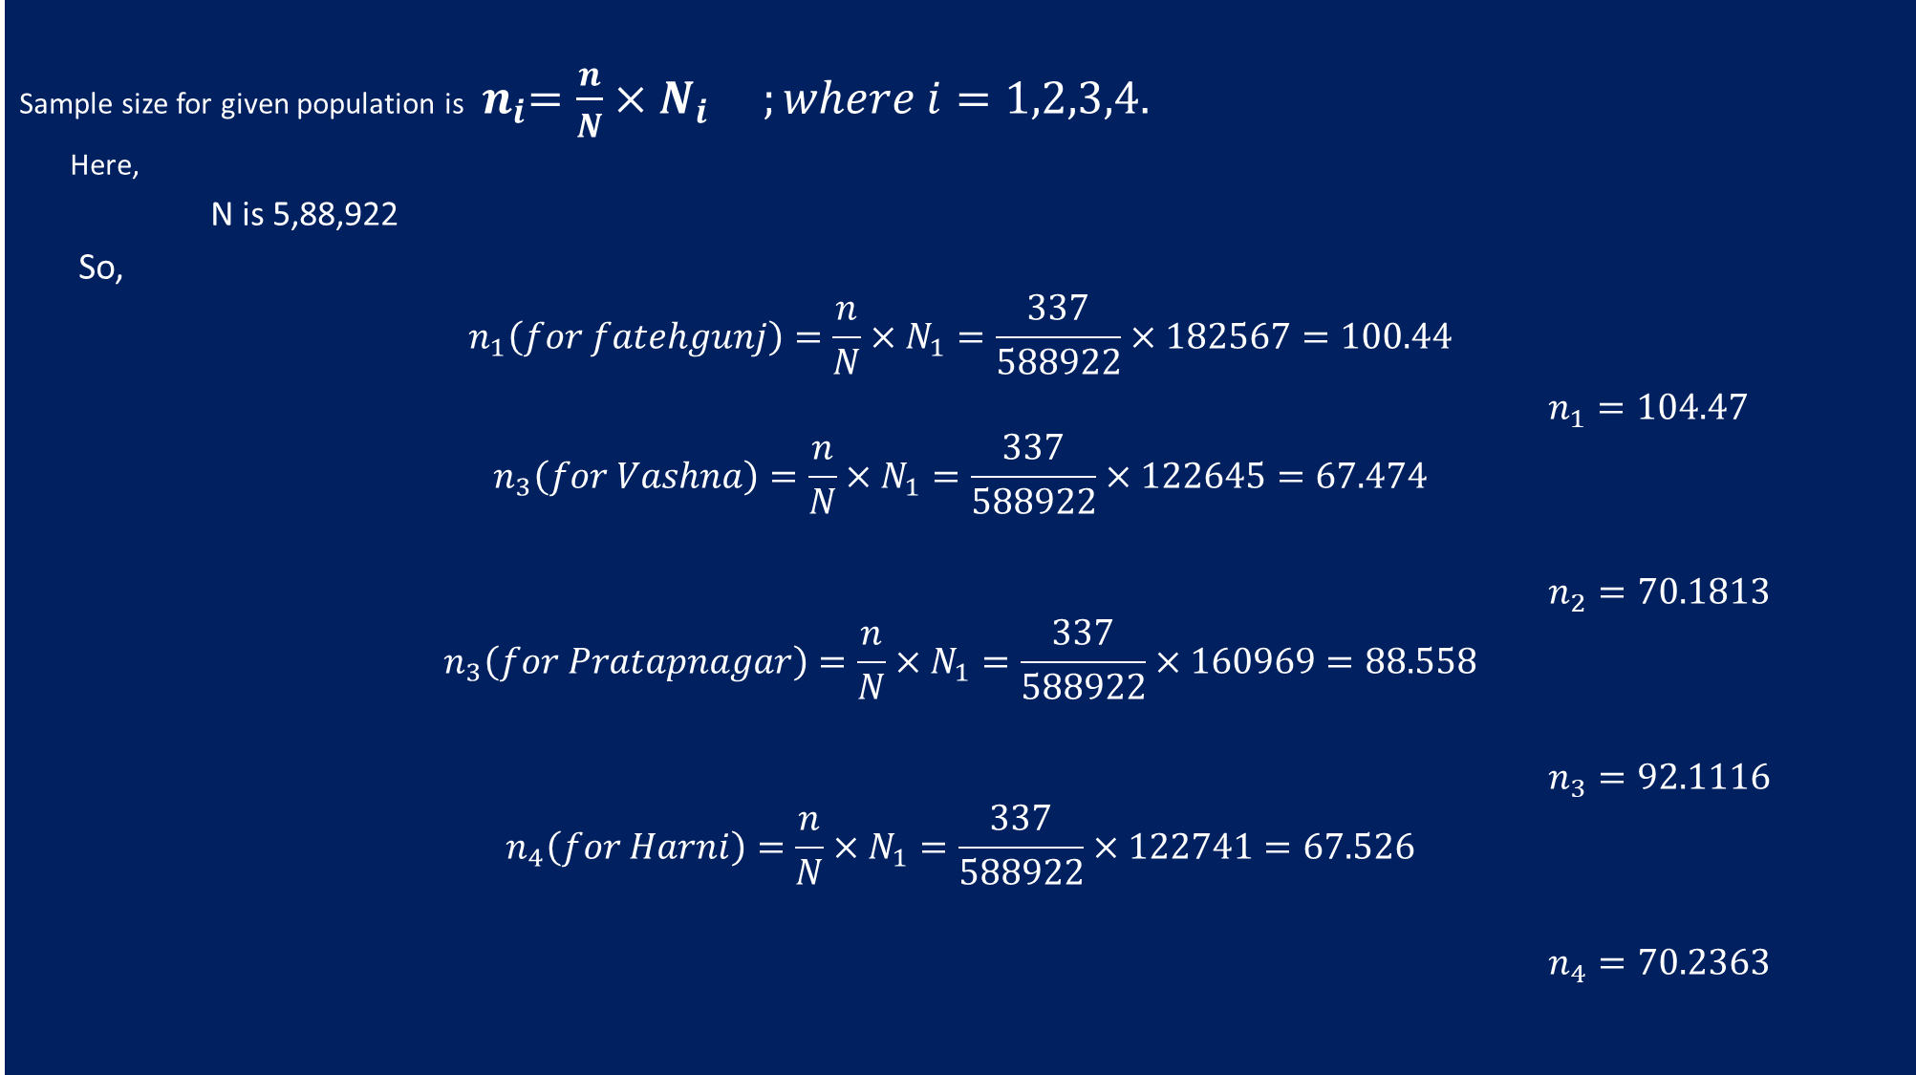
Sample size for given population is ${ n}_{i}=\frac{n}{N}×N_{i} ;where i=1,2,3,4.$
Here,
N is 5,88,922
So,
$$n_{1}\left(for fatehgunj\right)=\frac{n}{N}×N_{1}=\frac{337}{588922}×182567=100.44$$ $n_{1}=104.47$
$$n_{3}\left(for Vashna\right)=\frac{n}{N}×N_{1}=\frac{337}{588922}×122645=67.474$$
$n_{2}=70.1813$
$$n_{3}\left(for Pratapnagar\right)=\frac{n}{N}×N_{1}=\frac{337}{588922}×160969=88.558$$
$n_{3}=92.1116$
$$n_{4}\left(for Harni\right)=\frac{n}{N}×N_{1}=\frac{337}{588922}×122741=67.526$$
$n_{4}=70.2363$

Slide 13
Sr. no | Zone | Ward number | Ward name | Total Population | Sample size
1. | North Zone | 7 | Fatehgunj | 1,82,567 (= N1) | 105 (= 𝑛₁)
2. | West Zone | 11 | Vasna | 1,22,645 (= N2) | 70 (= 𝑛₂)
3. | South Zone | 4 | Pratapnagar | 1,60,969 (= N3) | 92 (= 𝑛₃)
4. | East Zone | 2 | Harni | 1,22,741 (= N4) | 70 (= 𝑛₄)

Slide 14
Graphical Visualization
2_Graphical Visualization.xlsx

Slide 15
STATISTICAL ANALYSIS
Proportion test
Proportion Test for checking users of mobile phone after 10 p.m. ward wise:
Ho: p1=p2=p3=p4
ag.
H1: Inequality at least one place.
Output:
prop 1 prop 2 prop 3 prop 4
0.8190476 0.9142857 0.7391304 0.6285714
Decision Rule: As p-value < Alpha, then reject Ho.
Here,
Alpha = 0.05
P-value = 0.0003684
Conclusion:
Here the p value < alpha, so the data provides the enough evidence to reject H₀ at 5% Level of significance and 3 degrees of freedom.
we conclude that proportion of users of mobile phone after 10 p.m. is not same in all the wards.
We observe that maximum proportion of users of mobile phone after 10 p.m. lie in ward 2 i.e. Vasna.

Slide 16
2) Proportion Test for checking users of mobile phone (in hours) per day ward wise:
Ho: p1=p2=p3=p4
ag.
H1: Inequality at least one place.
Output:
prop 1 prop 2 prop 3 prop 4
0.4952381 0.5619048 0.6884058 0.6333333
Decision Rule: As p-value < Alpha, then reject Ho.
Here,
Alpha = 0.05
P-value = 1.496e-05
Conclusion:
Here the p value < alpha, so the data provides the enough evidence to reject H₀ at 5% Level of significance and 3 degrees of freedom.
Hence, we conclude that proportion of users of mobile phone (in hours) per day is not same in all the wards.
We observe that maximum proportion of users of mobile phone (in hours) per day lie in ward 3 i.e. Pratapnagar.

Slide 17
Chi-Square test (AND Cramer’s V test)
Objective: To check association between Usage of mobile phone (in hour) per day and Gender.
To Test:
Ho: There is no association between Usage of mobile phone and Gender.
Vs
H1: There is association between Usage of mobile phone and Gender.
Decision Rule: As p-value < Alpha, then reject Ho.
Here,
Alpha = 0.05
P-value = 0.108
Conclusion:
As p-value > alpha, therefore the data provide enough evident to do not reject Ho at 5% Level of significance and 3 degree of freedom.
Hence, we conclude that usage of mobile phone is independent of gender.

Slide 18
4
Attribute | Attribute | p-value | Decision | Conclusion | Association
Usage of Mobile phone (in hour) per day | Gender | 0.108 | Do not reject H0 at 5% l.o.s | independent of gender | No Association
Usage of Mobile phone (in hour) per day | Age | 0.000 | Reject H0 at 5% l.o.s | Not independent of Age | 19.4%
Usual sleep habits (section-1, Global score) | Gender | 0.015 | Reject H0 at 5% l.o.s | Not independent of Gender | 27.8%
Usual sleep habits (section-1, Global score) | Usage of mobile phone after 10 p.m. | 0.006 | Reject H0 at 5% l.o.s | Not independent of Usage of mobile phone after 10 p.m. | 33.8%
Usual sleep habits (section-1, Global score) | Usage of Mobile phone (in hour) per day | 0.478 | Do not reject H0 at 5% l.o.s | Independent of Usage of Mobile phone (in hour) per day | No Association
Actual sleep | Gender | 0.000 | Reject H0 at 5% l.o.s | Not independent of gender | 28.3%
Actual sleep | Usage of mobile phone after 10 p.m. | 0.101 | Do not reject H0 at 5% l.o.s | Independent of Usage of Mobile phone after 10 p.m. | No Association
How they rate their sleep quality overall | Gender | 0.009 | Reject H0 at 5% l.o.s | Not independent of gender | 16.7%
How they rate their sleep quality overall | Usage of mobile phone after 10 p.m. | 0.000 | Reject H0 at 5% l.o.s | Not independent of Usage of Mobile phone after 10 p.m. | 30.2%

Slide 19
s
Attribute | Attribute | p-value | Decision | Conclusion | Association
Discomfort or Pain in Head | Gender | 0.003 | Reject H0 at 5% l.o.s | Not independent of gender | 31.4%
Discomfort or Pain in Head | Usage of Mobile phone (in hour) per day | 0.000 | Reject H0 at 5% l.o.s | Not independent of Usage of Mobile phone after 10 p.m. | 31.5%
Discomfort or Pain in Ear | Gender | 0.000 | Reject H0 at 5% l.o.s | Not independent of gender | 27.2%
Discomfort or Pain in Ear | Usage of Mobile phone (in hour) per day | 0.000 | Reject H0 at 5% l.o.s | Not independent of Usage of Mobile phone after 10 p.m. | 29.9%
Ringing or Buzzing in the Ear | Gender | 0.003 | Reject H0 at 5% l.o.s | Not independent of gender | 31%
Ringing or Buzzing in the Ear | Usage of Mobile phone (in hour) per day | 0.000 | Reject H0 at 5% l.o.s | Not independent of Usage of Mobile phone after 10 p.m. | 30.4%
Discomfort or Pain in Fingers | Gender | 0.03 | Reject H0 at 5% l.o.s | Not independent of gender | 27.6%
Discomfort or Pain in Fingers | Usage of Mobile phone (in hour) per day | 0.000 | Reject H0 at 5% l.o.s | Not independent of Usage of Mobile phone after 10 p.m. | 30.4%
Tingling in Fingers | Gender | 0.000 | Reject H0 at 5% l.o.s | Not independent of gender | 33.8%
Tingling in Fingers | Usage of Mobile phone (in hour) per day | 0.000 | Reject H0 at 5% l.o.s | Not independent of Usage of Mobile phone after 10 p.m. | 33.9%

Slide 20
3
Attribute | Attribute | p-value | Decision | Conclusion | Association
Discomfort or Pain in Thumbs | Gender | 0.003 | Reject H0 at 5% l.o.s | Not independent of gender | 29%
Discomfort or Pain in Thumbs | Usage of Mobile phone (in hour) per day | 0.000 | Reject H0 at 5% l.o.s | Not independent of Usage of Mobile phone after 10 p.m. | 33.9%
Discomfort or Pain in Arms (in wrist, in muscles) | Gender | 0.006 | Reject H0 at 5% l.o.s | Not independent of gender | 30.4%
Discomfort or Pain in Arms (in wrist, in muscles) | Usage of Mobile phone (in hour) per day | 0.000 | Reject H0 at 5% l.o.s | Not independent of Usage of Mobile phone after 10 p.m. | 29.1%
Discomfort or Pain in Shoulder | Gender | 0.000 | Reject H0 at 5% l.o.s | Not independent of gender | 33.8%
Discomfort or Pain in Shoulder | Usage of Mobile phone (in hour) per day | 0.000 | Reject H0 at 5% l.o.s | Not independent of Usage of Mobile phone after 10 p.m. | 34.9%
Text neck pain | Gender | 0.000 | Reject H0 at 5% l.o.s | Not independent of gender | 31.9%
Text neck pain | Usage of Mobile phone (in hour) per day | 0.000 | Reject H0 at 5% l.o.s | Not independent of Usage of Mobile phone after 10 p.m. | 33.9%
Stiff neck pain | Gender | 0.062 | Do not reject H0 at 5% l.o.s | independent of gender | No Association
Stiff neck pain | Usage of Mobile phone (in hour) per day | 0.000 | Reject H0 at 5% l.o.s | Not independent of Usage of Mobile phone after 10 p.m. | 27.5%

Slide 21
g
Attribute | Attribute | p-value | Decision | Conclusion | Association
Discomfort or Pain in Back | Gender | 0.003 | Reject H0 at 5% l.o.s | Not independent of gender | 31.3%
Discomfort or Pain in Back | Usage of Mobile phone (in hour) per day | 0.000 | Reject H0 at 5% l.o.s | Not independent of Usage of Mobile phone after 10 p.m. | 28.8%
Eye Dryness | Gender | 0.128 | Do not reject H0 at 5% l.o.s | independent of gender | No Association
Eye Dryness | Usage of Mobile phone (in hour) per day | 0.000 | Reject H0 at 5% l.o.s | Not independent of Usage of Mobile phone after 10 p.m. | 21.5%
Stain on Eye | Gender | 0.068 | Do not reject H0 at 5% l.o.s | independent of gender | No Association
Stain on Eye | Usage of Mobile phone (in hour) per day | 0.045 | Reject H0 at 5% l.o.s | Not independent of Usage of Mobile phone after 10 p.m. | 17%
Eye Burning | Gender | 0.002 | Reject H0 at 5% l.o.s | Not independent of gender | 25.5
Eye Burning | Usage of Mobile phone (in hour) per day | 0.000 | Reject H0 at 5% l.o.s | Not independent of Usage of Mobile phone after 10 p.m. | 26.6%
Tearing | Gender | 0.208 | Do not reject H0 at 5% l.o.s | independent of gender | No Association
Tearing | Usage of Mobile phone (in hour) per day | 0.000 | Reject H0 at 5% l.o.s | Not independent of Usage of Mobile phone after 10 p.m. | 21.6%

Slide 22
4
Attribute | Attribute | p-value | Decision | Conclusion | Association
Frequently Rubbing of Eye | Gender | 0.015 | Reject H0 at 5% l.o.s | Not independent of gender | 21.7%
Frequently Rubbing of Eye | Usage of Mobile phone (in hour) per day | 0.008 | Reject H0 at 5% l.o.s | Not independent of Usage of Mobile phone after 10 p.m. | 18.7%
Excessive blinking | Gender | 0.470 | Do not reject H0 at 5% l.o.s | independent of gender | No Association
Excessive blinking | Usage of Mobile phone (in hour) per day | 0.003 | Reject H0 at 5% l.o.s | Not independent of Usage of Mobile phone after 10 p.m. | 19.4%
Restlessness | Gender | 0.371 | Do not reject H0 at 5% l.o.s | independent of gender | No Association
Restlessness | Usage of Mobile phone (in hour) per day | 0.000 | Reject H0 at 5% l.o.s | Not independent of Usage of Mobile phone after 10 p.m. | 30.1%
Tiredness | Gender | 0.006 | Reject H0 at 5% l.o.s | Not independent of gender | 31.1%
Tiredness | Usage of Mobile phone (in hour) per day | 0.000 | Reject H0 at 5% l.o.s | Not independent of Usage of Mobile phone after 10 p.m. | 31.7%
Irritation | Gender | 0.175 | Do not reject H0 at 5% l.o.s | independent of gender | No Association
Irritation | Usage of Mobile phone (in hour) per day | 0.000 | Reject H0 at 5% l.o.s | Not independent of Usage of Mobile phone after 10 p.m. | 29.6%

Slide 23
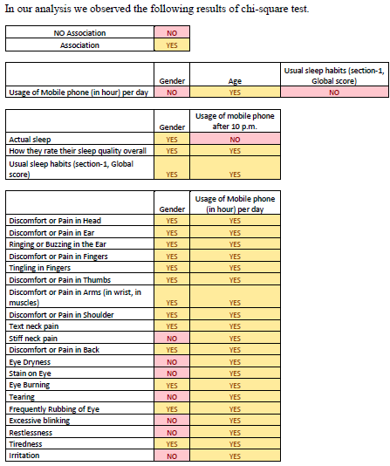
h

Slide 24
Multiple Response Analysis
Discomfort or Pain in Head (of section 2)
Observation: We observe from our survey that maximum (18.5%) of Discomfort or Pain in Head is Due to Entertainment.
Discomfort or Pain in Ear (of section 2)
Frequencies
 |  | Responses |  | Percent of Cases
 |  | N | Percent
 | Discomfort or Pain in Head Due to Texting | 114 | 17.6% | 42.4%
 | Discomfort or Pain in Head Due to Gaming | 117 | 18.1% | 43.5%
 | Discomfort or Pain in Head Due to Study | 90 | 13.9% | 33.5%
 | Discomfort or Pain in Head Due to Calling | 115 | 17.7% | 42.8%
 | Discomfort or Pain in Head Due to Entertainment | 120 | 18.5% | 44.6%
 | Discomfort or Pain in Head Due to Online activities | 92 | 14.2% | 34.2%
Total |  | 648 | 100.0% | 240.9%
a. Dichotomy group tabulated at value 1.
Frequencies
 |  | Responses |  | Percent of Cases
 |  | N | Percent
 | Discomfort or Pain in Ear Due to Texting | 46 | 9.3% | 20.0%
 | Discomfort or Pain in Ear Due to Gaming | 94 | 18.9% | 40.9%
 | Discomfort or Pain in Ear Due to Study | 42 | 8.5% | 18.3%
 | Discomfort or Pain in Ear Due to Calling | 114 | 22.9% | 49.6%
 | Discomfort or Pain in Ear Due to Entertainment | 92 | 18.5% | 40.0%
 | Discomfort or Pain in Ear Due to Online activities | 109 | 21.9% | 47.4%
Total |  | 497 | 100.0% | 216.1%
a. Dichotomy group tabulated at value 1.

Slide 25
Ringing or Buzzing in the Ear (of section 2)
Discomfort or Pain in Fingers (of section 2)
Observation: We observe from our survey that maximum (25.5%) of Discomfort or Pain in Fingers is Due to Texting.

Slide 26
Tingling in Fingers (of section 2)
Observation: We observe from our survey that maximum (21.3%) of Tingling in Fingers is Due to Gaming.
Discomfort or Pain in Thumbs (of section 2)
Observation: We observe from our survey that maximum (21.3%) of Discomfort or Pain in Thumbs is Due to Gaming.

Slide 27
Discomfort or Pain in Arms (in wrist, in muscles) (of section 2)
Observation: We observe from our survey that maximum (20.4%) of Discomfort or Pain in Arms (in wrist, in muscles) is Due to Entertainment.
Discomfort or Pain in Shoulder (of section 2)
Observation: We observe from our survey that maximum (22.9%) of Discomfort or Pain in Shoulder is Due to Entertainment.

Slide 28
Text neck pain (of section 2)
Observation: We observe from our survey that maximum (20.2%) of Text neck pain is Due to Gaming.
Stiff neck pain (of section 2)
Observation: We observe from our survey that maximum (21.8%) of Stiff neck pain is Due to Gaming.

Slide 29
Discomfort or Pain in Back (of section 2)
Observation: We observe from our survey that maximum (22.5%) of Discomfort or Pain in Back is Due to Entertainment.
Eye Dryness (of section 3)
Observation: We observe from our survey that maximum (20.4%) of Eye Dryness is Due to Entertainment.

Slide 30
Strain on Eye (of section 3)
Observation: We observe from our survey that maximum (20.4%) of Stain on Eye is Due to Entertainment.
Eye Burning (of section 3)
Observation: We observe from our survey that maximum (20.4%) of Eye Burning is Due to Texting

Slide 31
Tearing (of section 3)
Observation: We observe from our survey that maximum (22.1%) of Tearing is Due to Entertainment.
Frequently Rubbing of Eye (of section 3)
Observation: We observe from our survey that maximum (21%) of Frequently Rubbing of Eye is Due to Entertainment.

Slide 32
Excessive blinking (of section 3)
Observation: We observe from our survey that maximum (20.2%) of Excessive blinking is Due to Entertainment.
Observation: We observe from our survey that maximum (18.8%) of Restlessness is Due to Entertainment.
Restlessness (of section 4)

Slide 33
Tiredness (of section 4)
Observation: We observe from our survey that maximum (19.2%) of Tiredness is Due to Entertainment.
Irritation (of section 4)
Observation: We observe from our survey that maximum (19.9%) of Irritation is Due to Calling.

Slide 34
Multiple Response Chi-square for Independence of attributes
1) Objective: To check association physical health problem (upper limb, neck and back) of section 2 and Gender.
To Test:
Ho: There is no association between physical health problem (upper limb, neck and back) of section 2 and Gender
Vs
H1: There is association between physical health problem (upper limb, neck and back) of section 2 and Gender.
Decision Rule: As p-value < Alpha, then reject Ho.
Here,
Alpha = 0.05
P-value = 0.000
Conclusion:
As p-value < alpha, therefore the data provide enough evident to reject Ho at 5% Level of significance and 11 degree of freedom.
Hence, there is the association between Male and Female regarding the physical health problem (upper limb, neck and back) of
section 2.

Slide 35
5
Attribute | Attribute | p-value | Decision | Conclusion
Upper limb, back , neck (section 2) | Gender | 0.000 | Reject Ho at 5% l.o.s | There is association.
Upper limb, back , neck (section 2) | Usage of mobile phone | 0.149 | Do not reject Ho at 5% l.o.s | There is no association.
Eye problem(section 3) | Gender | 0.036 | Reject Ho at 5% l.o.s | There is association .
Eye problem(section 3) | Usage of mobile phone | 0.011 | Reject Ho at 5% l.o.s | There is association .
Physical stress( section 4 ) | Gender | 0.021 | Reject Ho at 5 % l.o.s | There is association.
Physical stress( section 4 ) | Usage of mobile phone | 0.178 | Do not reject Ho at 5% l.o.s | There is no association .

Slide 36
Mann -Whitney test:
Objective: To check the difference between the rank of Gender based on Sleep Latency.
To Test:
Ho: There is no difference between the rank of Gender based on Sleep Latency.
Vs
H1: There is difference between the rank of Gender based on Sleep Latency.
Observed rank :
Here,
Alpha = 0.05
P-value = 0.224
Conclusion:
As p-value > alpha, therefore the data provide enough evident to do not reject Ho at 5% Level of significance.
Hence,
There is no difference between the rank of Gender based on Sleep Latency.
Hence, Male and Female have similar Sleep Latency.

Slide 37
2) Objective: To check the difference between the rank of Gender based on usage of mobile phone after 10 p.m.
To Test:
Ho: There is no difference between the rank of Gender based on usage of mobile phone after 10 p.m.
Vs
H1: There is difference between the rank of Gender based on usage of mobile phone after 10 p.m.
Decision Rule: As p-value < Alpha, then reject Ho.
Here,
Alpha = 0.05
P-value = 0.110
Conclusion:
As p-value > alpha, therefore the data provide enough evident to do not reject Ho at 5% Level of significance.
Hence,
There is no difference between the rank of Gender based on usage of mobile phone after 10 p.m.
Hence, Male and Female have similar usage of mobile phone after 10 p.m.

Slide 38
3) Objective: To check the difference between the rank of Gender based on Global Score (seven component score together) of section 1.
To Test:
Ho: There is no difference between the rank of Gender based on Global Score (seven component score together) of section 1.
Vs
H1: There is difference between the rank of Gender based Global Score (seven component score together) of section 1.
Decision Rule: As p-value < Alpha, then reject Ho.
Here,
Alpha = 0.05
P-value = 0.006
Conclusion:
As p-value < alpha, therefore the data provide enough evident to reject Ho at 5% Level of significance.
Hence,
There is difference between the rank of Gender based on Global Score (seven component score together) of section 1.
As, Female reporting high Global Score (seven component score together) of section 1then Male.
Hence, Male have good Global Sleep Quality as compared to Female.

Slide 39
Kruskal-Wallis test :
1) Objective: To check the significant difference among the four wards based on Global Score (seven component score together) of Usual sleep habits.
To Test:
Ho: There is no significant difference among the four wards based on Global Score (seven component score together) of Usual sleep habits.
Vs
H1: There is significant difference among the four wards based on Global Score (seven component score together) of Usual sleep habits.
Decision Rule: As p-value < Alpha, then reject Ho.
Here,
Alpha = 0.05
P-value = 0.849
Conclusion:
Here the p value > alpha, so the data provides the enough evidence to do not reject H₀ at 5% Level of significance and 3 degrees of freedom.
Hence, there is no significant difference among the four wards based on Global Score (seven component score together) of Usual sleep habits.

Slide 40
Multinomial logistic Regression:
To study the placing pattern of their mobile phone based on Age, Gender and Occupation.
For multinomial logistic in Y:
Upper left side of your pocket = 1,
Front side of jeans pocket = 2,
Back side of jeans pocket = 3,
Mobile zipper pouch =4.
All are taken as the base with ascending order of categories.
Model is fitted by using forward stepwise multinomial logistic regression.

Slide 41
Ho: No significance between null model (model with only intercept) and final model (model with all variable)
Vs
H1: Significance between null model (model with only intercept) and final model (model with all variables)
Decision Rule: As p-value < Alpha, then reject Ho.
Here,
Alpha = 0.05
P-value = 0.000
Conclusion:
Here p-value < alpha. Therefore, Ho is rejected i.e. the fitted model is significant.
Goodness of fit
Ho: Model is not adequately fitted
Vs
H1: Model is adequately fitted

Slide 42
Decision Rule: As p-value < Alpha, then reject Ho.
Here,
Alpha = 0.05
P-value = 0.000
Conclusion: Since P-value < alpha. Therefore, we reject Ho i.e. model is adequately fitted.

Slide 43
Here Cox and snell = 0.343
34.3% of variation in Y is explained by fitted model
Overall Significance test of the variables
Since Sig. < 0.05 for Age and Gender, hence it can be concluded that the two variables are significant.
But for Occupation, Sig. >0.05
Hence it can be concluded that occupation variable is not significant.

Slide 44
Model Classification
66.5% times the fitted model does the correct classification.

Slide 45
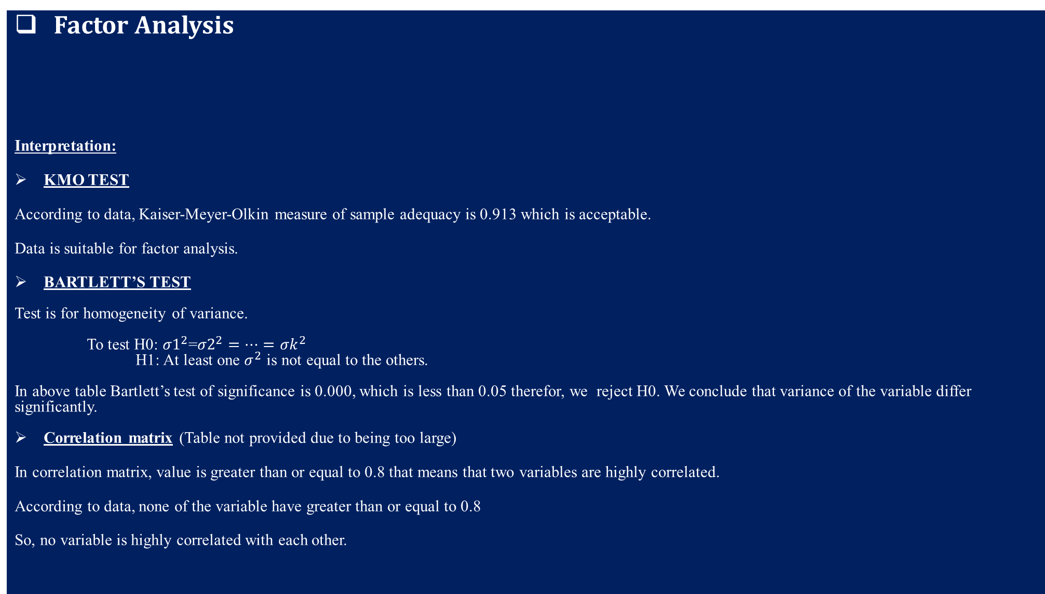
Factor Analysis
Interpretation:
KMO TEST
According to data, Kaiser-Meyer-Olkin measure of sample adequacy is 0.913 which is acceptable.
Data is suitable for factor analysis.
BARTLETT’S TEST
Test is for homogeneity of variance.
To test H0: ${σ1}^{2}$=${σ2}^{2}=…={σk}^{2}$
H1: At least one $σ^{2}$ is not equal to the others.
In above table Bartlett’s test of significance is 0.000, which is less than 0.05 therefor, we reject H0. We conclude that variance of the variable differ significantly.
Correlation matrix (Table not provided due to being too large)
In correlation matrix, value is greater than or equal to 0.8 that means that two variables are highly correlated.
According to data, none of the variable have greater than or equal to 0.8
So, no variable is highly correlated with each other.
KMO and Bartlett's Test
Kaiser-Meyer-Olkin Measure of Sampling Adequacy. |  | .913
Bartlett's Test of Sphericity | Approx. Chi-Square | 4841.931
 | df | 190
 | Sig. | .000

Slide 46
Communalities Table
Communalities
 | Initial | Extraction
Discomfort or Pain in Head | 1.000 | .430
Discomfort or Pain in Ear | 1.000 | .636
Ringing or Buzzing in the Ear | 1.000 | .641
Discomfort or Pain in Fingers | 1.000 | .559
Tingling in Fingers | 1.000 | .744
Discomfort or Pain in Thumbs | 1.000 | .795
Discomfort or Pain in Arms (in wrist, in muscles) | 1.000 | .854
Discomfort or Pain in Shoulder | 1.000 | .749
Text neck pain | 1.000 | .790
Stiff neck pain | 1.000 | .664
Discomfort or Pain in Back | 1.000 | .596
Eye Dryness | 1.000 | .552
Stain on Eye | 1.000 | .510
Eye Burning | 1.000 | .526
Tearing | 1.000 | .678
Frequently Rubbing of Eye | 1.000 | .744
Excessive blinking | 1.000 | .696
Restlessness | 1.000 | .647
Tiredness | 1.000 | .707
Irritation | 1.000 | .772
Extraction Method: Principal Component Analysis.

Slide 47
Component Matrix
Interpretation: Extraction by Principal Component Analysis. We extract 3 components
Component Matrixª
 | Component
 | 1 | 2 | 3
Discomfort or Pain in Head | .640
Discomfort or Pain in Ear | .780
Ringing or Buzzing in the Ear | .770 |  | -.211
Discomfort or Pain in Fingers | .730
Tingling in Fingers | .735 | -.412
Discomfort or Pain in Thumbs | .729 | -.479
Discomfort or Pain in Arms (in wrist, in muscles) | .735 | -.527
Discomfort or Pain in Shoulder | .776 | -.327
Text neck pain | .789 | -.389
Stiff neck pain | .773 | -.259
Discomfort or Pain in Back | .765
Eye Dryness | .631 | .367
Stain on Eye | .633 |  | .313
Eye Burning | .581 | .400
Tearing | .531 | .592 | .211
Frequently Rubbing of Eye | .549 | .576 | .333
Excessive blinking | .500 | .578 | .333
Restlessness | .616 |  | -.504
Tiredness | .676 |  | -.475
Irritation | .569 | .210 | -.636
Extraction Method: Principal Component Analysis.
a. 3 components extracted.

Slide 48
.
Total Variance Explained
Component | Initial Eigenvalues |  |  | Extraction Sums of Squared Loadings |  |  | Rotation Sums of Squared Loadingsª
 | Total | % of Variance | Cumulative % | Total | % of Variance | Cumulative % | Total
1 | 9.292 | 46.461 | 46.461 | 9.292 | 46.461 | 46.461 | 7.549
2 | 2.439 | 12.196 | 58.657 | 2.439 | 12.196 | 58.657 | 5.744
3 | 1.559 | 7.794 | 66.451 | 1.559 | 7.794 | 66.451 | 6.116
4 | .938 | 4.690 | 71.141
5 | .855 | 4.277 | 75.419
6 | .703 | 3.517 | 78.936
7 | .578 | 2.890 | 81.827
8 | .504 | 2.518 | 84.344
9 | .423 | 2.113 | 86.457
10 | .402 | 2.008 | 88.465
11 | .367 | 1.836 | 90.301
12 | .315 | 1.577 | 91.878
13 | .290 | 1.448 | 93.325
14 | .265 | 1.324 | 94.649
15 | .238 | 1.192 | 95.841
16 | .231 | 1.154 | 96.995
17 | .189 | .943 | 97.938
18 | .181 | .903 | 98.841
19 | .131 | .657 | 99.498
20 | .100 | .502 | 100.000
Extraction Method: Principal Component Analysis.
a. When components are correlated, sums of squared loadings cannot be added to obtain a total variance.
We extract 3 components from the data, where these components extract almost 67% of the variation in the data

Slide 49
Pattern Matrix
Pattern Matrixª
 | Component
 | 1 | 2 | 3
Discomfort or Pain in Head | .309 |  | -.386
Discomfort or Pain in Ear | .504 |  | -.380
Ringing or Buzzing in the Ear | .294 |  | -.521
Discomfort or Pain in Fingers | .270 | .241 | -.426
Tingling in Fingers | .878
Discomfort or Pain in Thumbs | .934
Discomfort or Pain in Arms (in wrist, in muscles) | .982
Discomfort or Pain in Shoulder | .831
Text neck pain | .862
Stiff neck pain | .674 |  | -.228
Discomfort or Pain in Back | .360 | .222 | -.387
Eye Dryness |  | .618
Stain on Eye | .410 | .505
Eye Burning |  | .653
Tearing |  | .833
Frequently Rubbing of Eye |  | .904
Excessive blinking |  | .890
Restlessness |  |  | -.806
Tiredness |  |  | -.803
Irritation |  |  | -.956
Extraction Method: Principal Component Analysis. Rotation Method: Oblimin with Kaiser Normalization.
a. Rotation converged in 7 iterations.

Slide 50
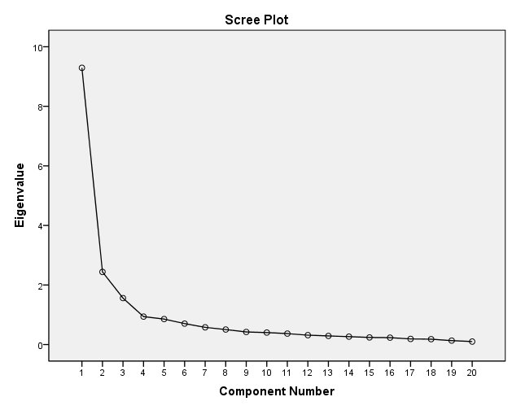
Component 1: According to data Discomfort or Pain in Head, Discomfort or Pain in Ear, Ringing or Buzzing in the Ear, Discomfort or Pain in Fingers, Tingling in Fingers, Discomfort or Pain in Thumbs, Discomfort or Pain in Arms(in wrist, in muscles) , Discomfort or Pain in Shoulder , Text neck pain, Stiff neck pain and Discomfort or Pain in Back are variables which are correlated to each other are defined in first component of section 2.
Component 2: Also, Eye Dryness, Stain on Eye, Eye Burning, Tearing, Frequently Rubbing of Eye and Excessive blinking are correlated to each other which are defined in first component of section 3.
Component 3: Restlessness, Tiredness and Irritation these all are related with each other and defined in our first component of section 4.
Scree Plot

Slide 51
Interpretation of Scree Plot:
These results show the rotated factor loadings for all the factors using the principal component method of extraction.
In above Scree plot, there are 3 components which are explained by 3 factors having greater than 1 eigen value.
The percentage of variability explained by factor 1 is 46.46% by factor 2 is 12.20% and by factor 3 is 7.79%.
The Scree plot shows that the first three factors account for most of the total variability in data. The remaining factors account for a small proportion of the variability.
We extract 3 components from the data, where these components extract almost 67% of the variation in the data.

Slide 52
REFERENCE
1st Section references
https://www.psychdb.com/_media/sleep/2-insomnia-disorder/the_pittsburgh_sleep_quality_index_psqi.pdf
http://www.goodmedicine.org.uk/files/assessment,%20pittsburgh%20psqi.pdf
https://www.psychiatry.pitt.edu/sites/default/files/inline-files/PSQI%20Article.pdf
https://www.hindawi.com/journals/sd/2018/9643937/
Likert scale reference https://en.wikipedia.org/wiki/Likert_scale#Scoring_and_analysis
Medical terms
1) ringing and buzzing in ear https://www.webmd.com/a-to-z-guides/understanding-tinnitus-basics
2) tingling in fingers https://www.webmd.com/brain/tingling-in-hands-and-feet#1
3) discomfort pain https://www.sciencedirect.com/science/article/abs/pii/S1524904217305222
4) stiff neck pain https://www.spine-health.com/conditions/neck-pain/stiff-neck-causes-symptoms-and-treatment
5) text neck pain https://www.physio-pedia.com/Text_Neck#:~:text=Text%20neck%20is%20a%20modern,posture%20or%20anterior%20head%20syndrome.
6) eye dryness https://www.medicalnewstoday.com/articles/170743
7) frequently rubbing on eyes https://www.healthline.com/health/eye-health/rubbing-your-eyes#:~:text=Rubbing%20your%20eyes%20can%20mean,too%20hard%20or%20too%20often.
8) excessive blinking https://www.healthline.com/health/eye-health/eye-blinking
9) restlessness https://www.sciencedirect.com/topics/medicine-and-dentistry/restlessness
10) tiredness https://patient.info/signs-symptoms/tiredness-fatigue

Slide 53
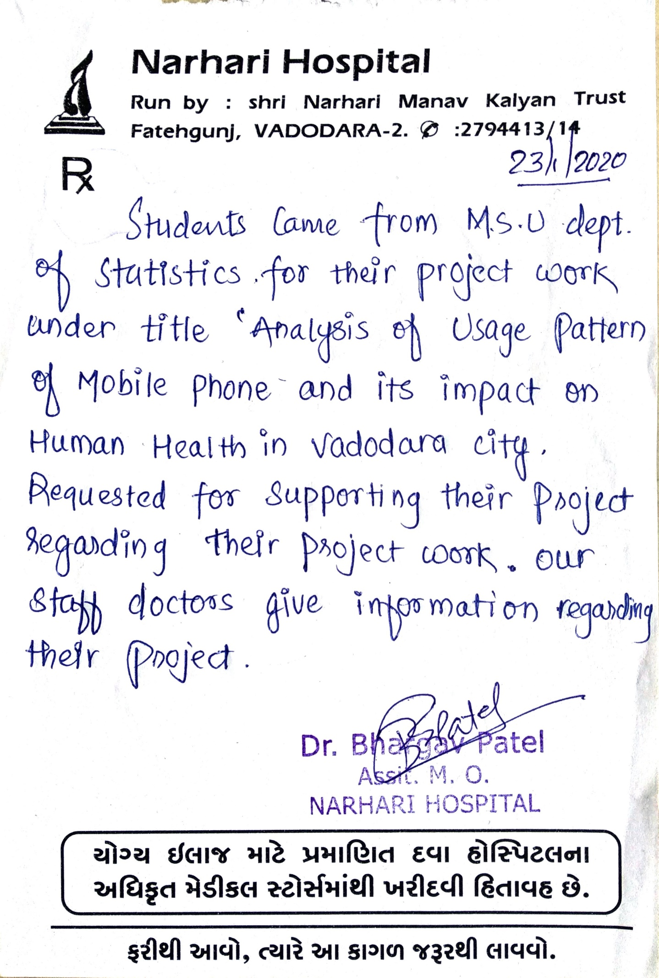
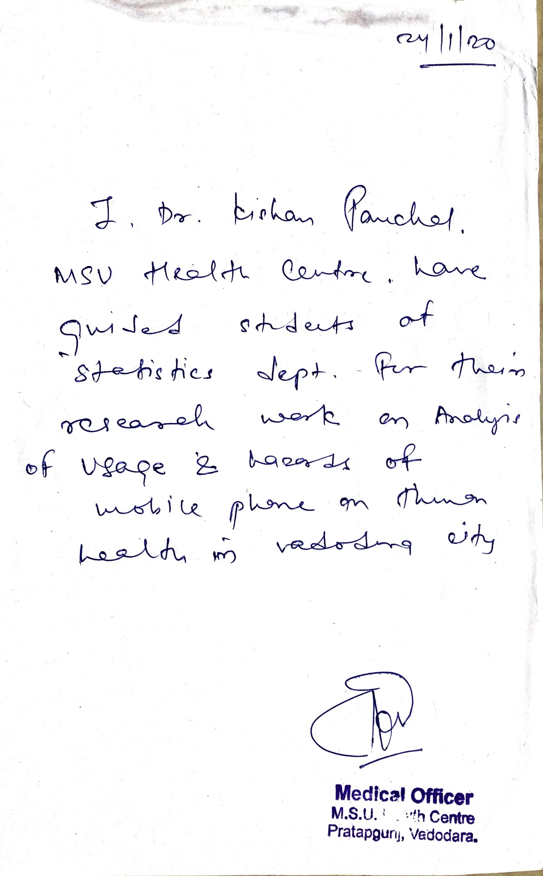
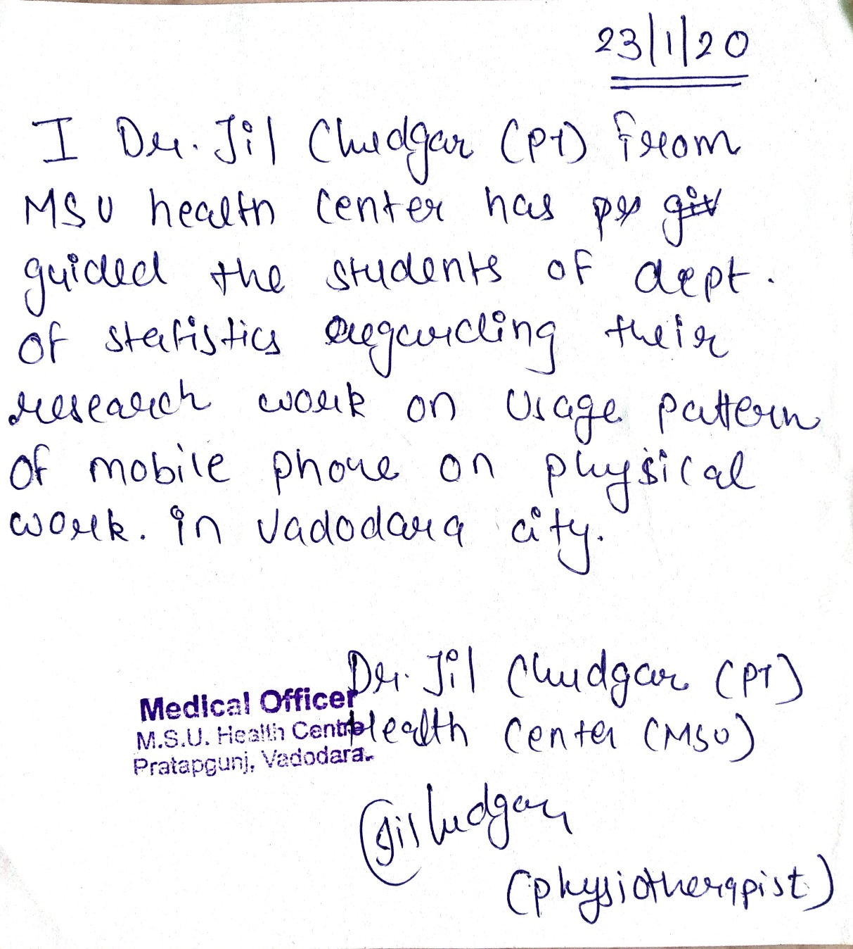

Slide 54
THANK YOU
/SUGGESTIONS/

