Slide 1
AgriGen AI: Intelligent Multi-Agent Farming Ecosystem
Phase 1 Comprehensive Project Review Presentation
👥 Team Members & Roles (6-Member Team):
1. Member 1 (Team Lead & Product Architect) — System Architecture, Phase 1 Progress & Strategy
2. Member 2 (Frontend & UI/UX Lead) — React/Vite Dashboard, Multilingual Voice & Scanner UI
3. Member 3 (Backend & Orchestration Lead) — FastAPI Microservices, Async SSE Streaming & Routes
4. Member 4 (Multi-Agent & RAG Specialist) — LangGraph Supervisor, FAISS Vector Knowledge Base
5. Member 5 (Machine Learning & Vision Lead) — PyTorch LSTM (Weather & Market) & Disease Vision
6. Member 6 (DevOps & Database Integration Lead) — PostgreSQL/SQLite Data Models, Docker & Scripts
Notes:
SPEAKER SCRIPT (Member 1 - Team Lead):
Good morning respected mentor and review panel. Today, our 6-member team is proud to present the Phase 1 Project Review for 'AgriGen AI: Intelligent Multi-Agent Farming Ecosystem'. AgriGen AI addresses critical agricultural challenges through deep learning, multi-agent LLM orchestration, computer vision, and real-time market/weather forecasting. During this presentation, each of our 6 team members will detail their specific engineering contributions.

Slide 2
PHASE 1 PROJECT REVIEW
Problem Statement & Project Objectives
🎤 Presenter:
Member 1 (Team Leader)
Agricultural Challenges
• Price Volatility: Farmers sell crops blindly without historical trend forecasts.
• Micro-Climate Surprises: Generic weather forecasts lack farm-level precision.
• Crop Disease Losses: Delayed leaf pest/disease diagnosis leads to total crop destruction.
• Information Silos & Language Barrier: Research papers are inaccessible; rural farmers struggle with text-only English apps.
AgriGen AI Objectives
• Multi-Agent Intelligence: Deploy specialist agents using LangGraph & Llama-3.
• LSTM Predictive Engines: Provide 7-day weather & crop price forecasts with peak profit alerts.
• Instant Vision Diagnostics: Computer vision to scan leaves and prescribe actionable remedies.
• RAG Agricultural Advisory: FAISS vector database indexed with verified research papers.
• Multilingual Voice Interface: Native English, Hindi, and Telugu speech interaction.
Notes:
SPEAKER SCRIPT (Member 1):
Modern farmers face compounding risks: volatile market prices, localized crop diseases, and unpredicted weather shifts. Our objective with AgriGen AI is to build a unified multi-agent platform that gives every farmer a hyper-personalized digital agronomist right in their pocket.

Slide 3
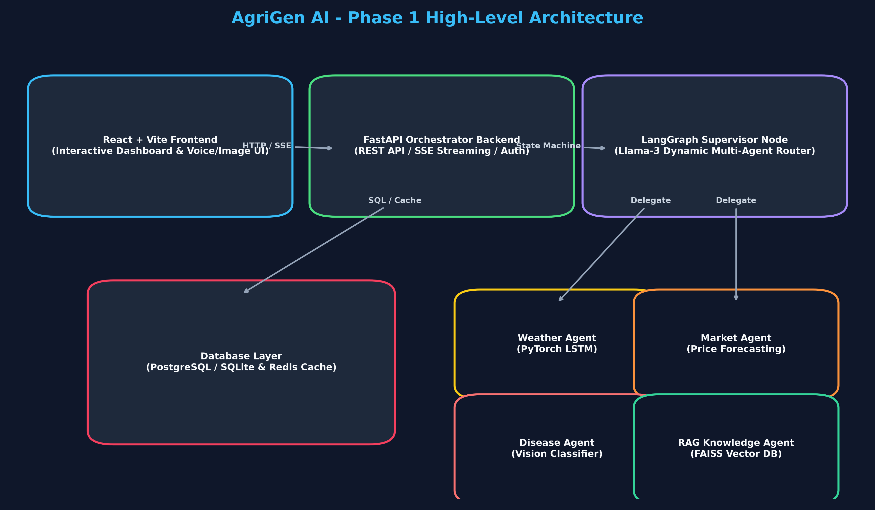
PHASE 1 PROJECT REVIEW
System Architecture & High-Level Workflow
🎤 Presenter:
Member 1 (Team Leader)
Core Architectural Pillars
• Decoupled Microservices: React Frontend + FastAPI Async Backend.
• Stateful Multi-Agent Graph: LangGraph Supervisor manages node state transitions.
• Hybrid Predictive Analytics: PyTorch LSTMs + Computer Vision + FAISS Vector DB.
• Dual Storage Strategy: PostgreSQL for relational persistence, Redis for caching & state memory.
Notes:
SPEAKER SCRIPT (Member 1):
Here is our system architecture diagram. User queries enter via our React frontend or voice widget, reach FastAPI, and are dispatched to the LangGraph Supervisor. The supervisor dynamically delegates execution to specialized agent nodes. I will now hand over to Member 2 to present the Frontend Dashboard.

Slide 4
PHASE 1 PROJECT REVIEW
Frontend Dashboard & UI/UX Architecture
🎤 Presenter:
Member 2 (Frontend Specialist)
User Interface & Experience
• Vite + React Core: Built for ultra-fast startup and smooth client-side interactions.
• Custom Agricultural Design System: Earthy dark palette, glassmorphism, tailored typography.
• Interactive Analytics: Dynamic Chart.js integration for price trends & moisture metrics.
• Location Picker Modal: Interactive GPS coordinate selector and field selector bar.
Multilingual Assistant Widget
• Floating Chat Widget: Persistent bottom-right drawer supporting rich Markdown responses.
• Voice Input / Output: Browser STT/TTS engine supporting English, Hindi, and Telugu.
• Drag-and-Drop Image Uploader: Instant leaf photo scanning for disease identification.
• Persistent User Memory: LocalStorage session preservation across chat resets.
Notes:
SPEAKER SCRIPT (Member 2):
Respected panel, as the Frontend Lead, my focus was building a responsive, accessible interface for farmers. We developed a React/Vite dashboard featuring custom charts, an interactive map location picker, and a floating AI assistant widget that supports Hindi and Telugu voice input.

Slide 5
PHASE 1 PROJECT REVIEW
Backend Microservices & Orchestration Layer
🎤 Presenter:
Member 3 (Backend Engineer)
FastAPI Microservices Architecture
• Async Python Engine: Built on FastAPI and Uvicorn for high-concurrency request handling.
• Modular V1 API Routing: Clean separation across auth, weather, market, disease, and report routes.
• Pydantic Validation: Strict schema validation for all API inputs and structured outputs.
• CORS & Security Controls: Configured middleware with environment variable isolation.
Real-Time Streaming & Orchestrator
• SSE Streaming Endpoint (`/api/v1/orchestrator/chat`): Real-time token streaming to frontend.
• Stateful Session Management: Tracks conversation histories and user preferences in memory.
• WeasyPrint PDF Generator: Asynchronous trigger for weekly summary PDF reports.
• Error Middleware: Graceful exception handling and fallback logging.
Notes:
SPEAKER SCRIPT (Member 3):
As the Backend Engineer, I designed our asynchronous FastAPI core. Our streaming orchestrator endpoint utilizes Server-Sent Events (SSE), allowing AI agent responses to stream incrementally to the farmer without blocking the server.

Slide 6
PHASE 1 PROJECT REVIEW
LangGraph Multi-Agent Router & RAG Advisory Engine
🎤 Presenter:
Member 4 (Multi-Agent Lead)
LangGraph Supervisor Workflow
• Directed Acyclic Graph (DAG): Implements state-machine routing powered by LLMs.
• Intent Router: Evaluates incoming prompt and context to assign the optimal agent.
• Specialist Nodes: Dedicated nodes for Weather, Market, Disease, and Knowledge RAG.
• State Preservation: State dictionary maintains thread history and agent decisions.
FAISS RAG Knowledge Engine
• Curated Agriculture Dataset: Indexed ICAR research papers, soil health data & subsidies.
• Vector Embeddings: Uses HuggingFace all-MiniLM-L6-v2 embeddings for fast retrieval.
• Similarity Thresholding: Mitigates LLM hallucinations by retrieving top-k verified context chunks.
• Grounded Advisory: Formulates actionable farmer responses strictly supported by retrieved facts.
Notes:
SPEAKER SCRIPT (Member 4):
My core contribution was building the multi-agent decision engine using LangGraph and RAG. The Supervisor evaluates intent—for example, if a query mentions 'fertilizer advice', it routes to our FAISS vector store containing official ICAR research.

Slide 7
PHASE 1 PROJECT REVIEW
Predictive Analytics & Deep Learning Models
🎤 Presenter:
Member 5 (Machine Learning Lead)
Weather LSTM Model
• PyTorch Architecture: Sequential LSTM network.
• Inputs: Historical temp, humidity, pressure, rainfall.
• Output: 7-day micro-climate precipitation & humidity trend.
• Accuracy: High R² score on local weather datasets.
Market LSTM Model
• Price Forecasting: Predicts mandi prices for major crops.
• Profitability Peak Alert: Identifies optimal selling window.
• Mandi Integration: Dynamic price tracking for regional markets.
Leaf Disease Vision
• CNN / Vision Classifier: Scans crop leaves for early pest/disease detection.
• Confidence Scoring: Outputs disease probability & severity level.
• Treatment Link: Directly maps detected disease to organic & chemical treatments.
Notes:
SPEAKER SCRIPT (Member 5):
As the ML Lead, I developed our PyTorch models. We have two trained LSTMs—one for 7-day weather forecasting and one for crop price prediction—alongside our Computer Vision module that identifies crop leaf diseases from images.

Slide 8
PHASE 1 PROJECT REVIEW
Database Architecture, DevOps & Infrastructure
🎤 Presenter:
Member 6 (DevOps & Database Lead)
Data Storage & Schema Design
• SQLAlchemy ORM: Unified data access layer across environments.
• Production PostgreSQL & Local SQLite: Seamless fallback mechanism (`agrigen.db`).
• Key Schemas: User profiles, farm plots, historical weather, market rates, diagnostic logs.
• Redis Caching: Fast session persistence and rate-limiting.
Containerization & Local Dev
• Docker & Docker Compose: Containerized backend, frontend, and database services.
• One-Click PowerShell Launcher (`run_local.ps1`): Launches backend and frontend concurrently.
• Virtual Environment Management: Custom virtual environment with patched hashlib dependencies.
• Production NGINX Config: Reverse proxy setup with SSL readiness.
Notes:
SPEAKER SCRIPT (Member 6):
My role focused on database design, devops, and local launcher orchestration. I implemented an ORM layer supporting PostgreSQL and local SQLite, containerized the platform using Docker, and automated local developer launch via `run_local.ps1`.

Slide 9
PHASE 1 PROJECT REVIEW
Phase 1 Implementation Progress & Key Milestones
🎤 Presenter:
Member 1 (Team Leader)
Completed Deliverables (Phase 1)
• ✅ Functional Multi-Agent Workflow: LangGraph Supervisor with specialist agent nodes.
• ✅ Responsive React Dashboard: Operational charts, location picker, and floating chat widget.
• ✅ FastAPI Backend: Async REST routes, SSE streaming endpoint, and WeasyPrint PDF reports.
• ✅ Trained Machine Learning Baseline Models: PyTorch LSTMs & Leaf Disease classifier.
• ✅ FAISS RAG Pipeline: Ingested agricultural research papers for advisory.
Testing & Verification Progress
• End-to-End Local Execution: Successfully tested via `run_local.ps1`.
• Multilingual Voice Test: Verified STT/TTS in English, Hindi, and Telugu.
• API Test Coverage: Verified all `/api/v1/` routes with Swagger UI (`/docs`).
• Robustness Patching: Resolved Windows native C-extension DLL fallback issues.
Notes:
SPEAKER SCRIPT (Member 1):
We are pleased to report that Phase 1 objectives have been successfully achieved! Our frontend dashboard, FastAPI backend, multi-agent supervisor, PyTorch models, and RAG knowledge base are fully integrated and running smoothly.

Slide 10
PHASE 1 PROJECT REVIEW
Key Technical Challenges & Engineering Solutions
🎤 Presenter:
Member 3 & Member 4
LLM Hallucinations
• Challenge: Generic LLMs gave unsafe agricultural advice.
• Solution: Implemented FAISS RAG vector retriever with strict confidence scoring.
Multi-Agent Latency
• Challenge: Sequential agent calls caused response lag.
• Solution: Enabled Server-Sent Events (SSE) streaming for real-time response rendering.
Native C DLL Conflict
• Challenge: Windows App Control blocked `xxhash` DLL in `langgraph`.
• Solution: Patched `langgraph` with pure-python `hashlib` fallback.
Notes:
SPEAKER SCRIPT (Member 3 & 4):
During Phase 1, we tackled critical engineering hurdles. We solved LLM hallucinations using FAISS RAG grounding, eliminated latency using SSE streaming, and bypassed Windows DLL restrictions with a custom hashlib patch.

Slide 11
PHASE 1 PROJECT REVIEW
Phase 2 Roadmap & Future Scope
🎤 Presenter:
Member 5 (Machine Learning Lead)
Phase 2 Feature Roadmap
• Edge Model Optimization: Quantize disease CNN to ONNX for offline mobile inference.
• IoT Smart Valve Integration: Direct relay control for autonomous irrigation based on weather LSTMs.
• Drone Orthomosaic Scanning: Processing aerial multispectral imagery for wide-area field analysis.
• Mandi Direct Trading: Automated market order execution at peak profitability windows.
Scalability & Deployment
• Kubernetes Auto-Scaling: Elastic cluster scaling for CPU-intensive PyTorch inference.
• Satellite Telemetry Integration: Real-time Sentinel-2 NDVI crop health index ingestion.
• Vernacular Voice Expansion: Adding regional Indian dialects (Tamil, Kannada, Marathi).
Notes:
SPEAKER SCRIPT (Member 5):
Looking ahead to Phase 2, our roadmap includes deploying edge vision models for offline mobile use, integrating IoT smart irrigation controllers, and incorporating satellite crop telemetry.

Slide 12
PHASE 1 PROJECT REVIEW
Team Work Breakdown & Individual Contribution Matrix
🎤 Presenter:
Member 6 (DevOps Lead)
6-Member Deliverables Breakdown
• Member 1 (Team Leader): Overall architecture design, supervisor workflow configuration, Phase 1 roadmap & review lead.
• Member 2 (Frontend Specialist): React/Vite UI components, location picker, dynamic Chart.js dashboards & voice widget.
• Member 3 (Backend Engineer): FastAPI orchestrator, SSE streaming endpoints, API routing structure & WeasyPrint PDF reports.
• Member 4 (Multi-Agent & RAG Specialist): LangGraph agent state machine, FAISS vector embeddings, agricultural RAG pipeline.
• Member 5 (Machine Learning Lead): PyTorch LSTM training (weather & crop price forecasting) & leaf disease vision classifier.
• Member 6 (DevOps & Database Lead): PostgreSQL/SQLite data schemas, Docker Compose orchestration, Redis cache, local run script.
Notes:
SPEAKER SCRIPT (Member 6):
This matrix details the clear distribution of responsibilities across our 6 team members. Every member has taken ownership of a major component of the AgriGen AI stack.

Slide 13
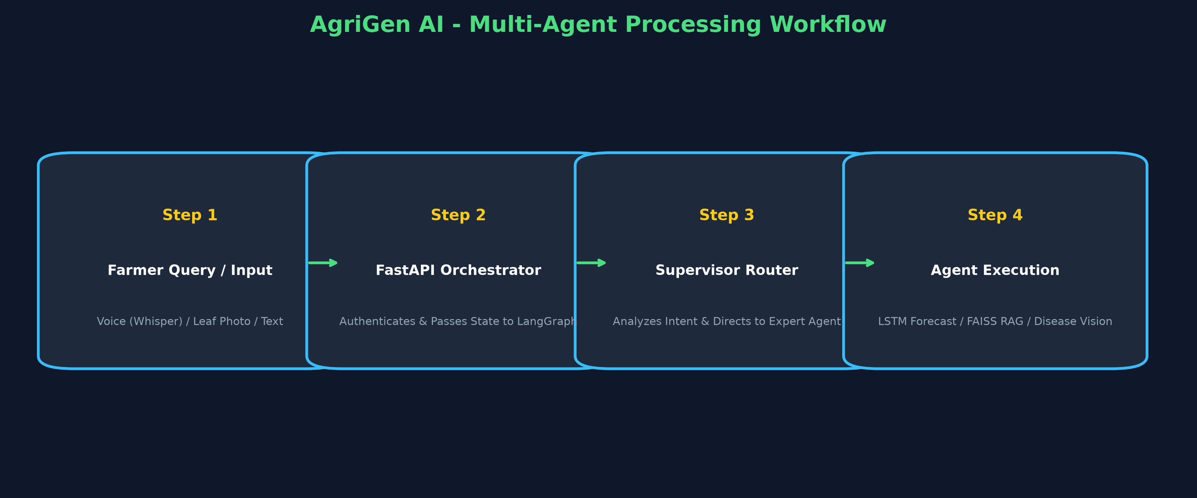
PHASE 1 PROJECT REVIEW
Live Demonstration & Workflow Execution
🎤 Presenter:
Member 2 & Team
Demo Highlights
• 1. Dynamic Dashboard: Location picker updates local mandi prices & weather forecasts.
• 2. Voice Input: Querying crop advisory in Telugu/Hindi via voice button.
• 3. Leaf Scanner: Uploading leaf photo -> Instant disease detection & organic remedies.
• 4. PDF Generation: One-click export of farmer summary report.
Notes:
SPEAKER SCRIPT (Member 2):
We demonstrate our live execution flow: from farmer input to LangGraph routing, PyTorch inference, FAISS retrieval, and instant UI rendering.

Slide 14
PHASE 1 PROJECT REVIEW
Conclusion & Panel Q&A Defense Strategy
🎤 Presenter:
Member 1 & Team
Summary of Phase 1 Readiness
• Fully Operational Prototype: All core modules integrated and tested locally.
• High Technical Rigor: Deep learning, microservices, and RAG working in unison.
• Social Impact: Empowers rural farmers with localized, accessible AI advisory.
• Prepared for Phase 2: Solid foundation established for IoT & Edge expansion.
Thank You! Questions & Discussion
• We welcome questions and feedback from our respected mentor and review panel.
• Project Repository: agriGen_AI
• Team Members: Members 1, 2, 3, 4, 5, 6
• Status: Ready for Phase 1 Sign-Off!
Notes:
SPEAKER SCRIPT (Member 1 & All):
In conclusion, AgriGen AI represents a major step forward in accessible agricultural intelligence. Thank you for your time and guidance. We are now open for questions and feedback from the panel.

