Slide 1
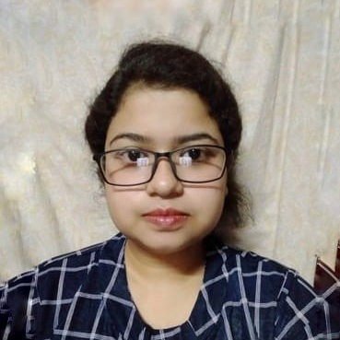



Kinkini Adhikari
Analyst/Software Engineer
Bachelor of Engineering
Electrical Engineering : 2018-2022
Skills
Java 8 /J2EE | Java Basics, OOPS, Generics, Collections, Arrays, Loops, Lambda Exp, Stream API Junit, Mockito, Servlets
Spring core | IOC & Dependency Injection, Autowire
Spring REST | REST controllers, Implementation of GET, POST, PUT & DELETE, Exception Handling, Testing Services, Controller & Repository layer
Spring Data JPA | Implement DAO layer using spring Data repositories
Spring Boot Microservices | Spring Boot Starters, annotations, RabbitMQ, Swagger
Spring Cloud | Eureka, Netflix Hystrix and Config Server
React | Components, Hooks, Event handling
Database | MongoDB No Sql basics , PostgreSQL
UI Tech | HTML 5 & CSS 3,JavaScript, ES6 Bootstrap 5
Tools | Git, Postman, Maven, IDE
Add On skills | Communications, Team management. Peer learning
Mumbai
kinkini.adhikari@capgemini.com
+91 8240841052
A4
Full Stack Developer
Hands on experience in creating microservices with Spring Boot, JWT Security Authentication, Role Based Authorization, Spring Security, Spring Cloud API Gateway, Eureka server and postman
Hands on experience in developing web pages using HTML5, CSS 3, ES6, JSON, understanding of Document Object Model (DOM).
Proficient in creating Single page Web Application in React js with Authentication.
Hands on experience in implementing case study with ReactJs & spring boot
Hands on experience in implementing case study using MongoDB Atlas & PostgreSQL
Experience in Swagger and in unit testing using Junit , Mockito.
Hands on experience in implementing RabbitMQ.
Online Railway Reservation System
Completed end to end case study of Online Railway Reservation System along with JWT authentication, Swagger and ReactJs used for user interface.
Library Management System
Completed end to end case study of Library Management System using Spring boot and ReactJs.
Check out my work on GitHub & Video Profile

