Slide 1
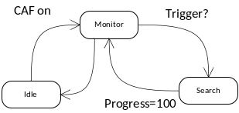
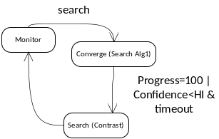
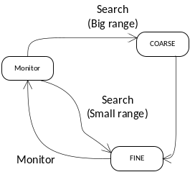
HAF states
AF
_
DEFAULT
PDAF+TOF
_
MIXER
Create
()
AF
_
HAF
-
PDAF
PrimeryAlg
+
Create
-
()
SecondaryAlg
AF
_
1
TOF
-
State
1
AF
_
+
process
DCIAF
_
monitor
()
+
Create
()
_
+
process
AF
FOLLOWER
_
search
()
Create
-
()
handle
_
converge
()
+
Create
()
-
handle
_
finescan
()
+
Create
-
1
()
handle
_
fallback
()
AF
_
CONTRAST
Default mixer states
1
+
process
_
monitor
()
+
process
_
search
()
+
SetSensetivity
()
Contrast States

