Slide 1
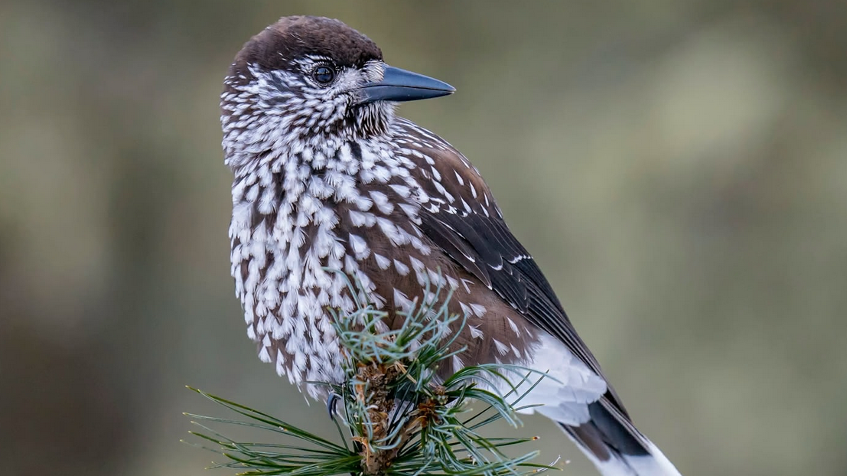
Semester project Patterns and trends in environmental data MSc ENR FS25
How frequently revisited sites differ between individuals and the sex of the spotted nutcracker in Davos

Slide 2
Context
The spotted nutcracker (Nucifraga caryocatactes) plays an important role in the dispersal of Swiss stone pine by dispersing seeds
Their movement data allows you to draw conclusions about frequently revisited sites resp. harvesting and caching sites
Understanding these patterns helps in forest conservation and management

Slide 3
Research Questions
How do frequently revisited sites vary among individuals, and can distinct clusters of these sites be identified?
Do revisited sites of individuals differ between males and females in terms of distance from each other?

Slide 4
Data used
Combined data set of two studies conducted in the same area with total 31 individuals (only 11 used for our project)
Data set contains:
X / Y coordinates
Timestamp (every 15-minutes / hourly 🫤)
Animal Id
Animal sex
…

Slide 5
Analysis of Frequently Revisited Sites after Sorensen et al. (2022) and Graf et al. (2024)
For each bird, we did/will do the following:
Get the number of revisits for each of their GPS point using the R package recurse
Extract the GPS location over a certain threshold of revisits. (We use the mean, but other thresholds are possible.)
Cluster the extracted GPS location into groups
Extract the 95% convex polygons of each cluster using the adehabitatHR package

Slide 6
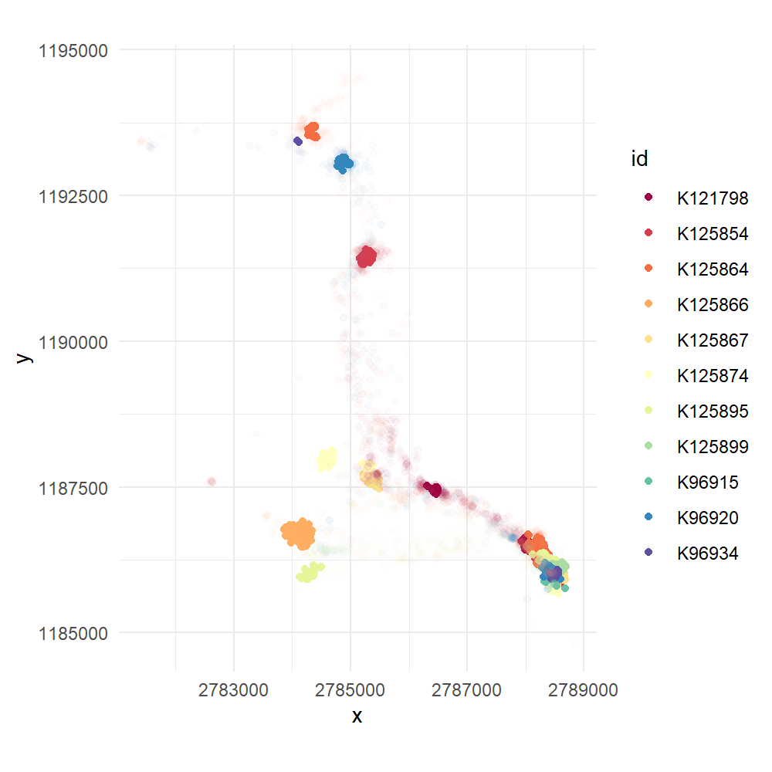
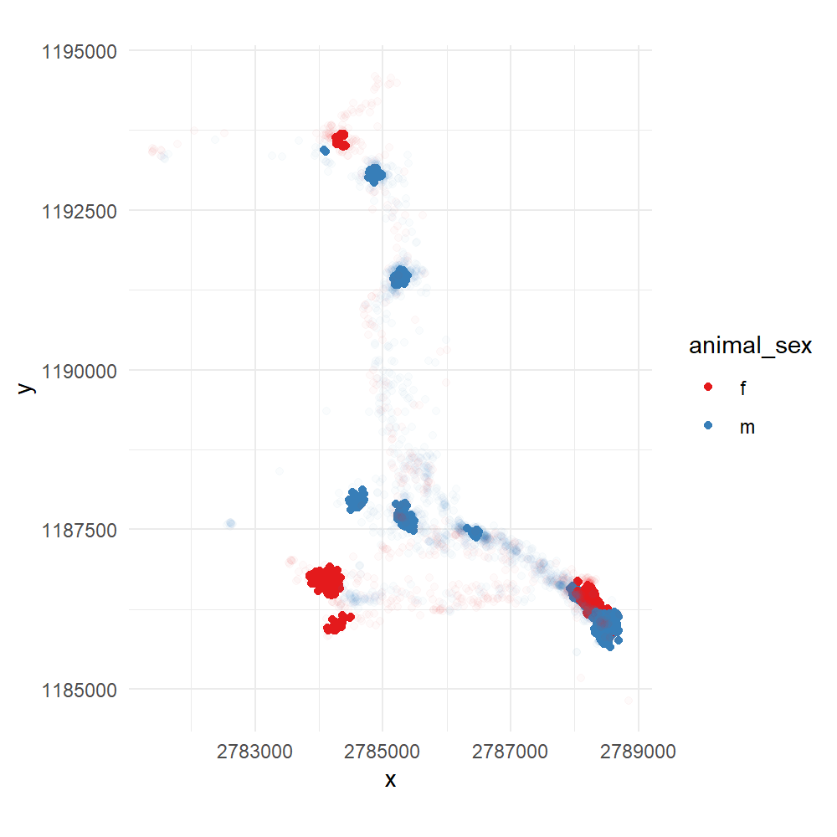
Work in Progress

Slide 7
Challenges
Combined data of two studies with different GPS sampling frequency (every 15 minutes resp. every hour)
→ using only the individuals with a 15-minute sampling interval
Lack of field observation or context data like the abundance of the Swiss stone pine (Pinus cembra) to classify frequently revisited sites into harvesting and caching sites
→ do without the classification

Slide 8
Thanks for you attention

