Slide 1
Monitors with Implicit Signals
Michael Xing, Jivan Luu, Taylor Morrow, Jack Huang

Slide 2
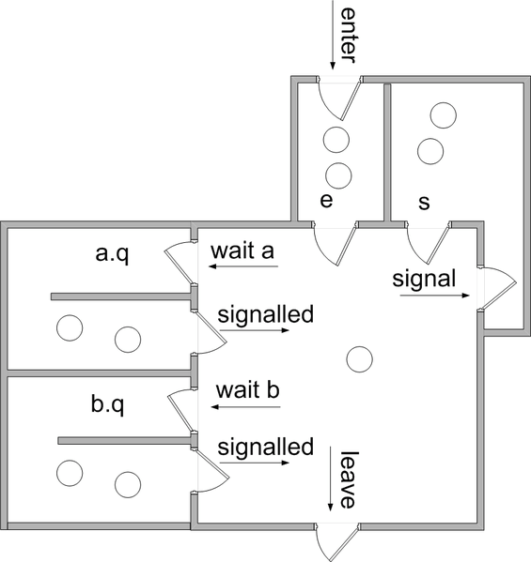
What is Monitor?
Only one thread allowed at any time to use the monitor resource
Threads can wait for different reasons
Wait to enter monitor (room E and S)
Wait for certain condition (room A and B)

Slide 3
Explicit vs. Implicit Signaling: a FIFO example
lock();
while(fifo.isFull()) {
notFull.await();
}
fifo.put();
notEmpty.signal();
unlock();
lock();
waitUntil(notFull);
fifo.put();
unlock();
Explicit
Implicit

Slide 4
Why Implicit Signaling?
Hide the signal mechanism from user
Easier to use
Ensure correct usage of monitor
Prevent deadlock
Prevent wrong signal
Some drawbacks
Overhead for condition checking
User cannot specify signal timing
at least for our implementation…

Slide 5
Implementation
public class ImplicitMonitor
{
public void lock();
public void unlock();
public void wait(ImplicitCondition c);
}
public interface ImplicitCondition
{
public boolean check();
}
Keeps a list of unique ImplicitCondition objects
wait() adds a condition to the list if it hasn’t been seen before
On unlock, loops through each condition in the list
if check() returns true, signals one process for that condition
ImplicitMonitor

Slide 6
Design Options
After finishing operation:
Notify all threads
Signal all threads per condition that is true
Signal one thread per condition that is true

Slide 7
Performance
Testing Conditions
1,000 producers (put)
1,000 consumers (get)
Each thread will run for 100 iterations

Slide 8
Performance Results

Slide 9
Conclusion
We covered:
Explicit vs. Implicit monitors
Implementation
Design options
Performance results

Slide 10
QUESTIONS?

