Slide 2
Class progress

Slide 4
Chapter 1. Literature review
Section 1: Model misspecification in fisheries
Review of common causes.
Review of current best practice for addressing
Key points: Cookbook approach (Carvalho),
Section 2: Model selection in fisheries
Review of best practice tecnhiques
Strengths Weaknesses of different techniques (AIC, AICc, BF, LRT)

Slide 6
Chapter 2. Applications of MASE
Objectives: Explore the ability of MASE to:
- 1. Detect model misspecification.
- 2. Select CSM/ best model form suite of models.
- 3. Weight models in an ensemble

Slide 7
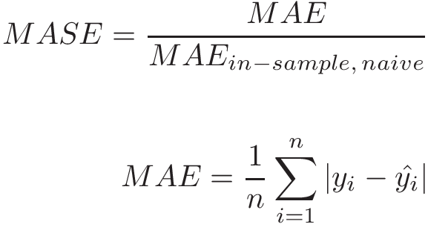
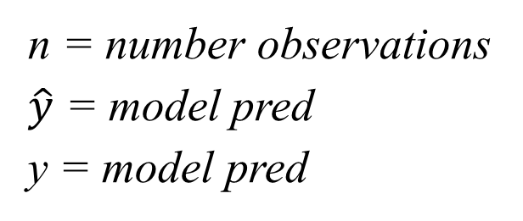
Background
Why MASE?
- Extreme values
- Different scales
- Interpretable
n = number observations
$\hat{y}$ = model pred
y = model pred
Notes:
Add what we are trying to use it for 1)msspec 2) model selection 3_ model weighting

Slide 8
Workflow
Data generation
Hindcast
MASE calculation
MASE application

Slide 9
Data generation
Data generation
Define operating models for life history patterns (halibut, cod, sardine).
Define three fishing patterns relative to Fmsy
Conduct parameter sensitivity for each pattern
Define misspecification set ( 9 models) for each combination of fishing patterns and species.

Slide 10
OM features
Duration | 100 years
Process error | Log normal rec-devs
Fleets | 2 (Fishery, Survey)
Selex (length) | Double normal, asymptotic
Selex (age) | Double normal, asymptotic
Process error | Log normal rec-devs
TV-pars | None

Slide 11
Cod model
Data generation
Based on N. Sea Cod
Reflective of ;
Model paramterised based on Ono et al., 2015

Slide 12
Sardine Model
Data generation
Based on Pacific sardine
Reflective of ;
Model will be parameterized based on Ono et al., 2015

Slide 13
Halibut-Model
Data generation
Based on IPHC Halibut assessment model
Significantly more complex than simplified simulation models
Key features
- Four model ensemble (CW-L,CW-S,SEP-S,SEP-L)
- Time-varying processes (Mort, fecundity, select).
- Dimorphic growth
- Env recuritmrent effect
- Multiple fleets (7)

Slide 14
Halibut-Model –like Model
Data generation
Simplification of IPHC model
Reduce complexity while retaining key features
Key features
- PDO-blocked r0
- 7 4 (comm., discard, rec., survey)
- Weight-at-age

Slide 15
Fishing patterns
Data generation
Simulate across three different exploitation histories
Years 1 – 25 burn in, fishing begins in year 26
FMSY = 0.12

Slide 16
 | type | method | Status
1. Misspec. M | Parameter misspec. | Fix M at higher value than OM | Implemented
2. Misspec. h | Parameter misspec. | Fix h at higher value than in OM | Implemented
3. time-vary M | Tv-M | M ramps down after year 65 | Implemented
4. Age comp weight | Data weighting | Increase sample size x3 | Implemented
5. Len comp weight | Data weighting | Increase sample size x3 | Implemented
6. Catch reporting | Catch reporting | Catch in EM raised by 1.15 | Implemented
7. Hyperstability | Non-linear index | CPUE decline faster than abun. | Implemented
8. Hyperdepletion | Non-linear index | CPUE decline slower than abun. | Implemented
9. Incorrect selex shape |  | Dome selex in OM, Asymp selex in EM | In progress

Slide 17
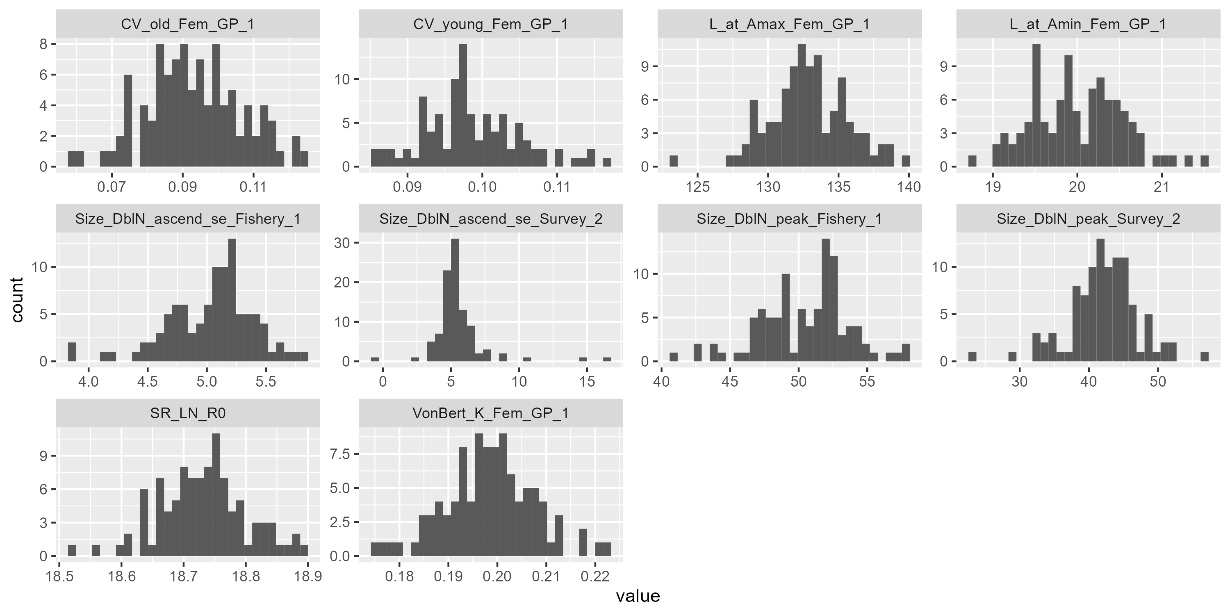
Correctly specified model (CSM)

Slide 18
Depletion
Data generation
1. Estimate median depletion for CSM.
2. Select higher depletion value (EM indicates fishery performing better than in reality).
3. Profile over different values for misspec. params.
4. Select a parameter value that causes median depletion to be equal to selected depletion value.

Slide 19
Depletion sensitivity analysis
Notes:
Note that wed really like to extend this to 1000 its for true model
Alsoo, now we have an approximate sequence, run that sequence for 1000 its.

Slide 20
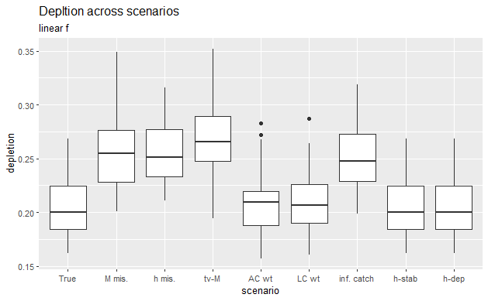
Data generation

Slide 21
Hindcast 1. Truncating time series
Hindcast
Remove terminal year(s) from data (retrospective years in SS3)
Refit models over whole time series, forecasting truncated periods.
Compare model expected values from truncated series to observed values from full series.
Full series
Ret. years = 1
 |  |  |  |  |  |  |  |  | F
Ret. years = 3
 |  |  |  |  |  |  | F | F | F
Ret. years = 5
 |  |  |  |  | F | F | F | F | F

Slide 22
Hindcast 2: Dropping data series
Hindcast
Remove single catch series for the entire period (-ve fleet trick)
Refit models over the whole time series, forecasting absent series periods.
Compare model expected values from truncated series to observed values from full series.
Full model
Age comp.
Len. comp
Drop CPUE
Age comp.
Len comp.
Drop Age comp.
Len. comp
Survey CPUE
Survey CPUE
Drop Len. comp
Age comp
Survey CPUE

Slide 23
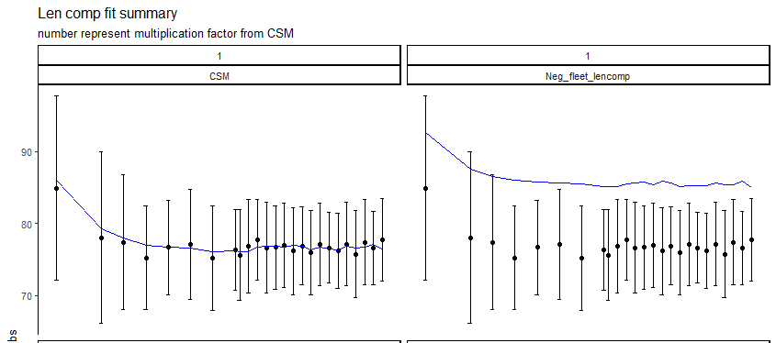

Slide 24
Chapter 2 . Results
MASE application

Slide 25
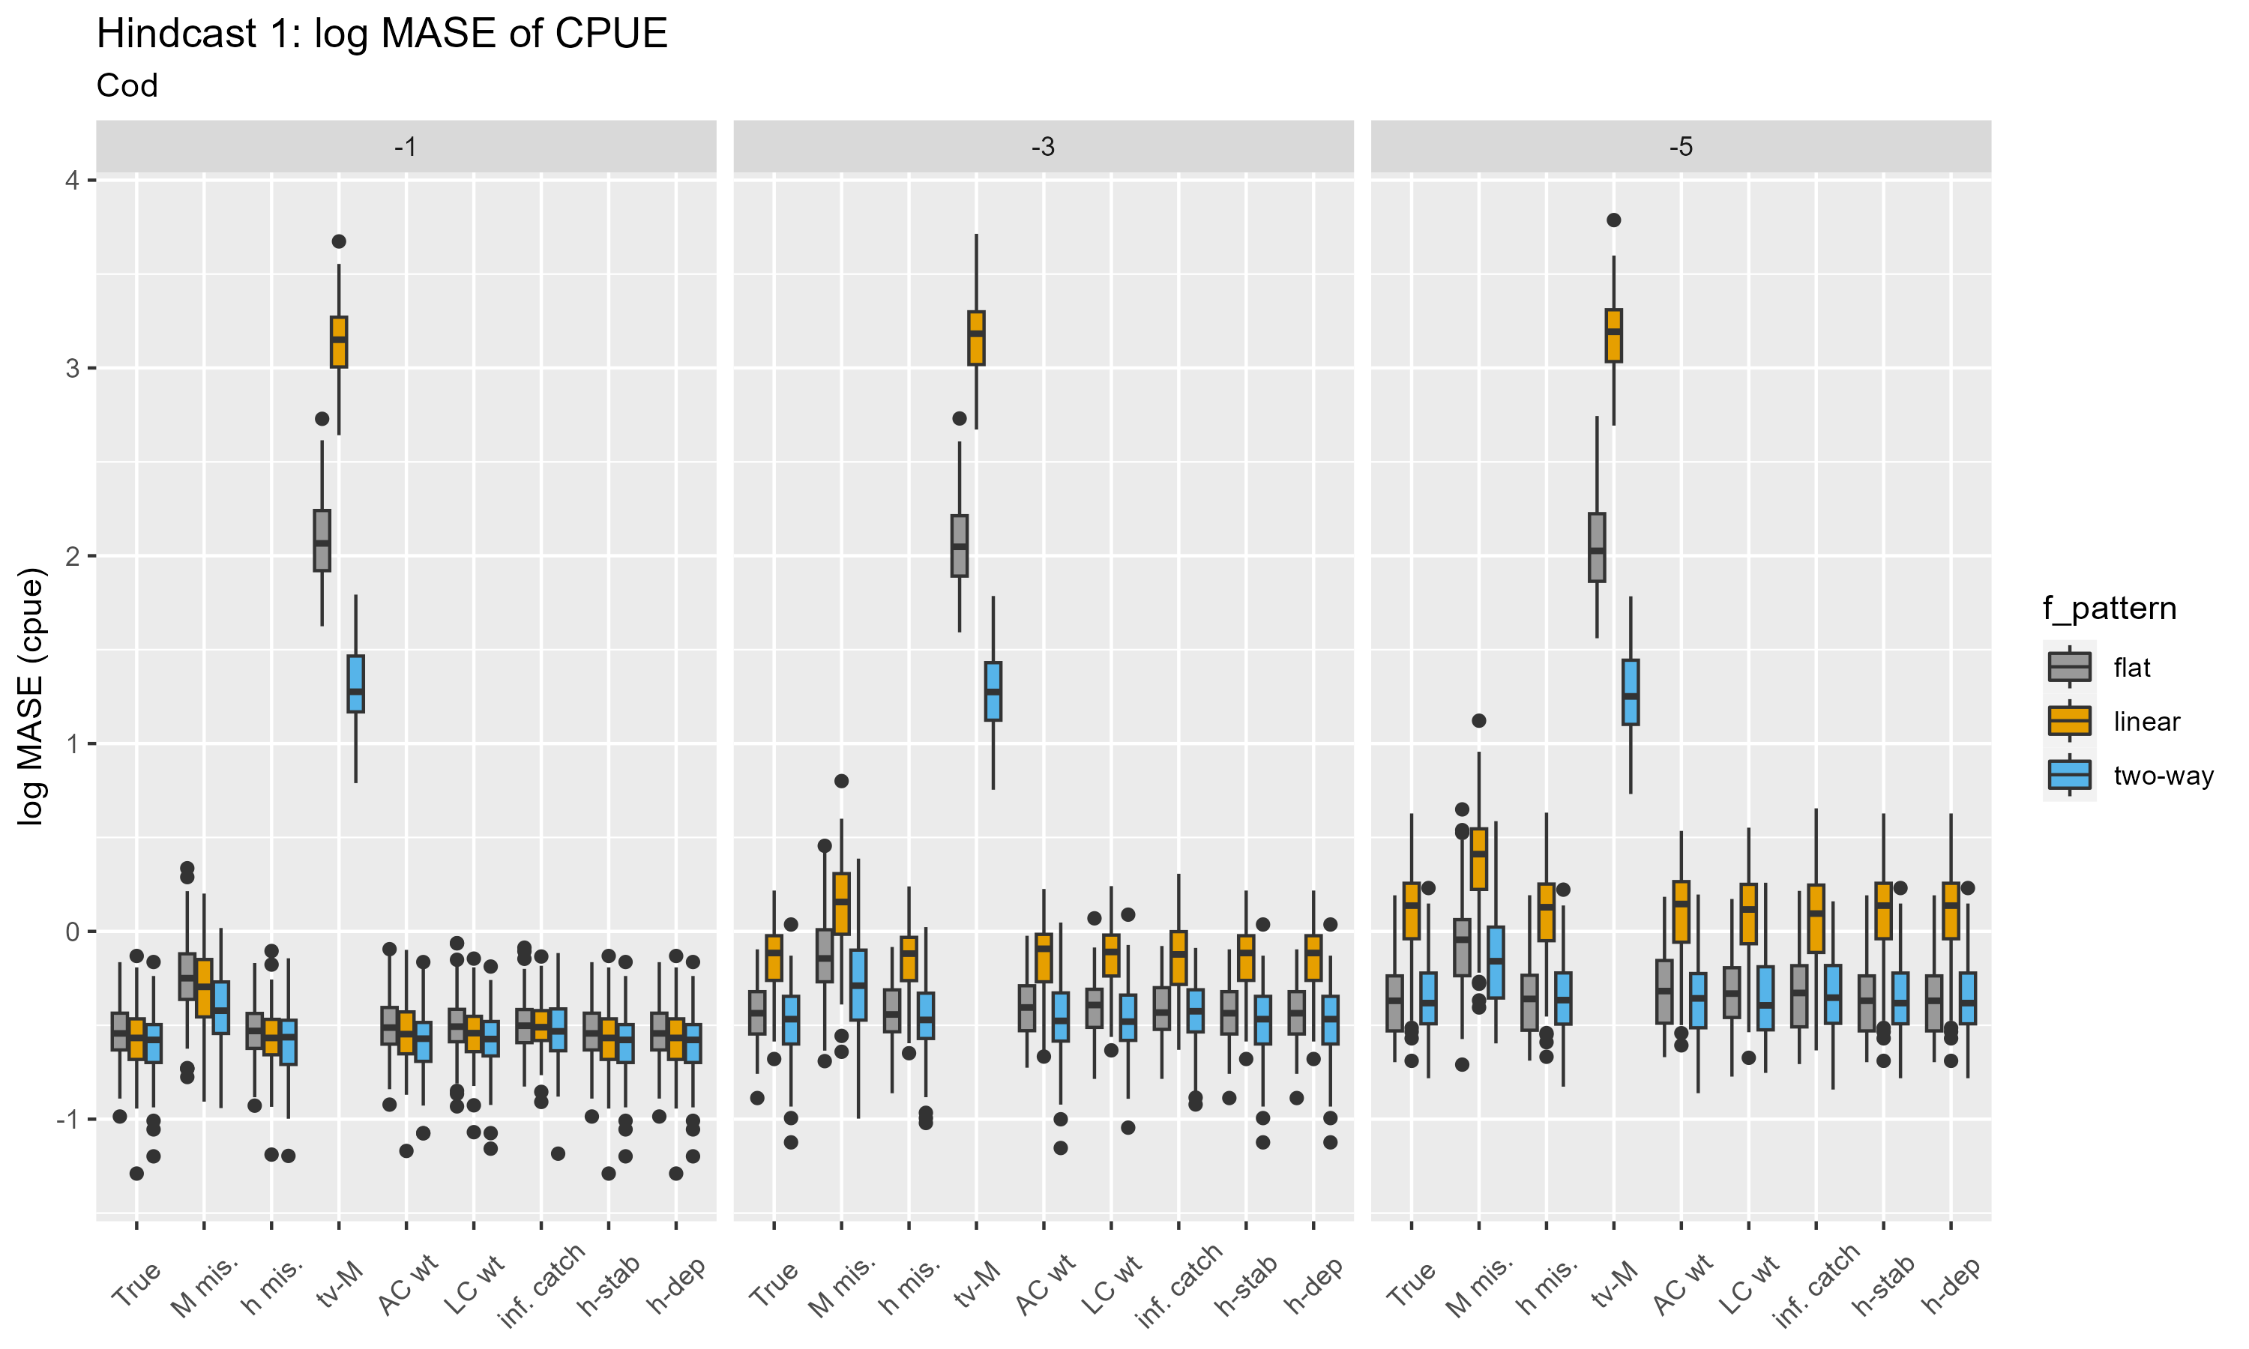

Slide 26
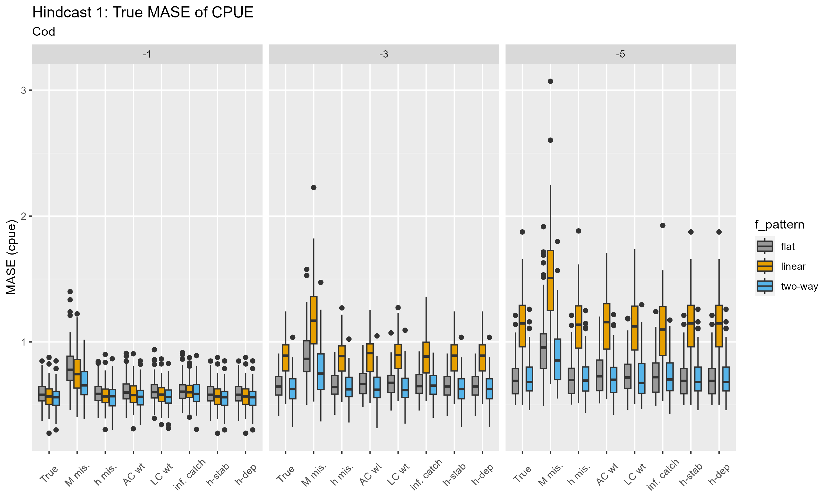

Slide 27
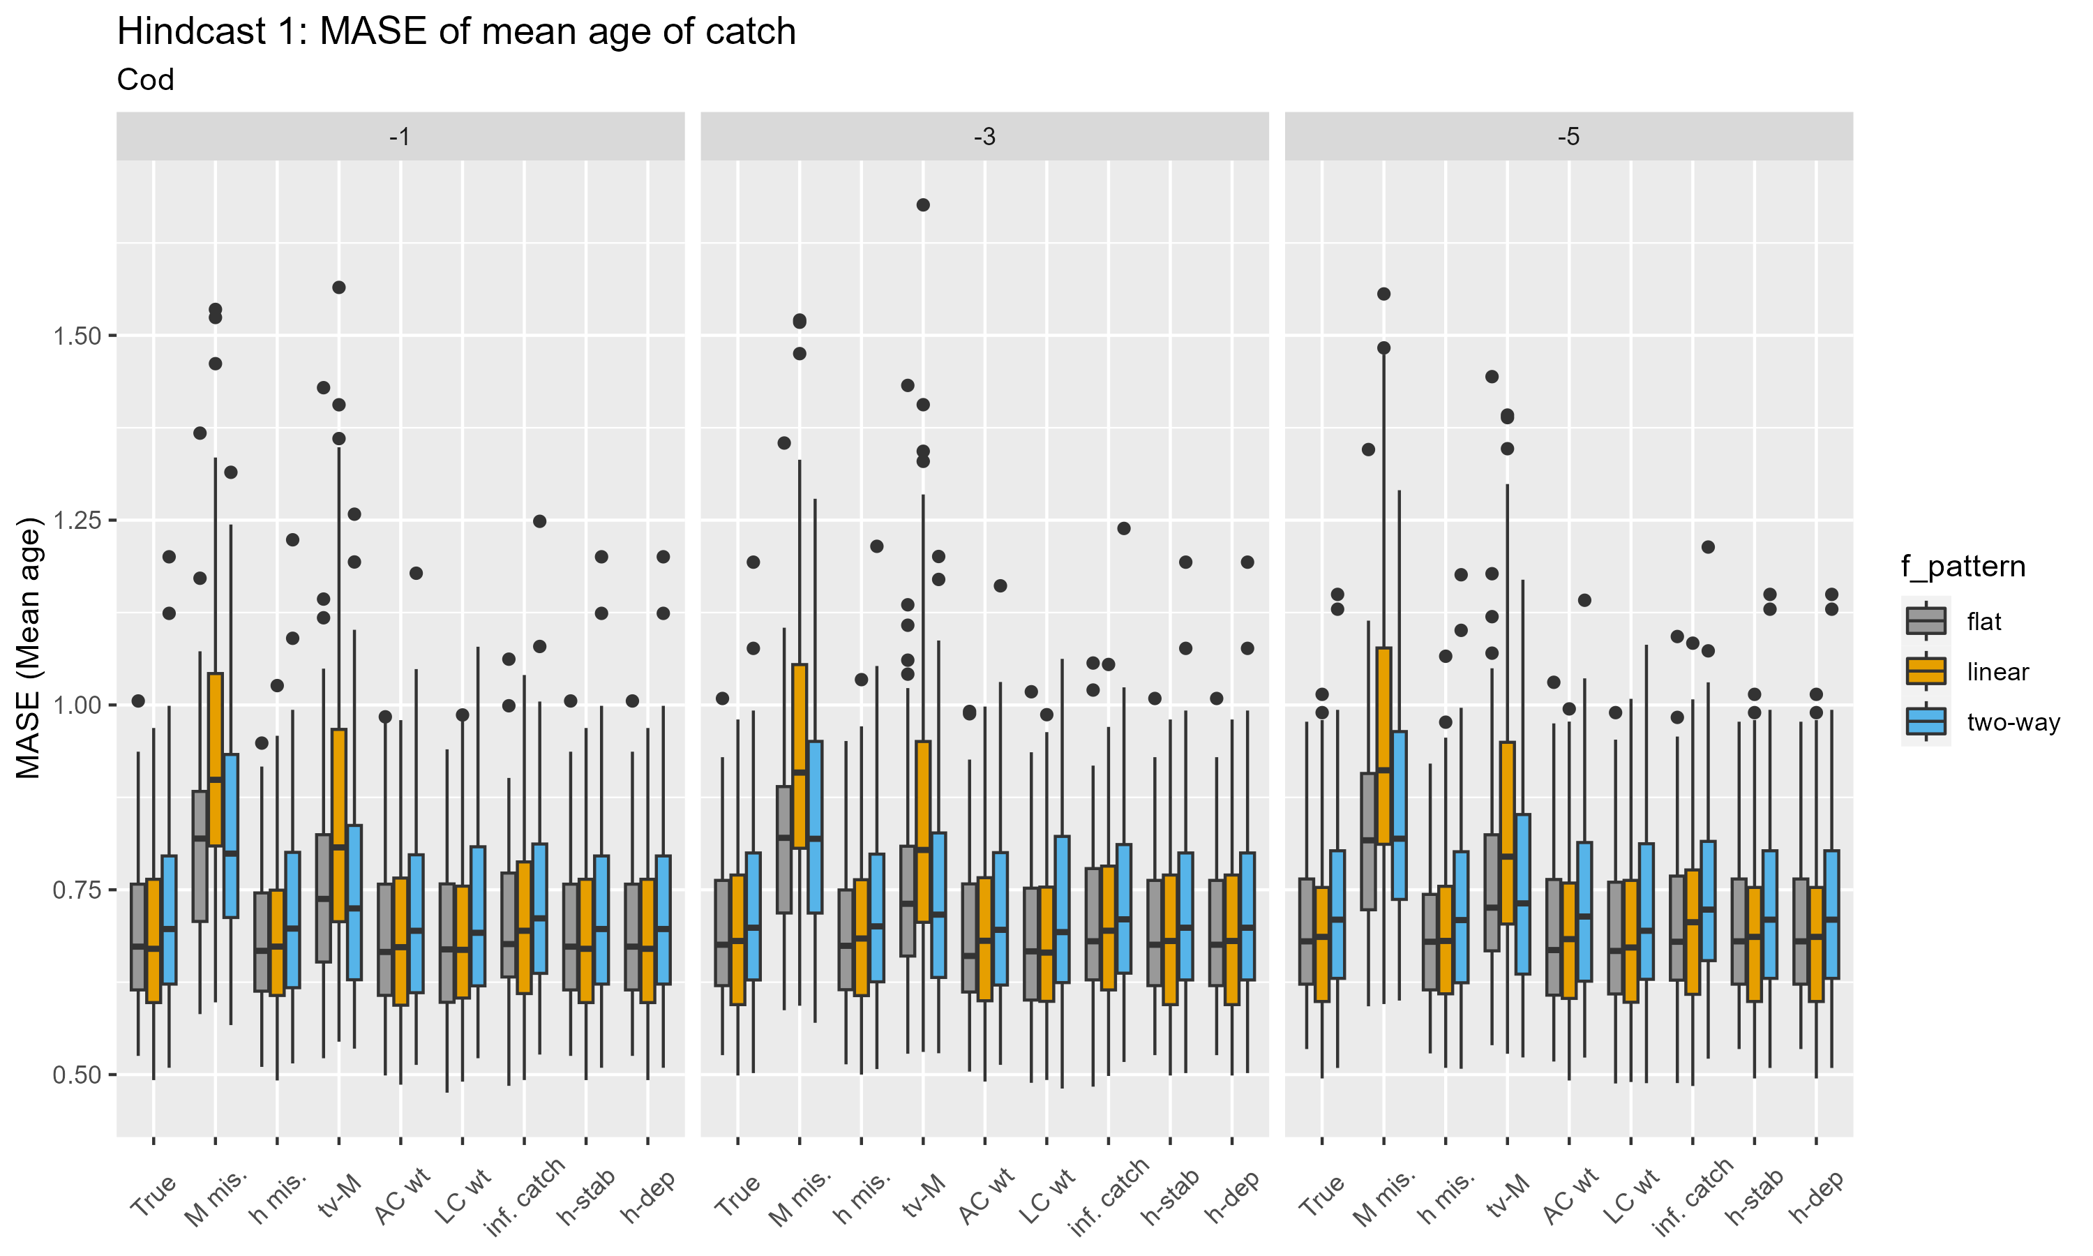

Slide 28
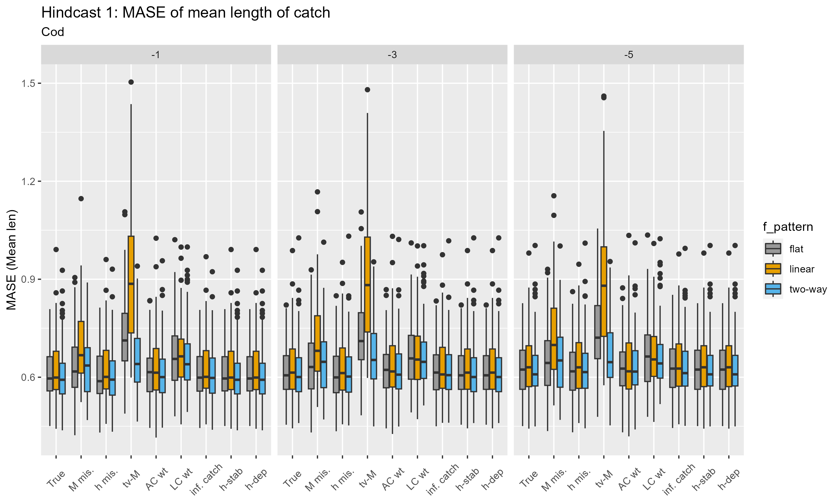

Slide 29
Chapter 2 . Results
MASE application
Key findings:
1. MASE is sensitive to misspec of M, inflated catch
2. MASE sensitive to the presence of time-varying m in OM ( Extend to other processes/parameters
3. Insensitive to data-weighting misspec.
4. Insensitive to non-linear CPUE indices (low contribution to overall model LL)

Slide 31
MASE application (Misspec)
MASE application
Try and estimate upper and lower bound for true vs misspec. Models
Similar to ‘Looking in the rearview mirror’ paper (Hurtado-Ferrero)
Partially completed for 558 class project, but needs further work.

Slide 33
Model selection testing
MASE application
Ranking criterion
MASE
Model 1
.
.
.
.
.
Model n
AICc
BIC
LRT
Notes:
Selex shape
Tv process
Misspecified pars.

Slide 34
Model weighting
MASE application
Employ MASE as weighting criteria in ensemble.
AIC unsuitable as models differ by i) years ii) data series
Compare MASE weighted model Vs LRT weighted model Vs equal weighting

Slide 35
Thesis progress
Chapter 1 | Progress | Chapter 2
Model misspec section | Complete | OM model spec | Partially complete
Model selection section | Complete | EM misspec. framework | Complete
Model weighting section | Partially complete | Hindcast framework 1 | Complete
MASE section | Complete | Hindcast framework 2 | Complete
MASE in fisheries section | Incomplete | MASE framework | Complete
MASE outside fisheries section | Incomplete | MASE dist. Framework | Partially complete
Manuscript draft 1 | Incomplete | Model selection framework | Incomplete
Manuscript draft 2 | Incomplete | Model Weight framework | Incomplete
 |  | Manuscript draft 1 | Incomplete
 |  | Manuscript draft 2 | Incomplete

Slide 36
Timeline
Summer 2024
Chapter 1
- Complete draft 1
- Review edits, and complete final draft.
Chapter 2
- Extend chapter 2 analysis for Sard OM.
- Review 558 distribution analysis.
- Finalise halibut OM.
Autumn 2024
- Develop model selection analysis and apply.
- Develop model weighting framework
- Extend chapter 2 analysis for halibut OM.
Present results: Think tank, quant sem.
Winter 2025
- Begin developing Ch.2 manuscript
- Finalise Chapter 2 results.
Complete Ch. 2 draft 1.
Spring 2025
- Review and incorporate chapter 2 edits.
- Complete chapter 2 final draft.
- Defend Thesis.

