Slide 1

AI & ML Laboratory Project on Traffic flow prediction K.HARSHITHA(2203A51177) S.MANASWI(2203A580) M.TEJASWINI(2203A51182)
UNDER THE GUIDANCE OF
B. Arpita
School of Computer Science & Artificial Intelligence
SR University 2024

Slide 2
ABSTRACT:
Traffic flow prediction is crucial for providing real-time traffic information to road users.
Deep learning methods have been successful in traffic flow prediction, providing better accuracy than traditional statistical methods.
Combining multiple deep learning methods can further improve the prediction accuracy of a single method.
A combined deep learning prediction (CDLP) model including two paralleled single deep learning models, CNN-LSTM-attention and CNN-GRU-attention, has been established.
The CDLP model can fit the change trend of traffic flow very well and has better performance than baseline models.
The CDLP model has higher prediction accuracy than baseline models under the same dataset.Data Collection: Gathering historical and real-time traffic data from sensors, cameras, GPS, and other sources.
Data Analysis: Using statistical and machine learning methods to analyze traffic data and identify patterns.
Model Development: Building models that can predict traffic flow based on historical trends, real-time information, and external factors like weather and special events.

Slide 3
Real-time Monitoring: Integrating real-time data for dynamic traffic management and real-time traffic flow prediction.
Visualization Tools: Developing tools to visualize traffic predictions, providing insights for users and decision-makers.

Slide 4
INTRODUCTION:
Traffic flow prediction estimates future traffic conditions on roads, highways, and transportation networks.
It is essential for transportation planning, traffic management, and urban development, impacting safety, efficiency, and environmental sustainability.
Accurate traffic flow prediction helps city planners, transportation authorities, and commuters make informed decisions to reduce congestion and optimize travel times.
Modern methods use advanced technologies such as machine learning, deep learning, and real-time data integration to improve prediction accuracy.
Data sources for traffic flow prediction include traffic sensors, cameras, GPS, and social media.
Key factors influencing traffic flow predictions are time of day, day of the week, weather, special events, and roadwork.
Applications of traffic flow prediction range from optimizing traffic signal timings to planning urban infrastructure and providing real-time information for navigation apps.
Accurate traffic flow predictions contribute to smoother traffic, enhanced road safety, and a reduced carbon footprint in transportation systems.

Slide 5
PROPOSED Solution
Data Collection and Integration
Comprehensive Data Sources: Gather data from various sources, including traffic sensors, cameras, GPS, mobile apps, social media, and weather reports. This holistic approach ensures a rich dataset for analysis.
Real-Time Data Integration: Ensure real-time data streams are integrated into the system to enable live updates on traffic conditions.
Advanced Analytics and Machine Learning
Feature Engineering: Identify and create meaningful features from raw data, such as time-based trends, location-specific patterns, and weather effects, for machine learning models.
Machine Learning Models: Utilize advanced machine learning algorithms like decision trees, support vector machines, or neural networks to predict traffic flow based on the engineered features.
Deep Learning Techniques: Employ deep learning models, such as convolutional neural networks (CNNs) and recurrent neural networks (RNNs), to capture complex patterns and dependencies in traffic data.
Model Training and Testing

Slide 6
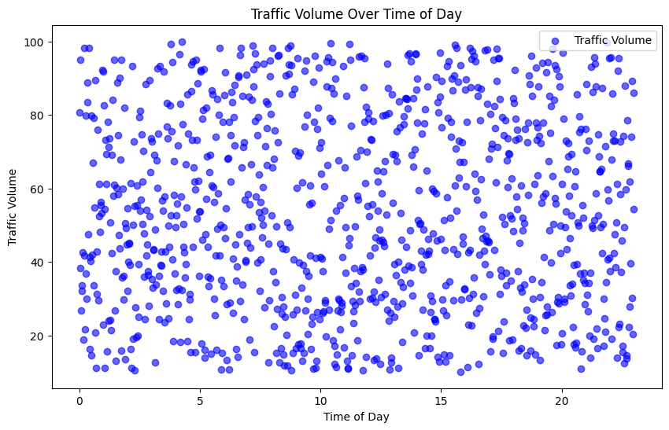
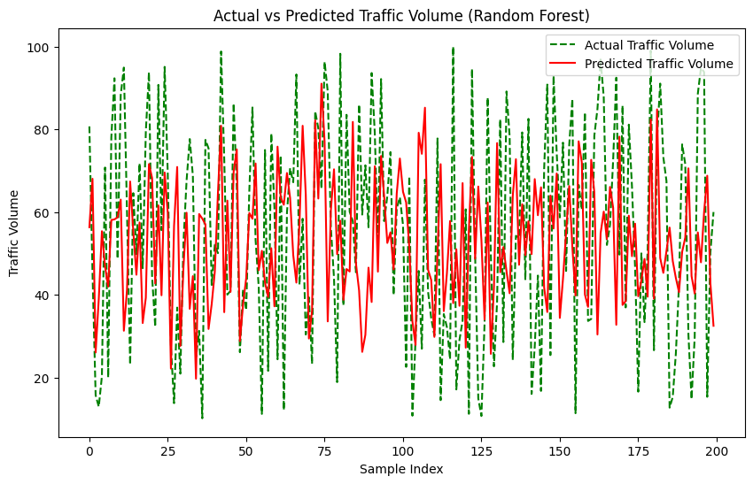
Results and Discussion

Slide 7
Non-Linearity: Traffic flow is a non-linear phenomenon, making it difficult to model and predict.
Uncertainty: Traffic flow is influenced by various uncertain factors, such as weather, road conditions, and driver behavior.
Scalability: Traffic flow prediction models need to be scalable to accommodate large road networks and high volumes of traffic data.
Data Quality: The accuracy of traffic flow prediction models relies on the quality of traffic data, which can be noisy, incomplete, or biased.
Approaches to Traffic Flow Prediction
Machine Learning: Machine learning algorithms, such as neural networks and support vector machines, are widely used for traffic flow prediction.
Time-Series Analysis: Time-series analysis techniques, such as ARIMA and SARIMA, are used to model and forecast traffic flow patterns.
Simulation-Based Models: Simulation-based models, such as microscopic and macroscopic simulation models, mimic real-world traffic scenarios to predict traffic flow.
Hybrid Approaches: Hybrid approaches combine multiple techniques to leverage their strengths and improve prediction accuracy.
State-of-the-Art Techniques

Slide 8
How to handle uncertainty and non-linearity in traffic flow prediction?
How to integrate multi-source data, such as sensor data and social media data, to improve prediction accuracy?
How to develop real-time traffic flow prediction systems that can respond to changing traffic conditions?
What do you think is the most challenging aspect of traffic flow prediction?
Do you have any experience with traffic flow prediction models or algorithms?
How do you think traffic flow prediction can be improved in the future?

Slide 9
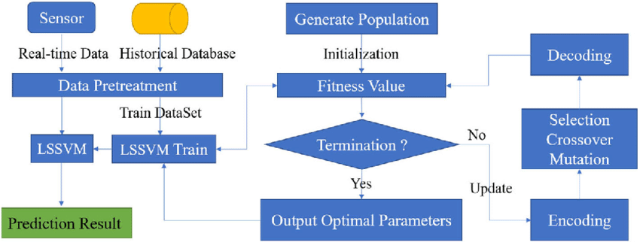
FLOW CHART

Slide 10
CONCLUSION
Traffic flow prediction is a critical aspect of intelligent transportation systems (ITS) in smart cities. Machine learning (ML) and deep learning (DL) techniques have been increasingly used to enhance traffic flow prediction. Common ML techniques used for traffic flow prediction include Convolutional Neural Network (CNN) and Long-Short Term Memory (LSTM). These techniques have been compared with existing baseline models to determine their effectiveness. However, there is still room for improvement in developing more accurate and reliable traffic flow prediction models that can handle the complexity and uncertainty of traffic flow.
An
Answer 2
3

Slide 11
GIT HUB Link and LINKDIN LINK
https://github.com/kinneraharshitha/Harshitha
https://github.com/smanaswi05/AIML-17/branches
https://github.com/2203A51182/aiml-batch-17

Slide 12
References
Weblink of Kaggle/ OpenMl, Analytic Vidya etc.

