Slide 1
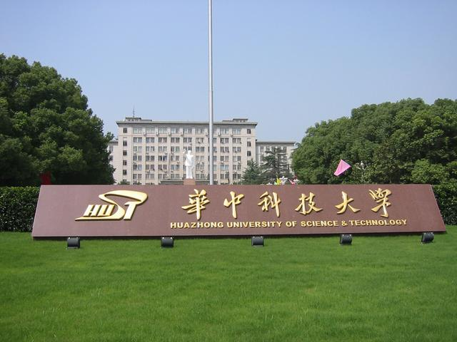
Wuhan 2002
A journey in 14 images

Slide 2
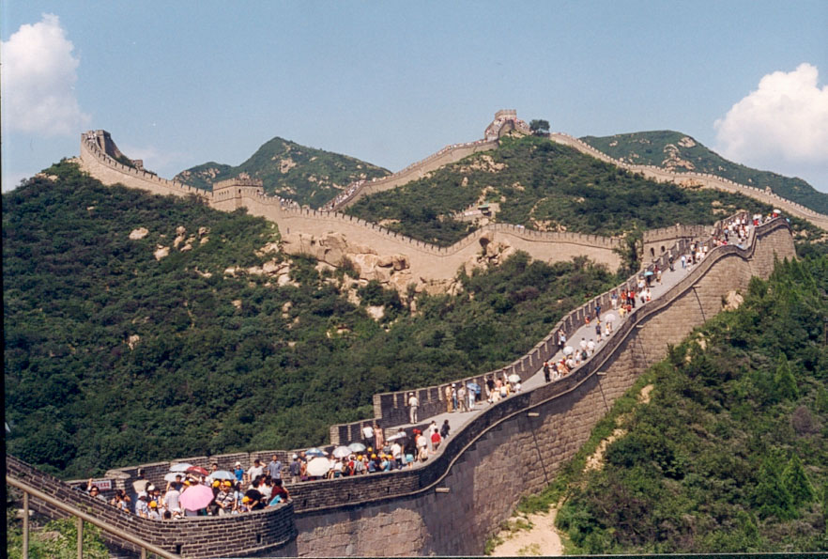
The Great Chinese Wall

Slide 3
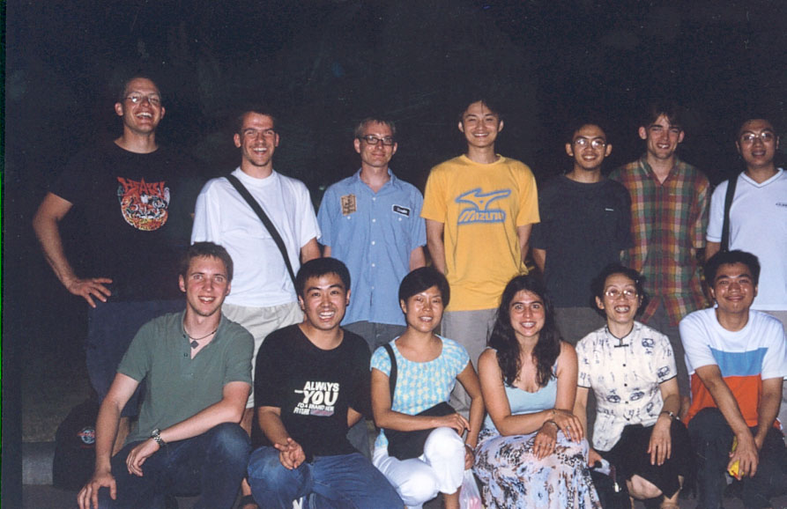
Welcome to HUST

Slide 4
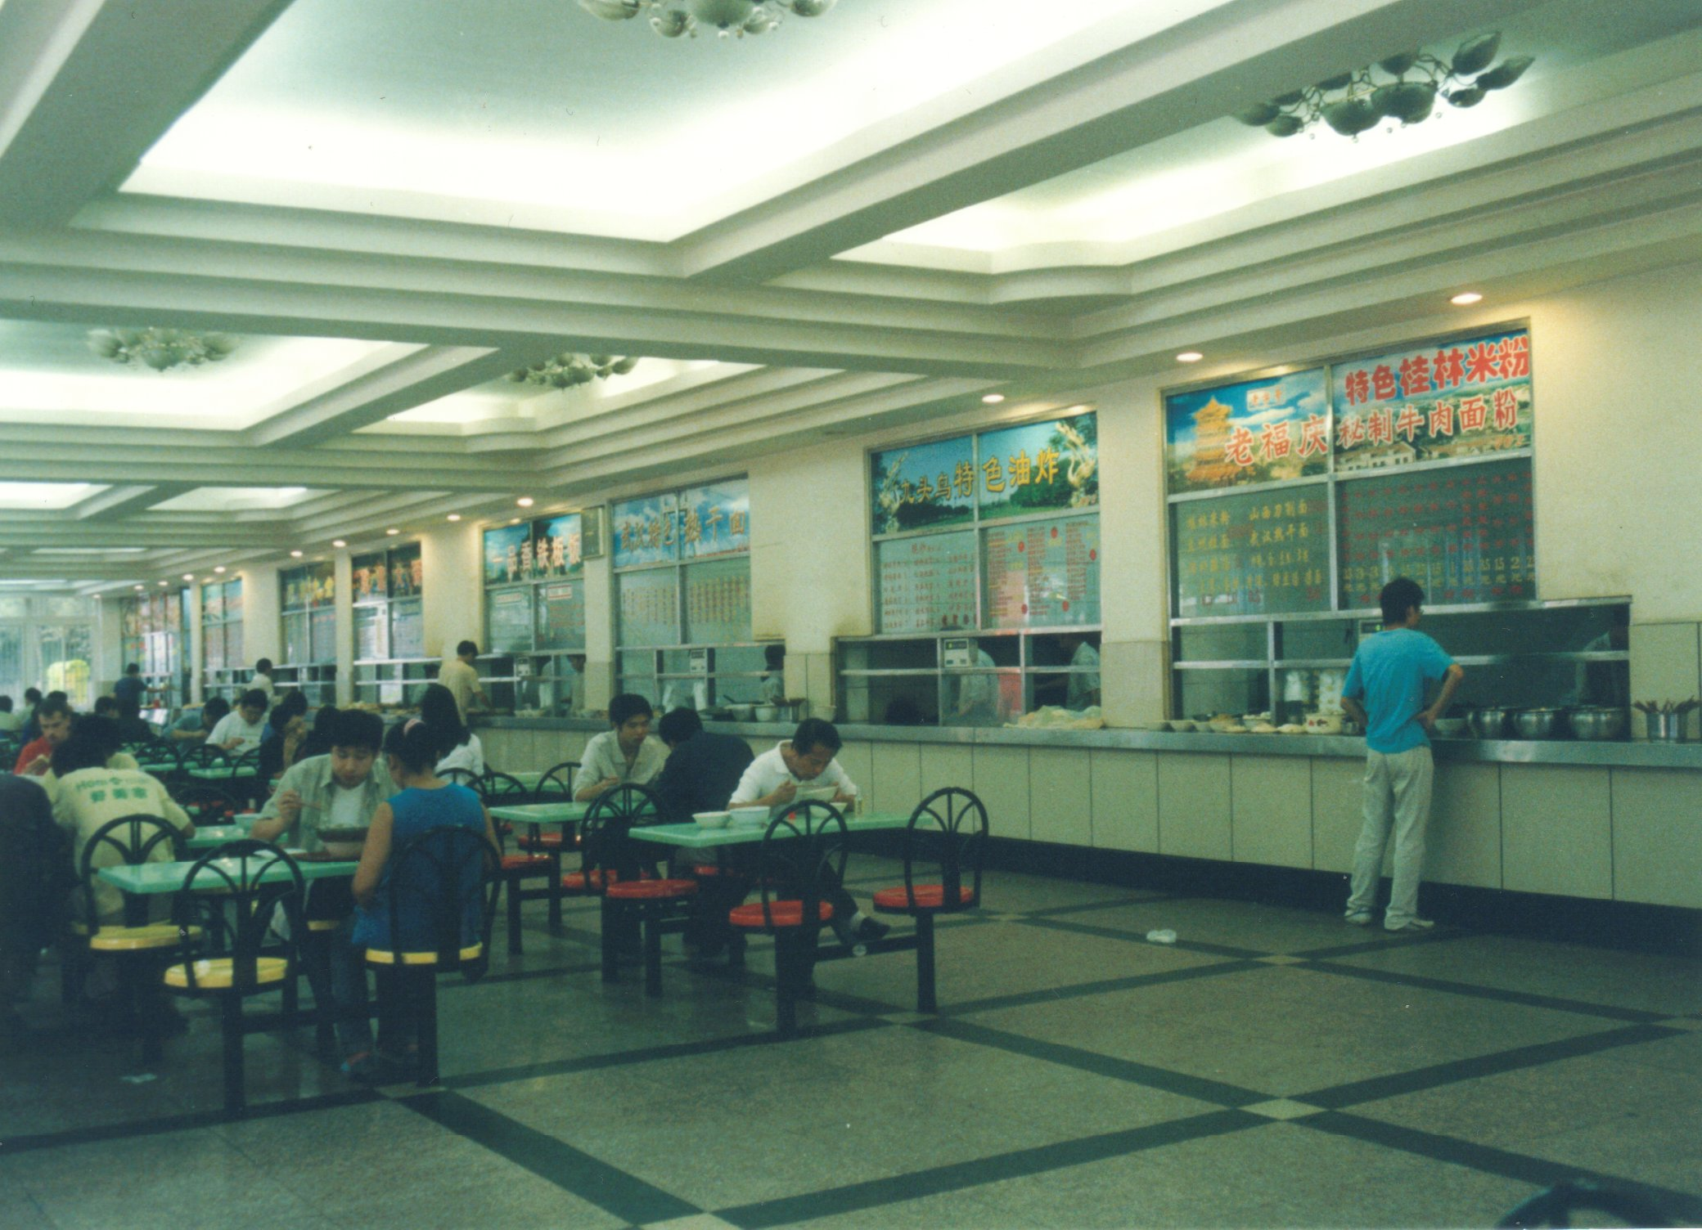
The University‘s restaurant

Slide 5
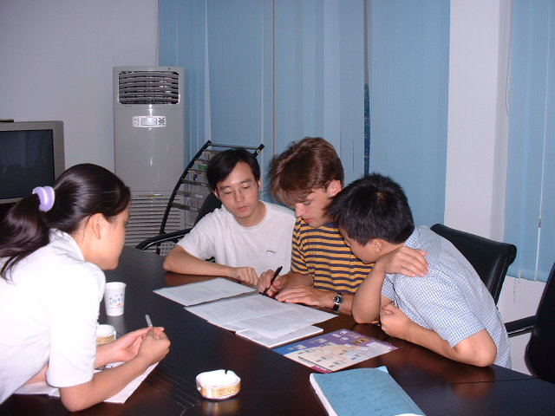
Project work in the laboratory

Slide 6
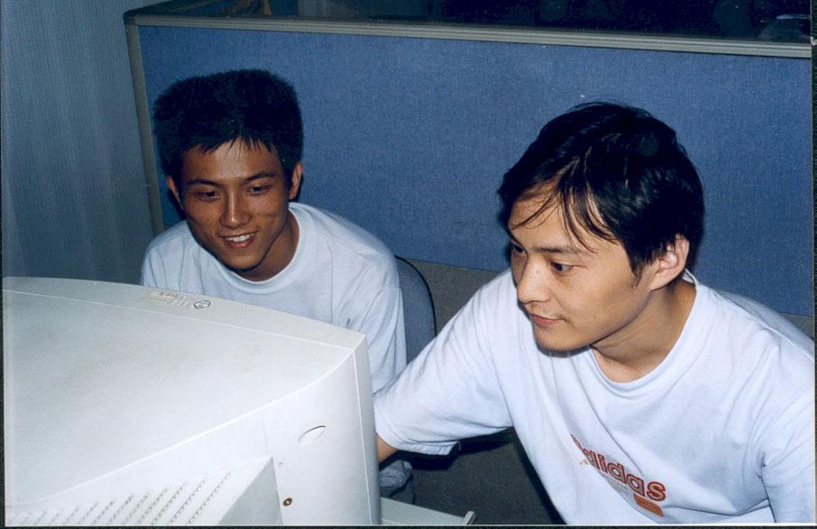
Zhang Fan
Shireman

Slide 7
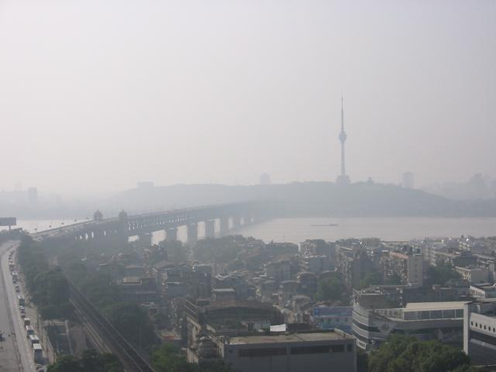
The Yangtsee Bridge

Slide 8
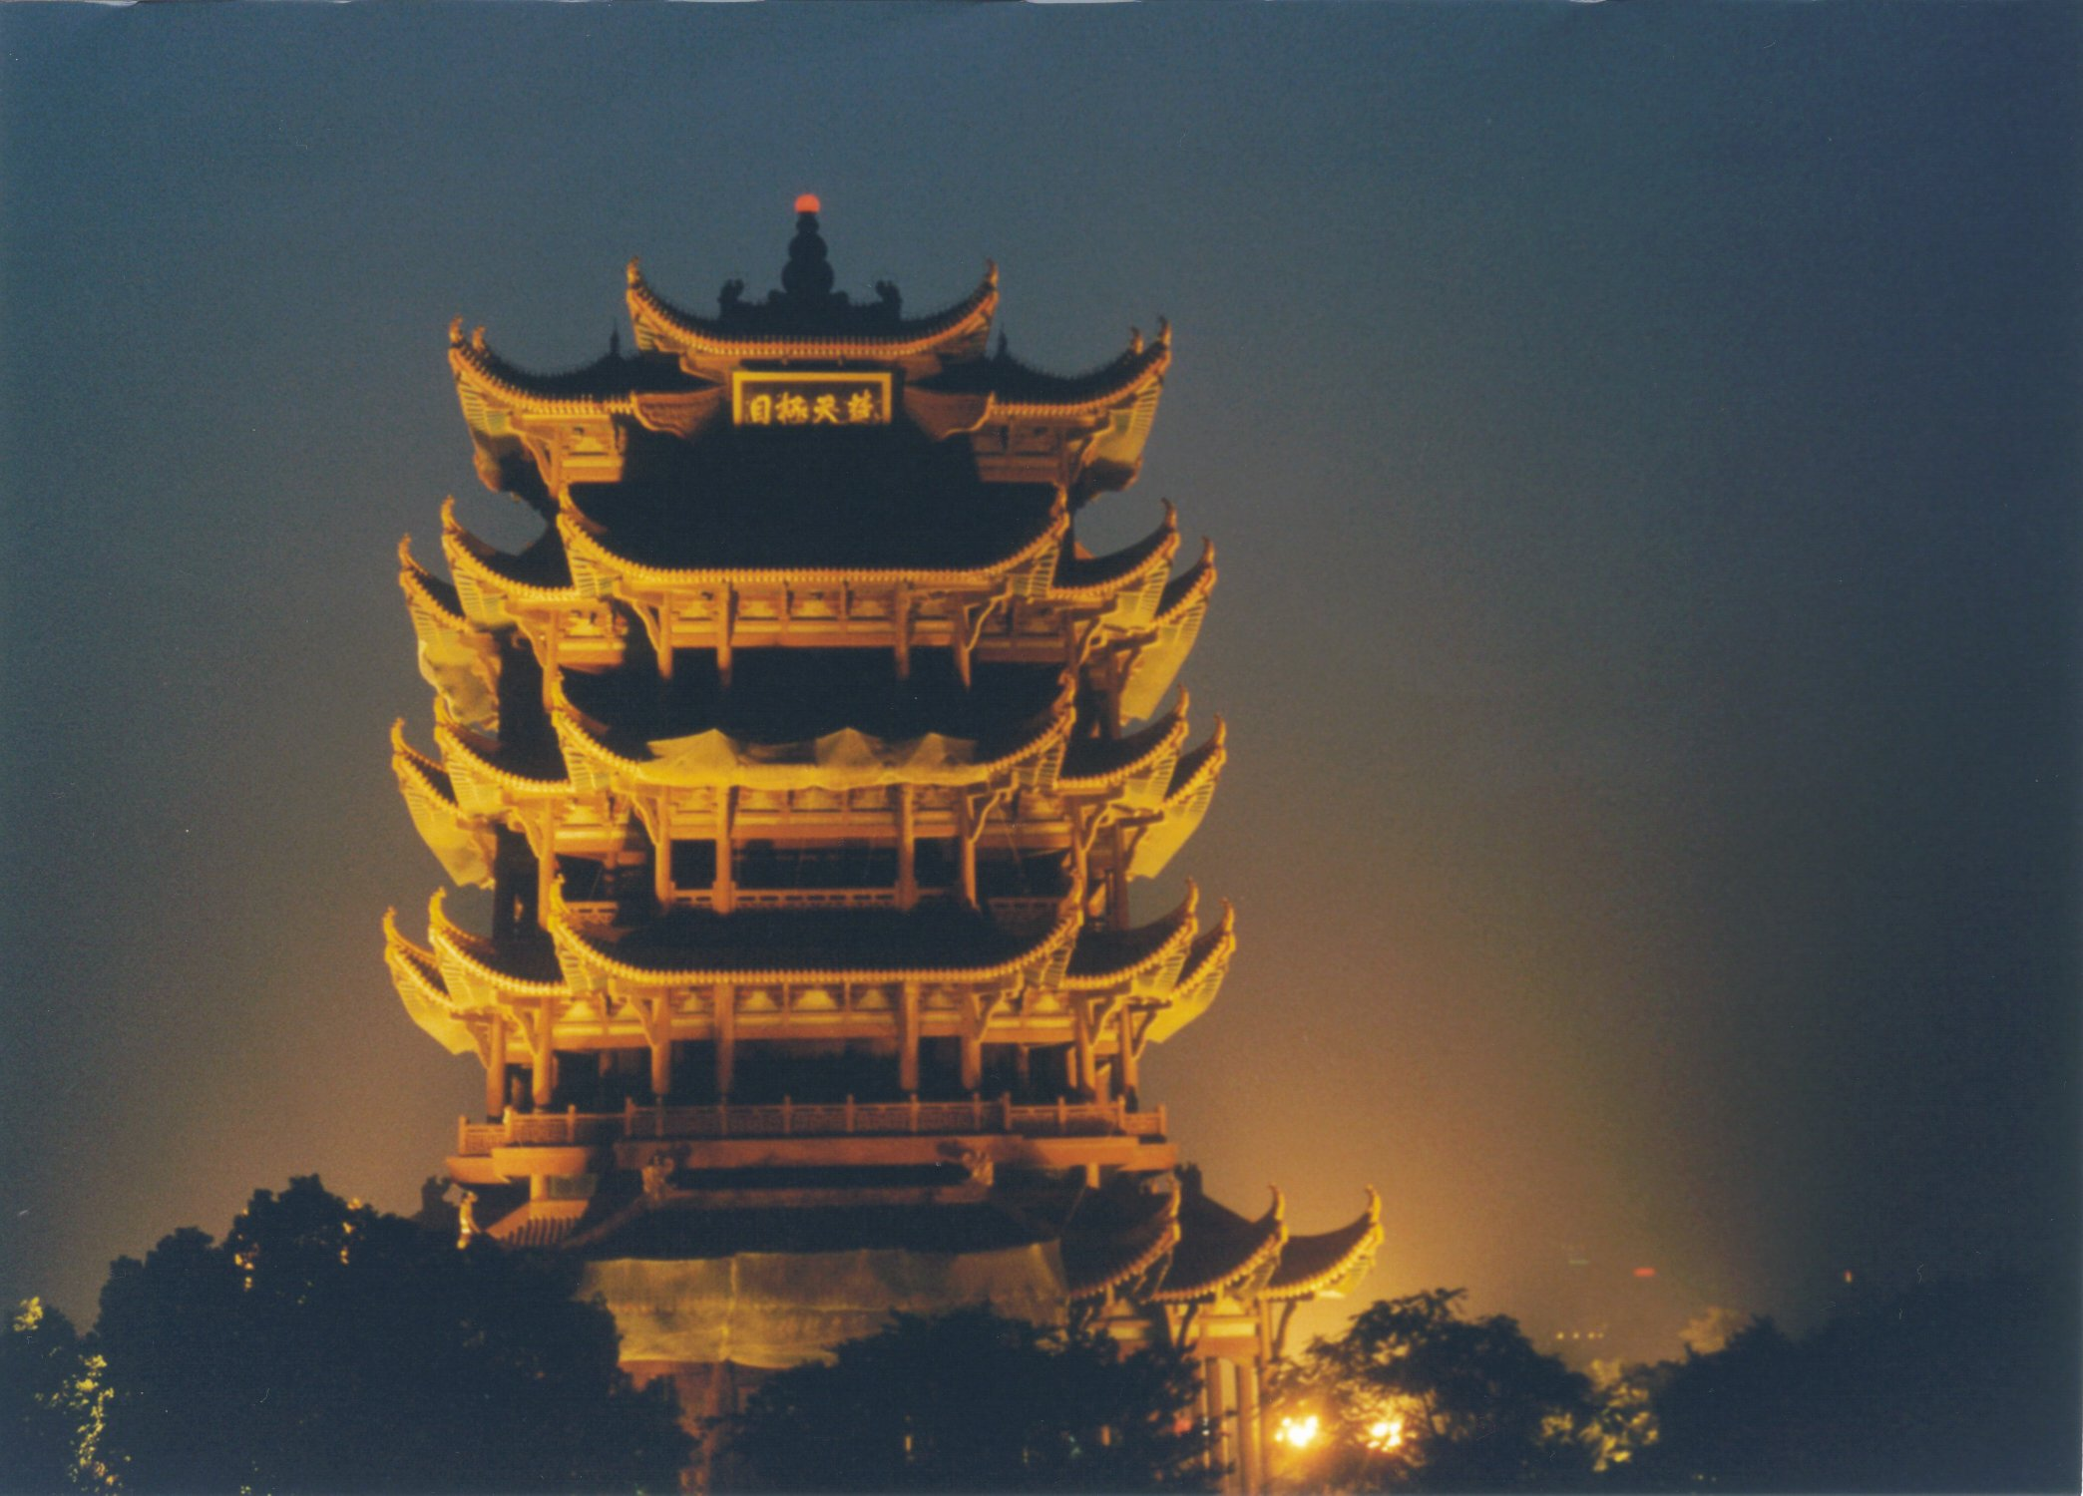
The
Yellow Crane
Tower

Slide 9
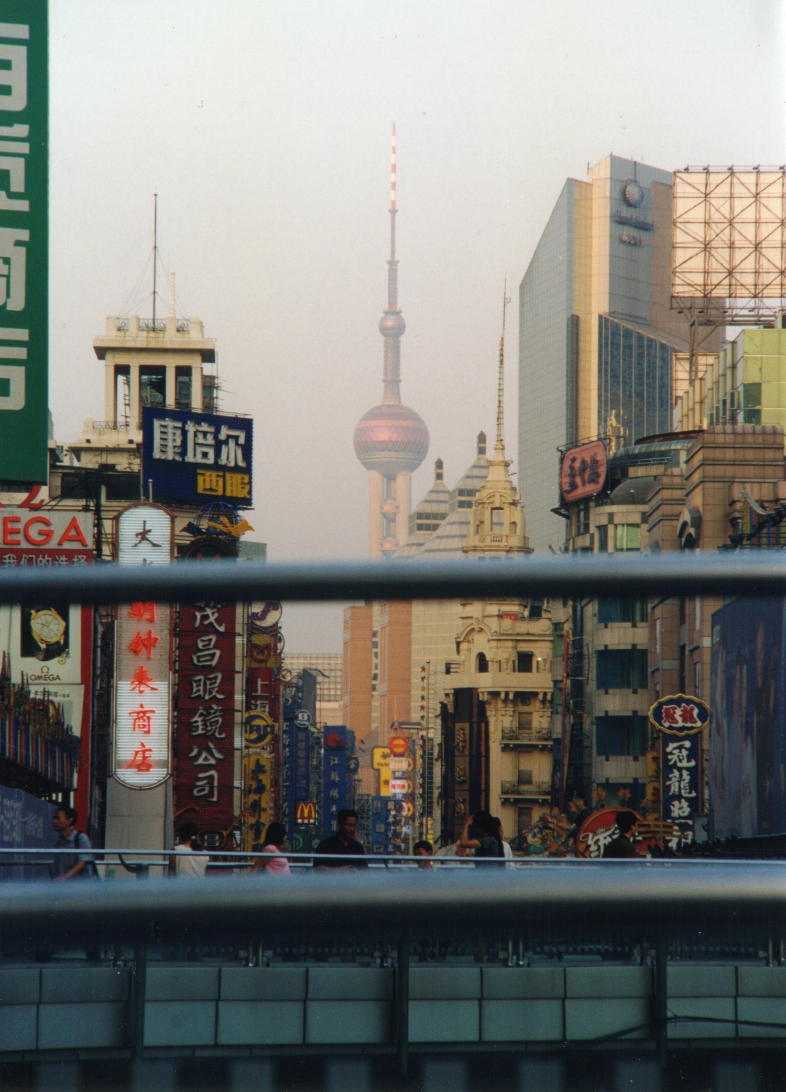
A Weekend in Shanghai

Slide 10
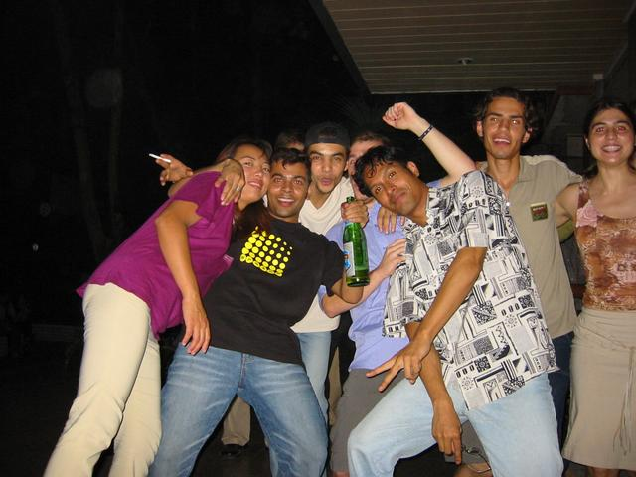
Having party
at the student hostel

Slide 11
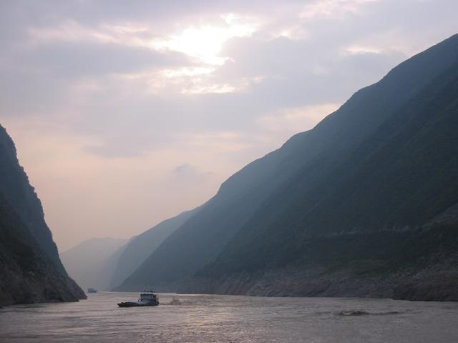
By boat through
the Three Gorges

Slide 12
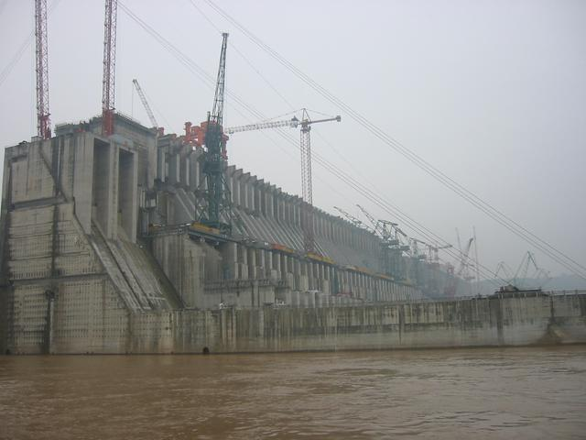
The Big Dam

Slide 13
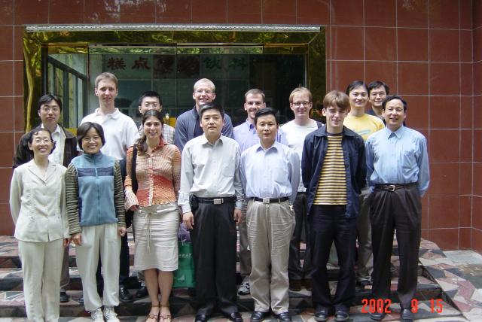
Goodbye HUST

Slide 14
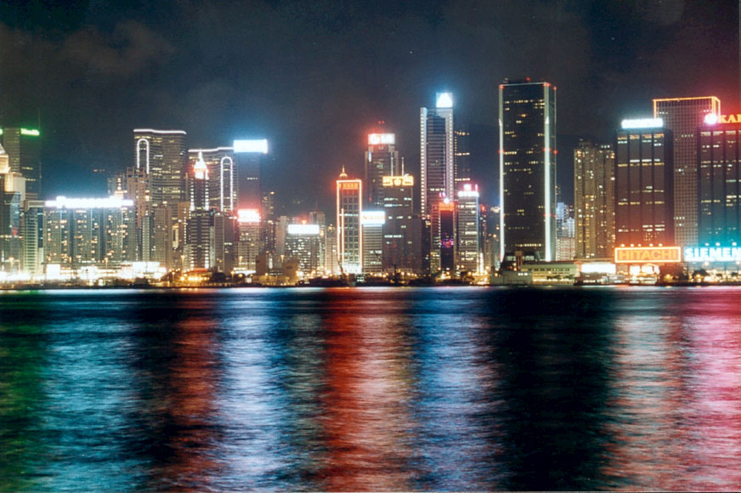
Back home via Hongkong

