Slide 1
Economic activity in the Central Business District
GeographyCaseStudy.Com
Content and case studies in context for post-16 Geography

Slide 2
Economic activities within the CBD
Economic activities in the CBD are almost always entirely tertiary sector activities.
This means they are about the provision of services, such as offices supplying legal services, financial services and administrative services. Tertiary sector activity is also about retail.
Retail is the sale of products directly to the end-user, i.e. the public, rather than selling to other businesses or as part of a supply chain. Retail is almost always done in small quantities to an individual, which is why shops group together (‘retail agglomeration’ ) to ensure they are accessible to the most individuals.

Slide 3
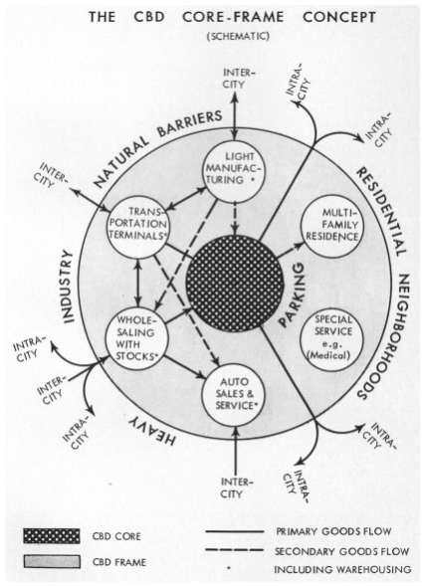
The Core Frame Model
The most common way to view the distribution of economic activities within the CBD is the Core Frame Model, first created by Ronald Boyce and Edgar Horwood in 1959 (Horwood and Boyce, 1959) and based on cities in the United States. The original model is shown below.
The original Core-Frame Model showing land use distribution in the CBD. Source: Horwood and Boyce, 1959.

Slide 4
The Core-Frame Model has since been updated to include not just a frame but an inner frame and an outer frame.
The outer frame contains economic activities that require proximity to the CBD but significant land space, such as educational institutions like universities.
The inner frame contains more services such as offices than the core, which is focused on retail and entertainment.

Slide 5
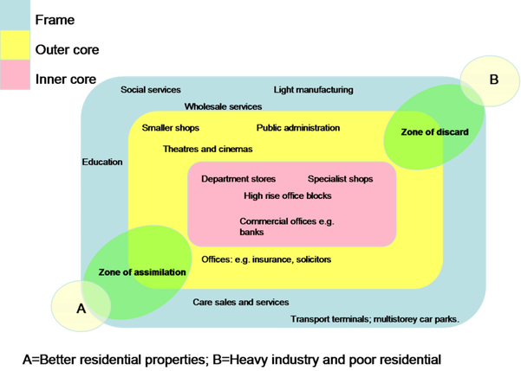
An updated Core-Frame Model showing an inner frame and an outer frame, as well as zones of assimilation and discard. Source: SuzanneKn, 2008.

Slide 6
The updated model also includes two extra ‘zones’ of assimilation and discard.
The zone of assimilation is when the core and inner-frame activities of the CBD are pulled outwards in that direction This may be because of investment such as new transport links, urban redevelopment projects or a new major store opening in that area.
Possible examples include Manchester’s bar area of Canal Street in the UK, and the extension of the Island Line transport link to Kennedy Town in Hong Kong.
The zone of discard is where the economic activity is declining, possibly including a negative multiplier effect (also known as negative cumulative causation). This might happen due to the closure of a major department store, or a lack of investment in the urban environment leading.
It’s important to note that the core doesn’t move at all: it will remain the best located part of the city and therefore the most attractive for business.

Slide 7
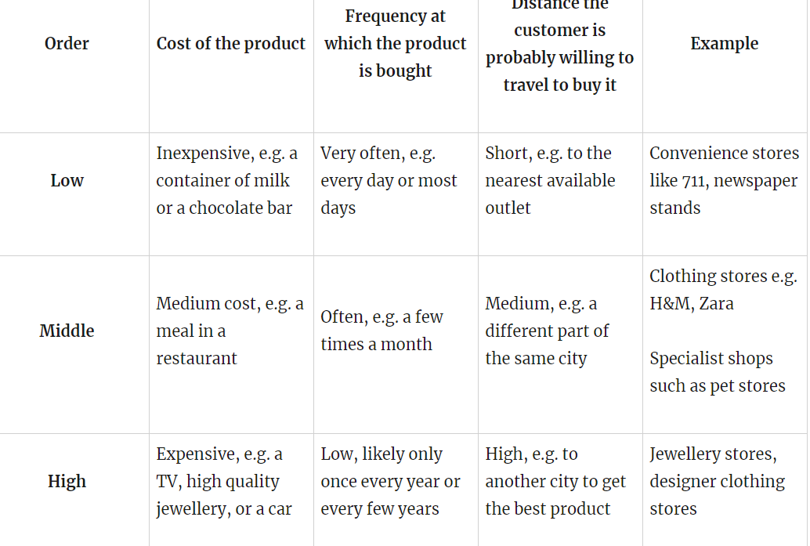
High, middle and low order outlets
The Core-Frame Model can also be explained by high, middle and low order shops and services. The table below outlines the difference between these types of shops and services.

Slide 8
However, it’s not as simple as higher order in the centre of the CBD and lower order around the edge:
High order shops and services are likely to be found in the core because they are expensive and make large profits from small sales
Middle order shops and services are likely to be in the core too. Although they may lower profits from each sale, they are aimed at the mass market and therefore make lots of sales, so their total profits are high. Some middle order shops e.g. specialist shops such as pet stores, are more likely be to found in the inner frame because they don’t have a mass market appeal.
Low order shops are found all over the CBD because they have a high volume of sales. People in the core still want to buy a can of soda, or a newspaper – and they don’t want to travel to the outer core to buy it. However, it’s unlikely that low order stores will cluster together, because people will just go to the nearest one.

Slide 9
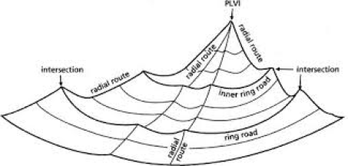
The Peak Land Value Intersection (PLVI)
The PLVI is an extension of bid rent, but rather than identifying a zone in which the value is high, it identifies the specific location within the core where land prices are highest. The diagram below shows how the PLVI is the most expensive land at the centre of the city, because it is the best place for businesses to locate.

Slide 10
Secondary data
It’s possible to work out the theoretical PLVI by identifying the land values (either through sale or rental prices) across the city and identifying the central point of the high values.
It won’t always be the actual highest price of land, because different buildings have different features e.g. the building on the theoretical PLVI might be old and falling down, so it would have a lower actual value than the theoretical PLVI.

Slide 11
Vertical zoning
The concept of vertical zoning applies almost exclusively to the CBD. Due to the high land value, buildings are taller so that they maximise the use of the same land area. Just like the Core-Frame Model explains the zoning across the land of the CBD, there is also zoning upwards through the buildings:
Basements: car parks, and light semi-industrial activities such as industrial laundries (cleaning sheets for hotels, for example). These activities do not require natural light and are not aimed at retail customers.
Ground floor: high volume shops such as convenience stores, and high order shops such as jewellery stores. They need to be highly visible to their customers at street level, and the best advertising is a large shop front.
First floors: shops and services that would like to be on the ground floor, but can’t compete. Eg. restaurants which don’t have customers throughout the day.
Upper floors: services such as offices for accountants and lawyers. They need to be easily accessible in the CBD, but they don’t require a visible presence at ground level and often they need a lot more space than the ground floor would provide.
An excellent example of vertical zoning is in Times Square in Hong Kong.

