Slide 1
Sunflower
Moves a running app to the computer with the cleanest power, without losing a request.
Challenge 3, ENACT: Kubernetes Dynamic Adaptation

Slide 2
GitHub repo
GitHub repo: github.com/kinnuworks/sunflower-enact
Start with the README: the result, the challenge checklist with a screenshot of every SDK step, and how to run it.
A recorded run you can play in a browser: docs/demo, drawn from the measured data, unedited.
The raw results: evidence/ holds the file behind every number we quote.
What we are giving back to ENACT: docs/field-report.md, 45 findings, each with the fix we used.
Licence: Apache-2.0

Slide 3
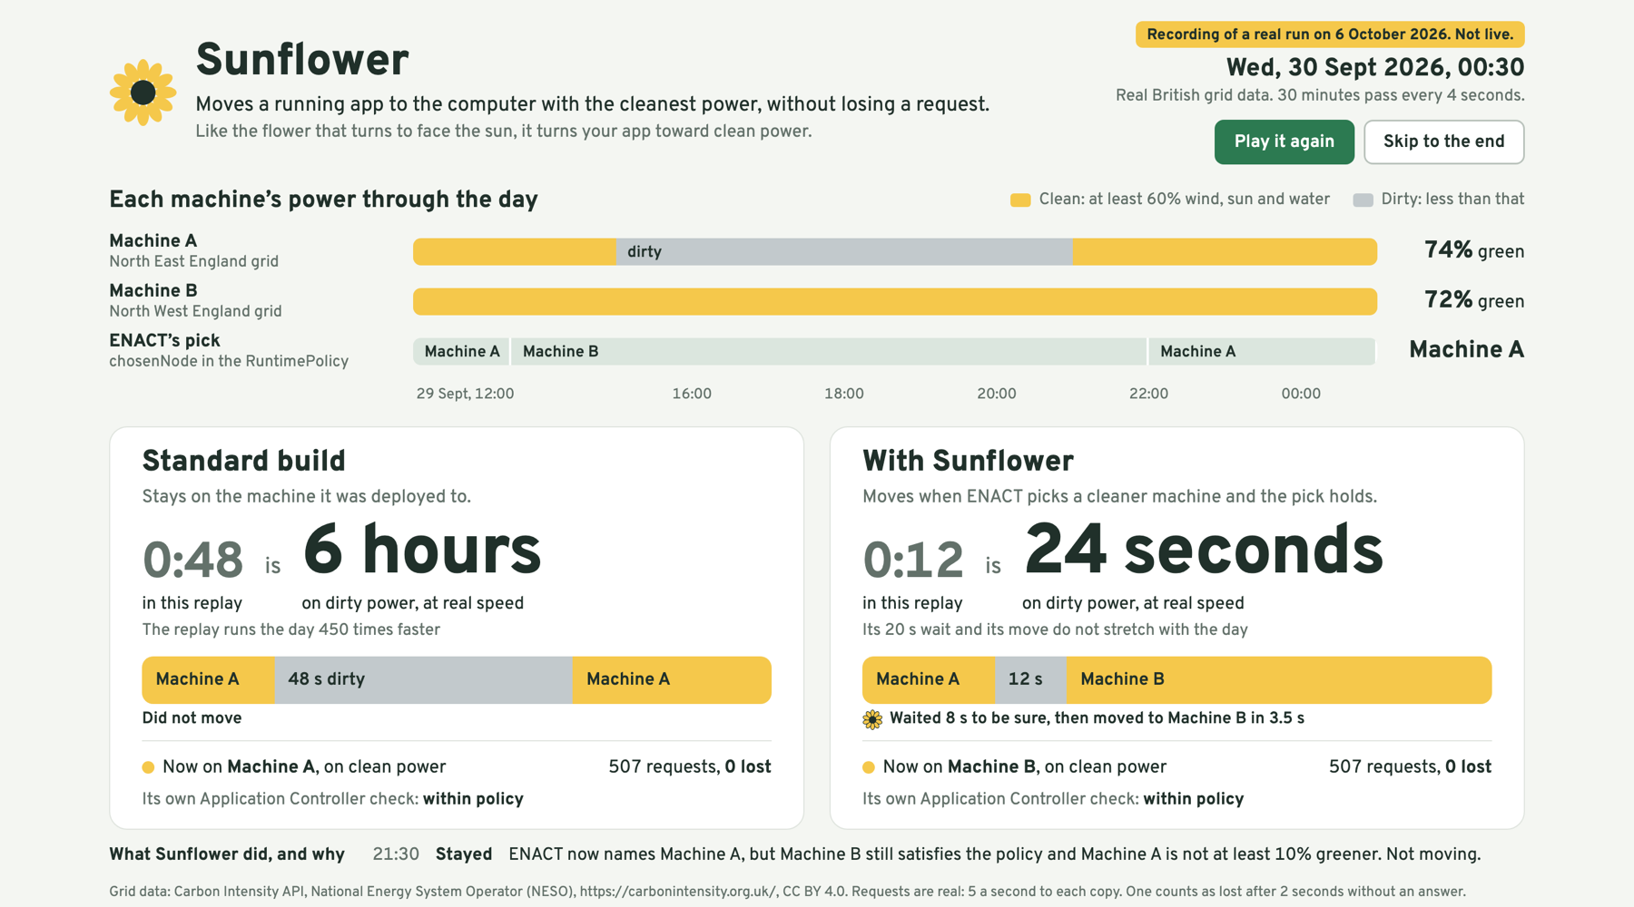
Summary
ENACT’s policy operator names the best machine for an app and keeps that answer current as the grid changes.
After deploy day the app does not follow. The SDK pins it once, so when its machine’s power turns dirty, GreenCharge stays there, below its own 60% rule.
Sunflower is a small controller that reads ENACT’s choice and moves the app to it, once the change has lasted, without losing a request.
We completed all five items of the challenge checklist in the ENACT SDK, dataspace included, then built Sunflower on top.
One real run on the challenge cluster. Left: the standard build, 6 hours on dirty power at real speed. Right: with Sunflower, about 24 seconds. Each was sent 507 requests and lost none.

Slide 4
Highlights
0
requests lost
across 30 moves in a row, 1,777 requests, on the challenge cluster
6 h → 24 s
on dirty power, at real speed
standard build against Sunflower, over a real day of British grid data
45
findings given back
problems we hit in ENACT, each written up with the fix we used
How we get 6 hours against 24 seconds: our replay runs the day 450 times faster and shows 48 s against 12 s. The standard build’s 48 s are the whole dirty stretch, which is 6 hours at real speed. Sunflower’s 12 s are a wait and a 3.5 s move that do not stretch with the day: with its default 20 s wait, about 24 seconds.
Checklist done in the ENACT SDK: dataspace feed, policy model, Application Controller extension (14 tests), policy, packaging, deployment and monitoring, plus one step with the SDK’s assistant. The repo has a screenshot of every step.
ENACT stays in charge: Sunflower reads the policy’s chosen machine and has no ranking of its own. It waits out short dips, ignores near-ties, limits how often it moves, and undoes a move that fails.
What we do not claim: carbon saved. This cluster reports energy as a model estimate, so we report time on dirty power, which we measured.

