Slide 1
Motor Data Report
Speaker: kino
Professor: Hsiao-Ping Tsai
Date: 2024/06/26

Slide 2
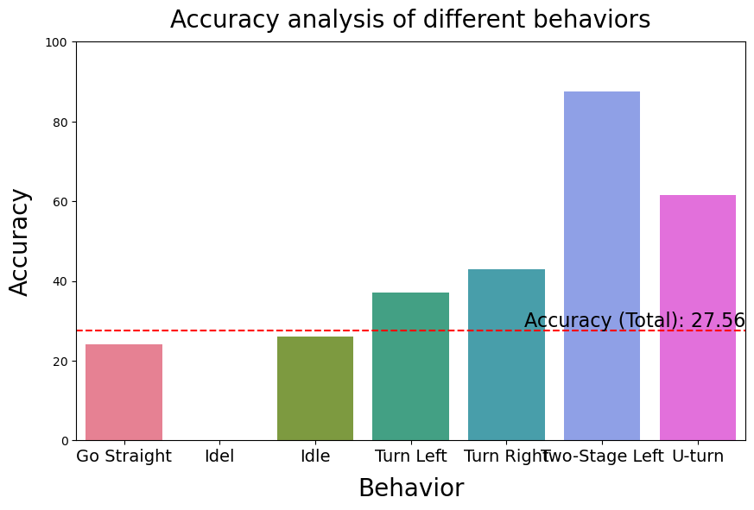
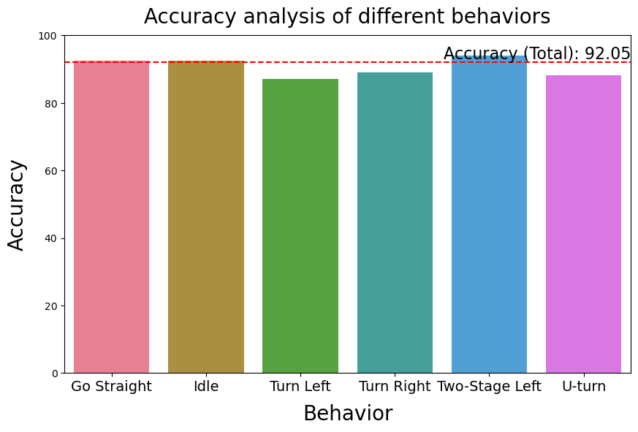
Result (Train & test are the same)
With angle data
Without angle data

Slide 3
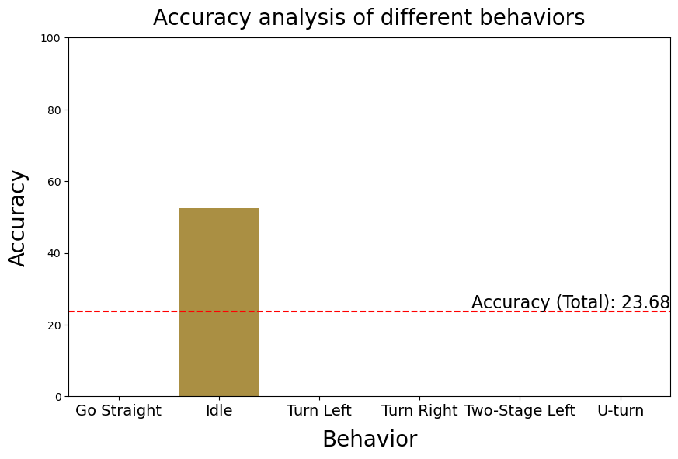
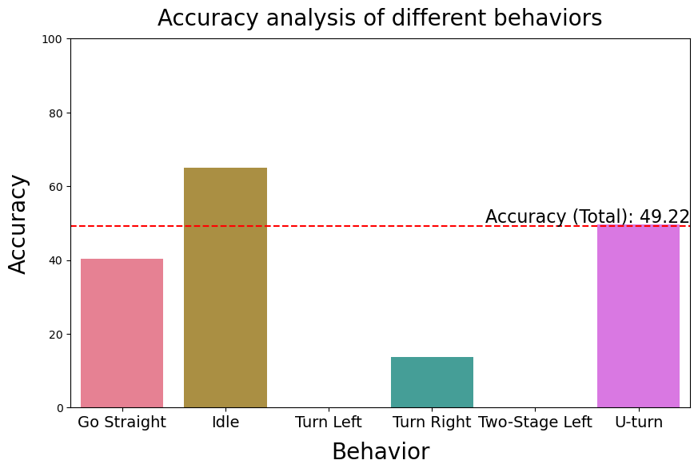
Result (First 50% train, second 50% test)
With angle data
Without angle data

Slide 4
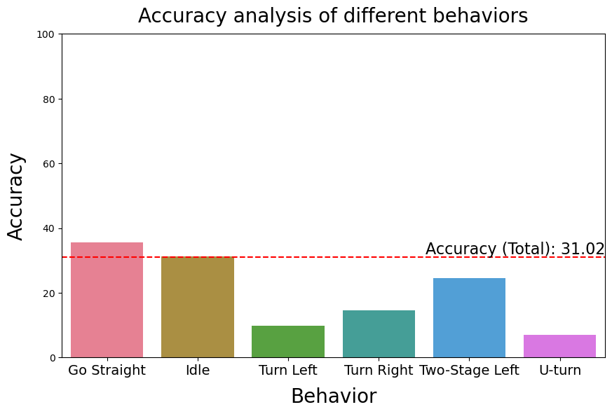
Result (Eric train, Kino test)
Without angle data

Slide 5
Future Work
Document the SOP for collecting data
Data Labeling App 2.1 is currently under development
Survey papers about deep learning model
Survey open datasets

