Slide 1
Rotorcraft Dynamic Model Part 2
Outline
Review of Rigid Body Dynamics and 6DOF Equations of Motion
Reference Frames / Notation
Useful kinematical equations
Translational and Rotational Dynamics
Euler Angles / Kinematics
Simple Helicopter Model
Model structure
Simple Aero Model
Simulation functions Illustrated via the Simple Helo Model
Numerical Integration
Numerical Linearization
Trim
Rotor Dynamic Model
Flapping Equations of Motion
Multi-blade Coordinates
Rotor Forces and Moments
Dynamic Inflow
Complete Modular Rotorcraft Simulation Model
Tail Rotor
Fuselage and Empennage Aerodynamics
Engine Dynamics
Flight Controls
Integrated Simulation Model
Other Configurations (tandem rotors, tilt-rotors, compounds, multi-copters)

Slide 2
Rotor Flapping Dynamics Part II
Multi-Blade Coordinates
Flapping Equation for an individual blade ( blade i ) are of the form:
Individual Blade Coordinates (IBC) for 4 bladed Rotor:
4
3
1
2
ψ₁

Slide 3
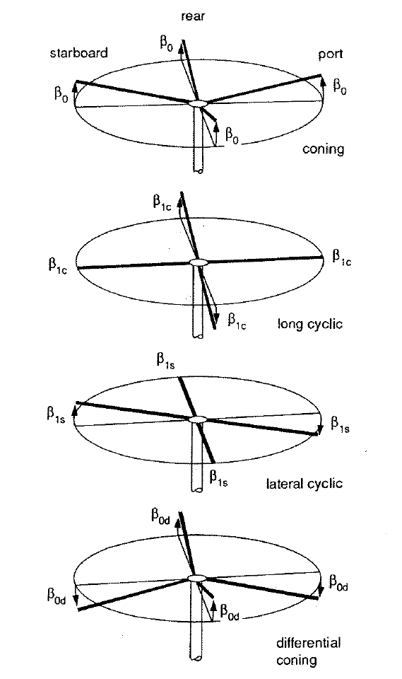
Introduce the multi-blade coordinates (MBC) for rotor flapping on a 4 bladed rotor:
Multi-Blade Coordinates for 4 bladed Rotor:
Coning
Differential Coning
Longitudinal Cyclic Flapping
Lateral Cyclic Flapping

Slide 4
Transformation from MBC to IBC for a four-bladed rotor :
Transformation from IBC to MBC for a four bladed rotor :

Slide 5
General MBC Transformation for Rotor of Any N_{b} ≥ 3
(see Johnson’s Rotorcraft Aeromechanics Ch. 15.4)
IBC to MBC
MBC to IBC
Differential coning only exists if there are an even number of blades.
The differential coning MBC and all MBCs with harmonics > 1 are “reactionless modes”. They result in no net force and moment on the hub when averaged over one revolution.

Slide 6
General MBC Transformations
These are MBC’s for rotors with 3-8 Blades:
MBC for 2-Bladed Rotor:
Standard transformation yields the following:
In this formulation, the Tip Path Plane is not defined and there is inherent 2/rev periodicity in the teetering angle, β_{T}.
These MBCs are not particularly useful for flight sim.
Coning Angle
Teetering Angle

Slide 7
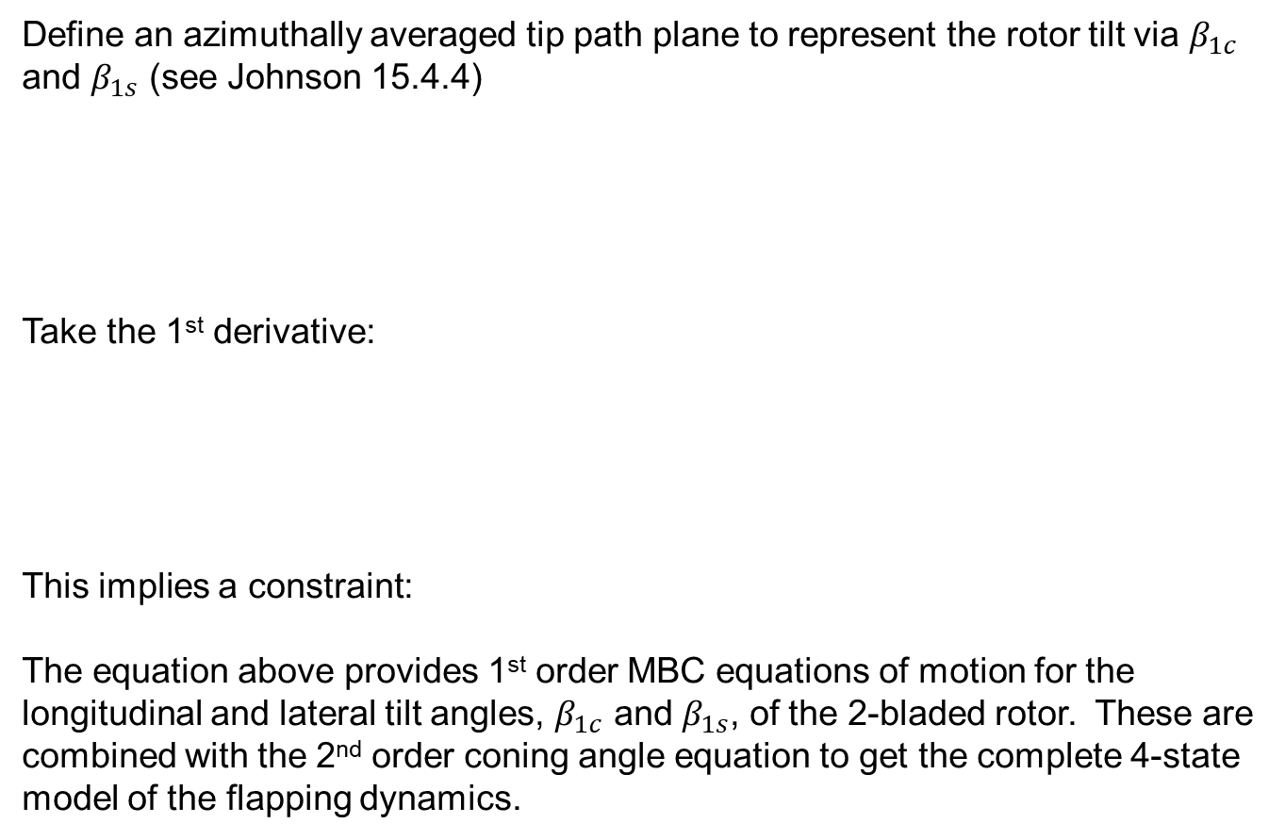
Special formulation for MBC of 2-bladed rotors
Define an azimuthally averaged tip path plane to represent the rotor tilt via $β_{1c}$ and $β_{1s}$ (see Johnson 15.4.4)
Take the 1st derivative:
This implies a constraint:
The equation above provides 1st order MBC equations of motion for the longitudinal and lateral tilt angles, $β_{1c}$ and $β_{1s}$, of the 2-bladed rotor. These are combined with the 2nd order coning angle equation to get the complete 4-state model of the flapping dynamics.

Slide 8
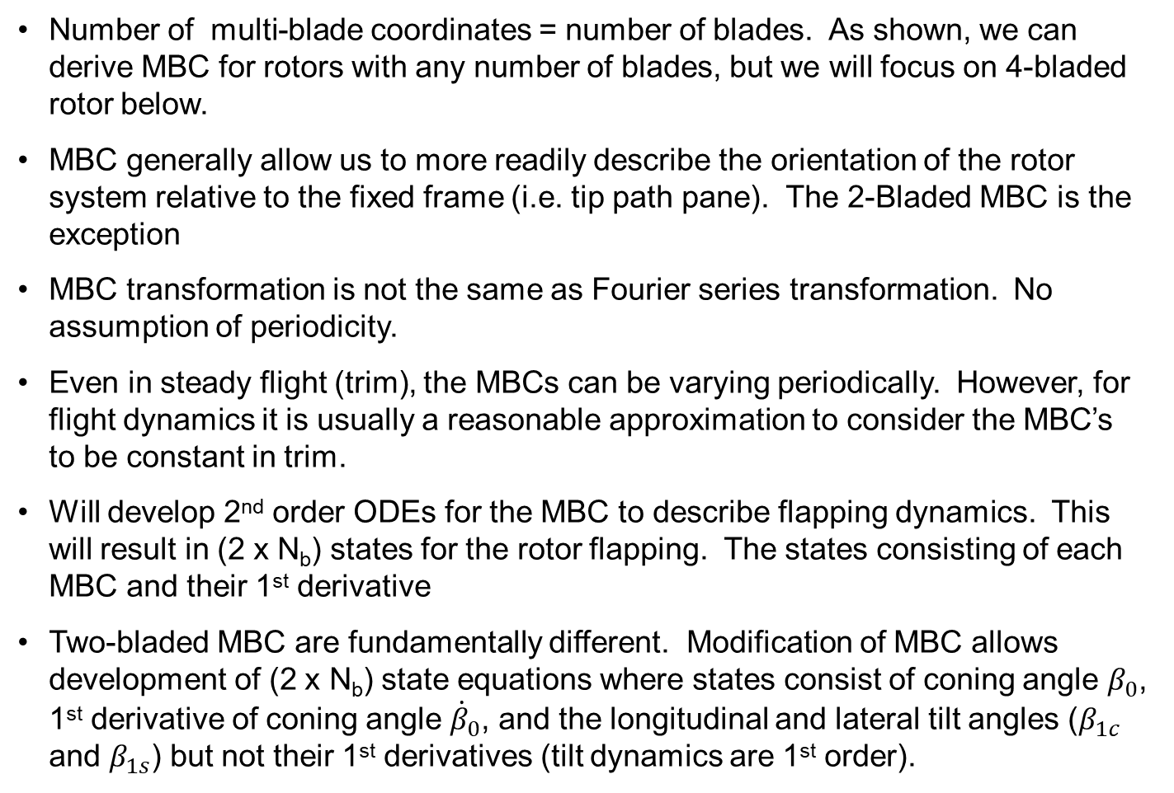
Notes on Multi-blade Coordinates (MBC)
Number of multi-blade coordinates = number of blades. As shown, we can derive MBC for rotors with any number of blades, but we will focus on 4-bladed rotor below.
MBC generally allow us to more readily describe the orientation of the rotor system relative to the fixed frame (i.e. tip path pane). The 2-Bladed MBC is the exception
MBC transformation is not the same as Fourier series transformation. No assumption of periodicity.
Even in steady flight (trim), the MBCs can be varying periodically. However, for flight dynamics it is usually a reasonable approximation to consider the MBC’s to be constant in trim.
Will develop 2nd order ODEs for the MBC to describe flapping dynamics. This will result in (2 x N_{b}) states for the rotor flapping. The states consisting of each MBC and their 1st derivative
Two-bladed MBC are fundamentally different. Modification of MBC allows development of (2 x N_{b}) state equations where states consist of coning angle $β_{0}$, 1st derivative of coning angle ${\dot{β}}_{0}$, and the longitudinal and lateral tilt angles ($β_{1c}$ and $β_{1s}$) but not their 1st derivatives (tilt dynamics are 1st order).

Slide 9
Multi-Blade Coordinates
If rotor is in steady state ( ) and no differential coning ( ):
β₀ = Coning Angle
β_{1c} = Longitudinal Flapping Angle
β_{1s} = Lateral Flapping Angle
or
β_{1s}
β_{1c}
Tip path plane (TPP)
Tip path plane (TPP)
β₀
β₀
View of Rotor from Aft
View of Rotor from Right Side

Slide 10
Next step is to transform flapping equations of motion from IBC to MBC.
Individual blade flapping equation:
The IBC equations can be written in matrix form:
For evenly spaced rotors, the individual blade azimuths are related by:

Slide 11
Next step is to transform flapping equations of motion from IBC to MBC
IBCs and MBCs are functions of time. Will use non-dimensional derivatives:
MBC Transformation matrices are functions of blade azimuth, and therefore are also functions of time. Will use 1st and 2nd non-dimensional derivatives for L_{β}:
Now convert 1st and 2nd derivatives of IBC flapping vector to MBC:
Substituting into flapping dynamics equation:

Slide 12
Or can write this as:
Note that the damping matrix, stiffness matrix, and forcing function are all functions of azimuth angle. When evaluated, many of the terms reduce to 0 or a constant value, but there are several trigonometric functions in ψ left. This implies the matrices are time-varying and periodic. However, we can often neglect the time varying terms for flight dynamics. We will now demonstrate with a 4-bladed rotor.
Consider the damping :

Slide 14
Evaluate the expression and use the following trig identities:
We get four terms that represent 2 per rev harmonics that come into play in forward flight (μ > 0). These terms are typically not important for flight dynamics / handling qualities (forces associated with the terms average to 0 over one rotor revolution). Neglecting these terms and we can derive a constant matrix:
Similar analysis can be done for D_{M} and H_{M}.

Slide 15
Summary of Flapping Dynamics of 4-bladed rotor in MBC for hinge offset model:

Slide 16
Center Spring Approximation
Derive center spring stiffness that produces same flapping frequency as hinge offset model:
Use this spring constant and e = 0.
Simplifies constants in flapping equations
β

Slide 17
Summary of Flapping Dynamics of 4-bladed rotor in MBC for Center Spring Model:

Slide 18
Flapping Dynamics in MBC
Matrices are function of airspeed (flight condition). If we assume it varies slowly then left hand side of equation represents linear ODE’s
Forcing terms on right hand side are a function of the control inputs, inflow, and the motion of the aircraft:
If the rotor tip path plane reaches a quasi-steady-state (multi-blade coordinates are approximately constant):

Slide 19
Simplified Flapping Dynamics in MBC
Note that differential coning state is decoupled from rest of flapping dynamics and forcing term is 0. Called “reactionless” mode, since it produces no steady force or moment on the aircraft, so it can be dropped for flight dynamics analysis. Also dropping variable rotor speed in this form:

Slide 20
Hover Flapping Dynamics
Set advance ratio to 0: μ = 0
Coning dynamics are de-coupled from longitudinal and lateral flapping
Terms preceded by Lock number (γ) are due to aerodynamic effects
Terms not preceded by Lock number are due to inertial effects
These are Linear ODEs. Can look at:
Stability, dynamic modes
Quasi-steady response to control inputs
Quasi-steady response to angular rates and inflow

Slide 21
Flapping Stability in Hover
Characteristic Equations in Hover:
Apply Laplace Transform. Equations are non-dimensional, where s is a non-dimensional frequency. Multiply by rotor frequency, Ω, to translate to dimensional frequency (rad/sec).
De-coupled equation for coning dynamics (β₀) results in 2nd order characteristic equation:
Longitudinal and lateral flapping dynamics (β_{1c} and β_{1s}) result in a 4th order characteristic equation:
Look at eigenvalues
Progressive Flap Mode
2j
Coning Mode
j
Regressive Flap Mode
-j
-2j

Slide 22
Quasi-Steady Flapping Response to Control Inputs and Disturbances in Hover
Assume rotor tip path plane has reached steady-state:
Quasi-steady coning:
Introduce rotor stiffness number:
Rotor stiffness number is an important parameter to determine the on-axis and off-axis flapping response of the rotor to control inputs and angular rates.
Stiffness number is 0 for rotor attached to a hinge at the shaft axis (e.g. articulated rotor with no hinge offset or a teetering rotor).

Slide 23
Quasi-Steady Flapping Response to Control Inputs and Disturbances in Hover
Consider response to control inputs and angular rates only:
Quasi-steady longitudinal flapping response:
On-Axis Response to Control
Off-Axis Response to Control
On-Axis Response to Angular Rate (damping)
Off-Axis Response to Angular Rate (cross-coupling)
Quasi-steady lateral flapping response:
On-Axis Response to Control
Off-Axis Response to Control
On-Axis Response to Angular Rate (damping)
Off-Axis Response to Angular Rate (cross-coupling)

Slide 24
Quasi-Steady Flapping Response to Control Inputs and Disturbances in Hover
Consider case where stiffness number is 0:
Longitudinal cyclic maps directly to longitudinal flapping (with negative sign)
Lateral cyclic maps directly to lateral flapping
Recall that blade pitch is controlled by swashplate and is governed by:
Collective
Lateral
Cyclic
Longitudinal
Cyclic
Flapping angle in steady-state is then given by:
Coning
Long.
Flapping
Lateral
Flapping

Slide 25
The 90° Phase Shift
The fundamental 90° phase shift
Flapping response is 90° out of phase with cyclic pitch control input.
Rotor with zero stiffness number is a resonant system.
Control excitation frequency = flapping natural freq = Ω
Front
ψ = 180°
Example: aft longitudinal cyclic input, θ_{1s} > 0
Right
ψ = 90°
β_{1c} = -θ_{1s}
Increase blade pitch here
Maximum flapping occurs here
β_{1c} = -θ_{1s}
Left
ψ = 270°
Aft
ψ = 0°

Slide 26
Quasi-Steady Flapping Response to Control Inputs and Disturbances in Hover
For rotor systems with stiffness number not equal to 0:
Note that higher stiffness tends to reduce on-axis flapping response and increase off-axis response
Can reduce cross-coupling effects using “swashplate phasing”, use slightly less than a 90° phase lag
Can show that a particular swashplate phasing angle eliminates cross-coupling in hover. You will derive this in homework assignment 2. However, coupling effects will change in forward flight, so cannot eliminate cross-coupling entirely with swashplate phasing.

Slide 27
Quasi-Steady Flapping Response to Control Inputs and Disturbances in Hover
Consider case were stiffness number is 0:
Terms in green box represent rate damping effect
E.g. pitch rate causes longitudinal flapping that causes a pitch moment that resists the pitch rate
Physically due to gyroscopic stability of rotor (inertial effects)
Note that Lock number is in denominator. Term becomes infinite in a vacuum (ρ = 0)
Terms in red box represent cross-coupling
E.g. pitch rate causes lateral flapping which causes roll moment which causes roll rate
Physically due to aerodynamic forces (e.g. pitch rate acts like lateral cyclic pitch)
Inflow also plays a part in the cross-coupling, which is not capture in these simplified equations (we dropped inflow terms)
Wake curvature effects can cause cross-coupling effects to respond in a direction opposite of the direction predicted by these equations.

Slide 28
Rotor “Blow Back”
Can also show that rotor translation relative to air induces rotor flapping
Free Stream
V
Increase in advance ratio μ results in similar rotor response to increase in θ_{1s}
Increased velocity on advancing blade causes increase in lift
Front
ψ = 180°
V + Ωr
Right (advancing side)
ψ = 90°
β_{1c}
Maximum flapping occurs here
β_{1c}
Left (retreating side)
ψ = 270°
Decreased velocity on retreating blade causes reduction in lift
V - Ωr
Aft
ψ = 0°

Slide 29
Lag Dynamics
Will not discuss in detail, but lag dynamics can also be important in flight dynamics
Hinges or flexibility in the lag degree of freedom are included in rotor design to relieve structural loads
Unlike flapping, lag motion serves no purpose in stability and control
Unlike flapping, lag dynamics are weakly coupled to fuselage motion
However, dynamics are lightly damped and stability becomes an issue with closed-loop control – Air Resonance or Rotor-Body Coupling
Mechanical or elastomeric dampers are used, but may not provide enough stability when using high gain feedback

Slide 30
Lag Dynamics
Lag Hinge
Simplified Model of Coupled Flap-Lag Dynamics:
ζ = Lag Angle
Ω
Damping and stiffness
Aerodynamic
moments
Lag dynamics are inherently nonlinear and coupled to flap dynamics through Coriolis terms
Damping for lag comes mainly through mechanical damper (aerodynamic damping is small)
Lag stiffness comes for lag hinge offset (similar to flapping stiffness due to hinge offset)

Slide 31
Typical Eigenvalues of Rotor Modes UH-60 Rotor at 80 kts
Flap Progressing Mode
Lag Progressing Mode
Lag Regressing Mode
Flap Regressing Mode
Ω = 27.0 rad/sec
= Identified from GENHEL Model
= Identified from Flight Test
(Ref. Fletcher, NASA RM 110362)

