Slide 1
Reduced Order Linear Models
Will use UH-60 HeloSim model to demonstrate linear model analysis and linear model reduction
If we extract linear model from HeloSim we get a 24 state model. Define the output to be identical to the state vector:
Want to simplify the model. The first step would be to eliminate the rotor RPM degree of freedom. Note that the linear model does not include the Engine RPM governor (aka Engine Control Unit). If we assume the helicopter operates with this system and that it works effectively, then we can assume the rotor speed is held approximately constant at the equilibrium set point:
Note the last 3 states include rotor speed and two engine states. These become decoupled when rotor speed is held constant, and all three can be removed. Also, the 5th control variable is the engine fuel control is decoupled and can also be removed

Slide 2
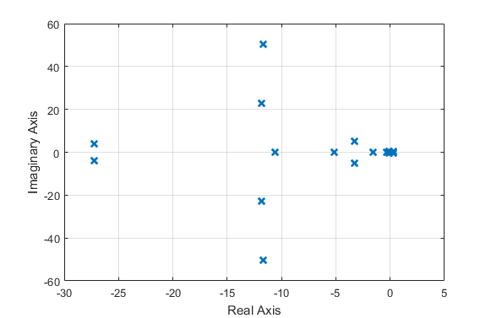
Reduced Order Linear Models
Extract this linear model in Hover and plot the eigenvalues:
A=A(1:21,1:21);
B=B(1:21,1:4);
C=eye(21);
D=zeros(21,4);
sys=ss(A,B,C,D);
E=eig(sys);
plot(E,'bx','LineWidth',2.0);
Lower Frequency Modes
Cyclic
Inflow Modes
Progressive and collective flapping modes and collective inflow

Slide 3
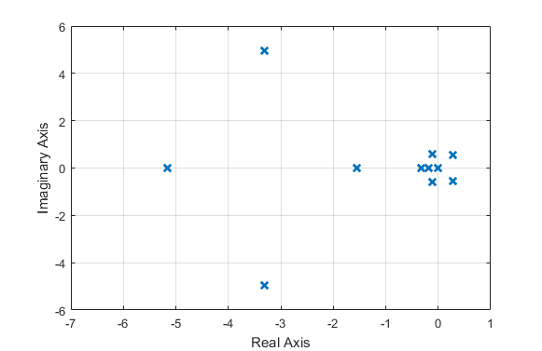
Reduced Order Linear Models
Zoom in on the lower frequency eigenvalues
Roll / Flap Regressive Mode
Roll Subsidence
Pitch Subsidence
Even lower frequency modes

Slide 4
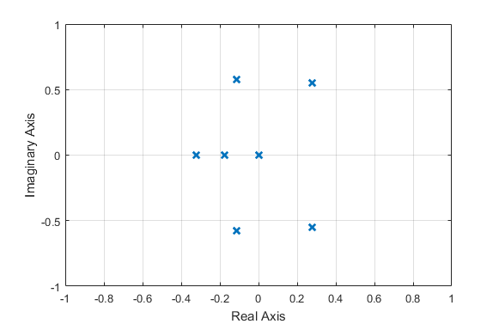
Reduced Order Linear Models
Zoom in again
Eigenvalues at origin are associated with decoupled states: x, y, z, and ψ
“Hover Phugoid” modes, one pair is unstable
Heave Subsidence
Four eigenvalues at the origin
Yaw Subsidence

Slide 5
Reduced Order Linear Models
How do I know how to classify these modes?
Partly due to experience and familiarity with this model
Can perform eigenvector analysis to see which states are most involved in the mode. Need to be very careful with this – states have different units!
Eigenvector analysis is challenging with 21 states. Can get better understanding by performing some addition order reduction methods.
Keep in mind the naming of modes is just taxonomy for our convenience. In a mathematical sense, the “modes are just the modes”, e.g. there is no set definition of “phugoid mode”
How do we reduce order further?
One approach is to use balanced realization and optimal Hankel Norm methods. Uses balreal function in MATLAB
I will not use this approach – the method requires that we apply a state transformation, and thus the states lose their physical meaning:

Slide 6
Reduced Order Linear Models
Instead we will use some known properties of the rotorcraft system and apply some of our physical insight to the system
Will use two basic approaches to reduce number of states:
Truncation – simply remove states: Remove associated rows and columns from A matrix. Remove associated rows from B matrix. When is this justified?
States are completely (or approximately) de-coupled from states of interest in the system (e.g. x, y, z, ψ and engine states once we assume rotor speed is constant)
States are assumed to be approximately constant (e.g. Ω )
Residualization / singular perturbation: Assume states reach steady-state condition very quickly and this the state derivative is zero most of the time, but state itself actually changes. Will explain futher …

Slide 7
Reduced Order Linear Models
Will explain order reduction through some simple linear systems:
In this system we can truncate x₁ if desired:
Why? It is de-coupled
These decoupled systems are an exact representation of full order system and eigenvalues are identical:

Slide 8
Reduced Order Linear Models
In this system we might truncate x₁:
Why? Because x₁ will reach steady-state equilibrium and stay there:
Note that the eigenvalues of the two de-coupled system are identical to the full order system

Slide 9
Reduced Order Linear Models
In this system we might eliminate x₁ through residualization:
Why? We see a significant difference in time scales in the eigenvalues. Note that state x₁ dynamics are dominated by the diagonal term -30 (note that one of the eigenvalues is very close to this value). We assume x₁ will reach a steady-state very quickly following any perturbation on the system:
Note these eigenvalues are close to those above (but without the “fast” dynamics associated with λ = -30.4)

Slide 10
General Approach to Residualization
Identify states that we believe are “fast” states, i.e. exhibit faster dynamics than the main states of interest.
In this class it will largely be done by physical intuition, i.e. the rotor and inflow states are “fast”, the fuselage states are “slow”
Reorder and partition the state vector and A and B matrices:
Apply steady-state constraint to fast states:
x₁ = Slow States
x₂ = Fast States

Slide 11
General Approach to Residualization
The approach requires that the de-coupled fast dynamics are asymptotically stable. This means that A₂₂ has all eigenvalues in the left half plane, and no 0 eigenvalues. This means that A₂₂ is invertible
We can then derive algebraic constraint on the fast states:
Substitute back into slow dynamics:
Reduced order model of slow dynamics:

Slide 12
General Approach to Residualization
Requirements for this approach:
There is also an approximate model for the fast states, which is derived by simply truncating the slow states (this assumes the slow states are held constant at equilibrium):
Should find that eigenvalues of the reduced order model of the slow dynamics are similar to the lowest frequency eigenvalues of the full order system.
Likewise the eigenvalues of the reduced order fast dynamics are similar to the highest frequency eigenvalues of the full order system

Slide 13
An 8-state linear model of the UH-60 in hover
Will develop an 8-state linear model of the fuselage dynamics, also known as a “stability derivative” model
Truncate decoupled states:
Truncate rotor speed and engine states:
Residualize the rotor and inflow states:
Left with 8 state model
Truncate x, y, z, and ψ
Truncate states 9 to 12
Truncate Ω , x_{e1}, and x_{e2}
Truncate states 22 to 24
Fast states =
Residualize fast states 13 to 21
Slow states =
Retain slow states 1 to 8

Slide 14
8-State Linear Model of Hovering UH-60
MATLAB commands:
%Truncate de-coupled states and engine states
Ar=A([1:8 13:21],[1:8 13:21]);
Br=B([1:8 13:21],[1 2 3 4]);
%Partition truncated model to fast states (1:8) and slow states (9:17)
Ar11=Ar(1:8,1:8);
Ar12=Ar(1:8, 9:17);
Ar21=Ar(9:17,1:8);
Ar22=Ar(9:17,9:17);
Br1=Br(1:8,:);
Br2=Br(9:17,:);
%Residualize fast states
Ar=Ar11-Ar12/Ar22*Ar21;
Br=Br1-Ar12/Ar22*Br2;
Now look at eigenvalues of reduced order slow dynamics
plot(eig(Ar),'rx','LineWidth',2.0);
Can also look at reduced order fast dynamics:
plot(eig(Ar22),‘gx','LineWidth',2.0);

Slide 15
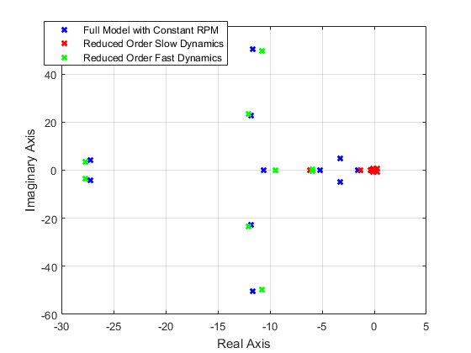
8-State Linear Model of Hovering UH-60

Slide 16
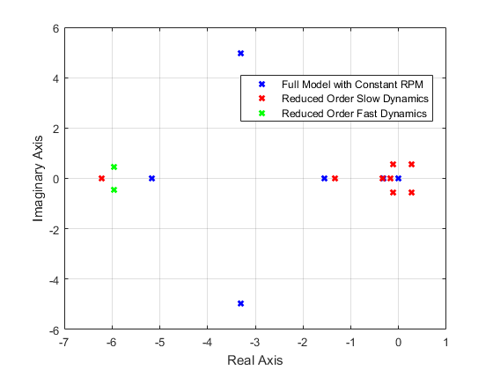
8-State Linear Model of Hovering UH-60

Slide 17
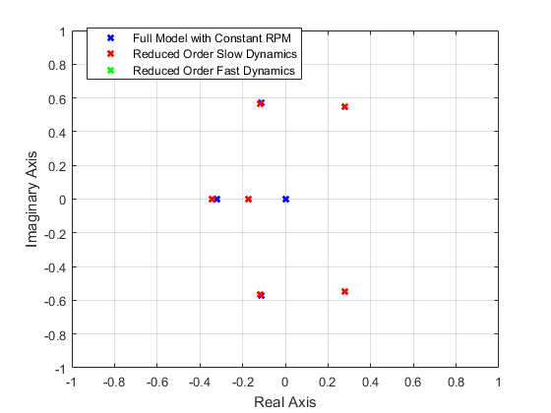
8-State Linear Model of Hovering UH-60

Slide 18
8-State Linear Model of Hovering UH-60
Many of the low frequency eigenvalues of reduced order model are nearly overlaying the full order model eigenvalues.
The 4 integrator states at the origin disappear, because the associated states were removed, but this has no effect on the dynamics of interest.
The most significant discrepancy is in the coupled roll mode / regressive flapping dynamics
The 8-state model has no flapping dynamics, so 1 real + 2 complex eigenvalues are replaced by a single real eigenvalue
The fast model has regressive flapping eigenvalues that are significantly different from those of the full order model
This is because there is some significant coupling between regressive flapping and aircraft roll dynamics. Nonetheless the 8-state model is not bad
Can address this discrepancy with a 10-state model which will be presented later in the course

