Slide 1
More Discussion of S&C Analysis
Will touch on a few more topics related to the study of rotorcraft S&C before moving on to the next topic (which is closed loop control)
Frequency domain analysis and its role in model order reduction and system identification
First order flapping dynamics in S&C models
Use of trim analysis to help understand and identify rotorcraft stability and control characteristics

Slide 2
Frequency Domain Analysis
Often use Bode plot analysis in rotorcraft flight dynamics
Consider UH-60 linear model in hover. Remove RPM DOF, engine model and de-coupled states x, y, z, ψ. Look at bode plot of roll rate due to lateral stick input
[F,G,M,A,B,C,D]=linearize('uh60',x0,u0,xdot0,constants);
Ar1=A([1:8 13:21],[1:8 13:21]);
Br1=B([1:8 13:21],[1 2 3 4]);
sys=ss(Ar1,Br1,eye(17),zeros(17,4));
bode(sys(4,1),{0.1,100});
hold all;
Now look at 8-state linear model and de-coupled lateral-direction models.
Ar=Ar1(1:8,1:8)-Ar1(1:8,9:17)/Ar1(9:17,9:17)*Ar1(9:17,1:8);
Br=Br1(1:8,:)-Ar1(1:8,9:17)/Ar1(9:17,9:17)*Br1(9:17,:);
sys8=ss(Ar,Br,eye(8),zeros(8,4));
bode(sys8(4,1),{0.1,100});
Alat=Ar([2 4 6 7],[2 4 6 7]);
Blat=Br([2 4 6 7],[1 4]);
syslat=ss(Alat,Blat,eye(4),zeros(4,2));
bode(syslat(2,1),{0.1,100});
egend('Full Linear Model','8 State Model','4 State Model');
Construct Truncated Model and LTI object
Bode: Output # 4 =p, Input #1 = dlat, limit frequency range to 0.1 to 100 rad/sec
4 state lateral model:
Output #2 = p, Input #1 = dlat

Slide 3
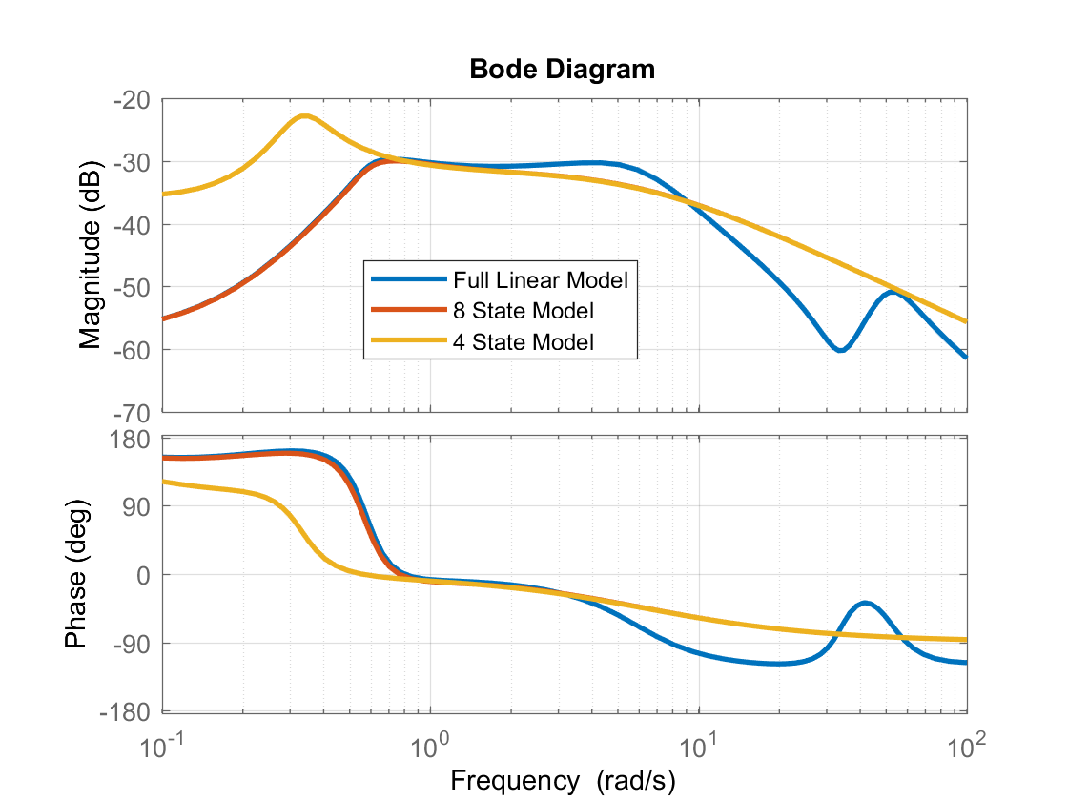
Resulting Bode Plot
8 State model overlays 4 state model out here

Slide 4
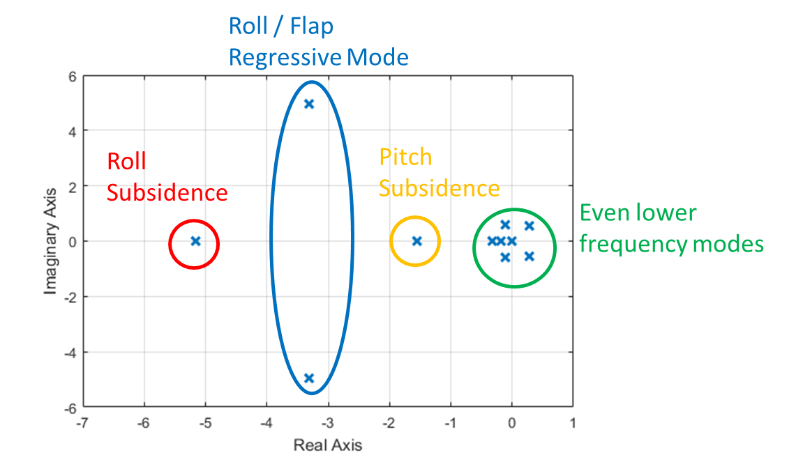
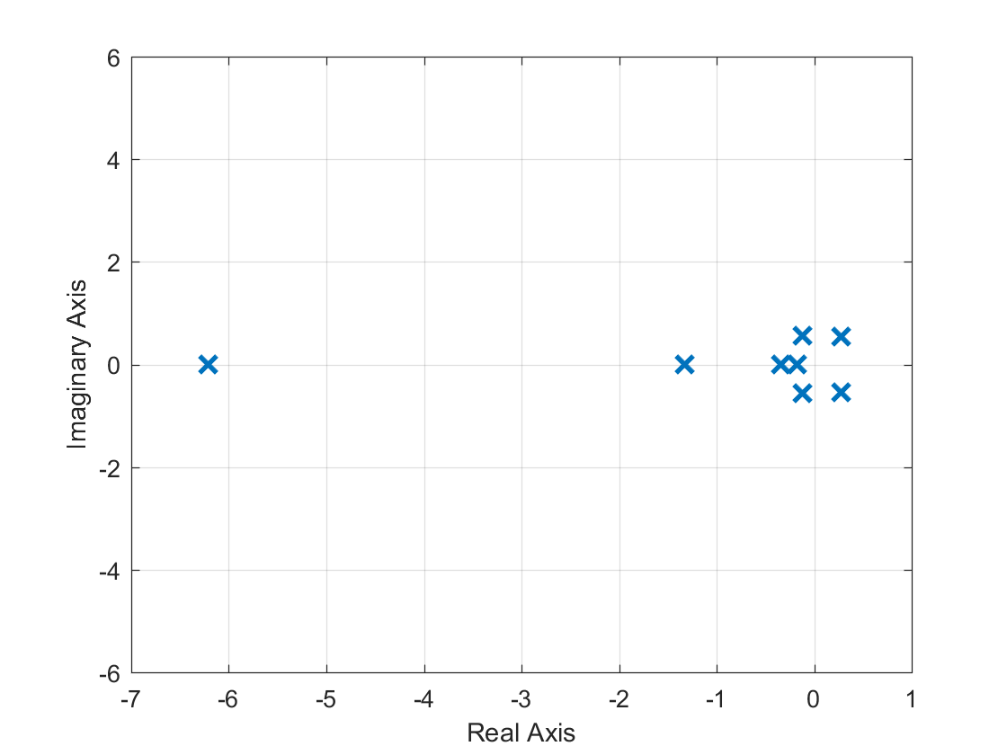
Summary of Roll Bode Analysis
The 8-state model is only accurate up to about 3 rad/sec
The 4-state model is only good between 0.8 and 3 rad/sec
For basic flight control design and handling qualities analysis, we are mainly interested in the frequency range of 0.2 to 2 Hz (about 1 to 12.5 rad/sec). So perhaps we lets try to improve the high frequency matching at least up to 12.5 rad/sec
Note that the original model had a coupled roll / regressive flap mode. This pair of eigenvalues was eliminated with the 8-state model
Roll Subsidence
Even lower frequency modes
Pitch Subsidence
21 State Model (full model without rotor RPM / engine)
8 State Model

Slide 5
The 10-State Model
We need to retain at least two more states to add the additional eigenvalues for the regressive flap mode.
This can be done by retaining both the lateral and longitudinal flapping states. I.e. these state become part of the “slow dynamics”
Apply the exact same reduction method we used before to generate a 10 state model.
Can also decoupling this model into lateral-directional and longitudinal models each with 5 states
Ar=Ar1([1:8 10 11],[1:8 10 11])-Ar1([1:8 10 11],[9 12:17])/Ar1([9 12:17],[9 12:17])*Ar1([9 12:17],[1:8 10 11]);
Br=Br1([1:8 10 11],:)-Ar1([1:8 10 11],[9 12:17])/Ar1([9 12:17],[9 12:17])*Br1([9 12:17],:);
sys10=ss(Ar,Br,eye(10),zeros(10,4));
bode(sys10(4,1),{0.1,100});
Alat5=Ar([2 4 6 7 9],[2 4 6 7 9]);
Blat5=Br([2 4 6 7 9],[1 4]);
syslat5=ss(Alat5,Blat5,eye(5),zeros(5,2));
bode(syslat5(2,1),{0.1,100});
Along5=Ar([1 3 5 8 10],[1 3 5 8 10]);
Blong5=Br([1 3 5 8 10],[2 3]);
syslong5=ss(Along5,Blong5,eye(5),zeros(5,2));
Fast states =
Slow states =

Slide 6
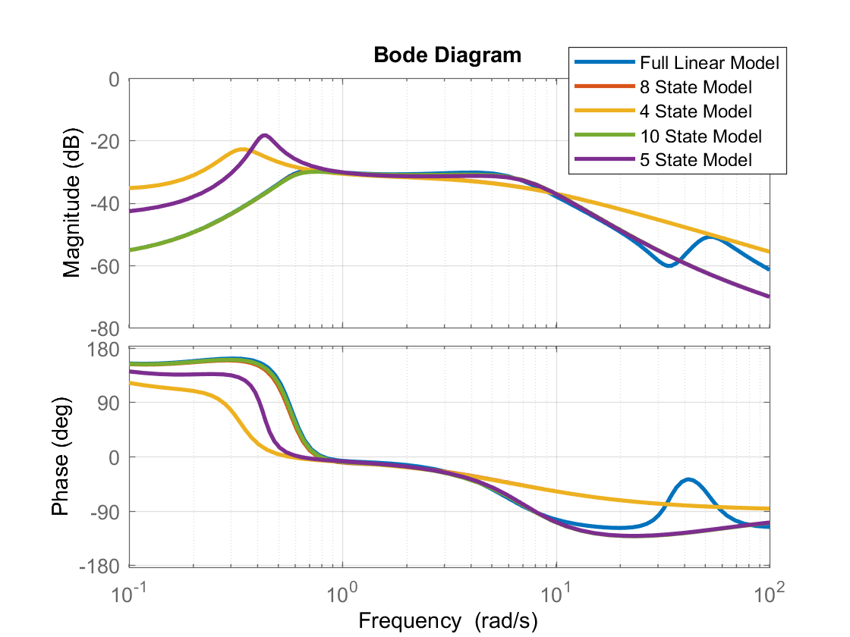
Resulting Bode Plots for Roll Rate due to Lateral Cyclic

Slide 7
First Order Flapping Representation
We find the 10 state model and the even 5 state model are quite accurate for modeling the roll rate response out to 20 rad/sec.
The 10 state model is effectively representing the lateral and longitudinal flapping as first order
Many of the terms were the S&C derivatives reside will be very different
These terms will look very different from the 8 state model
These terms will look very different from the 8 state model
Smaller Terms
Smaller Term
Smaller Term
Smaller Term
Smaller Terms
Smaller Terms
Smaller Term
Smaller Term
Smaller Term

Slide 8
First Order Flapping Representation
In full model, the 2nd order lateral and longitudinal flapping dynamics are inherently coupled
But when we approximate with 1st order flapping, lateral and longitudinal flapping are approximately de-coupled
Focus on roll dynamics, assume roll rate and lateral flapping can de-coupled from the rest of the model as:
Assumptions:
The lateral flapping state can be thought of as lateral tilt of the rotor disk
Effect of roll rate on lateral tilt of the rotor disk is purely gyroscopic precession, this is why there is a coefficient of 1 in front of roll rate in the flapping equation.
The lateral tilt is well-damped, where the damping is described the flapping time constant τ_{f}.
Roll control is only generated indirectly through tilting of the rotor disk (so the is no roll control derivative, L_{δlat} )
The roll damping term L_{p} is only from airframe and tail rotor effects. The roll damping from the main rotor comes indirectly through tilting of the rotor disk

Slide 9
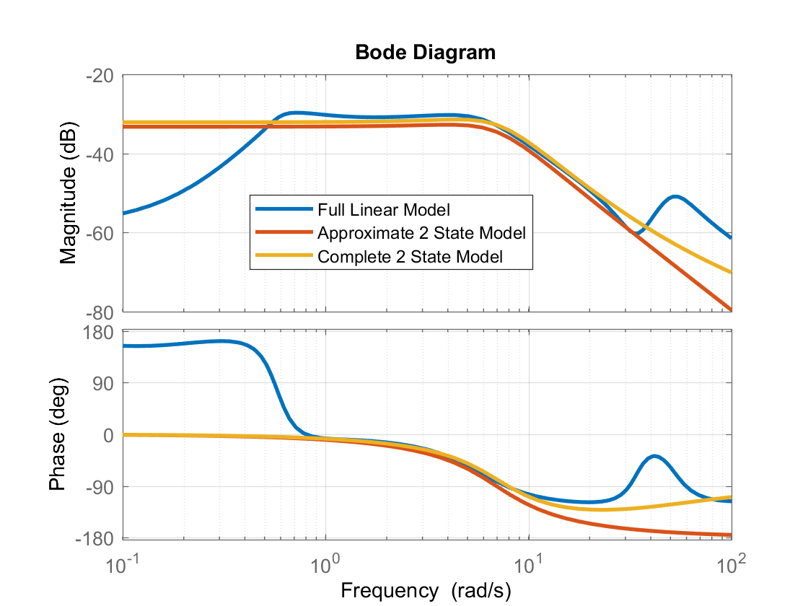
2nd Order Roll Dynamics
We can construct the 2nd order model by pulling out coefficients from the 10-state model:
The bode plot is shown below, and we can see this approximate 2nd order model (in red) is pretty good at modeling roll rate dynamics between 1-20 rad/sec, but it under predicts the magnitude a bit.
sysp=ss([Ar(4,4),Ar(4,9);1,-7.8529],[0.;Br(9,1)],[1 0],0);
Bode(sysp,{0.1,100});
Can do better if we keep the small value L_{δlat} in Br(4,1) and use the actual value at Ar(9,4) (it is 1.066 not 1). To construct complete 2nd order model (shown in yellow):
sysp=ss(Ar([4 9],[4 9]),Br([4 9],1),[1 0],0)

Slide 10
Parameter Identification
In some cases you might have flight data and need to get a reasonably good linear model form the data (i.e. system identification or parameter identification)
These simplified models are very useful to developing a model structure that you can fit to the flight data. In rotorcraft, frequency domain identification methods are prevalent. This is because rotorcraft exhibit dynamic modes across a wide range of frequencies
The US Army developed a tool called CIFER®, which is commonly used in the rotorcraft industry for performing parameter identification
General concept of frequency domain ID
During flight test, a pilot performs a “frequency sweep”, i.e. a sinusoidal input with increasing frequency (also called a “chirp” signal)
FFT type algorithms are used to construct frequency response directly from the flight test data.
Linear models are then fit to match the frequency responses from flight test data (e.g. using least squares like optimization algorithms). These can be done either as transfer functions or state space models
This process requires that you define a model structure and specific parameters to fit to the data (although there are other system ID methods that do not require a pre-defined model structure)

Slide 11
Parameter Identification
Example: Will use a bode plot of the full order linear model as our notional “truth data”, allows us to skip step 1 and 2.
[FltMag,FltPhase,FltOmega]=bode(sys(4,1),{0.8,20.});
Assume a model structure with roll rate and 1st order flapping
Define a cost function that yields a vector of weighted errors of the magnitude and phase:
Apply MATLAB lsqnonlin to fit parameters to match flight test data. Will need a reasonably good initial guess
See ParIDExample.m (script) and RollFitCost.m (function) used to do the fit
Red boxes indicate parameters to fit
Weighting factor:
1 dB mag error = 10° phase error
Makes error wrap between -180° to 180°

Slide 12
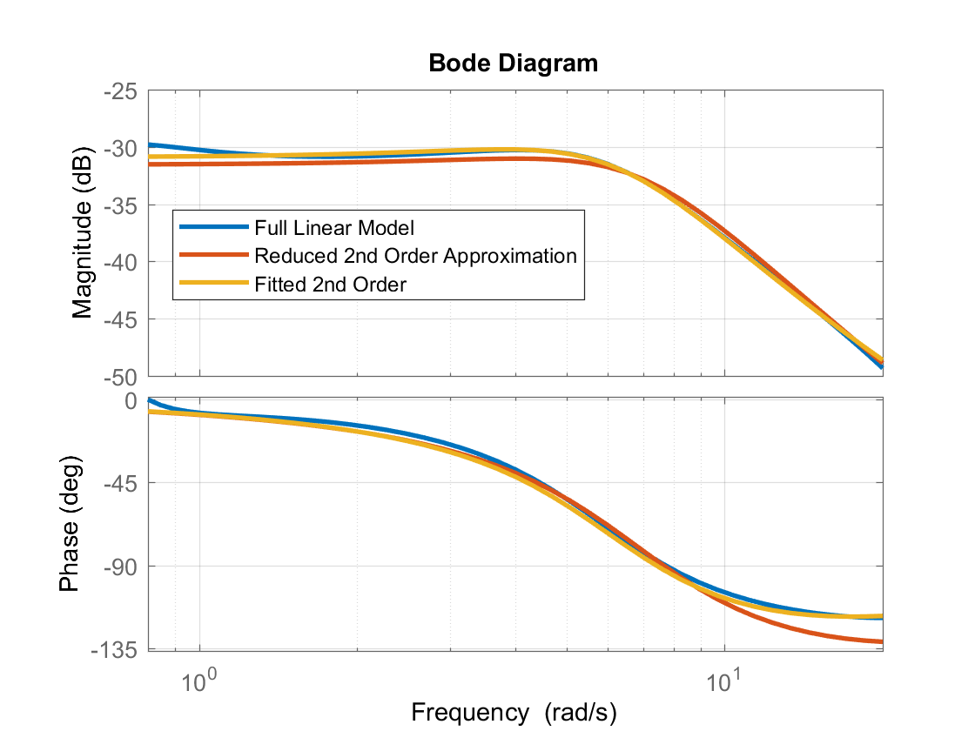
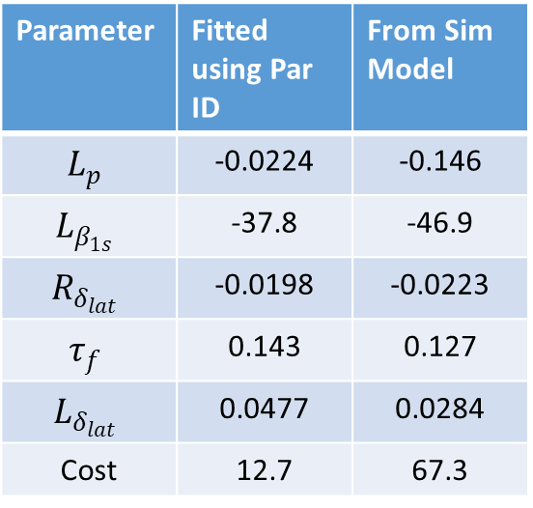
Parameter Identification
The fitted model:
Parameter | Fitted using Par ID | From Sim Model
$$L_{p}$$ | -0.0224 | -0.146
$$L_{β_{1s}}$$ | -37.8 | -46.9
$$R_{δ_{lat}}$$ | -0.0198 | -0.0223
$$τ_{f}$$ | 0.143 | 0.127
$$L_{δ_{lat}}$$ | 0.0477 | 0.0284
Cost | 12.7 | 67.3
Parameter ID is very powerful but the process can be very challenging!
It is almost always a non-convex problem. Need to deal with local minima, convergence issues, sensitivity to initial guess, overfitting, etc …

Slide 13
Script: ParIDExample.m
%Set up notional "Flight Data" frequency response,
%Use linear model between 0.8 and 20 rad/sec
[FltMag,FltPhase,FltOmega]=bode(sys(4,1),{0.8,20.});
FltMagDB=20*log10(squeeze(FltMag));
FltPhase=squeeze(FltPhase);
%Now set up initial guess of parameters based on sim model
Lp=-0.146;
Lb1s=-46.9;
Rdlat=-0.0223;
tauf=0.127;
Ldlat=0.0284;
sysr=ss([Lp Lb1s;1. -1./tauf],[Ldlat;Rdlat],[1 0],0);
par0=[Lp;Lb1s;Rdlat;tauf;Ldlat];
sys
%Test cost function
CostVec=RollFitCost(par0,FltMagDB,FltPhase,FltOmega);
Cost=CostVec'*CostVec
%Increase number of allowable functin calls and iterations
OPTIONS = optimoptions('lsqnonlin','MaxFunctionEvaluations',2000,'MaxIterations',1000);
%Upper lower bounds on parameters helps keep search from finding local minima with unrealistic parameters
LBvec=[-2.;-100.;-0.2;0.05;0.0];
UBvec=[0.;-10.;0.;0.5;0.5];
%Run leastsquares algorithm
par=lsqnonlin(@(par) RollFitCost(par,FltMagDB,FltPhase,FltOmega),par0,LBvec,UBvec,OPTIONS);
%Check cost
CostVec=RollFitCost(par,FltMagDB,FltPhase,FltOmega);
Cost=CostVec'*CostVec
%Construct fitted system and compare bode plots
Lp=par(1);
Lb1s=par(2);
Rdlat=par(3);
tauf=par(4);
Ldlat=par(5);
sysFit=ss([Lp Lb1s;1. -1./tauf],[Ldlat;Rdlat],[1 0],0);
figure
bode(sys(4,1),sysr,sysFit,{0.8,20.});
legend('Full Linear Model','Reduced 2nd Order Approximation','Fitted 2nd Order');

Slide 14
Function: RollFitCost,m
function Cost = RollFitCost(par,FltMagDB,FltPhase,FltOmega)
%Cost of simple 2 staet filt of roll dynamics
%Model parameters
Lp=par(1);
Lb1s=par(2);
Rdlat=par(3);
tauf=par(4);
Ldlat=par(5);
%Construct system
sys=ss([Lp Lb1s;1. -1./tauf],[Ldlat;Rdlat],[1 0],0);
%Get frequency responses
[Mag,Phase]=bode(sys,FltOmega);
MagDB=20*log10(squeeze(Mag));
Phase=squeeze(Phase);
%Claculate erros
ErrMag=MagDB-FltMagDB;
ErrPhase=mod(Phase-FltPhase+180.,360.)-180.; %This wraps the phase error
Cost=[ErrMag;ErrPhase/10.]; %Cost Vector

Slide 15
Trim Analysis for S&C Derivatives
Sometimes trim flight data provide us information on certain S&C derivatives
A good example is the use of “Steady Heading Sideslip” maneuvers for analyzing directional and dihedral stability
Flight test procedure:
Trim aircraft at test airspeed
Apply a slight amount of right pedal and left stick to put the aircraft into a sideslip while trying to hold heading rate to 0 (can use Turn and Slip Indicator). Aircraft should be held in a sideslip with an opposing bank angle
Increase pressure on pedal and re-stabilize, repeat until pedal is on stop, reach an envelope limit, or cannot hold steady heading
Repeat moving pedal to left
Plot pedal, bank angle, and lateral stick position versus sideslip angle

Slide 16

Steady Heading Sideslip Analysis
The maneuver is based on the following theory
In trim, the angular rates and state derivatives are 0. Can also apply small angle assumption:
Neglect ${N^{′}}_{δ_{lat}}$ . Rearrange to the constraints below:

Slide 17
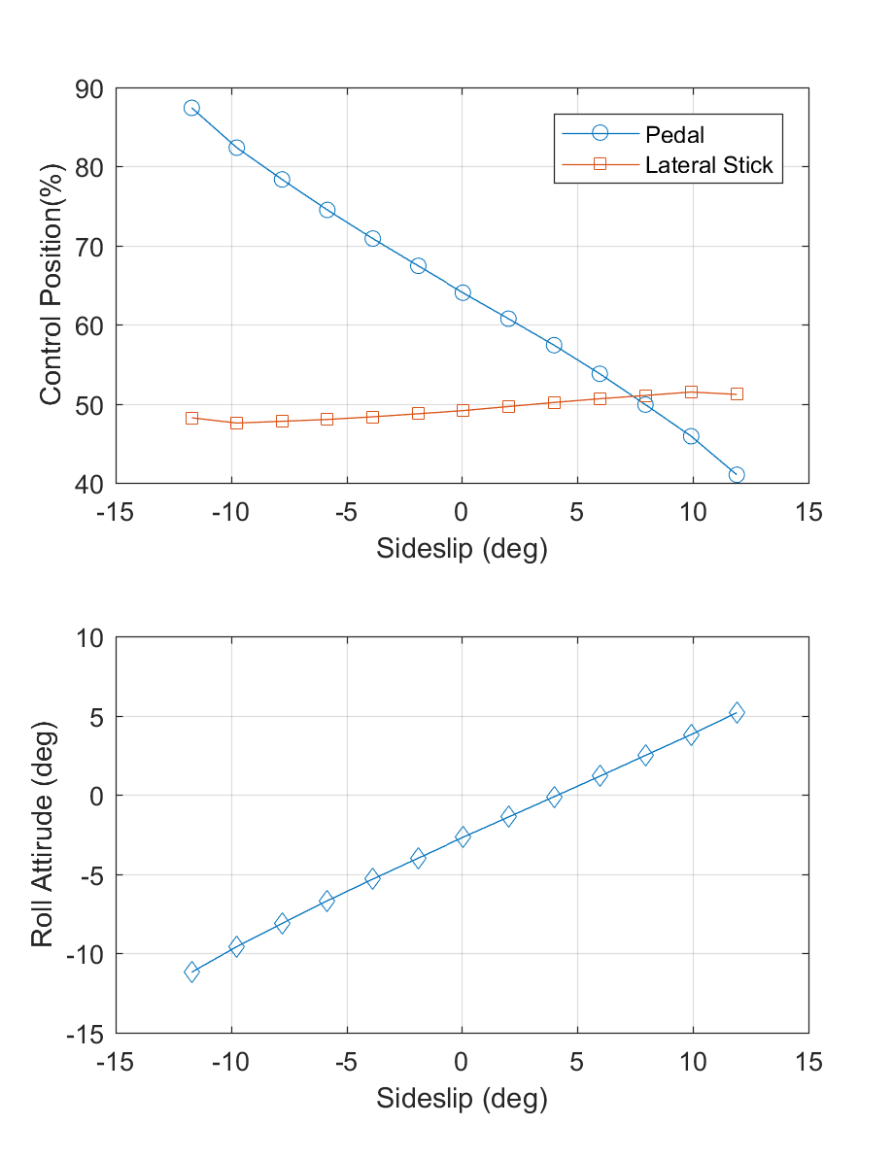
Steady Heading Sideslip Analysis
Remember that the state v is approx. proportional to sideslip angle in forward flight:
The results of the analysis lets us relate the gradients of the controls to certain ratios in the stability and control derivatives (will put in terms of sideslip angle in degrees β°):
The change in side force is often dominated by the Y_{v} term:
Side Slip Trims of UH-60 Sim

Slide 18
%Init model first in hover so trim settings are for fixed heading and prescribed sideslip trim (will solve for phi)
%Steady Heading Sideslip Sweep
H60_sim_init; %Enter 0
% Trim the aircraft at 0 sideslip and 120 knots
nB=13;
posbetas=[-12:2:12];
Vel=120*1.688;
saveX=zeros(constants.NSTATES,nB);
saveU=zeros(constants.NCTRLS,nB);
for ib=1:nB
beta=posbetas(ib)
targ_des(10)=Vel*cosd(beta);
targ_des(11)=Vel*sind(beta);
%Trim target is just state derivative vector in this case
[x0,u0,itrim]=trimmer('uh60',x0,u0,targ_des,constants);
saveX(:,ib)=x0;
saveU(:,ib)=u0;
end
%Resulting betas from the sweep
betaT=180/pi*asin(saveX(2,:)./sqrt(saveX(1,:).^2+saveX(2,:).^2+saveX(3,:).^2));
figure
subplot(2,1,1);
plot(betaT,saveU(4,:),'o-');
hold on;
plot(betaT,saveU(1,:),'s-');
grid on;
xlabel('Sideslip (deg)');
ylabel('Control Position(%)')
subplot(2,1,2);
plot(betaT,180/pi*saveX(7,:),'d-');
xlabel('Sideslip (deg)');
ylabel('Roll Attirude (deg)')
grid on;
%Get linear model and S&C Derivs
targ_des(10:11)=[Vel;0.];
[x0,u0,itrim]=trimmer('uh60',x0,u0,targ_des,constants);
[F,G,M,A,B,C,D]=linearize('uh60',x0,u0,xdot0,constants);
s8model;
%Estimated slopes based on linear model
dpdb_est=-Alat(3,1)/Blat(3,2)*x0(1)/57.3;
dldb_est=-(Alat(2,1)-Blat(2,2)*Alat(3,1)/Blat(3,2))/Blat(2,1)*x0(1)/57.3;
dphidb_est=-Alat(1,1)*x0(1)/32.17;

