Slide 1
Rotorcraft Flight Control Design Part 1
Focus on design of AFCS to meet ADS-33 design requirements using the modeling tools we have developed to date
Focus on Explicit Model Following (EMF) controller
In explicit model following (and many other control design methods), the controller attempts to make the dynamics follow a prescribed reference model (aka ideal response model, command model, command filter)
It uses both feedforward and feedback compensation to achieve this.
In explicit model following, the pilot control inceptor is fed into the reference model to determine the desired state response
An inversion is used to determine the control effector change to follow the reference model
Classical feedback is used to maintain stability, reject disturbances, and account for modelling error in the inversion
The reference model can be select based on ADS-33, we will show this specifically for the bandwidth requirement. We typically select a simple linear system (at least in initial design)

Slide 2
Simple Pitch Dynamics Example
Consider the simple first order pitch rate model with equivalent time delay. The pitch attitude is just the integration of pitch rate:
When we construct the Bode diagram of the pitch attitude frequency response, we know that the magnitudes and phase simply sum up the various components of the transfer function:
Consider pitch dynamics with the following properties:

Slide 3
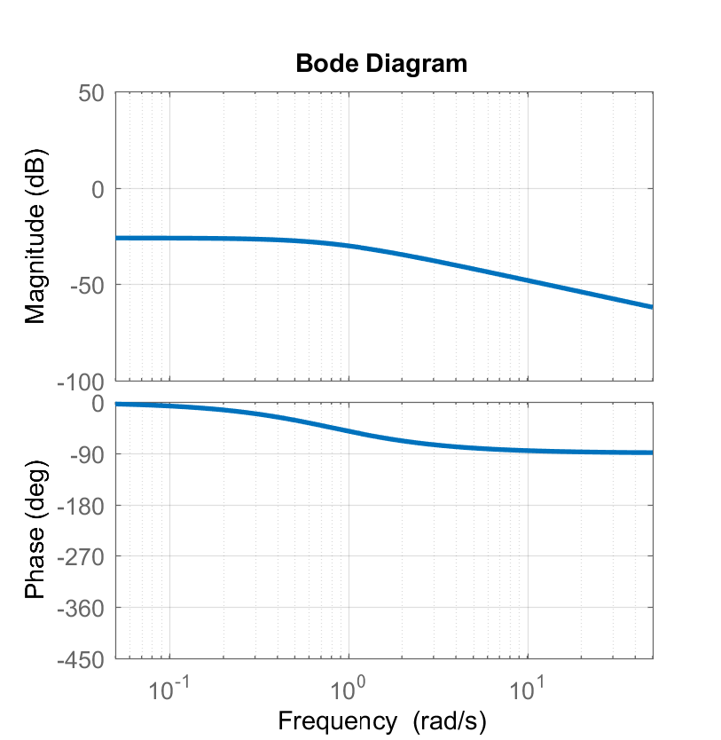
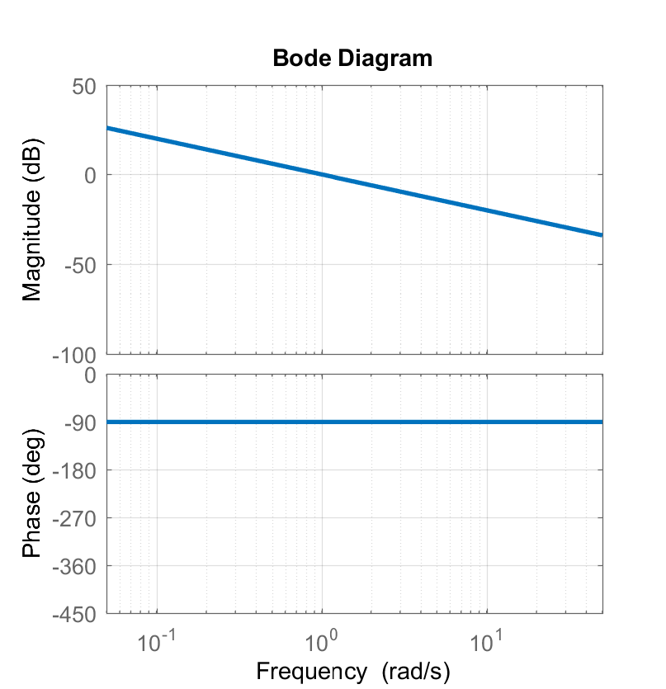
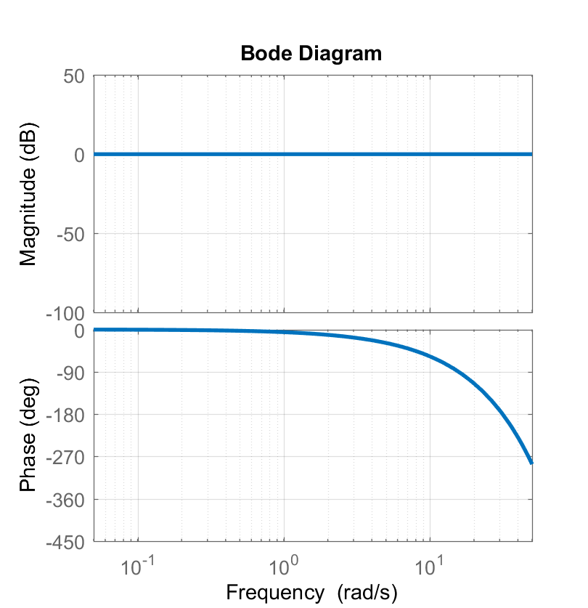
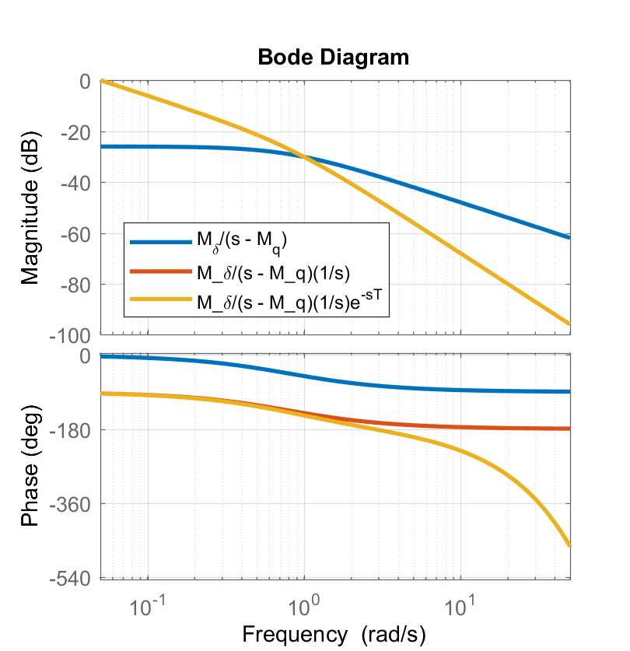
Simple Pitch Dynamics Bode Diagrams
+
+
=

Slide 4
Bandwidth Analysis of Simplified Pitch Dynamics
Phase Margin Bandwidth is where attitude dynamics phase passes through -135°
For pitch rate dynamics, with no phase delay the phase passes through -45° at exactly ω = -M_{q}
The integrator added to pitch attitude dynamics shifts the phase down by exactly -90° relative to the rate dynamics, such that phase passes through -135° at exactly ω = -M_{q}. Thus, without a phase delay the bandwidth is defined by:
The added phase delay shifts the -135° phase crossing shifts slightly to the left. The phase margin bandwidth can be solved from this equation:
BW = 0.690 rad/sec
BW = -M_{q} = 0.8 rad/sec without phase delay
τ_{p} = 0.074

Slide 5
Model Following
Lets design an ideal response for the pitch rate response that meets Level 1 HQ in the ADS-33 Pitch Axis Bandwidth requirement for rotorcraft performing target tracking and acquisition. Will use a simple 1st order reference model:
Will use an inverse plant model to achieve this ideal response
Aircraft Dynamics
Ideal Response

Slide 6
Model Following
Will invert our plant model. We know that this plant model is an approximation (we never know the exact vehicle dynamics, and this one is a very low order approximation):
Putting the inverted plant model in series with the ideal response model and the actual plant:
In theory, if our plant model is exact, the system will follow the ideal response model exactly.
G_{ideal}(s)
δ(t)
G(s)
q(t)
q_{cmd}(t)
-
Plant
Controller

Slide 7
Model Following
There are two issues with the inverted plant model:
The plant model is an “improper” transfer function. The numerator has higher order then the denominator. We would call this a “1st over 0th order transfer function”, based on the numerator and denominator polynomial order. Such a transfer function requires unfiltered differentiation of a signal, which is not desirable. However, this is an issue we can deal with.
The inverse plant model is “non-causal”. This is because we have a pure phase lead in the inverted transfer function. This is a bigger problem, since it would require the controller to predict what the input was going to be, which is impossible

Slide 8
Model Following
Instead let’s apply inversion without the phase delay. The resulting dynamics with the controller follows the ideal response but with the phase delay of the plant model:
The resulting BW is just above 2.0 rad/sec
We accept the added phase delay which decreases our Bandwidth slightly.
The phase delay is used to model the higher order dynamics in the rotor system and possibly in the actuators.
We must accept the phase lag due to these systems. It is not good control design practice to try to increase the speed of response of the actuators and rotor.

Slide 9
Model Following Controller
So far, we have focused only on feedforward control. This can be helpful for following the pilot commands, but …
It will not stabilize the rotorcraft
It will not reject disturbances
It will be susceptible to modeling error since we expect perfect inversion of the plant model
Will now augment the controller with feedback compensation:
q_{cmd}(t)
G_{ideal}(s)
+
δ(t)
q(t)
G(s)
-
+
K(s)
Plant
q_{ref}(t)
e(t)
q(t)
+
-
Feedback Compensation
Feedforward Compensation
Equivalent Time Delay

Slide 10
Model Following Controller
Consider the case where the feedback signal is zero, K(s)e(s)=0. If our plant model is perfect (and by extension our inverse plant model is perfect) the response will follow the ideal response model with the phase delay:
Note, that we add the equivalent phase delay when constructing the reference signal for pitch rate. With this addition, it turns out the tracking error will be exactly zero if we have a perfect plant model:
The idea of Explicit model following control is that the inverse plant model does most of the job getting the plant dynamics to follow the ideal response model, and the system is less reliant on feedback.

Slide 11
Model Following Controller
Note that the feedback loop is isolated from the ideal response model and inverse plant model:
The feedback compensator, K(s), can be designed separately using only the plant model. This can be designed to meet requirements on:
Eigenvalue location
Stability margins
Disturbance rejection requirements
While feedforward (inverse plant and ideal response models) take care of the response to pilot input
Plant
+
δ(t)
q(t)
G(s)
+
K(s)
Feedback Loop
e(t)
-

Slide 12
Model Following Controller
For practical implementation, we need a gain to convert pilot inceptor displacement into a command state value. Also, we can replicate the ideal response model after the signal split, so we do not need to implement an improper transfer function for the inversion.
As illustrated for Pitch Rate Command Model Following Controller:
The command gain is selected to get desired stick sensitivity (e.g. 20 deg/sec/inch). Note that the above diagram is exactly equivalent to previous diagram on slide 8, except for the command gain has been added. We will get the same stability and response bandwidth
Cmd Gain
δ_{long}(t)
q_{cmd}(t)
+
δ(t)
q(t)
K_{cmd}
G(s)
Pilot Inceptor
+
K(s)
Plant
q_{ref}(t)
e(t)
q(t)
+
-

Slide 13
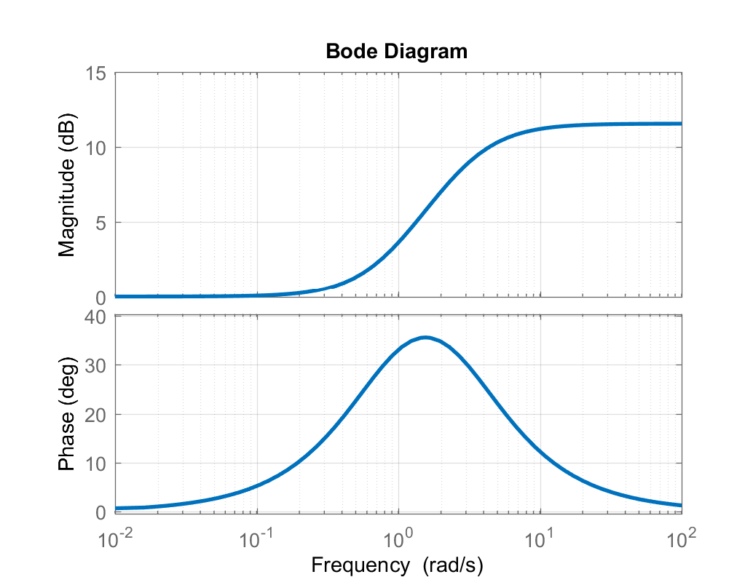
Model Following Controller
In the previous diagram, the feedforward compensation includes the product of the inverse plant model and the ideal response model:
Usually, the controller is set up to increase the Bandwidth of the aircraft. This implies that:
Thus, the feedforward compensator is a “lead compensator”. It adds phase lead:
Bode diagram of lead compensation generated by:

Slide 14
Model Following Controller
How to select compensator, K(s)?
Can use classical control methods, e.g. root locus, stability margin analysis etc …
K(s) could be a simple gain
Or if it helps, could be a PID type compensator
Or a phase lead or phase lag compensator
Could also use modern MIMO design methods that include coupling between different control axes:
LQR
Robust control theory (H₂ / H_{inf} …)
Recent work in rotorcraft control design suggests using a design tradeoff via stability margins and “Disturbance Rejection Bandwidth” (DRB)
Before introducing DRB, we need to add attitude response to the design

Slide 15
Model Following Controller
How could we design a MF Controller with Attitude Command response type?
Just make attitude the command signal. Ideal response type would be a 2nd order transfer function:
Note that in this case, the compensator would need to at least have derivative action to add damping, and should have integrator action to provide attitude hold:
Cmd Gain
δ_{long}(t)
θ_{cmd}(t)
+
δ(t)
θ(t)
K_{cmd}
Pilot Inceptor
+
K(s)
Plant
θ_{ref}(t)
e(t)
+
-

Slide 16
Model Following Control
How about Rate Command / Attitude Hold?
Note that in practice might need to add some non-linear terms to account for attitude kinematics when aircraft is in banked turn
Compensator on pitch should be PI to hold attitude. Note in linear sense, that the feedback compensation is equivalent to comp PID on attitude :
δ_{long}(t)
q_{cmd}(t)
+
δ(t)
q(t)
K_{cmd}
G(s)
Pilot Inceptor
+
+
K_{q}
q_{ref}(t)
+
-
K_{θ}(s)
θ(t)
θ_{ref}(t)
+
-

Slide 17
Disturbance Rejection Bandwidth
DRB is a relatively new criteria that has been suggested for the next version of ADS-33 to provide guidance on disturbance rejection requirements
Note that the feedback compensation will be responsible for holding attitude in the presence of external disturbances (e.g. wind gusts)
DRB considers disturbances on the plant output. A disturbance input is added to measurement of the outer most feedback loop for a hold mode. This is attitude for an Attitude Hold system (could be velocity or position for Velocity Hold or Position Hold modes)
The requirement is based on the frequency response of the attitude output due to the attitude disturbance:
Plant
+
δ(t)
θ(t)
G(s)
+
K(s)
e(t)
+
-
+
θ_{d}(t)
This is also called the “Sensitivity Function” of a feedback system
θ_{o}(t)

Slide 18
Disturbance Rejection Bandwidth
Look at DRB frequency response from our sample pitch attitude dynamics with PID compensation on attitude (will be the same as proportional pitch rate feedback + PI compensation on attitude)
Sensitivity function has the form:
In DRB we will only look at magnitude of the frequency response
The resulting transfer function is 3rd order over 3rd order, with two zeros at the origin (due to s² term). The zeros at origin mean this will have zero DC gain. This will always happen if we use an integrator in the feedback compensator

Slide 19
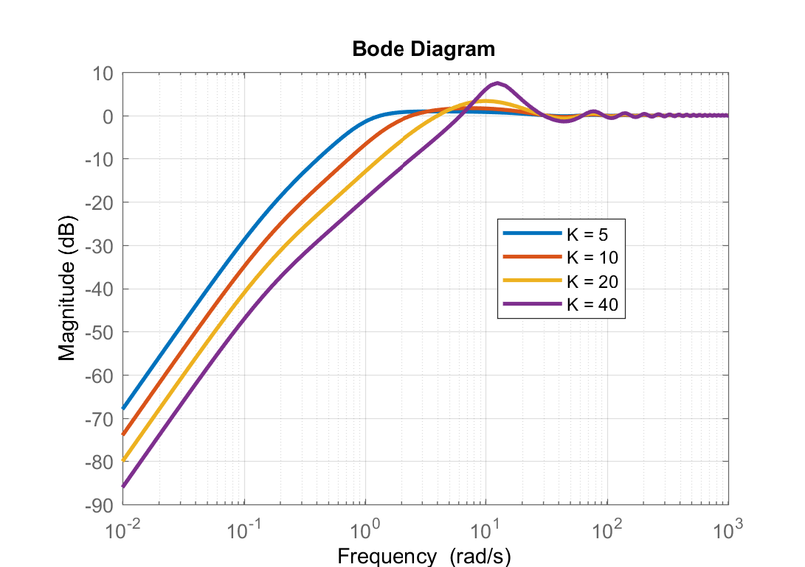
Disturbance Rejection Bandwidth
I am going to select a PID compensator of the following form:
Now look at the DRB magnitude frequency response (magnitude of the sensitivity function) with different gain values K:
DRB is defined as the frequency where the magnitude passes through -3 dB. Note that at lower frequencies DRB -> -∞ ( 0 Gain)
There is also another metric “Disturbance Rejection Peak” (DRP), which is defined as the peak of the magnitude curve
 | DRB (rad/sec) | DRP (dB)
K = 5 | 0.8 rad/sec | 0.92 dB
K = 10 | 1.5 rad/sec | 1.7 dB
K = 20 | 2.7 rad/sec | 3.3 dB
K = 40 | 4.9 rad/sec | 7.5 dB

Slide 20
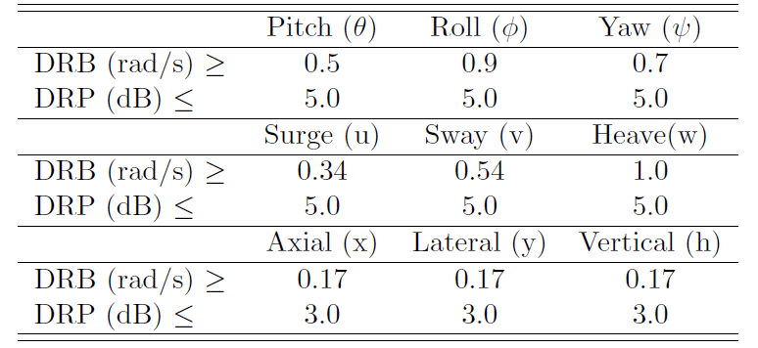
Proposed ADS-33 Disturbance Rejection Requirements
Proposed boundaries for Level 1 HQ for Disturbance Rejection Properties DRB and DRP
The DRB means the aircraft controller can effectively reject disturbances up to that frequency, so higher DRB = Better Disturbance Rejection. Usually comes with higher feedback gain.
The DRP indicates a lack of damping or added overshoot due to the disturbance rejection properties of the controller, so higher DRP = more oscillation and overshoot to Hold modes in controller. High DRP usually a result of excessively high gain. High DRP is also associated with lower stability margins which I will show in next lecture

