Slide 1
Rotorcraft Flight Control Design Part 2
Will look more at EMF flight controller
Analyze feedback loop in terms of trade off in of stability margin and disturbance rejection bandwidth
Look at how to design controller and analyze performance using higher order linear models

Slide 2
SM vs DRB tradeoff
Will continue to look at a simple first order pitch dynamics with time delay:
Will Analyze the feedback loop:
Where the feedback compensator is Proportional-Derivative (PD)
Loop TF and DRB TF are:
Plant
+
δ(t)
θ(t)
G(s)
+
K(s)
e(t)
+
-
+
θ_{d}(t)
θ_{o}(t)

Slide 3
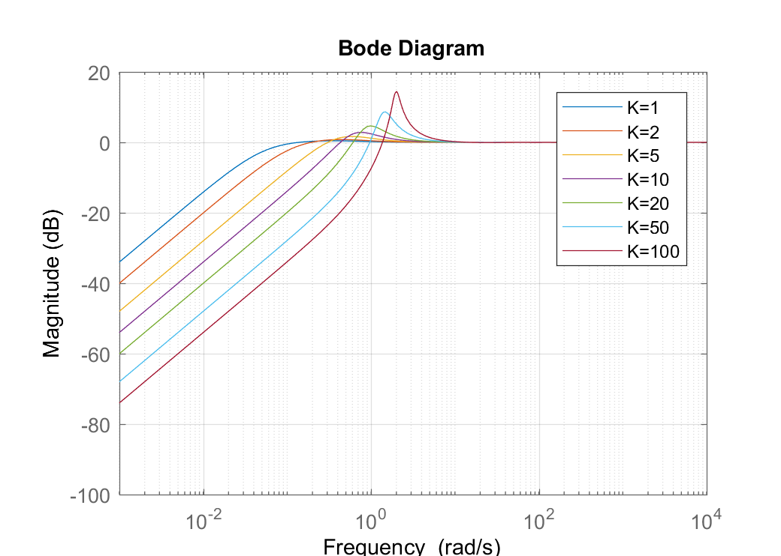
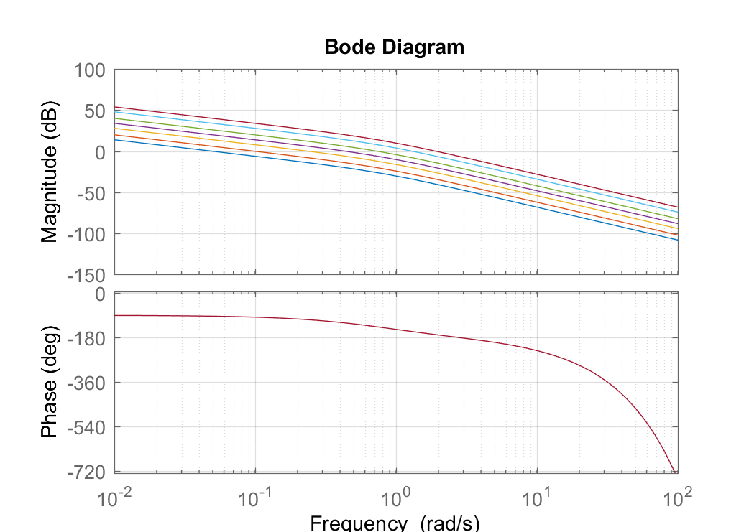
SM vs DRB tradeoff
First assume just proportional gain with no derivative gain (T_{D} = 0) and analyze stability margins and DRB for increasing gain K:
s=tf('s');
sys=0.04*exp(-0.1*s)/(s*(s+0.8));
f1=figure;
f2=figure;
for K=[1 2 5 10 20 50 100]
figure(f1),bode(K*sys), hold all; % Stability Margin Analysis
figure(f2),bodemag(1/(1+K*sys)), hold all; % DRB Analysis
end

Slide 4
SM vs DRB tradeoff
Results of analysis:
Gain, K | DRB (rad/sec) | DRP (dB) | Gain Crossover (rad/sec) | Gain Margin (dB) | Phase Margin (deg)
1 | 0.05 | 0.4 | 0.05 | 46 | 86
2 | 0.09 | 0.8 | 0.099 | 40 | 82
5 | 0.19 | 1.7 | 0.24 | 32 | 72
10 | 0.32 | 2.8 | 0.44 | 26 | 58
20 | 0.50 | 4.7 | 0.74 | 20. | 43
50 | 0.82 | 8.6 | 1.3 | 12 | 24
100 | 1.2 | 14.5 | 1.9 | 6.1 | 12

Slide 5
SM vs DRB tradeoff
Some trends to note in the analysis:
As gain increases DRB goes up, but stability margins go down and DRP goes up. This represents the stability versus disturbance rejection tradeoff
Note that the gain crossover frequency has similar trend as the DRB frequency (gain crossover is a bit higher but trends upward with gain just like DRB)

Slide 6
SM vs DRB tradeoff
Design Choice
Flight control design specifications (SAE 94900) call for 6 dB Gain Margin and 45° Phase Margin
The recommended disturbance rejection properties for level 1 pitch disturbance rejection are:
DRB > 0.5 rad/sec and DRP < 5 dB
Looks like K = 20 almost meets these requirements, DRB and DRP just barely meet requirement, and Phase Margin is just under 45°
However, we should meet the requirement with some additional design margin on DRB (note that this model is very approximate)
Start with K = 50, which has a good DRB above the requirement, but it has poor stability
Then add derivative gain to enhance stability

Slide 7
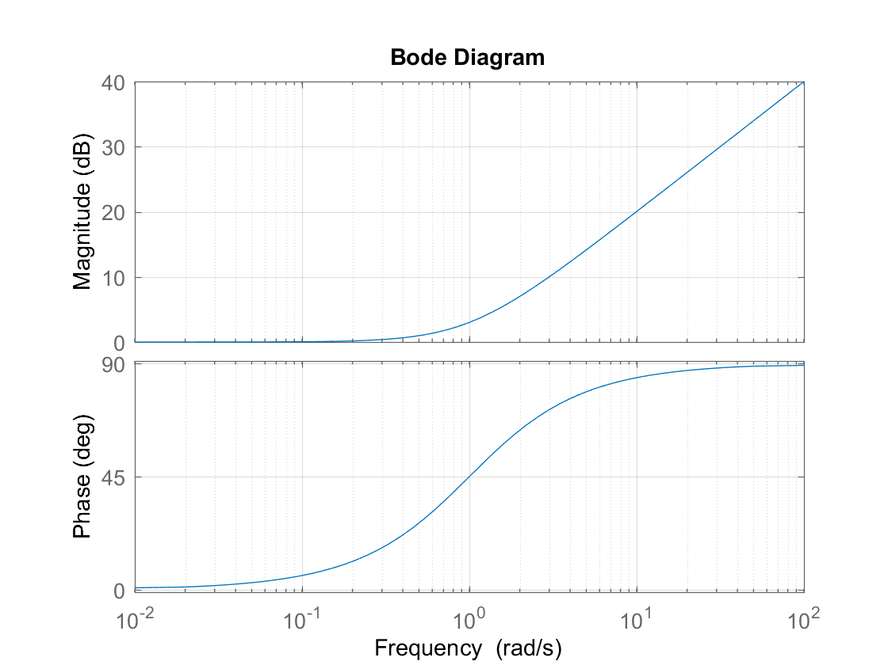
PD Compensator
Note that all of the loop transfer function bode plots have the same phase curve, since we are only increasing gain
If we add a zero to the compensator at a frequency above the gain crossover, we should add phase lead with minimal change in the gain crossover frequency.
For K = 50, gain crossover is 1.3 rad/sec,
Choose T_{D} = 0.5 sec => 1/T_{D} = 2 rad/sec > 1.3
K=50, gain crossover
Want to add phase lead here
Magnitude doesn’t increase much until ω > 1/T_{D}
Bode Diagram for PD Compensator:
Adds 45 deg phase lead at frequency ω =1/T_{D}

Slide 8
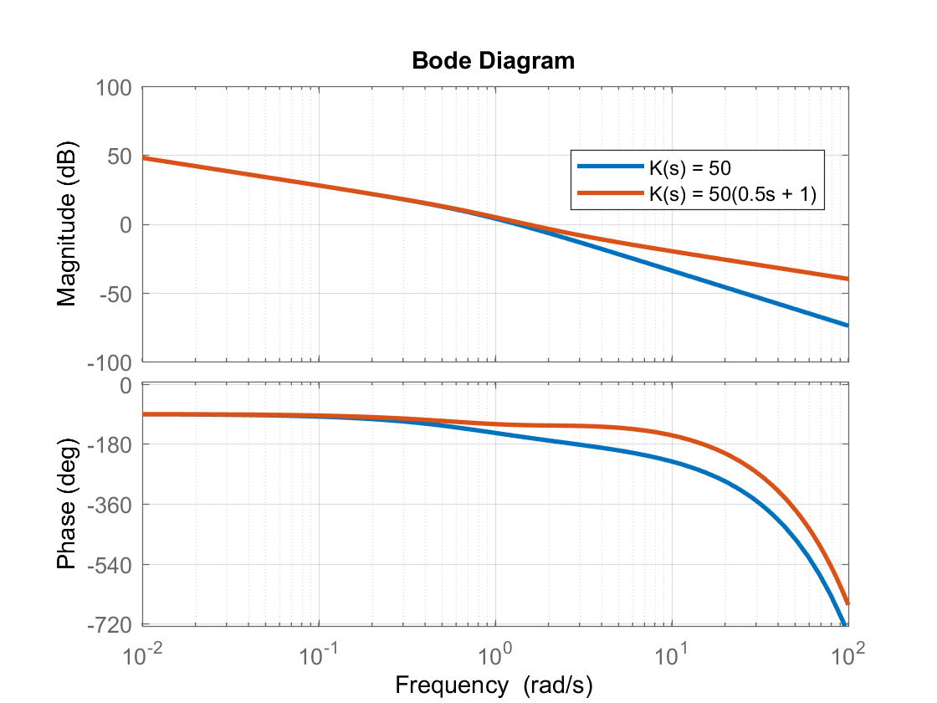
PD Compensator
Look at Bode of loop transfer function. Can see added phase lead. Gain curve increases at high frequency but does not change the gain crossover by much
Easily meet stability margin requirements
Proportional Compensator, K(s) = 50:
Gain Crossover = 1.3 rad/s
Gain Margin = 12 dB
Phase Margin = 24°
PD Compensator, K(s) = 50(0.5 s + 1)
Gain Crossover = 1.48 rad/s
Gain Margin = 23 dB
Phase Margin = 56°
Gain Crossover (frequency where gain is 0 dB)
Phase Lead Added

Slide 9
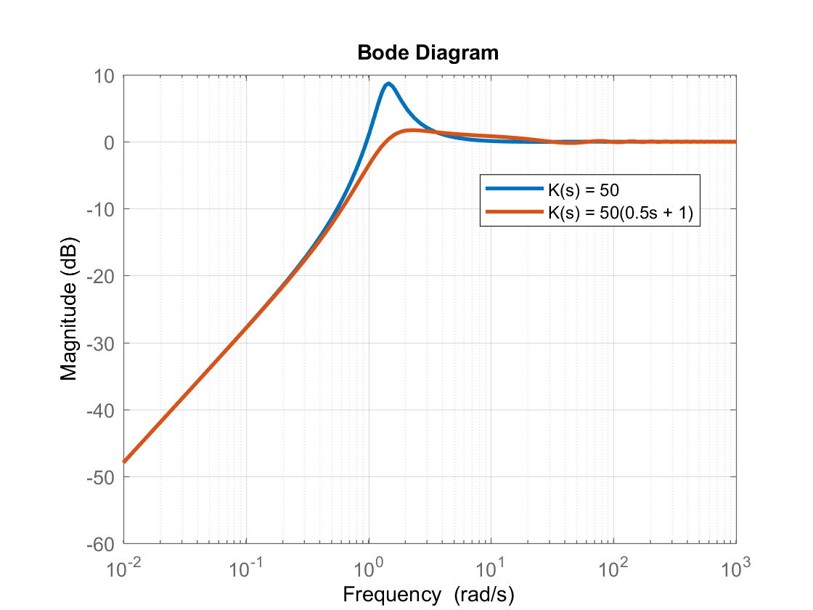
PD Compensator
Also see that the DRP decreases with PD compensator (due to better stability)
DRB also improves due to higher gain increase from PD compensator at high frequency
Proportional Compensator, K(s) = 50:
DRB = 0.82 rad/s
DRP = 8.6 dB
PD Compensator, K(s) = 50(0.5 s + 1)
DRB = 1.04 rad/s
DRP = 1.7 dB

Slide 10
PID Compensator
With this simple model we do not need an integrator, since there is already a pole at the origin in the loop TF (Type 1 system)
For the real aircraft, we will need an integrator in the compensator to hold pitch attitude, as the true dynamics will not have a pole at the origin
A PID Compensator can be written as:
This adds a pole at the origin and two zeros at –z_{I} and -1/T_{D}.
Recall the zero associated with the derivative gain, -1/T_{D}, was chosen to be at a sufficiently high frequency (above the gain crossover) to add phase with minimal impact on gain around the crossover frequency
For the zero associated with integrator, we want the opposite. Put it at a sufficiently low frequency so it adds gain at low frequency, but does not affect the phase around the crossover frequency.
z_{I} = 1/10 of gain crossover after PD design => z_{I} = 0.148 rad/sec

Slide 11
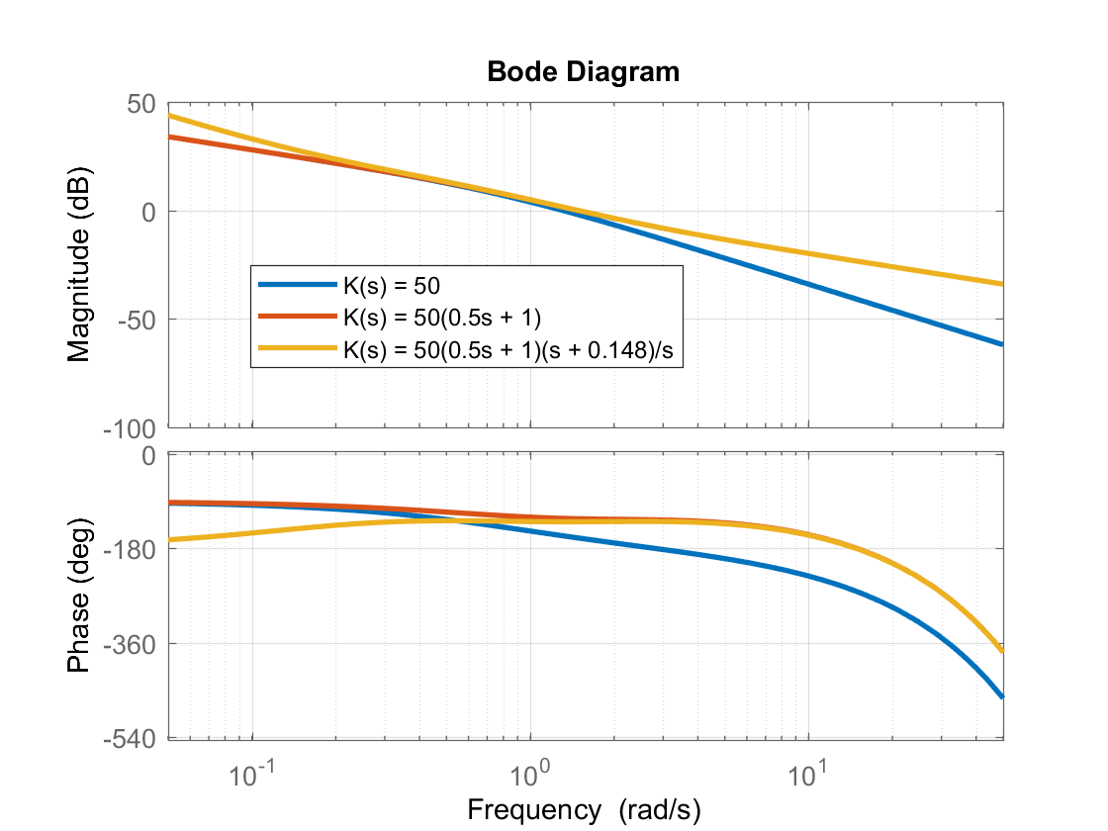
PID Compensator
Bode diagrams for loop TFs
The PID compensator adds an additional pole at the origin, ensuring zero steady-state error in attitude hold.
Integrator phase lag at low frequency but does not degrade stability
PID Margins are almost the same as those of PD
Proportional Compensator, K(s) = 50:
Gain Crossover = 1.3 rad/s
Gain Margin = 12 dB
Phase Margin = 24°
PD Compensator, K(s) = 50(0.5 s + 1)
Gain Crossover = 1.48 rad/s
Gain Margin = 23 dB
Phase Margin = 56°
PID Compensator, K(s) = 50(0.5 s + 1)(s + 0.148)/s
Gain Crossover = 1.48 rad/s
Gain Margin = 23 dB
Phase Margin = 51°

Slide 12
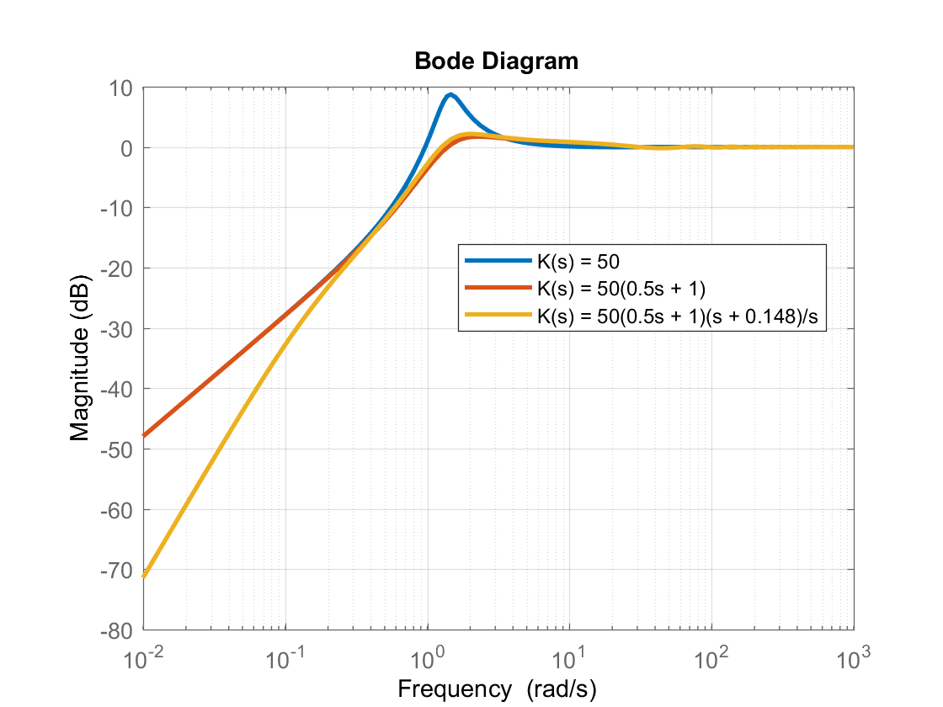
PID Compensator
Retain disturbance rejection properties with minimal changes from PD
Advantage of the integrator is not clear because we are using such a simplified model, but can see slope at low frequency of DRB curve decreases, resulting in better steady-state behavior
Proportional Compensator, K(s) = 50:
DRB = 0.82 rad/s
DRP = 8.6 dB
PD Compensator, K(s) = 50(0.5 s + 1)
DRB = 1.04 rad/s
DRP = 1.7 dB
PID Compensator, K(s) = 50(0.5 s + 1)(s + 0.148)/s DRB = 0.99 rad/s
DRP = 2.2 dB

Slide 13
MATLAB Code
%Define theta/dlong(s)
s=tf('s');
sys=tf(.04,[1 0.8 0])*exp(-0.1*s); %Or can use 0.04/(s*(s+0.8))*exp(-0.1*s);
%Initial gain study
f1=figure;
f2=figure;
for K=[1 2 5 10 20 50 100]
figure(f1),bode(K*sys), hold all; % Stability Margin Analysis
figure(f2),bodemag(1/(1+K*sys)), hold all; % DRB Analysis
end
%Note can check stability margins directly with
%margin(K*sys);
%PD Comensator
KPD= 50*(0.5*s+1);
KPID=50*(0.5*s+1)*(s+0.148)/s;
%Bode SM Analysis of Proportional, PD and PID Compensators
figure;
bode(K*sys,KPD*sys,KPID*sys);
grid on;
legend('K(s) = 50','K(s) = 50(0.5s + 1)','K(s) = 50(0.5s + 1)(s + 0.148)/s');
%DRB Analysis of Prop, PD and PID
figure;
bodemag(1/(1+K*sys),1/(1+KPD*sys),1/(1+KPID*sys));
grid on;
legend('K(s) = 50','K(s) = 50(0.5s + 1)','K(s) = 50(0.5s + 1)(s + 0.148)/s');

Slide 14
Design with Higher Order Model
This analysis has been conducted using a highly simplified model of pitch dynamics.
Can do much of the same analysis using a more complex linear model.
Will demonstrate with a more complex dynamic model derived from the UH-60 sim
Extract 10-state model (with lateral / longitudinal flapping states)
Pull out 5-state de-coupled pitch axis model
Extract 8-state model as well to get S&C derivatives needed for EMF
[F,G,M,A,B,C,D]=linearize('uh60',x0,u0,xdot0,constants);
Ar1=A([1:8 13:21],[1:8 13:21]); % Remove RPM,psi,x,y,z
Br1=B([1:8 13:21],[1 2 3 4]);
%Reduce to 10 state
A10=Ar1([1:8 10 11],[1:8 10 11])-Ar1([1:8 10 11],[9 12:17])/Ar1([9 12:17],[9 12:17])*Ar1([9 12:17],[1:8 10 11]);
B10=Br1([1:8 10 11],:)-Ar1([1:8 10 11],[9 12:17])/Ar1([9 12:17],[9 12:17])*Br1([9 12:17],:);
sys10=ss(A10,B10,eye(10),zeros(10,4));
%De-coupled longitudinal
Along5=Ar([1 3 5 8 10],[1 3 5 8 10]);
Blong5=Br([1 3 5 8 10],[2 3]);
syslong5=ss(Along5,Blong5,eye(5),zeros(5,2));
%8-state model
A8=Ar1([1:8],[1:8])-Ar1([1:8],[9:17])/Ar1([9:17],[9:17])*Ar1([9:17],[1:8]);
B8=Br1([1:8],:)-Ar1([1:8],[9:17])/Ar1([9:17],[9:17])*Br1([9:17],:);
Mq=A8(5,5);
Mdlong=B8(5,2);
T=-1./A10(10.,10.);

Slide 15
Design with Higher Order Model
For the EMF Controller, we need parameters for the inverse model and time delay:
M_{q} – pulled from A matrix of 8-state model
M_{δ} – pulled from B matrix of 8-state model
T - a reasonable estimate of the phase delay is the flapping time constant. This is pulled from the 10-state model. This term might be tuned based on frequency response comparisons with the full order model
Can do feedback compensator design on 5-state longitudinal model. Note that when coupled with full order model, the design may not work initially because of cross-coupling, but once you close loops in the other axes, the cross-coupling is reduced and the design should be good:

Slide 16
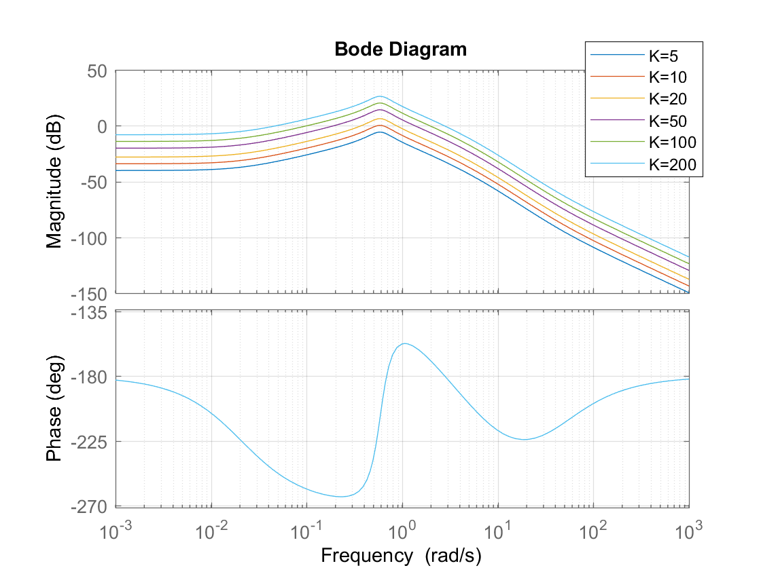
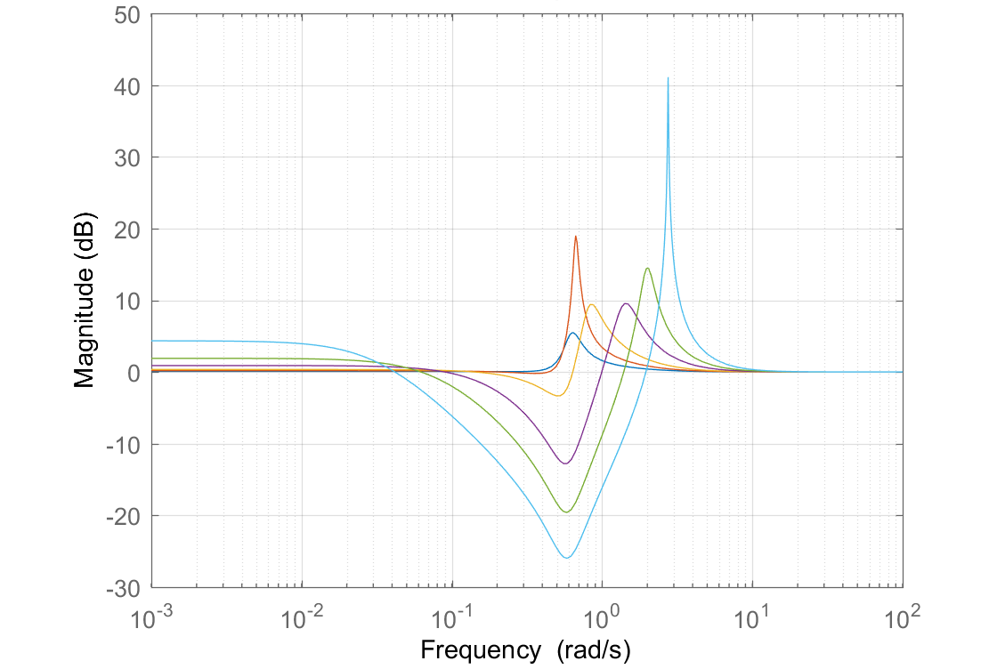
Proportional Gain Analysis
Do a gain study with pitch attitude feedback as we did with simple model:
Note that the stability analysis is more complex. There are two phase crossovers at 0.7 and 2.8 rad/sec.
This is a conditionally stable system.
We will have both a lower limit on the gain (as well as an upper limit)
This makes sense since the open-loop aircraft is unstable. It is also unstable for K = 5 and 10
Note the DRB bode plots do not go to 0 gain at low frequency! We are not able to hold attitude without an integrator.
%Initial gain study
f1=figure;
f2=figure;
for K=[5 10 20 50 100 200]
figure(f1),bode(K*syslong5(4,1)), hold all; % Stability Margin Analysis
figure(f2),bodemag(1/(1+K*syslong5(4,1))), hold all; % DRB Analysis
end
Gain curves need to go above 0 dB for stability (not case for K = 5 and 10)
Two phase crossovers
These do not go to 0 gain (-inf dB) at low frequency, so DRB = 0!

Slide 17
Margin Analysis
Can use “allmargin” in MATLAB to analyze stability margins for conditionally stable systems or can use SISOTOOL
Look for “Stable” flag to see if closed loop is stable
Can see there are multiple gain / phase crossovers, and multiple gain and phase margins
GMFrequency is same as phase crossover frequency
PMFrequency is same as gain crossover frequency
Gain Margins shown are not in dB. GM dB = 20*log10(GM)
allmargin(50*syslong5(4,1))
GainMargin: [10.1569 0.2314 4.1338 Inf]
GMFrequency: [0 0.6852 2.7909 Inf]
PhaseMargin: [-83.5237 20.2475]
PMFrequency: [0.1931 1.3512]
DelayMargin: [24.9952 0.2615]
DMFrequency: [0.1931 1.3512]
Stable: 1

Slide 18
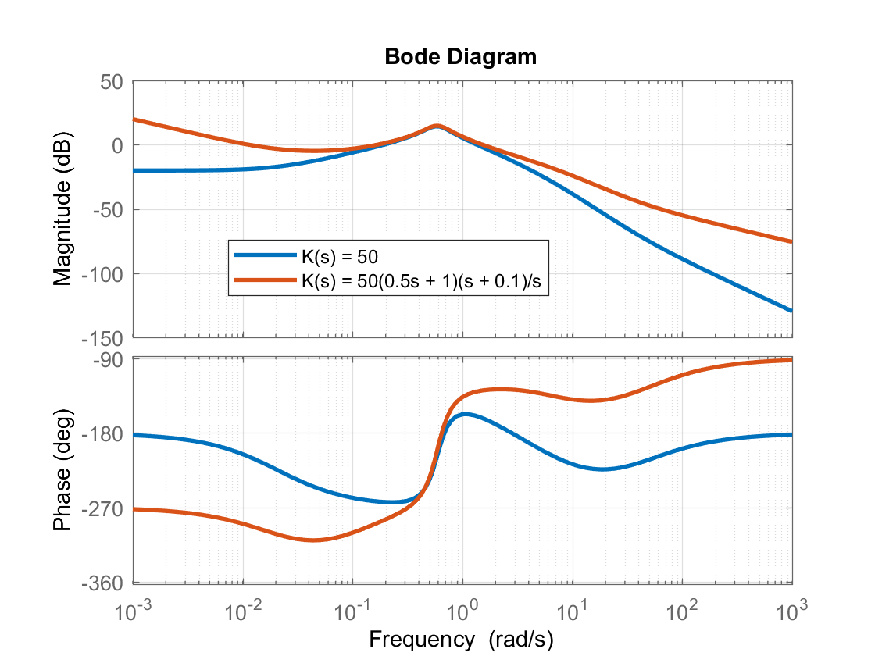
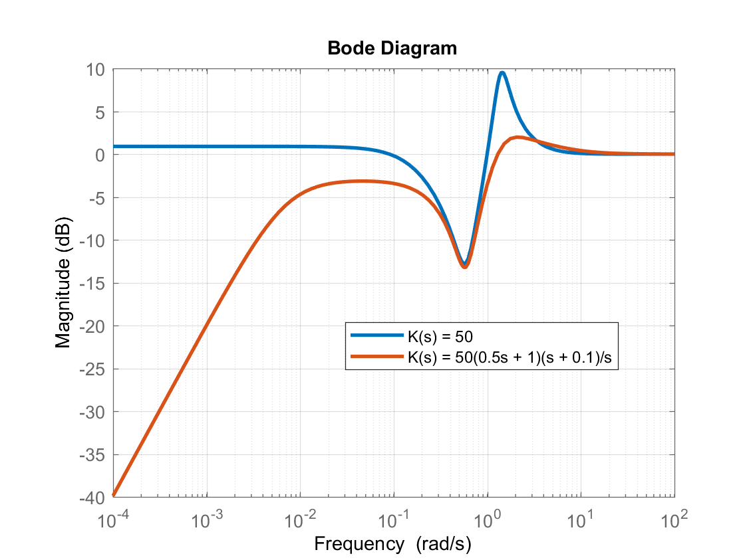
PID Design
Will now use PID compensator
The proportional gain of K = 50 shows promise, as it the DRB curve passes through -3 dB around 0.9 rad/sec, but then the magnitude goes back up due to lack of integrator
Gain crossover with K = 50 is 1.4 rad/sec, but phase margin is only 20°
Select PID compensator:
Bode Plot of Loop TF
DRB Plot

Slide 19
Summary of Feedback Design
PID design has DRB around 1 rad/sec and DRP is 2 dB
Phase Margin is 51° for gain crossover at 1.52 rad/sec
But … the closed loop system with PID is actually unstable! Can see this with allmargin command.
Closed loop system has pole at +0.007, which is just slightly divergent
Why? Pilot commands a change in pitch attitude. The PID controller will ensure that attitude is held. The rotorcraft cannot possibly return to trim, and in fact according to linear model, the velocity will slowly diverge. Controller would need a velocity hold to stabilize
In non-linear dynamics, quite possible the system would stabilize
Shows the challenges and limitations of control design
However, for a piloted aircraft it is possible this slow divergence would be acceptable (pilot can stabilize the mode)

Slide 20
EMF Controller
Now we will add the feedforward part of the controller to achieve ACAH response type
This could readily be done in Simulink, but I will construct using LTI objects in MATLAB
+
δ(t)
θ(t)
θ_{cmd}(t)
+
K(s)
Plant
θ_{ref}(t)
e(t)
+
-

Slide 21
MATLAB Construction of EMF Controller
Note that the controller can be written equivalently as:
+
+
δ(t)
θ(t)
θ_{cmd}(t)
+
-
K(s)
Plant
K(s)
%Closed loop system
syscl=feedback(syslong5(4,1),KPID);
eig(syscl); %Can see unstable eigenvalue here
%Construct complete system
%Ideal response time constant
wn_ideal=2.;
zeta_ideal=0.8;
%Inversion
sys_inv=(s-Mq)*s/Mdlong*wn_ideal^2/(s^2+2*zeta_ideal*wn_ideal*s+wn_ideal^2);
%Model
sys_mod=exp(-T*s)*wn_ideal^2/(s^2+2*zeta_ideal*wn_ideal*s+wn_ideal^2);
% Complete Model Following System form pitch command to pitch attitude output
sys_MF=syscl*(sys_inv+KPID*sys_mod);
%This takes care of pole zero cancellations
sys_MF=minreal(sys_MF);
%Frequency response from theta_cmd to theta, also compare to ideal response
figure;
bode(sys_MF,sys_mod);
THIS CONSTRUCTS SYSTEM ABOVE

Slide 22
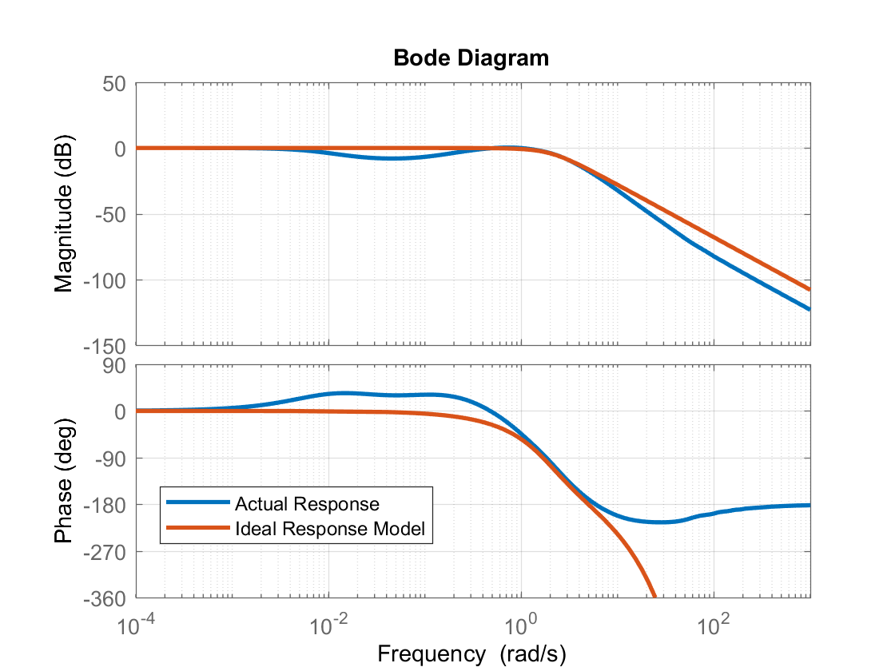
Closed Loop
Closed Loop Bode shown below
Note low frequency gain is 0 dB, θ = θ _{cmd} in steady-state
But dip in gain around 0.1 rad/sec is not good. Controller might need more tuning
Bandwidth is about 3 rad/sec, which easily meets requirement. The ideal response model passes though -90° at the natural frequency of the ideal response model ω_{n} = 2 rad/sec. So it exceeds requirement.

