Slide 1
Stability with Feedback
Will study behavior of rotorcraft with feedback control
Two motivations:
  Feedback control design is important for modern rotorcraft engineering, because so many rotorcraft now feature some type of Automatic Flight Control System (AFCS) that uses feedback
  Feedback control theory is also used to understand how a pilot controls a rotorcraft, and is therefore integral to understanding rotorcraft handling qualities
Most rotorcraft are inherently unstable over some portion of the flight envelope, so they must be stabilized either by a pilot or an AFCS (or sometimes both)

Slide 2
Stability with Feedback
Standard structure of a feedback controller, with compensation in the forward path. The helicopter dynamics are the “plant”:
The compensator can be as simple as a gain, or can include some kind of internal dynamics, or even much more complex logic and non-linear dynamics
We will mainly focus on linear control theory and linear feedback compensation that can be expressed in the form of either a state space system or a transfer function.
Consider the components of the feedback system, K(s) and G(s), as classical transfer functions.
Signals can also be represented by their Laplace transforms:
Signals
r(t) = reference command
e(t) = tracking error
u(t) = control input
y(t) = output
r(t)
+
e(t)
K(s)
u(t)
G(s)
y(t)
-
Compensator
Plant

Slide 3
Stability with Feedback
Signals are related as follows:
The Closed Loop Transfer Function (CLTF), M(s), can be derived as:
In general, these can be MIMO transfer functions (transfer function matrices) and vector signals
However, we will mostly use SISO analysis:
The Open Loop Transfer Function (OLTF or just “loop transfer function”) is just the product of the plant and compensator:
The closed loop poles are governed by the roots of:
Suppose the compensator is just a constant (or gain), K, we can look the variation in the poles with this parameter. This is a root locus:

Slide 4
Stability with Feedback
The transfer functions are usually a ratio of a numerator polynomial, N(s), and a denominator polynomial, D(s)
Implies as that when K = 0, branches initiate at roots of D(s), i.e. the open loop poles.
And as K -> ∞ branches either approach the roots of N(s), the transmission zeros of the G(s), or they run along asymptotes where the roots grow infinitely large.

Slide 5
Stability with Feedback
Generating Root Loci in MATLAB:
  rlocus(sys); %Draws root locus and complementary root locus
  rltool(sys,1); %Interactive root locus with negative feedback + positive gain
  rltool(sys,-1); %Interactive root locus with negative feedback + negative gain (complementary root locus)
  sisotool(sys); %Like rltool but does a lot of other stuff
Note that sys is the loop transfer function and not the closed loop transfer function
All of these tools require sys be SISO (Single Input / Single Output)
rltool allows you to interactively change gain and move poles and zeros. It is generally more useful than rlocus
Often need to use zoom and pan tools to focus on portions of root locus of interest
Root loci usually have some branches that run move off to infinitely large values, so selecting appropriate axis scales (zoom) is important

Slide 6
Example: Longitudinal Dynamics of UH-60 in Hover
Know that the UH-60 has an unstable mode in hover, related to the longitudinal hover phugoid mode
Will attempt to stabilize the mode with feedback
Try stabilizing via longitudinal speed feedback
The gain K is in (% long. stick) / (long. speed in fps)
sys_udlong =
-0.17048 (s+0.3478) (s^2 + 0.3362s + 7.112)
---------------------------------------------
(s+1.123) (s+0.3482) (s^2 - 0.2839s + 0.3151)
The roots of this term are in RHP
u_{cmd}(t)
+
δ_{long}(t)
u(t)
K
G(s)
-

Slide 7
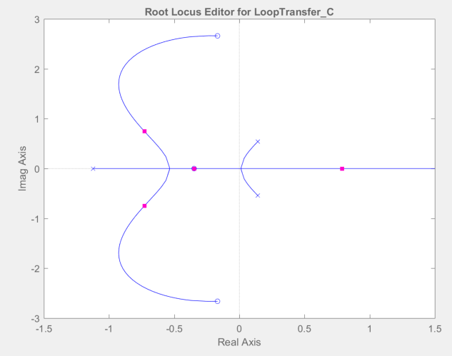
Example: Longitudinal Dynamics of UH-60 in Hover
Trim UH-60 model and extract the decoupled 4 state model of the longitudinal dynamics. Apply rltool
G=syslong(1,1); Pulls out u/dlong(s) T.F.
rltool(G); Assumes negative feedback / positive gain
We see the following root locus:
Can interactively move magenta squares – this is changing the gain K
As K increases CL poles approach zeros are move out along an asymptote
In this case there is a branch always in RHP, Unstable!
Location of closed-loop poles with K = 1
Open Loop poles (K = 0)
Loop TF zeros (roots of numerator)

Slide 8
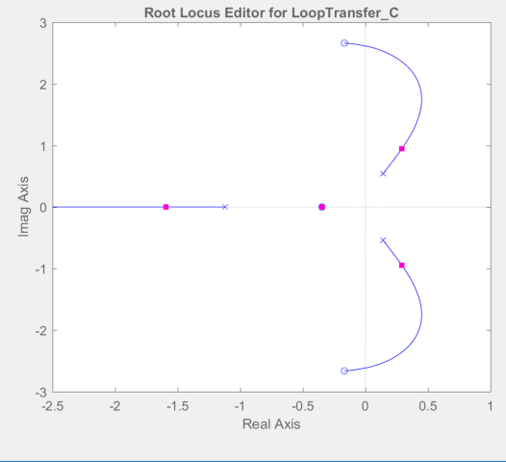
Example: Longitudinal Dynamics of UH-60 in Hover
Why can’t we stabilize? In this case we are using a gain with the wrong sign. Need a negative gain. Why?
Recall that positive longitudinal cyclic, δ_{long} > 0 ,leads to nose up change in pitch attitude, Δθ > 0. This will tend to make the rotorcraft accelerate backwards, a negative change in long. speed, Δu < 0
Thus, the feedback control strategy will not work. Need a negative gain.
Use the following:
rltool(G,-1); Uses negative gain
%OR
rltool(-G); Will result in the same root locus
Will stabilize with K < -120 % / (ft/sec)
Is this practical?
Approximate pole zero cancellation for the heave mode. So this pole does not move

Slide 9
Example: Longitudinal Dynamics of UH-60 in Hover
Feedback control via velocity feedback is not practical.
The gain is extremely large – would use full control through for less than 1 ft/sec tracking error in velocity!
Even if stabilized with extremely high gain the closed loop poles would have a pair of complex poles (oscillatory mode) with damping ratio around 0.06 and frequency of 2.7 rad/sec. This is very poor damping
Suppose there is no AFCS, and pilot acts as feedback system: A pilot cannot control a rotorcraft using only compensation on position or velocity. Need to control attitude as well.
Repeat exercise using attitude feedback:
The gain K_{θ} is in (% long. stick) / (pitch attitude in radians)
θ_{cmd}(t)
+
δ_{long}(t)
θ(t)
K_{θ}
G(s)
-

Slide 10
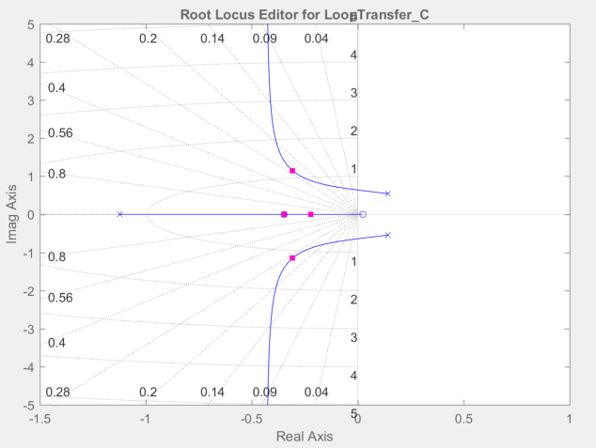
Example: Longitudinal Dynamics of UH-60 in Hover
Get transfer function from cyclic to pitch attitude:
rltool(syslong(4,1))% No need for sign change in gain
Apply root locus method:
Max damping achieved for gain around K = 40 % / radian (or 0.7 % / deg)
Mode ω_{n} = 1.17 rad/sec, ζ = 0.26
Damping is still not great

Slide 11
Example: Longitudinal Dynamics of UH-60 in Hover
How can we do better?
We need more damping in pitch. This can be achieved by pitch rate feedback. Could be achieved via pilot (increases pilot workload), or via a type of AFCS called a Stability Augmentation System (SAS)
In older rotorcraft, pitch and roll rate damping have also been enhanced by a type of mechanical feedback system - a stabilizer bar.
System with rate feedback can be represented as a multi-loop feedback system with “inner” and “outer” feedback loops.
Will use known linearized kinematics of pitch attitude:
Inner Loop
ν (t)
θ_{cmd}(t)
+
δ_{long}(t)
q(t)
θ(t)
K_{θ}
G(s)
-
K_{q}

Slide 12
Example: Longitudinal Dynamics of UH-60 in Hover
Can derive the closed loop transfer function:
Have two gains we want to find, cannot apply classical root locus
Will apply successive loop closures, starting with the inner loop.

Slide 13
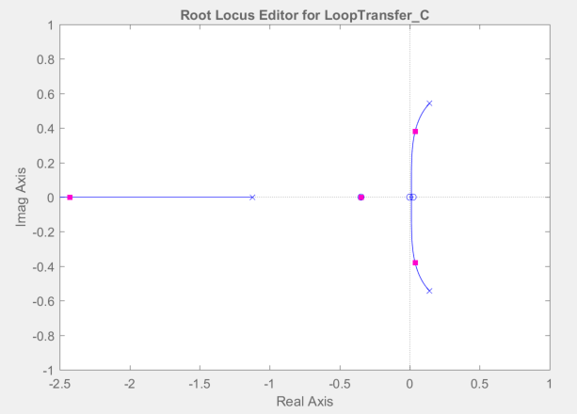
Example: Longitudinal Dynamics of UH-60 in Hover
First decrease instability of hover phugoid with rate feedback (note that it will not stabilize the poles) but will reduce frequency and decrease rate of divergence
rltool(syslong(3,1))
Then create system with the rate feedback loop closed
sys2=feedback(syslong(3,1),40.)
Selected gain of K = 40 % / radian /sec
Still unstable (cannot stabilize) but poles “less unstable”
This creates this TF

Slide 14
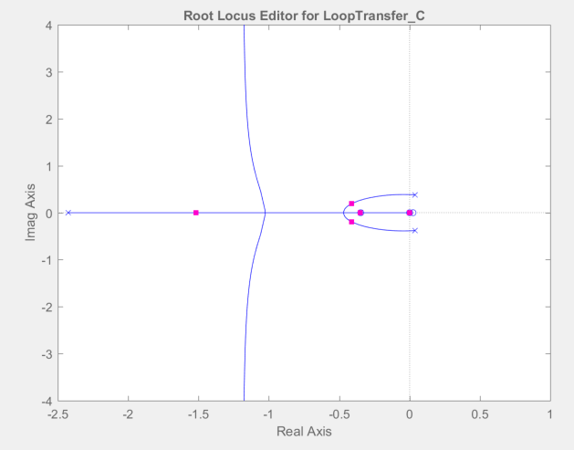
Example: Longitudinal Dynamics of UH-60 in Hover
Now create loop transfer function for pitch attitude feedback by multiplying by integrator:
sys3=tf(1,[1 0])*sys2
Apply root locus to this system:
This creates this TF
Selected gain K = 40 % / radian (or 0.7 % / deg) again
Oscillatory mode: ω_{n} = 0.46 rad/sec, ζ = 0.91
Much more well damped
Could iterate (revisit rate gain) if desired
Final closed loop system defined by:
syscl=feedback(40.*sys3,1.)

