Slide 1
Frequency Domain Analysis
Will take a closer look at frequency domain analysis as it plays an important role in S&C analysis, handling qualities, and feedback control of rotorcraft
Bode diagrams (frequency response of magnitude and phase plotted on a log scale) provide a broad amount of information on rotorcraft dynamics
Note that in Bode diagrams, we use a log scale on the frequency axis (the x-axis) which allows us to see dynamics across a wide range of frequencies (or time scales)
The magnitude plot is expressed in dB (20*log10(X)) which effectively makes it a log scale
The phase is plotted on a linear scale, traditionally in increments of 45° or 90°
Bode diagrams reveal resonant peaks associated with oscillatory modes (complex eigenvalues) as well as notches associated with complex zeros.
Bode diagrams can also reveal the stability and relative stability of a system both with and without feedback
You should consult supplementary notes that provided on how different parts of a linear system transfer function affect the shape of the Bode plot

Slide 2
Basics of Frequency Response
Consider a linear system driven by a sinusoidal input:
Can show that if the system is stable, then the steady-state response of the system will also be sinusoidal with the same frequency as the input but different amplitude and phase.
If we vary the input frequency, the magnitude (or gain) and phase shift will vary according to well known relationships:
u(t)=Asin(ωt)
G(s)
y(t)

Slide 3
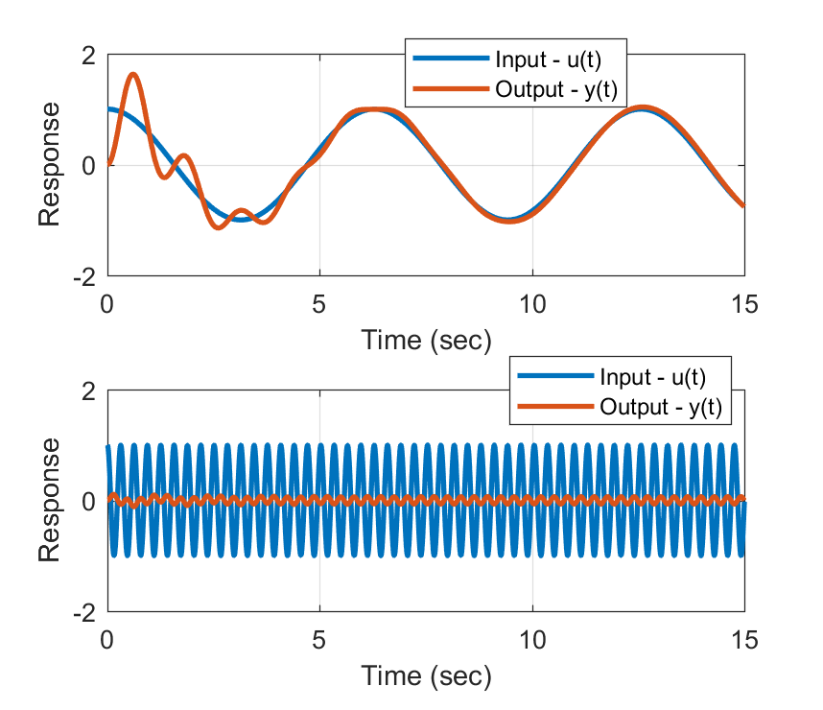
Basics of Frequency Response
Example time responses of a 2nd order system:
Transient Response
ω = 1 rad/sec
ω = 20 rad/sec

Slide 4
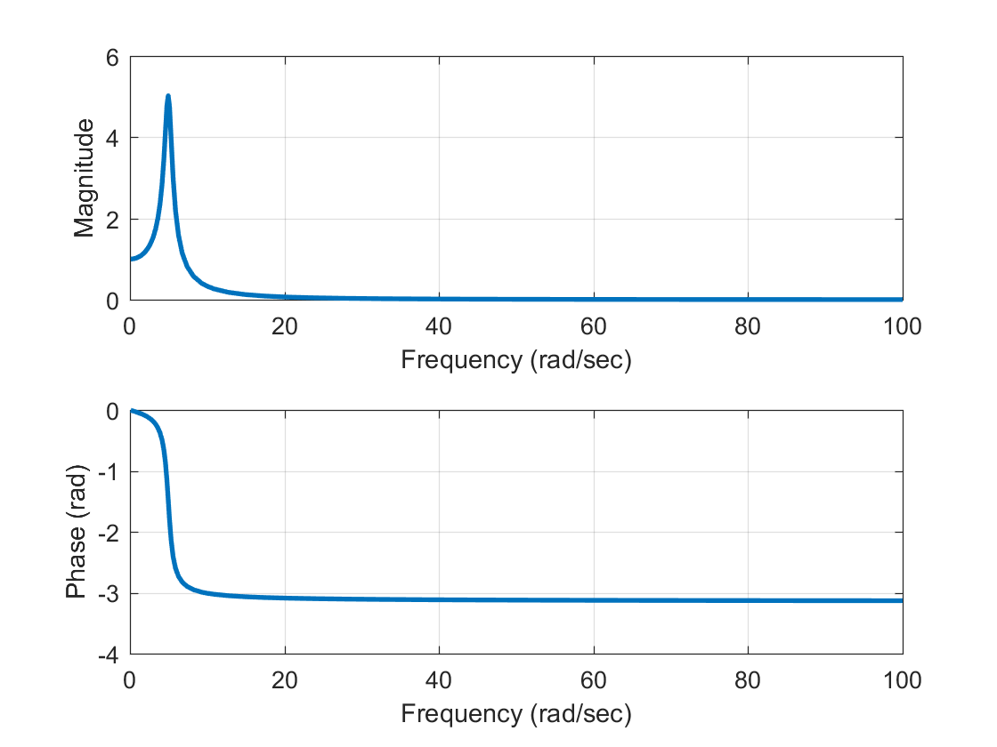
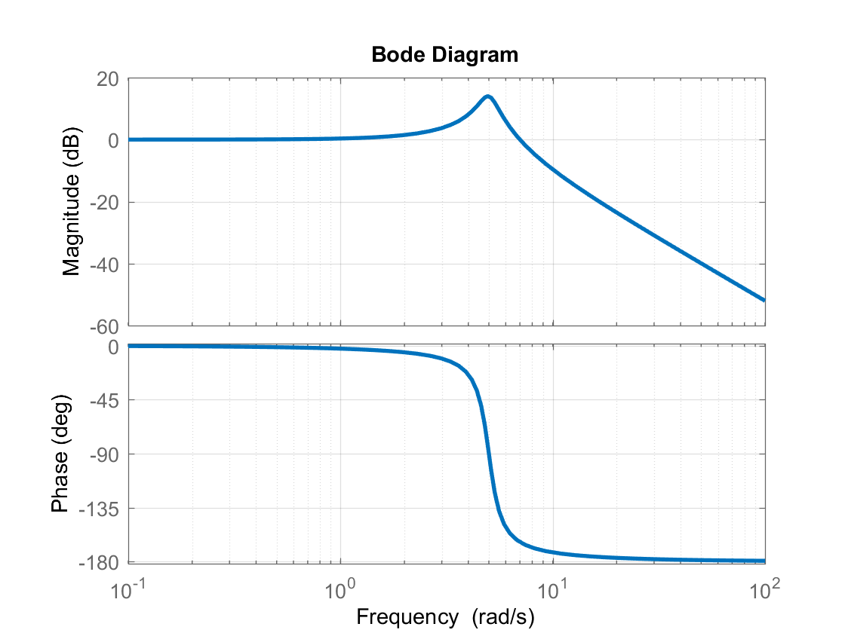
Basics of Frequency Response
Example frequency response of a 2nd order system:
Resonant Peak
Frequency Response on Linear Scale
Phase at natural frequency

Slide 5
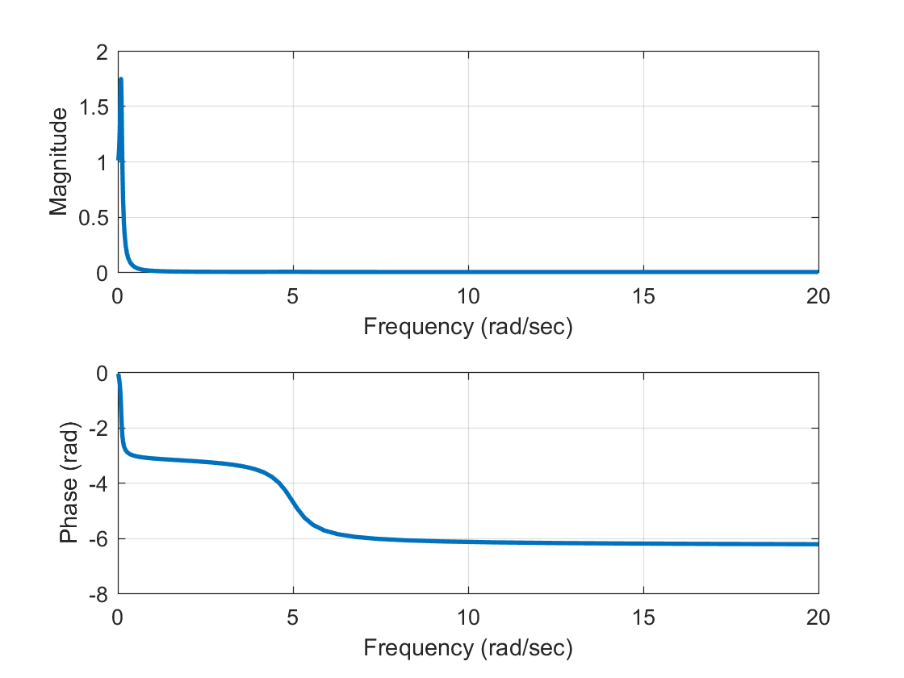
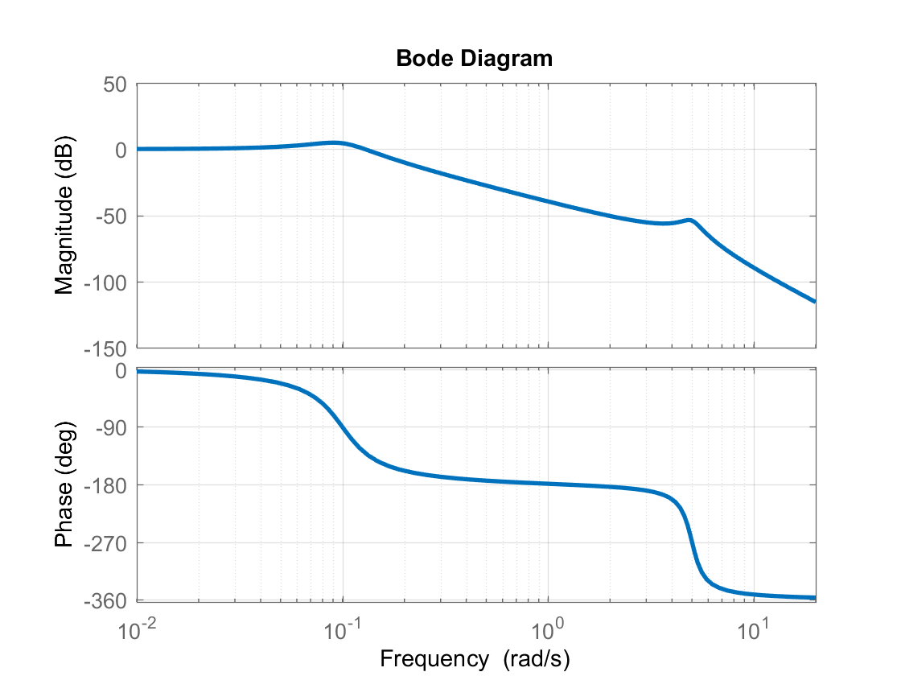
Basics of Frequency Response
Customary to use log scale for frequency, dB scale for magnitude, and degrees for phase. The help see dynamics across wide range of frequency.
Example of system with two modes widely separated in frequency:
0.25
= ------------------------------------------
s^4 + 1.06 s^3 + 25.07 s^2 + 1.51 s + 0.25
Frequency Response on Linear Scale

Slide 6
MATLAB Code for these examples
%Frequency response example
sys=tf(25,[1 2*0.1*5 25]);
%Time response
t=[0:.01:15];
u1=cos(1*t); u20=cos(20*t);
y1=lsim(sys,u1,t); y20=lsim(sys,u20,t);
subplot(2,1,1),plot(t,u1,t,y1,'LineWidth',2.0);
grid on; legend('Input - u(t)','Output - y(t)');
xlabel('Time (sec)'); ylabel('Response');
subplot(2,1,2),plot(t,u20,t,y20,'LineWidth',2.0);
grid on;
legend('Input - u(t)','Output - y(t)');
xlabel('Time (sec)'); ylabel('Response'); ylim([-2 2]);
%%
%Frequency response on linear and log scale
[mag,phase,freq]=bode(sys); mag=squeeze(mag); phase=squeeze(phase)*pi/180.;
figure;
subplot(2,1,1),plot(freq,mag,'LineWidth',2.0);
grid on; xlabel('Frequency (rad/sec)'); ylabel('Magnitude');
subplot(2,1,2),plot(freq,phase,'LineWidth',2.0);
grid on;
xlabel('Frequency (rad/sec)'); ylabel('Phase (rad)');
figure; bode(sys); grid on;
%%
%Frequency response of system with modes at two separate frequencies
sys2=sys*tf(0.1^2,[1 2*0.3*0.1 0.1^2]);
[mag,phase,freq]=bode(sys2,{0.01,20}); mag=squeeze(mag); phase=squeeze(phase)*pi/180.;
figure;
subplot(2,1,1),plot(freq,mag,'LineWidth',2.0);
grid on; xlabel('Frequency (rad/sec)'); ylabel('Magnitude');
subplot(2,1,2),plot(freq,phase,'LineWidth',2.0);
grid on; xlabel('Frequency (rad/sec)'); ylabel('Phase (rad)');
figure; bode(sys2,{0.01,20}); grid on;

Slide 7
Stability Margins
Suppose we look at a system with feedback. Using Nyquist stability theory we can analyze the stability of the Closed Loop system by looking at the Bode diagram of the Open Loop system (Bode of the “loop transfer function”)
In addition, we can analyze stability margins, i.e. how much gain and phase shift are allowed before the closed loop system becomes unstable.
Loop transfer function is: G(s)K(s). For stability margin analysis you generate the Bode diagram of this system.
Use the last system we plotted as an example:
r(t)
+
e(t)
K(s)
u(t)
G(s)
y(t)
-
Compensator
Plant

Slide 8
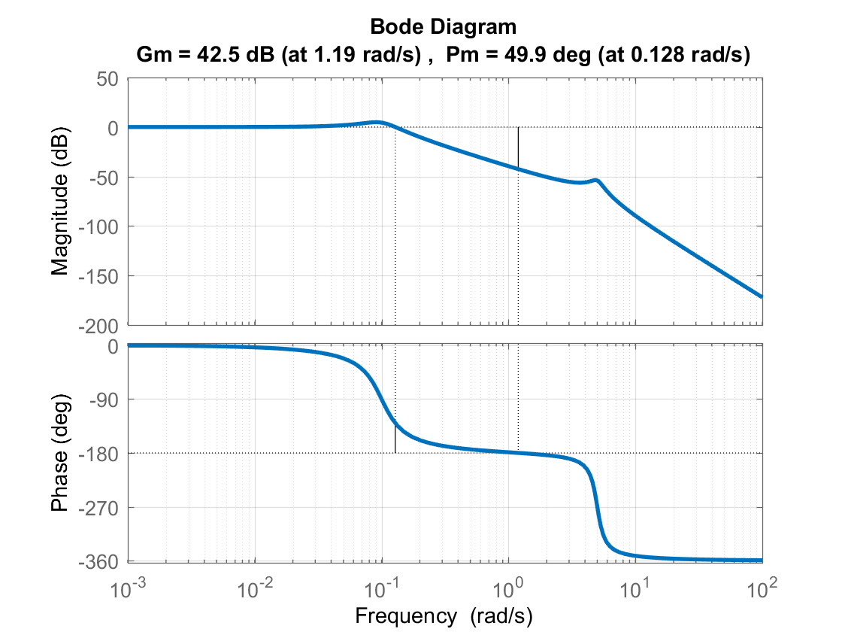
Stability Margins
Bode Diagram for:
For this I used the MATLAB margin command which clearly shows the gain and phase margins:
margin(sys2);
GM = 42.5 dB, implies we can increase gain of loop TF by up to 42.5 dB ( multiply gain by factor 133) and closed loop system will still be stable
Gain Margin
Gain Crossover Frequency (magnitude crosses 0 dB)
Phase Crossover Frequency (phase crosses -180°)
PM = 49.9°, implies we can add up to 49.9° phase lag at the gain crossover frequency and closed loop system will still be stable
Phase Margin

Slide 9
Stability Margins
Stability Margins provide a measure of robustness to the system. Suppose there is uncertainty in the form of:
Where K_{u} is the gain uncertainty, and Φ_{u} is the phase uncertainty. This uncertainty term is in series with the plant and compensator:
The maximum value of Φ_{u} is PM/57.3 - note conversion to radians, and the maximum value of K_{u} is 10^(GM/20) - note the conversion from dB to a gain amplification on linear scale.
r(t)
+
G(s) K(s)
y(t)
-
Uncertainty
Loop TF

