Slide 1
Forward Flight Dynamics
Will investigate flight dynamics in forward flight using the HeloSim UH-60 model as an example
Trim
Migration of eigenvalues (natural modes)
Migration of stability and control derivatives
Time response to pulse inputs
Simplified de-coupled longitudinal / lateral dynamics, relate the dynamics directly to specific S&C derivatives

Slide 2
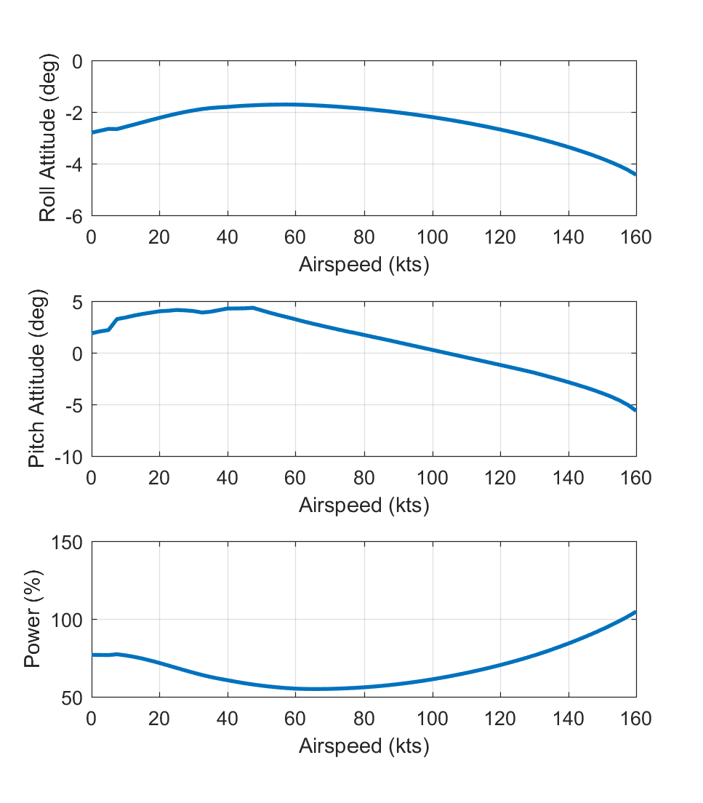
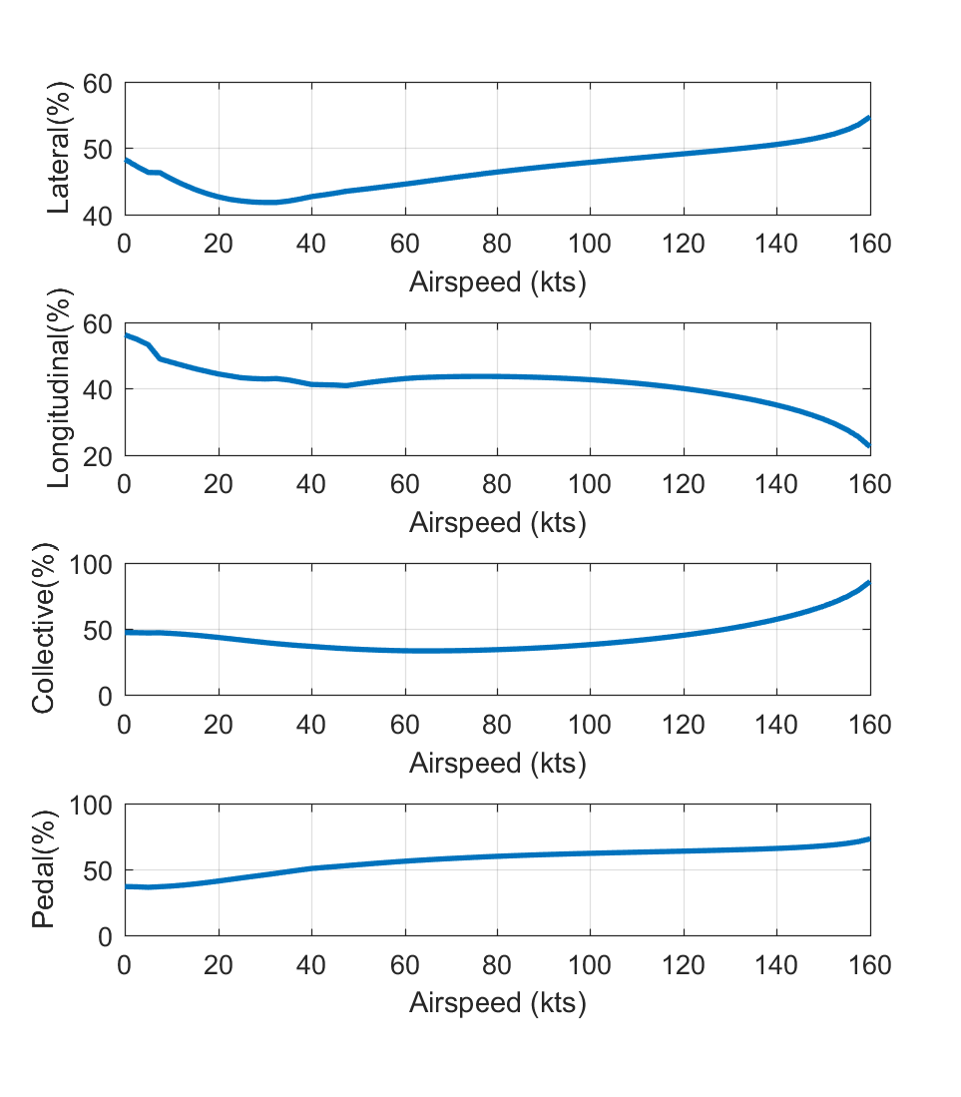
Forward Flight Trim

Slide 3
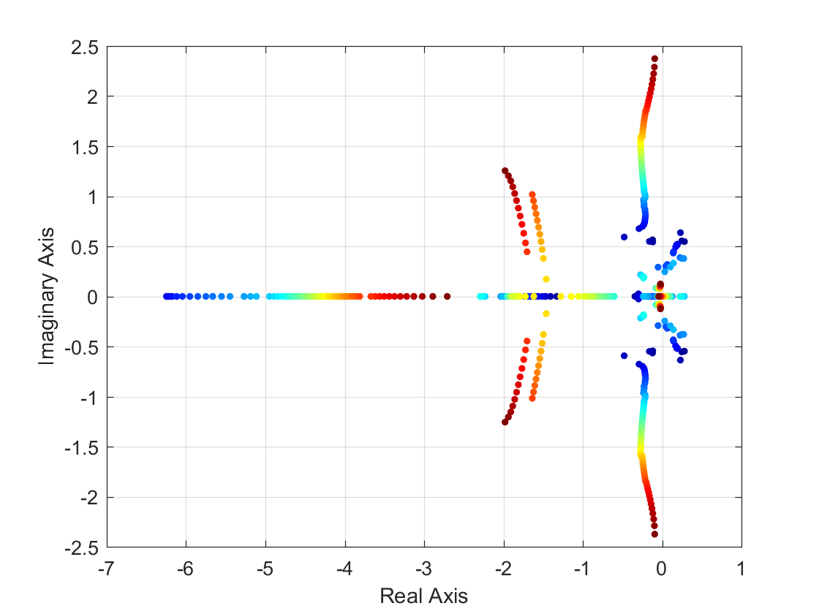
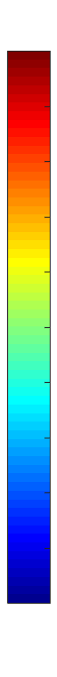
Migration of Eigenvalues with Airspeed
UH-60 Model – eigenvalues of reduced order 8 state model from hover to 160 knots
Blue = Low Speed, Dark Red = High Speed
Lateral hover phugoid evolves into Dutch Roll mode as airspeed increases
Heave subsidence and pitch subsidence coalesce to become short period mode
Roll subsidence decreases in frequency
Dutch Roll Mode
Short Period Mode
150 kts
130 kts
Roll Subsidence Mode
110 kts
90 kts
70 kts
50 kts
30 kts
0 kts

Slide 4
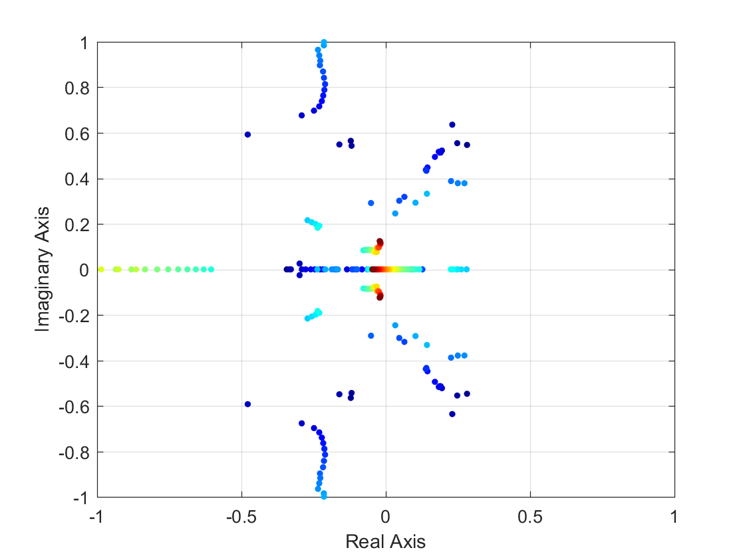
Migration of Eigenvalues with Airspeed
UH-60 Model – eigenvalues of reduced order 8 state model from hover to 160 knots
Blue = Low Speed, Dark Red = High Speed
Longitudinal hover phugoid evolves into forward flight phugoid as airspeed increases
Yaw subsidence becomes spiral mode
150 kts
Longitudinal Phugoid Mode
130 kts
110 kts
SpiralMode
90 kts
70 kts
50 kts
30 kts
0 kts

Slide 5
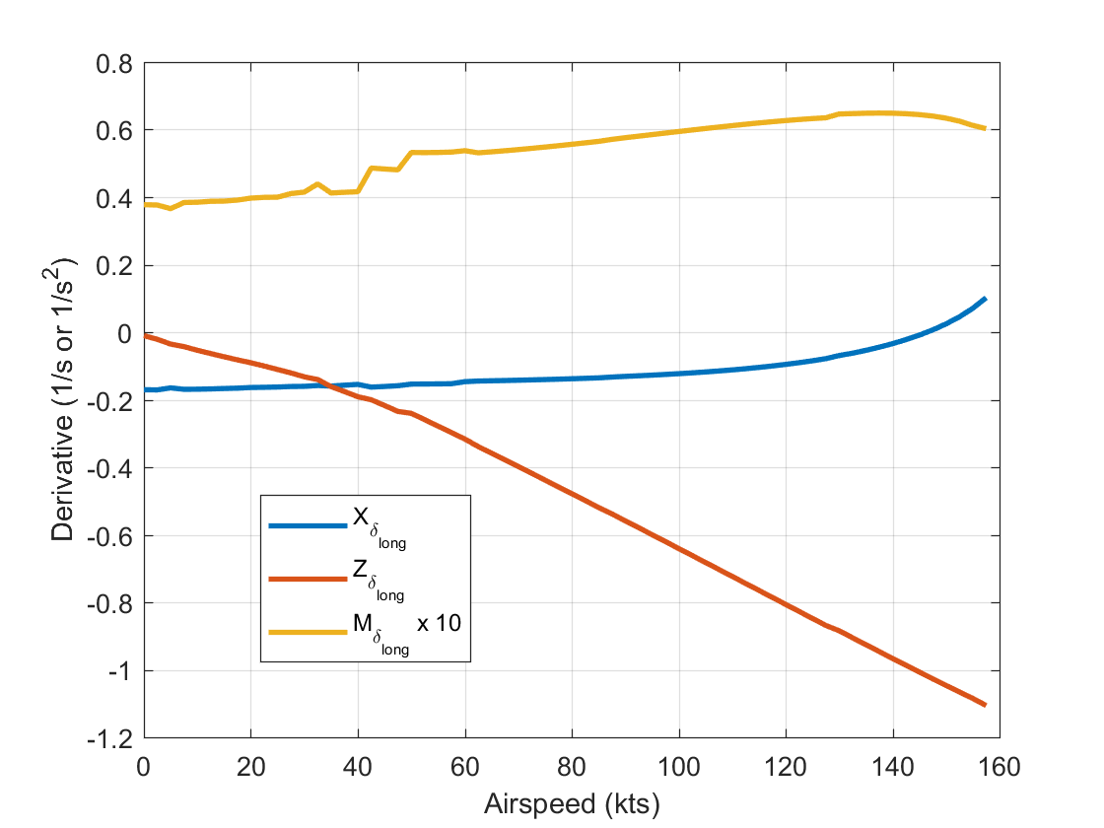
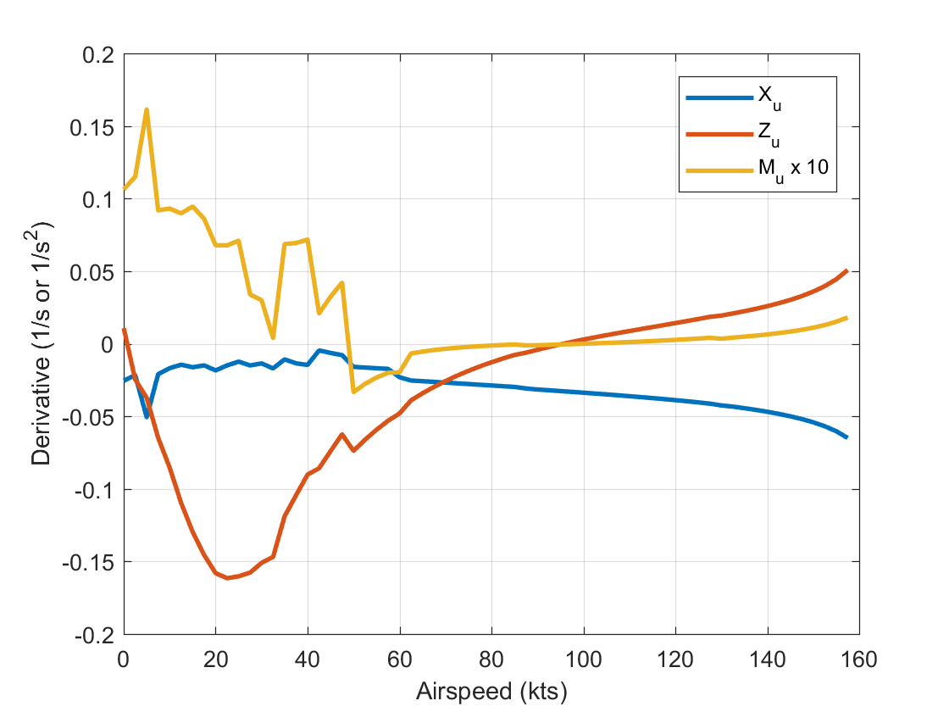
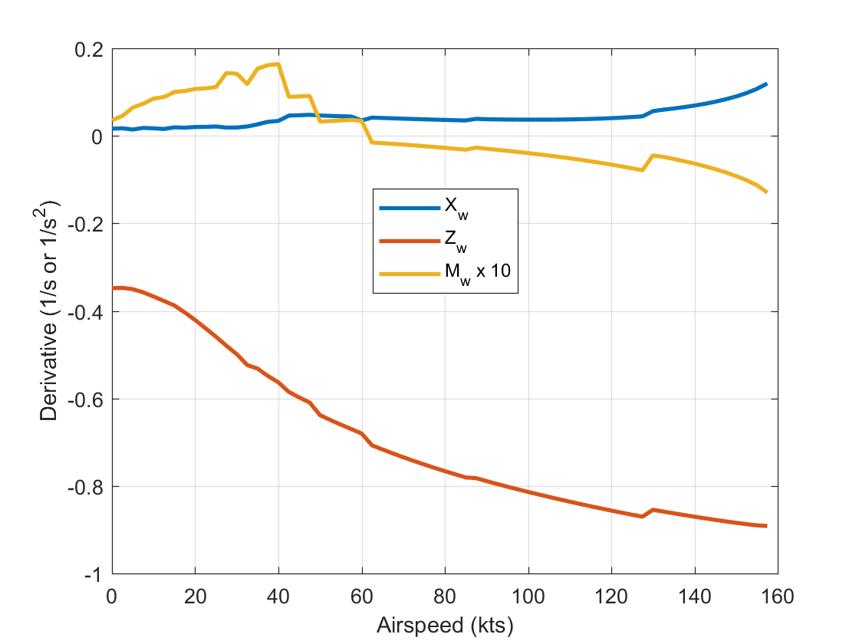
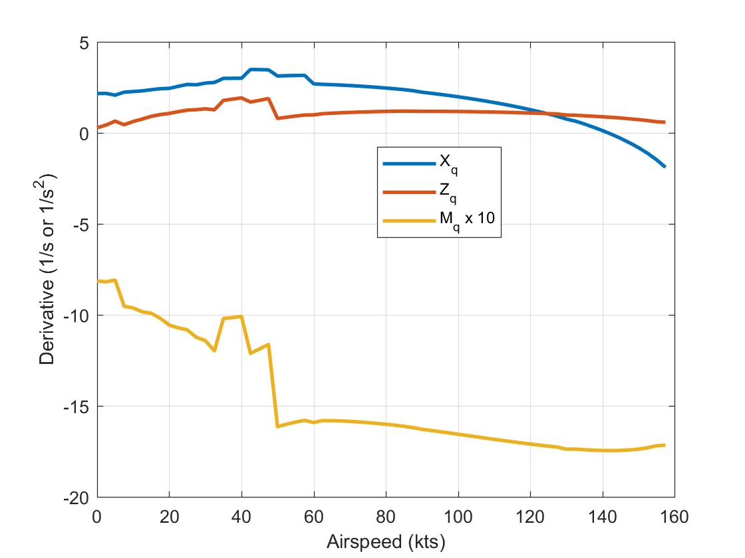
Longitudinal S&C Derivatives

Slide 6
Longitudinal Dynamics in Forward Flight
Start with de-coupled longitudinal linear model
Assume the inertial terms related to pitch rate are dominant (X_{q}<<w_{e}, Z_{q}<<u_{e}) and the X_{w} derivative is negligible. Can also neglect the control cross-coupling derivatives:
To analyze forward flight, it is convenient to make a change in state variables, so that we use angle of attack, α, and the vertical velocity in the inertial frame (rate of descent) V_{D}, in place of w and θ
These equations linearize as:

Slide 7
Longitudinal Dynamics in Forward Flight
The change in state variables can be written in terms of a state transformation matrix:
Can then apply similarity transformation on state space system:
The transformed system partitions the longitudinal dynamics as:

Slide 8
Longitudinal Dynamics in Forward Flight
We can now apply residualization (or singular perturbation) to reduce the model by assuming a separation in time scale.
It is reasonable to assume the pitch rate and angle of attack dynamics (associated with attitude dynamics) are much faster than the airspeed and rate of descent (associated with trajectory dynamics).
For slow model, we assume α and q reach steady-state:
We now have an algebraic constraint on α and q which can be substituted back into the original model to get a 2nd order system of the slow dynamics

Slide 9
Longitudinal Dynamics in Forward Flight
The “slow” dynamics in forward flight are governed by:
This model will give us a reasonably good approximation of the phugoid dynamics of the rotorcraft in forward flight. The eigenvalues of these dynamics are governed by the characteristic equation:

Slide 10
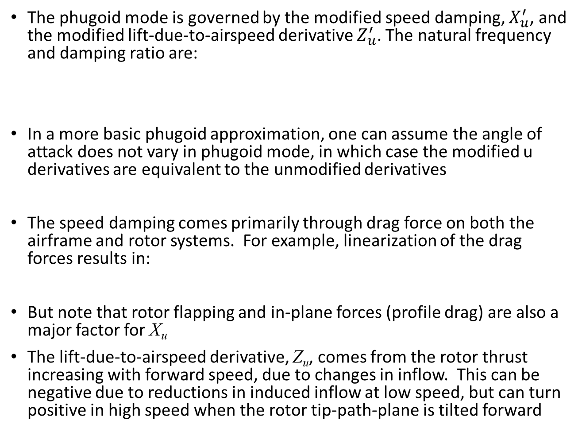
Longitudinal Dynamics in Forward Flight
The phugoid mode is governed by the modified speed damping, $X_{u}^{′}$, and the modified lift-due-to-airspeed derivative $Z_{u}^{′}$. The natural frequency and damping ratio are:
In a more basic phugoid approximation, one can assume the angle of attack does not vary in phugoid mode, in which case the modified u derivatives are equivalent to the unmodified derivatives
The speed damping comes primarily through drag force on both the airframe and rotor systems. For example, linearization of the drag forces results in:
But note that rotor flapping and in-plane forces (profile drag) are also a major factor for X_{u}
The lift-due-to-airspeed derivative, Z_{u}, comes from the rotor thrust increasing with forward speed, due to changes in inflow. This can be negative due to reductions in induced inflow at low speed, but can turn positive in high speed when the rotor tip-path-plane is tilted forward

Slide 11
Longitudinal Dynamics in Forward Flight
The fast dynamics can also be extracted. These assume the slow states remain constant:
The A matrix eigenvalues describe the short period mode stability:
Transfer functions of the responses of the angle of attack:

Slide 12
Analysis of UH-60 Long. Modes at 140 knots
Comparisons of Eigenvalues via Approximations:
We see there is significant error when going to 4 state longitudinal model indicating that cross-coupling effects are important. But closed form approximations of modes from the 4 state model are OK
Lets check phugoid response in complete non-linear simulation. The best model predicts:
 | Short Period Mode |  | Phugoid Mode
 | ω_{n} rad/sec | ζ | ω_{n} rad/sec | ζ
8 State Model | 2.01 | 0.879 | 0.116 | 0.174
4 State Model | 1.72 | 0.756 | 0.0554 | 0.436
Mode Approximations | 1.72 | 0.755 | 0.0541 | 0.493
Amplitude Ratio Between Cycles:
Period of Oscillation:
Time to Half Amplitude:

Slide 13
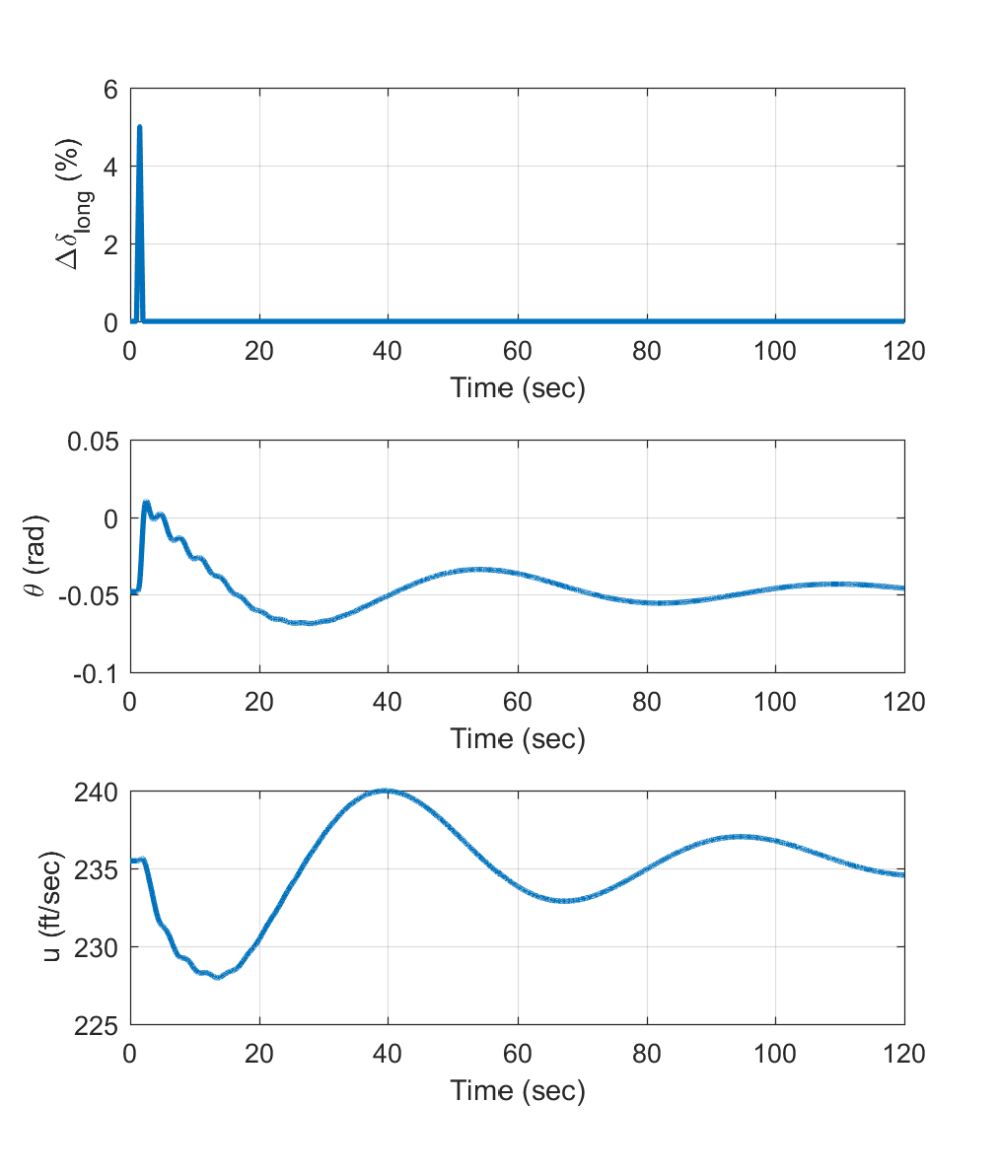
Longitudinal Response to Cyclic Pulse
Pulse Performed at 140 knots
H60_sim_init;
% 5% triangular pulse in long. stick
tinp=[0. 1. 1.5 2. 120.]';
uinp=zeros(5,4);
uinp(3,2)=5.;
%Turn SAS Off, but ECU On
SASOn=0;
ECUOn=1;
%Run Sim
sim('HeloSim');
%Plot Results
figure
subplot(3,1,1),plot(tinp,uinp(:,2),'LineWidth',2.0);
grid on;
xlabel('Time (sec)');
ylabel('\Delta\delta_{long} (%)');
subplot(3,1,2),plot(tout,yout(:,8),'LineWidth',2.0);
grid on;
xlabel('Time (sec)');
ylabel('\theta (rad)');
subplot(3,1,3),plot(tout,yout(:,1),'LineWidth',2.0);
grid on;
xlabel('Time (sec)');
ylabel('u (ft/sec)');
T
A₁
A₂

Slide 14
Analysis of UH-60 Long. Modes at 80 knots
Comparisons of Eigenvalues via Approximations:
The 8-state model predicts and over damped short period mode (damping ratio > 1 means there are two real eigenvalues). The mode approximation has complex eigenvalues but they very heavily damped and near the same frequency.
Mode approximations predict phugoid mode is on real axis and becomes unstable. The natural frequency and damping ratio are actually imaginary values, but if we construct the roots of λ²+2ω_{n}ζλ+ω²_{n} then we get the eigenvalues above
Small eigenvalues of phugoid can become very sensitive to variations in aircraft parameters
 | Short Period Mode |  | Phugoid Mode
 | ω_{n} rad/sec | ζ | λ
8 State Model | 1.28 | 1.074 | -0.0341±0.0857
4 State Model | 1.24 | 0.942 | -0.0875, 0.0593
Mode Approximations | 1.24 | 0.945 | -0.0809,0.0639

Slide 15
Longitudinal Dynamics in Forward Flight
Overall summary of longitudinal dynamics
The longitudinal modes of a rotorcraft in forward flight are the same as those of a fixed-wing aircraft, but variations in the modes with airspeed are different because the important forces are not all proportional to free-stream dynamic pressure
A lot of non-linearity in the low- to high-speed transition region (20 to 60 knots) can cause rapid changes in modes as airspeed increases
Phugoid Mode: Usually Low frequency / lightly damped oscillation in airspeed, pitch attitude, and altitude, that is easy to see in flight response. Frequency tends to decrease as airspeed increases.
Short-Period Mode: High frequency, heavily damped oscillation in angle of attack and pitch. Pitch stiffness, M_{α}, and pitch damping, M_{q}, are critical to the stability of this mode. The frequency tends to increase as airspeed increases and the horizontal stabilizer becomes more effective. Generally hard to see it time history of aircraft response (too damped)
Possible for either mode to become overdamped (two negative real eigenvalues) or to exhibit static instability (one positive real eigenvalue, and negative real eigenvalue)
Mode approximations are not very accurate for some forward flight conditions. Cross-coupling effects (which are neglectied in approximations) can sometimes play an important factor

Slide 16
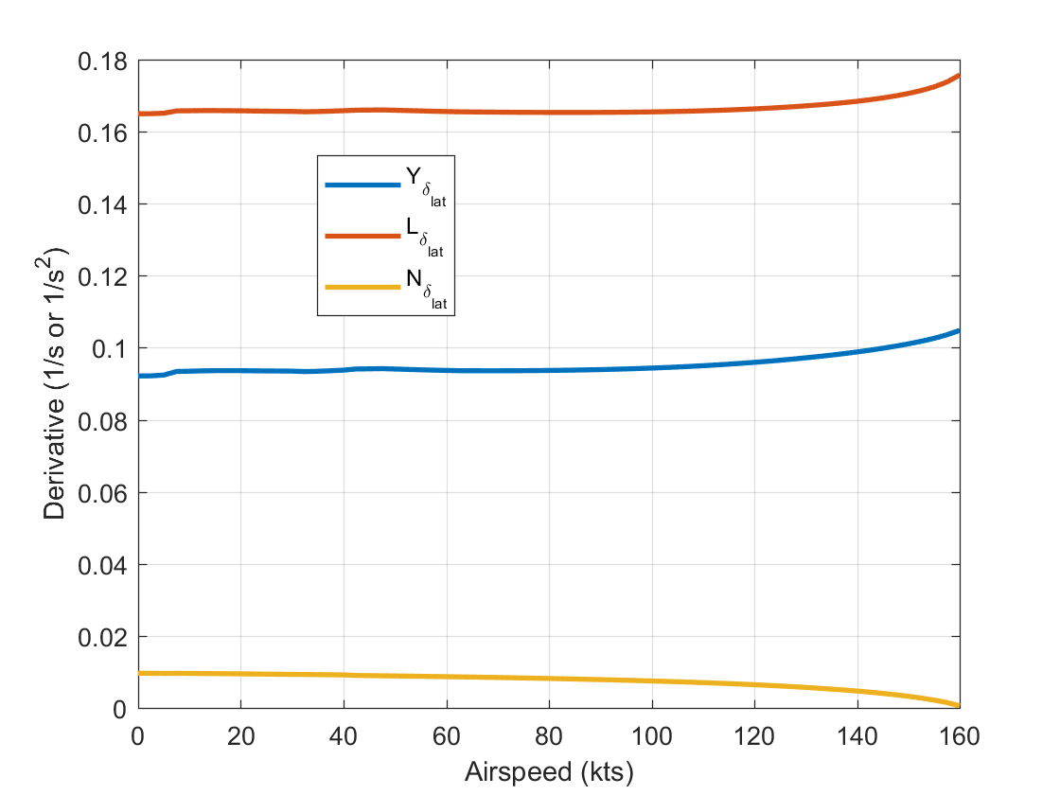
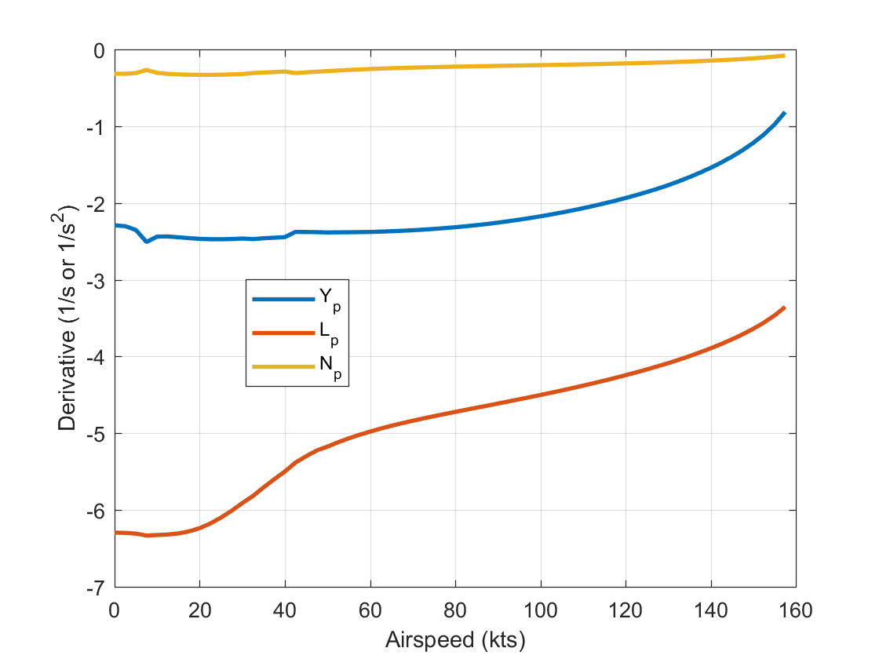
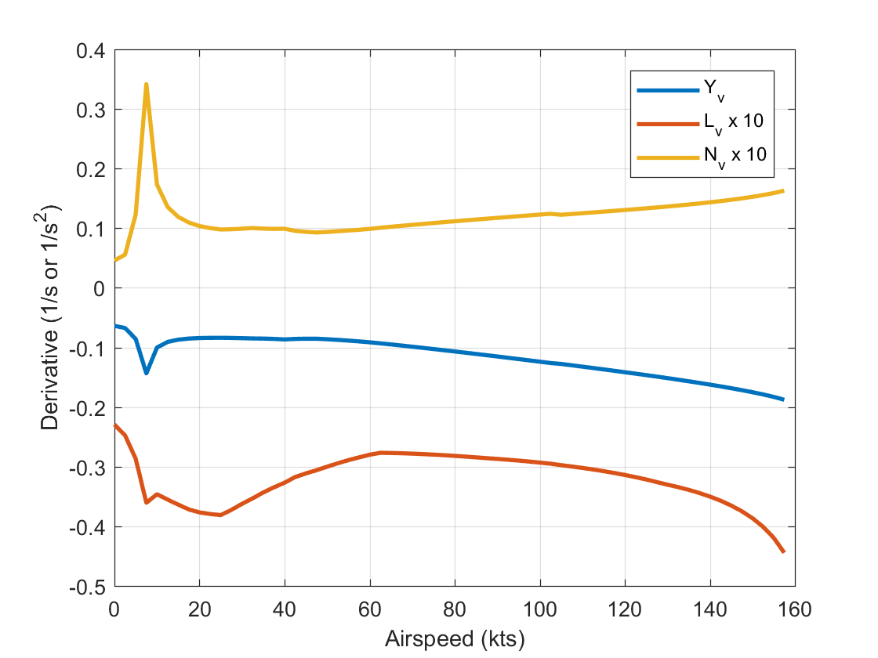
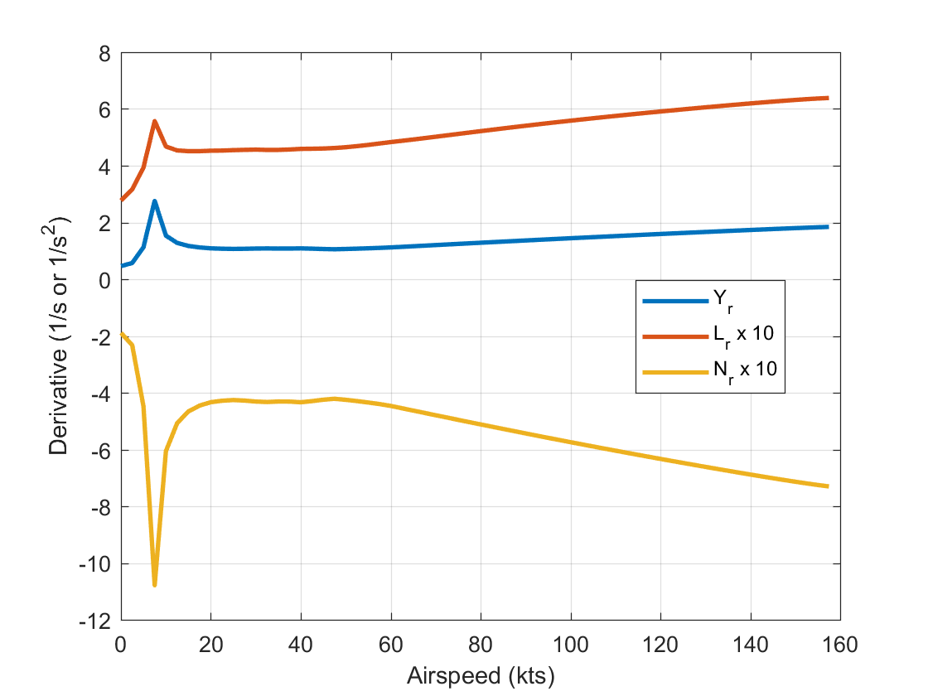
Lateral-Directional S&C Derivatives

Slide 17
Lateral-Directional Models
Simplified lateral-directional dynamics (dropped Y_{p} and Y_{r}).
Can apply similar order reduction methods (see Padfield section 4.3.3) to get closed form expressions for natural modes
Spiral mode:
Roll subsidence mode:
Dutch roll mode:

Slide 18
Analysis of UH-60 Lateral Directional Modes at 140 knots
Comparison of Eigenvalues for Approximations
Four-state model and mode approximation underpredict DR mode damping (sometimes cross-coupling effects can degrade DR mode damping)
Otherwise, the approximations are pretty good
 | Spiral | Roll | Dutch Roll
 | λ_{S} | λ_{R} | ω_{n} rad/sec | ζ
8 State Model | -0.0368 | -3.60 | 2.05 | 0.0543
4 State Model | -0.0371 | -4.14 | 1.97 | 0.156
Mode Approximations | -0.0309 | -3.93 | 2.04 | 0.174

Slide 19
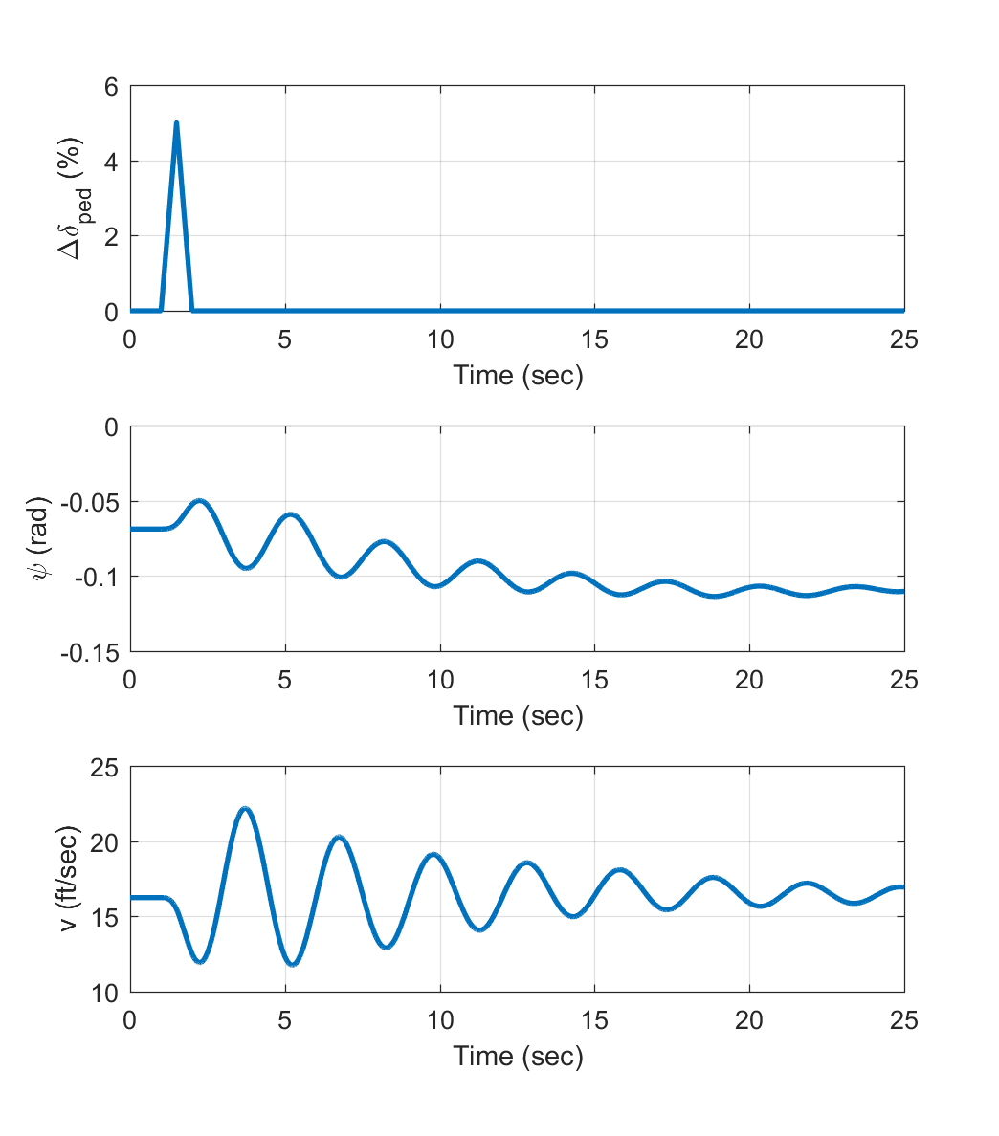
Lat. Dir. Response to Pedal Pulse
Pulse Performed at 140 knots
H60_sim_init;
% 5% triangular pulse in pedal
tinp=[0. 1. 1.5 2. 25.]';
uinp=zeros(5,4);
uinp(3,4)=5.;
%Turn SAS Off, but ECU On
SASOn=0;
ECUOn=1;
%Run Sim
sim('HeloSim');
%Plot Results
figure
subplot(3,1,1),plot(tinp,uinp(:,4),'LineWidth',2.0);
grid on;
xlabel('Time (sec)');
ylabel('\Delta\delta_{long} (%)');
subplot(3,1,2),plot(tout,yout(:,9),'LineWidth',2.0);
grid on;
xlabel('Time (sec)');
ylabel('\psi (rad)');
subplot(3,1,3),plot(tout,yout(:,2),'LineWidth',2.0);
grid on;
xlabel('Time (sec)');
ylabel('v (ft/sec)');

Slide 20
Analysis of UH-60 Lateral Directional Modes at 80 knots
Comparison of Eigenvalues for Approximations
Roll and Dutch Roll modes are very well predicted by mode approximations
Spiral mode switches signs when going to de-coupled 4 state model. Indicates cross-coupling effects play a part in unstable spiral mode (not too surprising, since spiral mode can cause increase in airspeed)
 | Spiral | Roll | Dutch Roll
 | λ_{S} | λ_{R} | ω_{n} rad/sec | ζ
8 State Model | 0.0233 | -4.40 | 1.45 | 0.180
4 State Model | -0.0230 | -4.77 | 1.43 | 0.196
Mode Approximations | -0.0302 | -4.72 | 1.44 | 0.190

Slide 21
Lat. Dir. Dynamics in Forward Flight
Overall summary of lateral-directional dynamics
The lateral-directional modes of a rotorcraft in forward flight are the same as those of a fixed-wing aircraft
Dutch Roll Mode: Usually lightly damped oscillation in roll and yaw. The mode frequency tends to increase with airspeed. Mode damping on rotorcraft is often lower than desired, because of large negative value of L_{v}
Roll Subsidence Mode: Heavily damped mode. Very well approximated by the roll damping derivative. Stays approximately constant with airspeed (moves to right a bit on UH-60)
Spiral mode: Very slow mode, either a subsidence or a slow divergence (unstable). It is very sensitive to model parameters (small changes in derivatives can switch its sign). Generally, requires L_{v} < 0 to stabilize spiral mode

