Slide 1
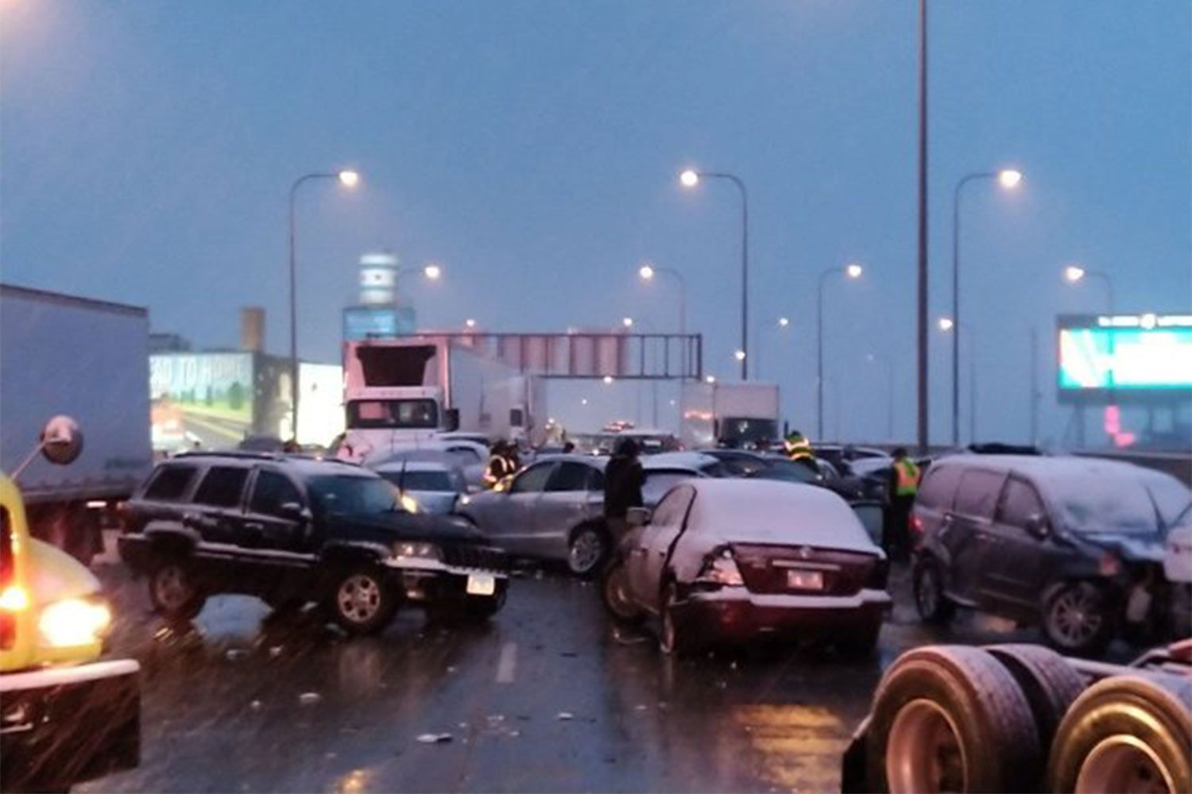
Chicago Traffic Crashes
By Kinoti
26th May 2023

Slide 2
Project Overview
This project involves the analysis of the Traffic Crashes in Chicago, and obtaining insights on the main contributors to these incidences, as directed by the government.

Slide 3
Data Understanding
The source of our data is Chicago Traffic Crashes data.
The techniques used in the exploration of this data are:
  Exploratory Data Analysis(EDA)
  Classification Modelling- For prediction purposes.

Slide 4
Research
Additional research was done to check on the:
  Yearly weather conditions in Chicago
  The size of the roads including lane counts
  The traffic volumes in the city

Slide 5
Data Analysis
Data analysis was done on the relevant items of the dataset to explore their properties.
The various properties of these items were used to select the most suitable features for our modelling exercise.
The following results were obtained:

Slide 6
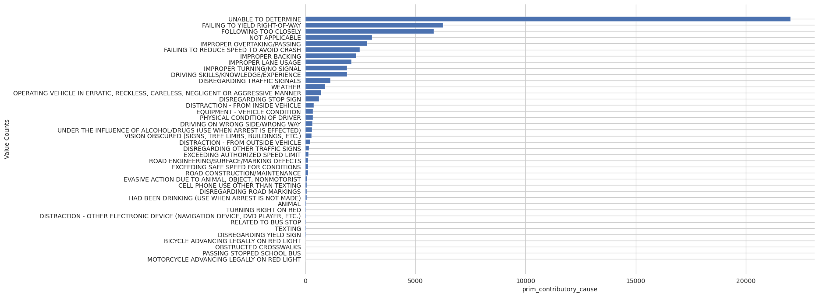
Primary Accident Causes
Most of the accidents are driver-related.
The traffic rules not being adhered to strictly.

Slide 7
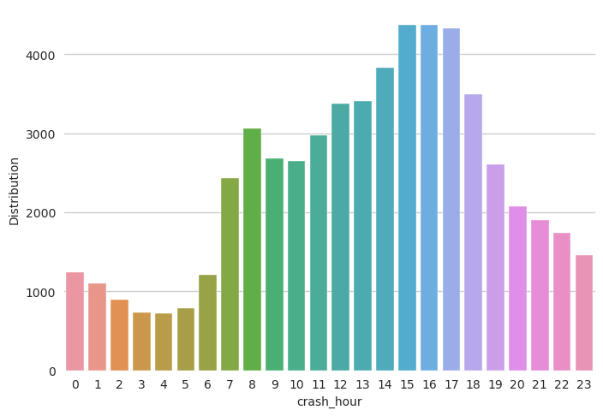
Distribution of Incidences / Day
Most of the accidents occur during the day.
This is the case since we have most people traveling during the day.
Hence high traffic volumes, and accident likelihood.

Slide 8
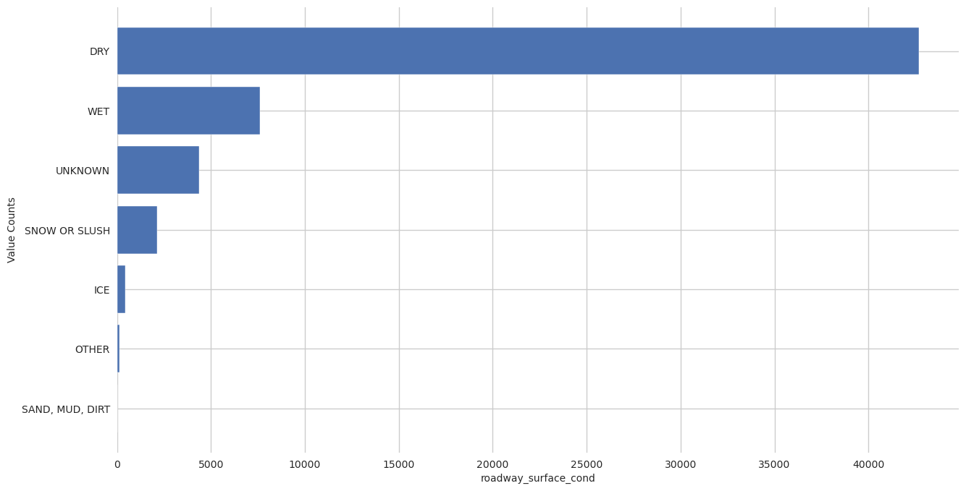
Weather Contribution
Adverse weather conditions don’t much affect traffic.
However, when the pavement is wet- rain/snow-it contributes to accident occurrence.

Slide 9
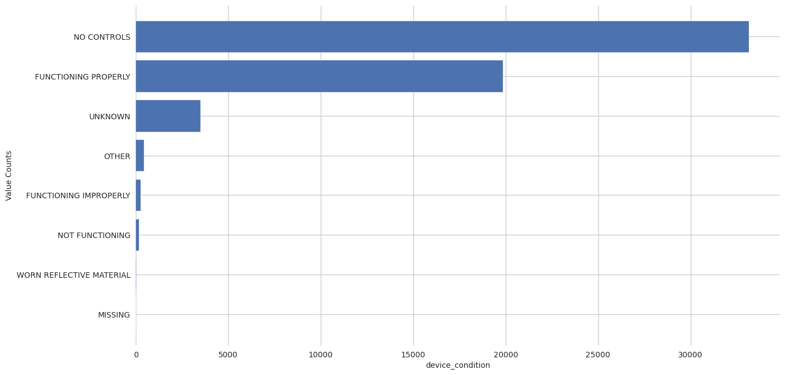
Traffic Control Devices
Traffic controls are import in any road network, especially at intersections.
Absence of such devices and personnel, and faulty ones adds to occurrence of accidents.

Slide 10
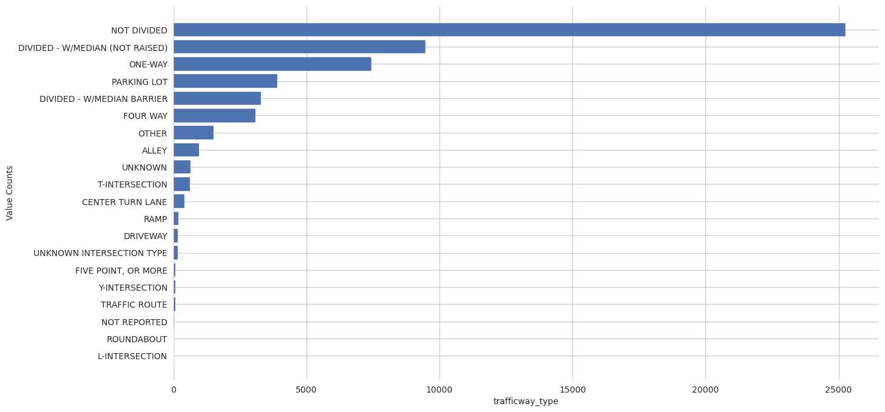
Road Type
Different roads are adopted depending on traffic volume, and location accessibility.
Most accidents are occurring in one-way traffic.
Other incidences are occurring in parking lots, alleys, and intersections, but not directly connected to the type of the road.

Slide 11
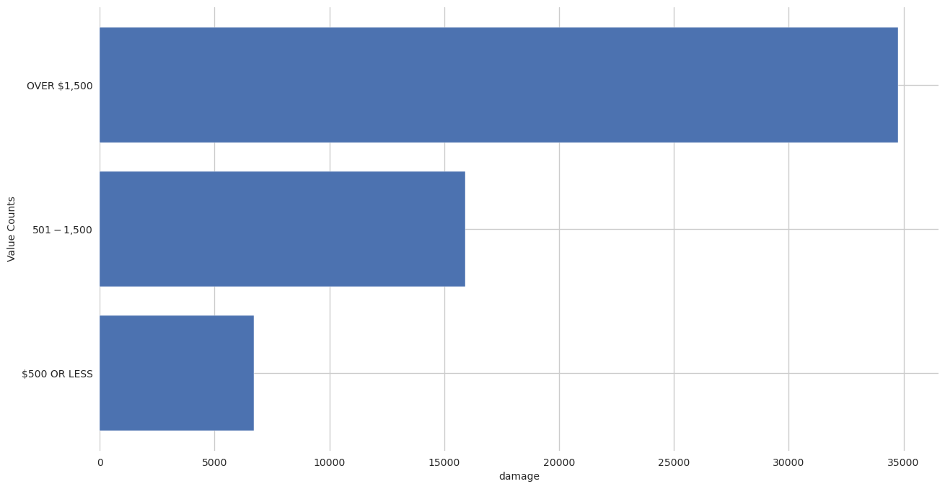
Damages Incurred
One of the devastating outcome of accidents is damages- both to individual and public property, and infrastructure.
Looking at the results, most of the damages are costly, surpassing the $1,500 mark.
This cost being observed per incident is very high.

Slide 12

Modeling
The final model used in predictive analysis was XGBoost Model.
This model is able to predict damages to be incurred in a given incident, provided with features, such as the “weather condition”.
This model has an accuracy of 57%, which good for this kind of project.

Slide 13
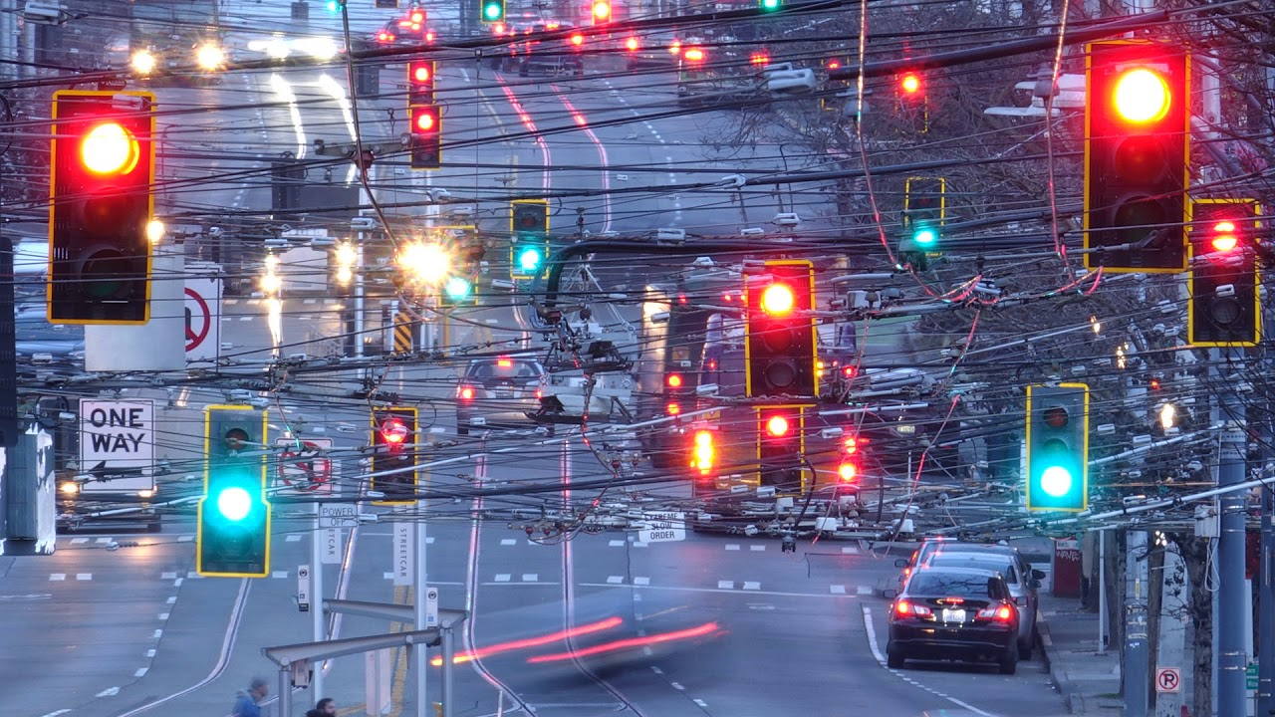
“Let’s make our roads safer”
Thank you

