Slide 1

Does Age and Gender/Ethnicity play a factor in Suicide Numbers?
Toni Kinsey
DSC530 Final Project

Slide 2
Variable Definitions
The mode of the Stub Label would be: 4.22
Indicating it falls between Female: Asian or Pacific Islander
The spread of the Stub Label would be:-1942.76
The tails of the Stub Label would be: -0.455
AGE_NUM
A number value is given to indicate which age range the suicides occurred in.
The mean of the age groups that were included in this analysis: 2.65.
This indicates it falls in the range of 20 – 44 years old. Being in-between two ranges of 20-24 and 25 – 44 years old.
The mode of the age groups that were included in this analysis: 0.0.
0 indicates ‘all ages’
The spread of the age groups that were included in this analysis: 6.0.
The tails of the age groups that were included in this analysis: -0.12.
ESTIMATE
Estimated suicides from a 100,000 persons’ population
The mean of all suicides that were included in this analysis: 13.70.
The mode of all suicides that were included in this analysis: 4.3.
The spread of all suicides that were included in this analysis: 74.8.
The tails of all suicides that were included in this analysis: 1.65
YEAR
Defines the year that the data was from
The mean of the year of the suicide analysis: 1997.52
The mode of the year of the suicide analysis: 2018.
The spread of the year of the suicide analysis: 68
The tails of the year of the suicide analysis: -0.9307712634152077
STUB_LABEL
Defines gender and/or ethnicity.
The mean, mode, spread, and tails of the Stub Label would be undefined since it is a string. Instead, I used Stub_Label_Num. Which gives each stub label a value.
STUB_LABEL_NUM
A number value is given to indicate which stub_label
The mean of the Stub Label would be 4.68.
Indicating it falls between Female: Asian or Pacific Islander and Male: White.

Slide 3
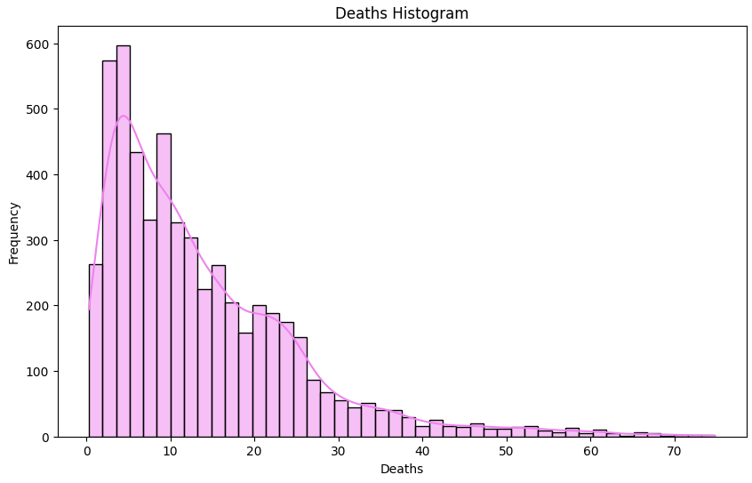
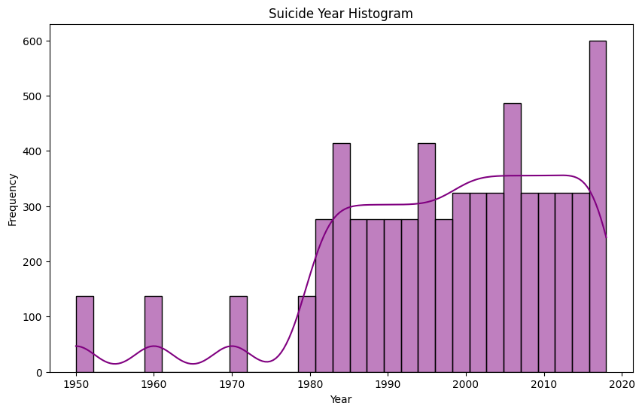
Histograms
To identify outliers, we can look at the “ESTIMATE” column, which represents the number of deaths per 100,000 residents’ population. The values in the "ESTIMATE" column range from 10.4 to 14.2, with most values clustered around 12-13.5. From the data provided, we can observe that the values for the years 1950, 1960, and 1970 (with estimates of 13.2, 12.5, and 10.5, respectively) are slightly lower than the surrounding values but still within a reasonable range. These values are not extreme outliers and could be considered normal variations. On the other hand, the value for the year 2018 stands out as the highest estimate with 14.2. This value is at the upper end of the observed range and is notably higher compared to the surrounding values. It could be considered an outlier as it strays significantly from the general trend.
To identify outliers, we can look at a simple box plot. This would show that there does not appear to be any outliers in the "YEAR" column. The years range from 1950 to 2018, which is a plausible time frame.

Slide 4
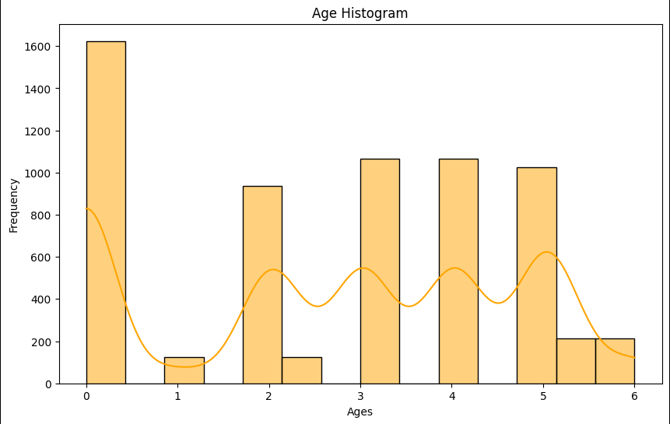
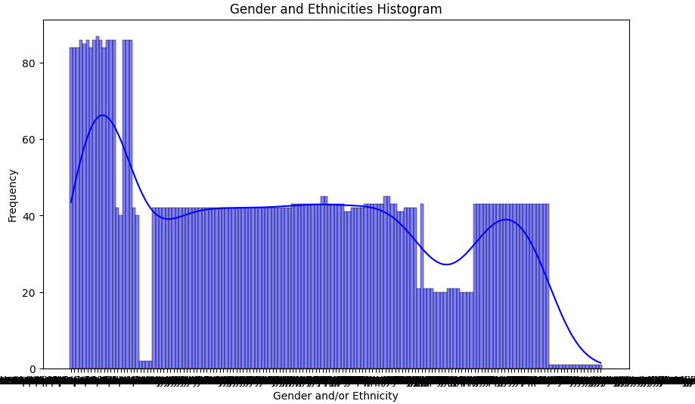
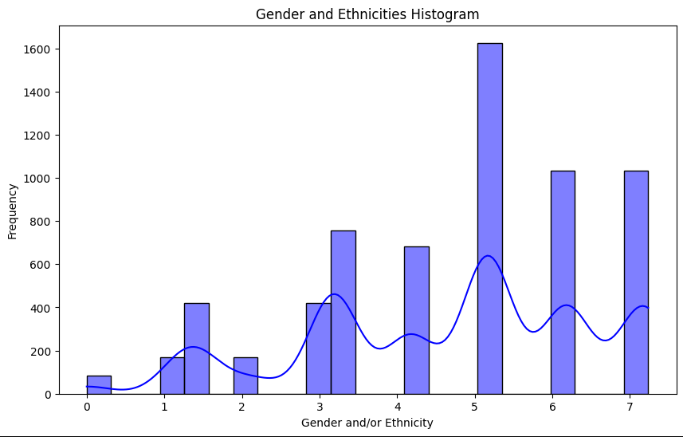
Histograms
To identify outliers, we can look at a simple box plot. This would show that there does not appear to be any outliers in the “AGE_NUM" column. The ages provided are a range grouping of various ages.
There are no outliers in the references “STUB_LABEL” grouping. This column represents the gender and ethnicity of the person who died.
There are no outliers in the references “STUB_LABEL_NUM” grouping. This column gives a value to the “STUB_LABEL” column that represents the gender and ethnicity of the person who died.

Slide 5
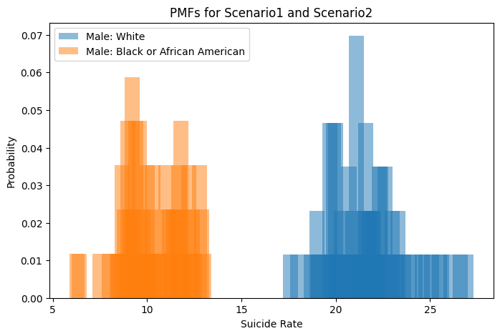
PMF Scenario Comparison
When looking at the PMF between the selected scenarios, you can see the differences in the probability distributions of death rates between the “Male: White” and “Male: Black or African American”. Looking at the plot, you can see that there is a higher death rate in the “Male: White” is higher than that of the “Male: Black or African American” category; however, the probability seems to be similar.

Slide 6
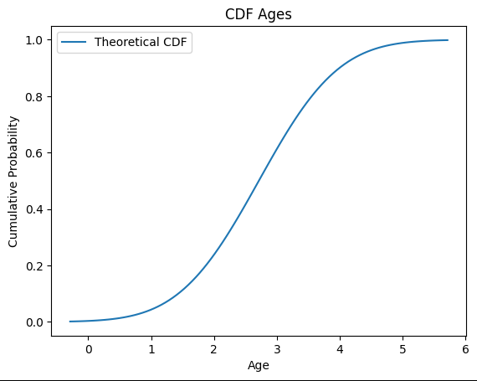
CDF Curve
By analyzing the CDF of the "AGE_NUM" variable, one could gather:
The steeply increasing CDF indicates a positively skewed distribution.
Given that this was done with a range of numbers, the 50% is 3.0 which represents the age range 25-44 years old. The 75% is 4.1 which represents the age range of 45-54 years.

Slide 7
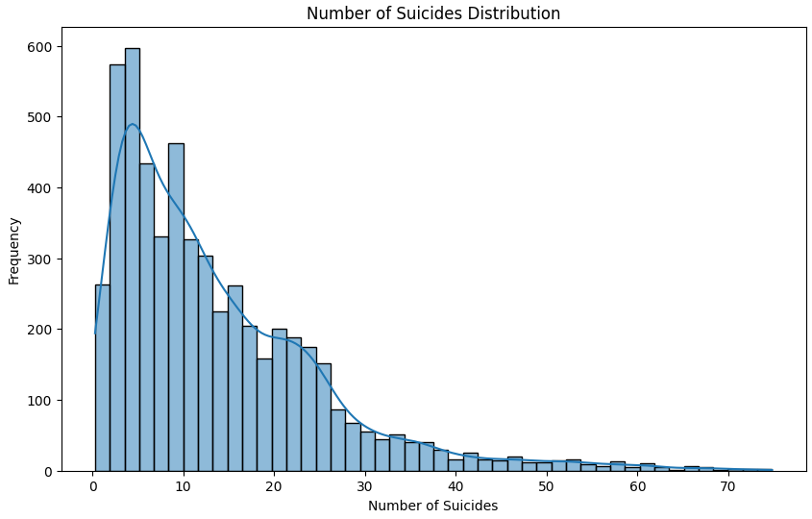
Distribution
The shape of the Distribution allows us to observe the frequency of different ranges of the number of suicides. Since the distribution is skewed to the left, it suggests an imbalance in the frequency of suicides. Showing that suicides occurred more frequently in earlier years.

Slide 8
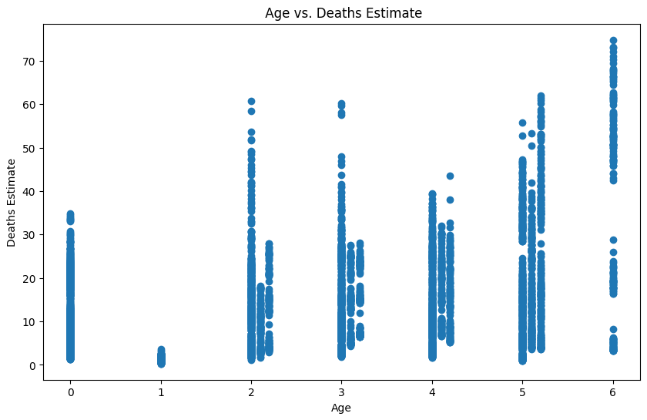
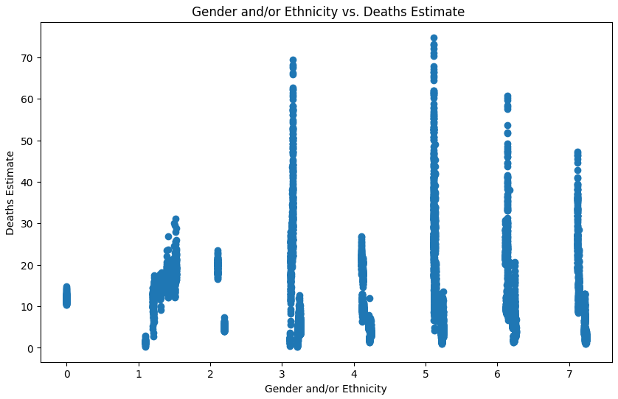
Scatter Plots
The covariance value was found null. A covariance close to zero suggests no linear relationship. In this case, the calculated covariance can help us determine the direction of the relationship between the ‘STUB_LABEL_NUM' and 'ESTIMATE' variables.
Pearson's Correlation Coefficient value was found to be null. Pearson's correlation coefficient measurement of 0 indicates no linear relationship. Pearson's correlation coefficient can provide insights into the strength and direction of the relationship between the ‘STUB_LABEL_NUM' and 'ESTIMATE' variables.
The scatter plot shows that there are some ethnicity and gender combinations that have higher than others. Specifically, the 3 and 5 number ranges that include Males and Males: Black or African American.
The covariance value was found null. A covariance close to zero suggests no linear relationship. In this case, the calculated covariance can help us determine the direction of the relationship between the 'AGE_NUM' and 'ESTIMATE' variables.
Pearson's Correlation Coefficient value was found to be null. Pearson's correlation coefficient measurement of 0 indicates no linear relationship. Pearson's correlation coefficient can provide insights into the strength and direction of the relationship between the 'AGE_NUM' and 'ESTIMATE' variables.
The scatter plot does not show a significant difference in the age ranges except for the value 1 which represents age range 10 -14 years old.

Slide 9
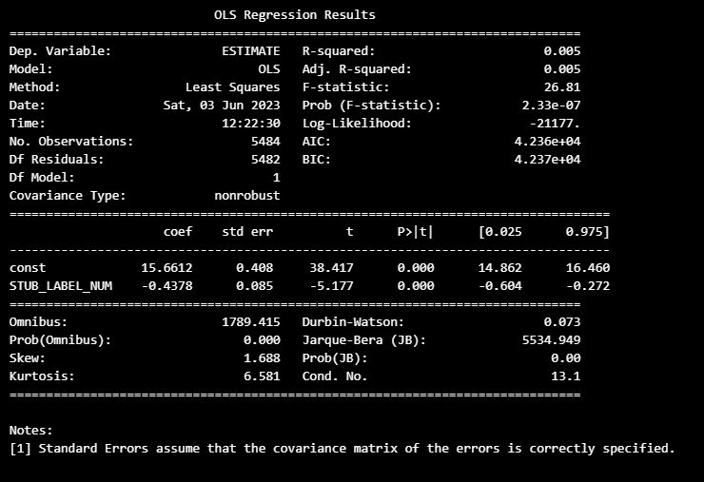
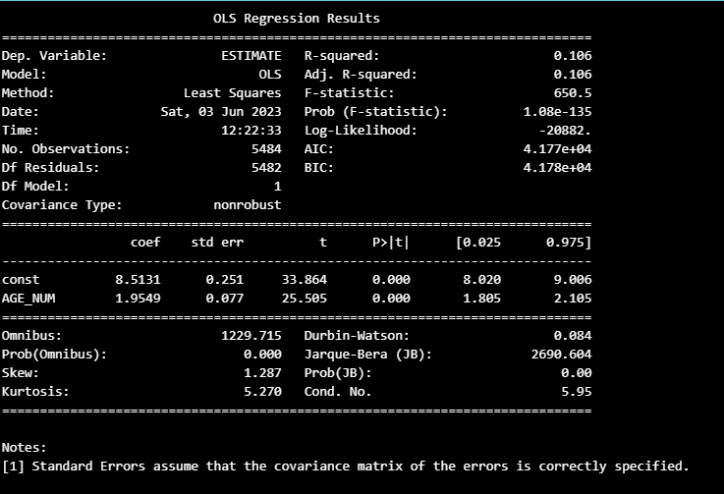
Linear Regression Models
The linear regression model between "AGE_NUM" and "ESTIMATE" explains only a small portion of the variability in the data. The coefficient of "AGE_NUM" is statistically significant, indicating a positive relationship between age and the estimated number of deaths. However, the model may not fully capture the complex relationship between these variables, and further analysis and modeling techniques might be needed to obtain a better understanding of the data.
The linear regression model between "STUB_LABEL_NUM" and "ESTIMATE" explains only a small fraction of the variability in the data. The coefficient of "STUB_LABEL_NUM" is statistically significant, indicating a relationship between gender and the estimated number of deaths. However, the model has limited explanatory power, and other factors not included in the model may have a more substantial impact on the estimated deaths. Further analysis and consideration of alternative modeling techniques may be necessary to gain a deeper understanding of the relationship between gender and the estimated number of deaths.

