Slide 1
Automatic Determination of Facial Muscle Activations from Sparse Motion Capture Marker Data
Authors:
Eftychios Sifakis, Igor Neverov, Ronald Fedkiw
Presentation by:
Alessandro Febretti

Slide 2
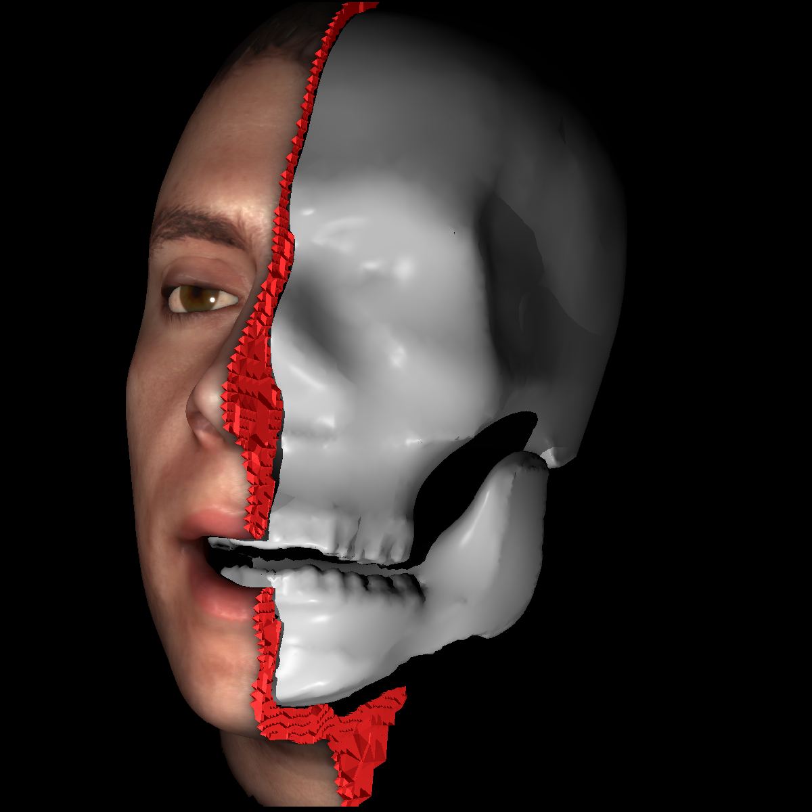
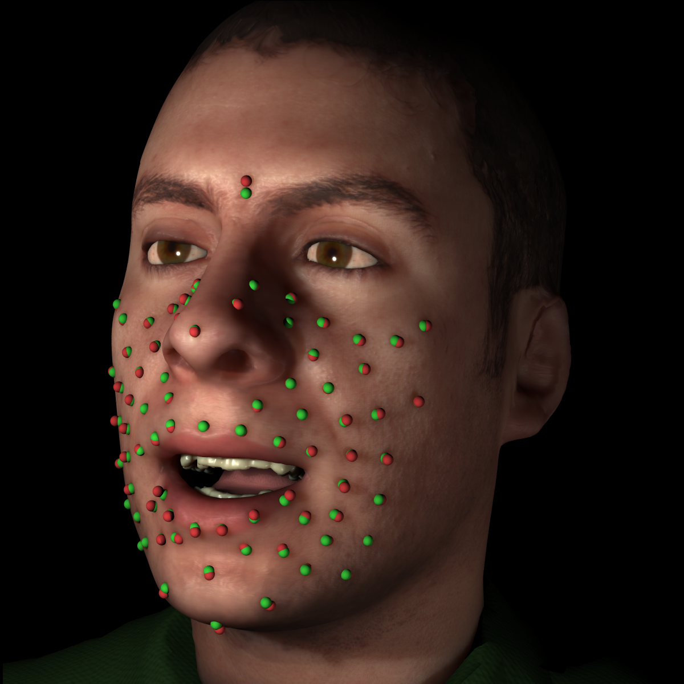
Purpose of this Work
Creation of an anatomically correct model of the Head
Automatic computation of muscle activations from motion capture data

Slide 3
Previous Work
Not biomechanically correct models
2D Approaches
Linear solutions

Slide 4
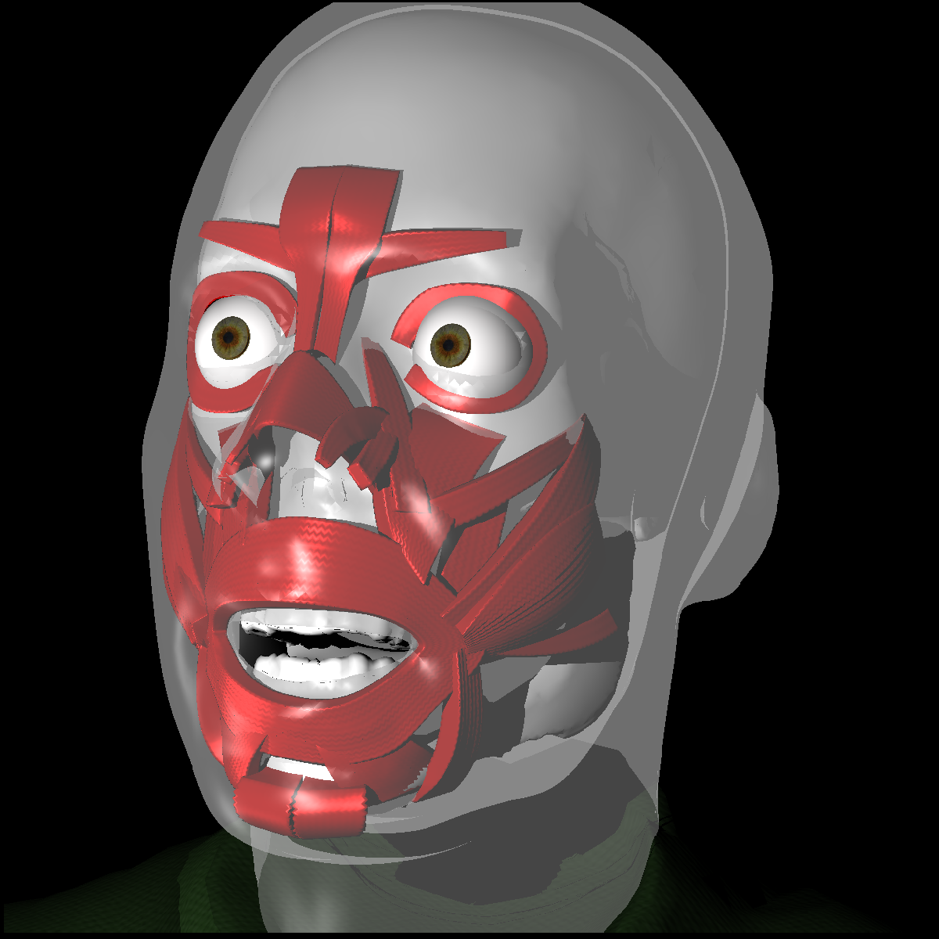
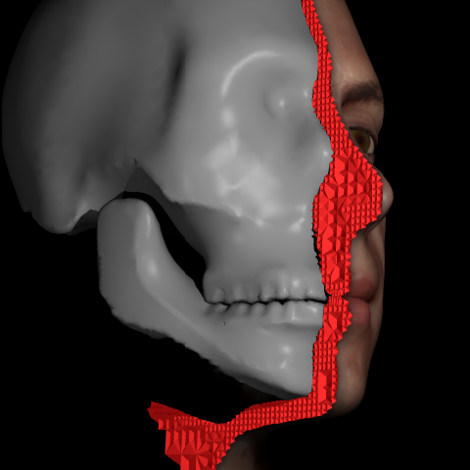
Building the Face Model
Triangulated surface for bones
Tetrahedral mesh for skin
Embedded representation of muscles

Slide 5
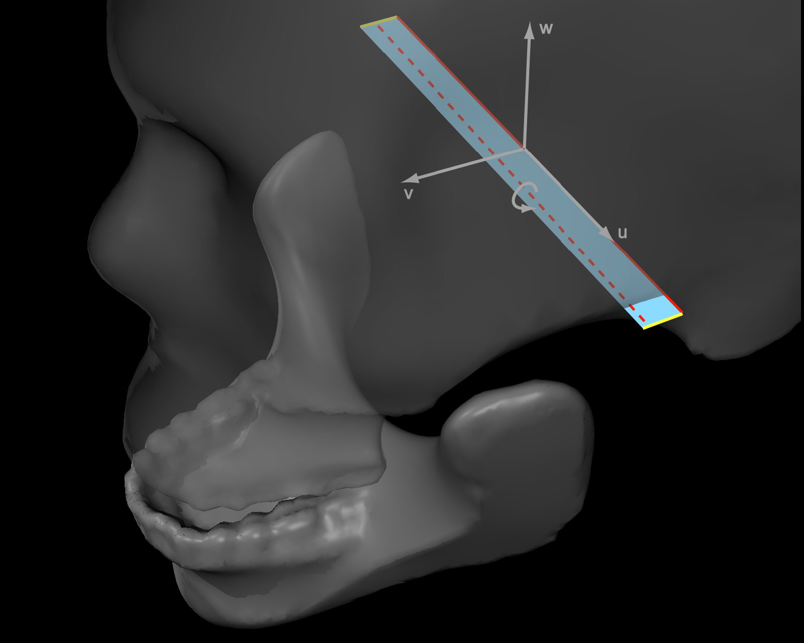
Model Kinematics
Mandible can rotate around an axis whose endpoints can move asymmetrically as sides of cranium

Slide 6
Quasistatic Skin Model
Skin represented by a mesh X
X(a, b)
Actuation
parameters
Bone constraints
We have to compute the skin deformation given ONLY a and b

Slide 7
Computing Skin Deformation
Each point of the skin is influenced by a force f
f(x, a) = f_{o}(x) + Σa_{i}f_{i}(x)
Skin elastic response
Contribution of fully activated muscle
Final skin deformation is computed by finding the
equilibrium point of the skin mesh
f(X(a, b), a) = 0

Slide 8
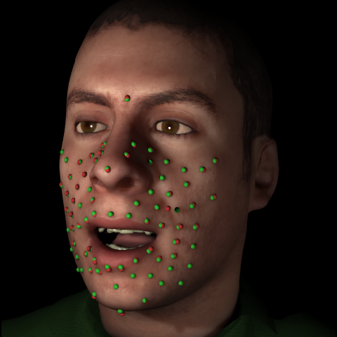
From Markers to Controls
We have to compute actuation parameters and constraints from mocap data:
Add virtual landmarks to our skin model
Optimal set of controls: one which minimized distance between markers and corresponding landmarks

Slide 9
From Markers to Controls
Solution of the previous problem requires minimizing a complex nonlinear quantity
Iterative solution approach: linearize around C_{k} to find ammisible solution for step k + 1 (Gauss-Newton approach)
C_{opt}(X^{T}) = argmin||X^{L}(c) – X^{T}||
cєC₀
Feasible
Control
set
Landmark
positions
Marker
positions

Slide 10
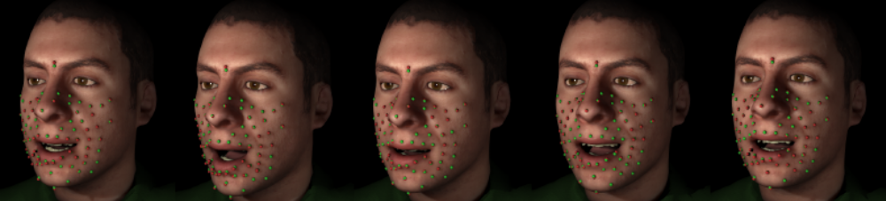
Optimization Framework
Easy but extremely effective idea: use C_{opt} of frame i as C₁ for frame i + 1
Optimization leads to drastic reduction of computation times for the Gauss-Newton step

Slide 11
Future Work
Extending the current head model to include forehead and eye region
Adding support for markerless input data
Adding support for estimation of extra-control data (like model parameters)

Slide 12
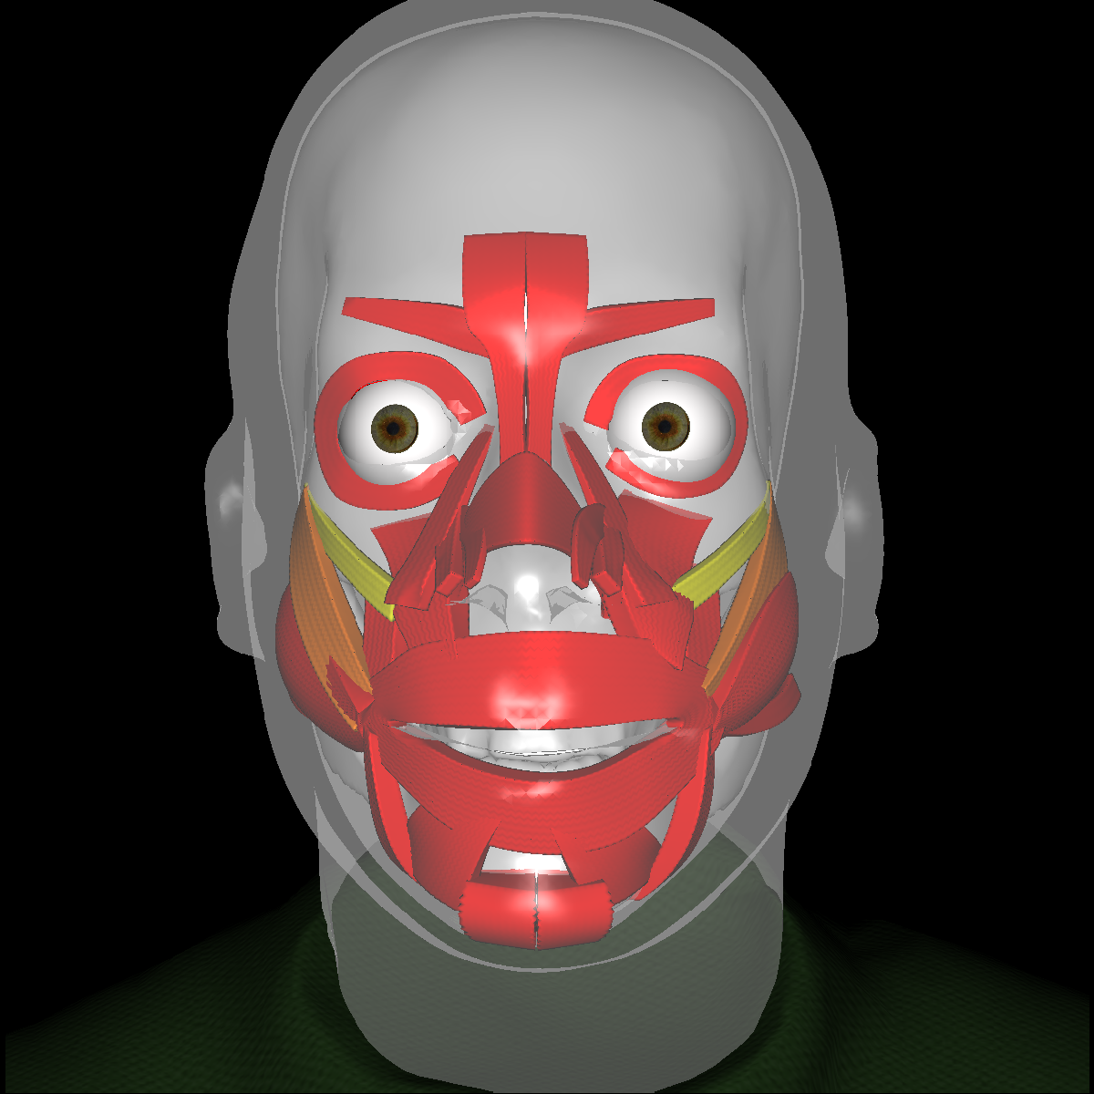
That’s It!
Questions ?

