Slide 1
CS2164 Lab 1
Intro to programming using C
Instructor: Gustavo Sandoval
gustavo.sandoval@nyu.edu

Slide 2
Objectives
Download Compiler and tools
Learn basic Unix commands
Download Editor
Download Github GUI
Learn Basic Edit, compile, execute cycle
Commit code to your github
Write a couple of simple Programs

Slide 3
Download compiler and tools
Windows: http://cygwin.com/install.html
Mac:
Developer.apple.com/downloads
Download the latest Command Line Tools OS X 10.11 (or your version of the OS.)

Slide 4
Installing….

Slide 5
Let’s open a command window and practice some…

Slide 6
UNIX commands
ls | List files in the current directory
ls -aFl | n "awful" listing -a (all), F (full), l (long) you'll see way too much information and there will be a character at the end of each line showing if the file is executable (*) a directory (/) or plain text (no indication)
Ls | more | The | is called pipe which takes the output of the command on its left and sends it to the command on the right.more keeps only a screenful on the screen until the user hits the Enter key (go to the next line) or the space bar (go to the next screenful) or, as almost all UNIX commands can be killed with, ^C.
anycommand > filename anycommand >> filename | Output redirection Whatever the command would have written on the screen is put into the file > creates (destructively) >> appends it the file already exists, creates if it doesn't

Slide 7
More commands
Cd ___ | Change current directory to
pwd | Print working directory
gcc filename.c or Cc filename.c | compile and link the C source code to produce the file named a.out
rm filename | remove (delete) filename
!l | do a history search and reissue the command. UNIX keeps a history of your commands and you can repeat them using the exclamation point (!). It matches the most recently issued command that matches at least what you typed. If you had issued rm and then rmdir, you'd have to type !rm to get the rm to be executed.
^Z (control Z) | pause the running process. Useful if you are in an editor, want to save and test your code and go right back into the editor (see next)
fg | foreground - go back to paused process

Slide 8
Mkdir <name> | Make a directory with name <name>
Cd <name> | Go into the directory

Slide 9
Download an Editor
Your choice of
Sublime
http://www.sublimetext.com/
Emacs
Included in Mac, need to install with Cygwin
Vi
Included in Mac, need to install with Cygwin
Notepad/wordpad
Included in windows, mac

Slide 10
Exercise
Let’s create a directory for our first program
Mkdir hello
Type in the helloworld programs from class using your editor of choice
Compile
Execute the program

Slide 11
Git
The version control problem:
How to maintain different versions of your work
Synchronize work with peers working on the same projects
Resolve conflicts
Example:
Wikipedia
Google Docs

Slide 12
Options for version Control
Centralized (SCCS, RCS):
Systems have a copy of the project hosted on a centralized server
Everyone connects to the server to make changes
Everyone gets access and can make changes
First come – first served
Distributed (CVS, Subversion, Git):
Every developer has a copy of the entire project
Developers can make changes to their copy without affecting the master copy or other devs
Later changes can be synchronized
“owner” can choose which changes to accept

Slide 13
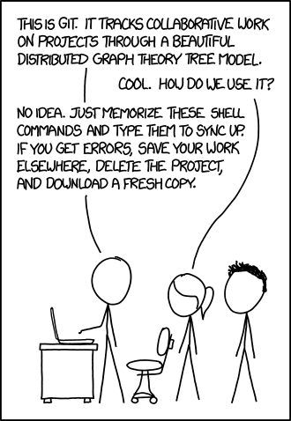
git

Slide 14
Git & Github
Git:
Is a distributed version control system
Tracks your project history
Created by Linus Torvalds (also created Linux)
Github:
One of the providers that allow users to put repositories in the cloud.
Allows git operations through a web interface, desktop and mobile apps

Slide 15
Install Git
OS X:
http://git-scm.com/download/mac or
Sudo brew install Git
Windows:
https://git-scm.com/download/win

Slide 16
Git Workflow
Basic operations:
Initialize:
Tell git this directory is a repo.
Track:
Tell git which files you will be working with.
Commit:
“check in” the changes to the files on your local repo.
Push:
Publish your changes to the remote server

Slide 17
Git Commands
Initialize:
Git init
Track:
Git add <filename>
Commit:
Git commit –m “message” <filename>
Push:
Git push origin master

Slide 18
Let’s add your hello directory to your repo
Git init
Git add .
Create the repo on github
Follow instructions…
Let’s edit it...

Slide 19
Homework: Fahrenheit to Celsius
Write a program that prints out the Fahrenheit temperatures from 0 – 300 and their corresponding Celsius equivalents.
The formula is: C = 5/9(F-32).
Print them in 10 F degrees increments
Push the program and your changes to your git repo.
Due by next wed@ 2:00pm

Slide 20
More reading on git
https://guides.github.com/activities/hello-world/
https://guides.github.com/activities/forking/index.html
Git videos:
http://git-scm.com/videos
https://www.youtube.com/watch?v=0fKg7e37bQE

Slide 21
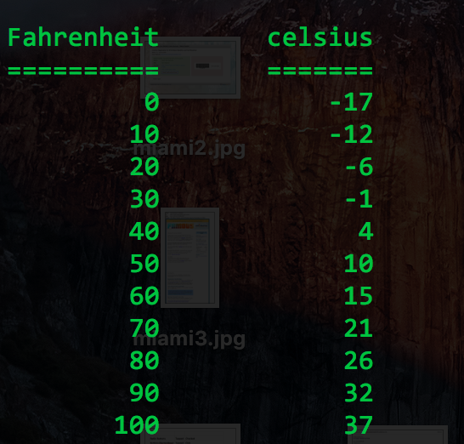
Output should look like…

