Slide 1
CS2164 Lab 1
Intro to programming using C
Instructor: Gustavo Sandoval
gustavo.sandoval@nyu.edu

Slide 2
Objectives
Download Compiler and tools
Learn basic Unix commands
Download Editor
Download Github GUI
Learn Basic Edit, compile, execute cycle
Commit code to your github
Write a couple of simple Programs

Slide 3
Deliverables
Program that writeshello world 10 times
Fahrenheit to Celsisu

Slide 4
Download compiler and tools
Windows: http://cygwin.com/install.html
Mac:
Developer.apple.com/downloads

Slide 5
Installing….

Slide 6
UNIX commands

Slide 7
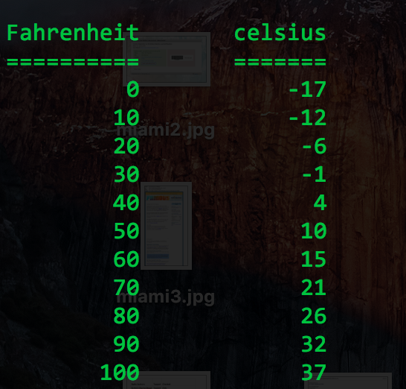
Output should look like…

Slide 8
Fahrenheit to Celsius
Write a program that prints out the Fahrenheit temperatures from 0 – 300 and their corresponding Celsius equivalents.
The formula is: C = 5/9(F-32).
Print them in 10 F degrees increments

