Slide 1
CS2164 Lesson 1
Intro to programming using C
Instructor: Gustavo Sandoval
gustavo.sandoval@nyu.edu

Slide 2




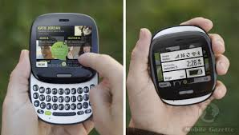
About me
Grew up in Guatemala
High School Teacher of Math, Physics and CS.
MS in Computer Science
Professional Software Developer & Development Manager with Microsoft for almost 20 years
Consultant with Startups

Slide 3
Syllabus & Grading
Github:
https://github.com/NYU-CS2164/syllabus/blob/master/README.md

Slide 4
Labs
As of Thursday the enrollment we have is:
11:00 – 12:30pm 12
3:00 – 4:30 pm 26
we should try to make it even, it’s better for everyone !

Slide 5
Questions?

Slide 6
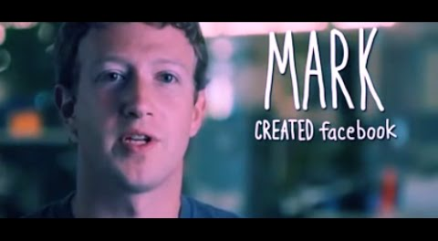
Why Programming ?

Slide 7
“All Problems in Computer Science can be solved by another level of indirection”
David Wheeler

Slide 8
How to program
General Approach
Approach to Part of a problem
Specific Steps to the solution
Specific Steps to the solution
Approach to Part of a problem
Specific Steps to the solution

Slide 9
Procedural Programming
Main Tasks
Subtask 1
Subtask 2
Subtask 3
Function 1
Function 2
Function 3

Slide 10
Abstraction Level for Programming Languages
 | Store 8 bit value in a register/variable
Binary | 10110000 00110111
Hexadecimal | B0 55
Assembly | MOV BL, 055
C | int a = 55;
Python, Ruby, MathLab | a = 55

Slide 11
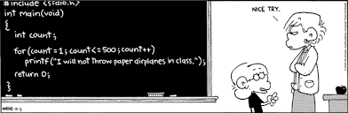
Why C

Slide 12
Why C
Simple, terse and efficient
Portable
Modular
Native Language of UNIX/Linux
Basis for C++, Java, Objective C
Still a huge demand (2nd most in demand)

Slide 13
History
Designed in the early 70s by Dennis Ritchie in Bell Labs as a general purpose programming language.
It was designed to overcome the limitations of B
First big project with it was the Unix Operating System
Original definition of the language was “The C programming Language” book written by Kernighan and Ritchie. K & R.
Standardized by American National Standards Institute (ANSI) in 1988

Slide 14
Some C Properties
C is a Compiled Language
C is low level: deals with characters, numbers and addresses.
C is small and simple: few data types, control structures so it can be learned quickly !
C is not a garbage collected language.
C does not provide I/O or File manipulating facilities you need a library function for that.

Slide 15
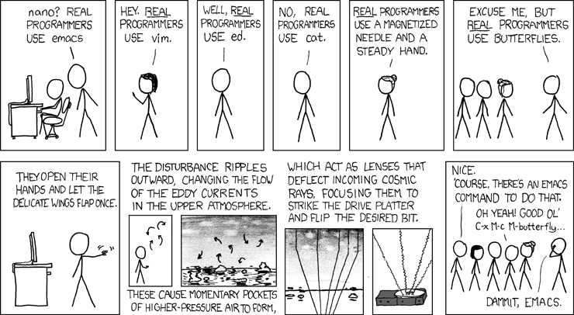
Editors

Slide 16
Editors
Emacs
Vi
Sublime
Which one do you use ?

Slide 17
DEMO

Slide 18
Compiled vs Interpreted
Compiled:
Slow to develop: need to edit, compile and run
Fast to execute, because it’s optimized to the target machine
Interpreted:
Fast to develop: just edit and run
Slow to execute: needs to be translated to machine code every time

Slide 19
Demo

Slide 20
Simple.c
main() | Special entry point to every program
{ | Tell the compiler this is the start of a function
} | Tell the compiler it’s the end of the function
Notes:
Main is the special entry point to every program
() tell the compiler this is a function
{} surround the body of a function definition

Slide 21
Simple2.c
/*
* Author: Gustavo Sandoval
* Date: Jan 2016
*
*/
int main()
{
return (0);
}
Notes:
A more complete program.

Slide 22
HelloWorld.c
#include <stdio.h> | Include information about the standard library
int main() | Define a function called main that returns an integer and takes no arguments (parameters)
{ | Statements of a function are enclosed in “brackets” {
printf(“hello world\n”); | Call the library function printf to print a sequences of characters. \n is the newline character
} | Closing bracket

Slide 23
Demo
What happens if ?
Notes:
We remove the \n
We separate each of the words ? And the \n
What if we add many \n

Slide 24
Variables
In C all variables must be declared or named at the beginning of the program
A variable name, also called identifier, consists of a sequence of letters, digits and potentially underscores.
Can not start with a digit
Should be chosen to identify their contents
Examples:
Int kilometers;
Float miles;

Slide 25
Demo
Marathon.c

Slide 26
Homework
Git Concepts:
Fork
Clone
Pull request
Git reading:
https://guides.github.com/activities/forking/index.html
Git videos:
http://git-scm.com/videos
https://www.youtube.com/watch?v=0fKg7e37bQE

