Slide 1
CS2164 Lesson 6 Feb 10, 2016
Intro to programming using C
Instructor: Gustavo Sandoval
gustavo.sandoval@nyu.edu

Slide 2
Homework Discussion

Slide 3
Assignment 1
Requirements:
Write a function that counts the number of characters in a string.
See strlen2.c
Solution strlen.c

Slide 4
Key Concepts
Loops
Functions
Null Terminated strings.

Slide 5
Assignment 2: Fahrenheit to Celsius
Write a program that prints out the Fahrenheit temperatures from 0 – 300 and their corresponding Celsius equivalents.
The formula is: C = 5/9(F-32).
Print them in 10 F degrees increments
See C2FTable.c

Slide 6
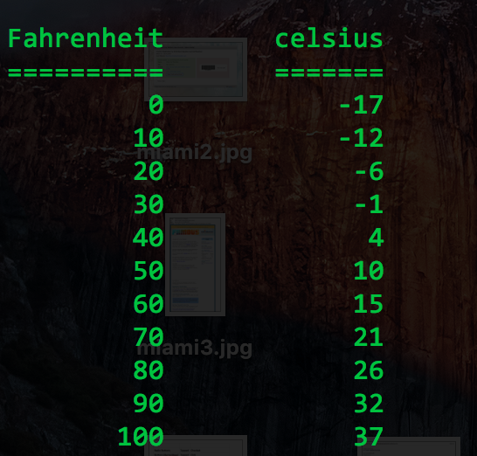
Output should look like…

Slide 7
Key Concepts:
Loops: incrementing on more than 1
Integer vs floating point division

Slide 8
Recap from some parts of last class…

Slide 9
6 kinds of tokens for the compiler in C
Identifiers
Keyword
Constants
String literals
Operators
Punctuators (Other separators)
Note: Blanks, Horizontal and vertical tabs, newlines and comments are ignored
Notes:
nn

Slide 10
Increment & decrement operators
Example | Name | Effect
++a | Pre-increment | Increments by 1 then returns a
a++ | Post-increment | Returns a then increments by 1
--a | Pre-decrement | Decrements by 1 then returns a
a-- | Post-decrement | Returns a then decrements by 1

Slide 11
Difference in a loop
See Loopy.c

Slide 12
Remember… (equivalent expressions in the same color)
for (int i=0; i<10; i++)
printf(”yo %d \n", i);
int i = 0;
While (i<10) {
printf(”yo %d \n", i);
i++;
}

Slide 13
Declarations, Expressions & Assignment

Slide 14
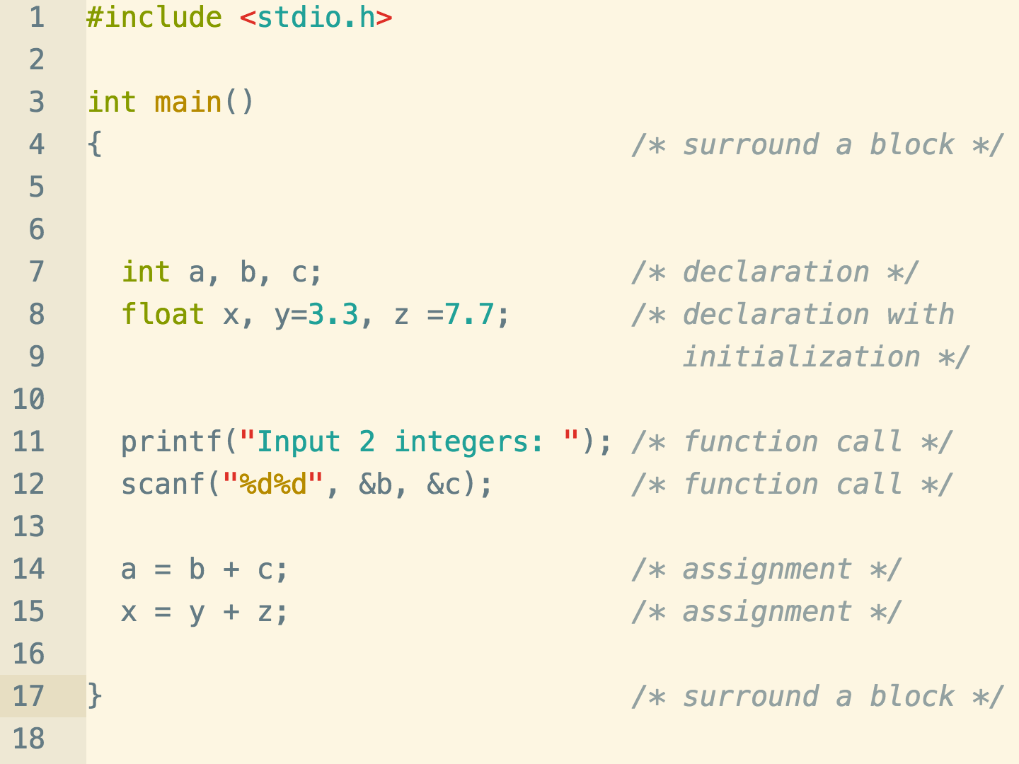
Declarations.c

Slide 15
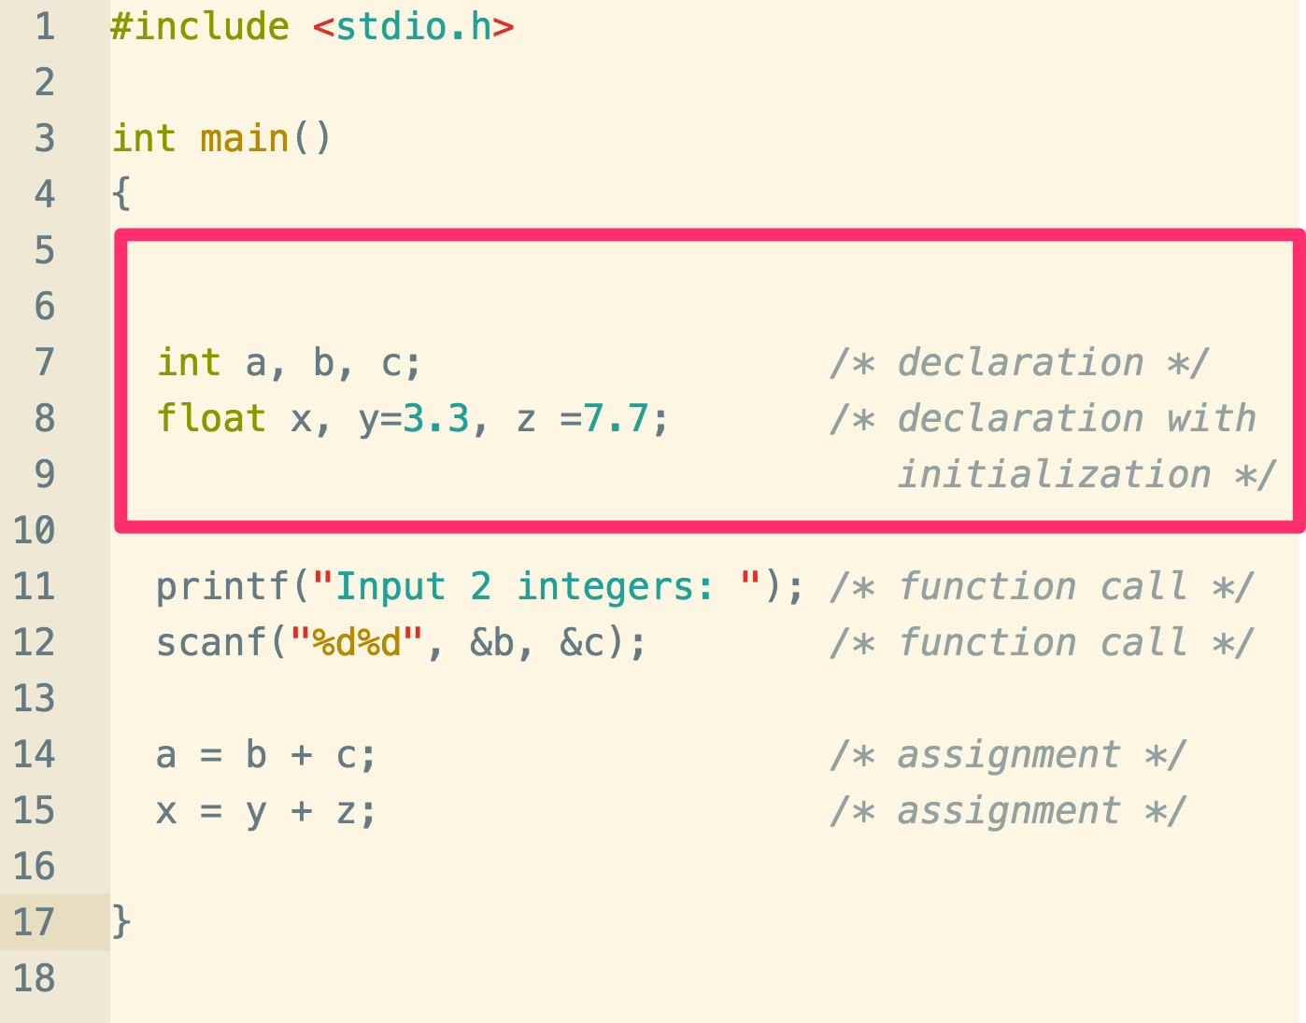
Declarations:
All variables must be declared before use.
Specify a type and contain a list of one or more variables of that type.
Associate a type (float, int, char) with each declared variable
Might also be used to initialize the variable.
Depending on the type the compiler sets aside different amount of space. Talk about that soon…

Slide 16
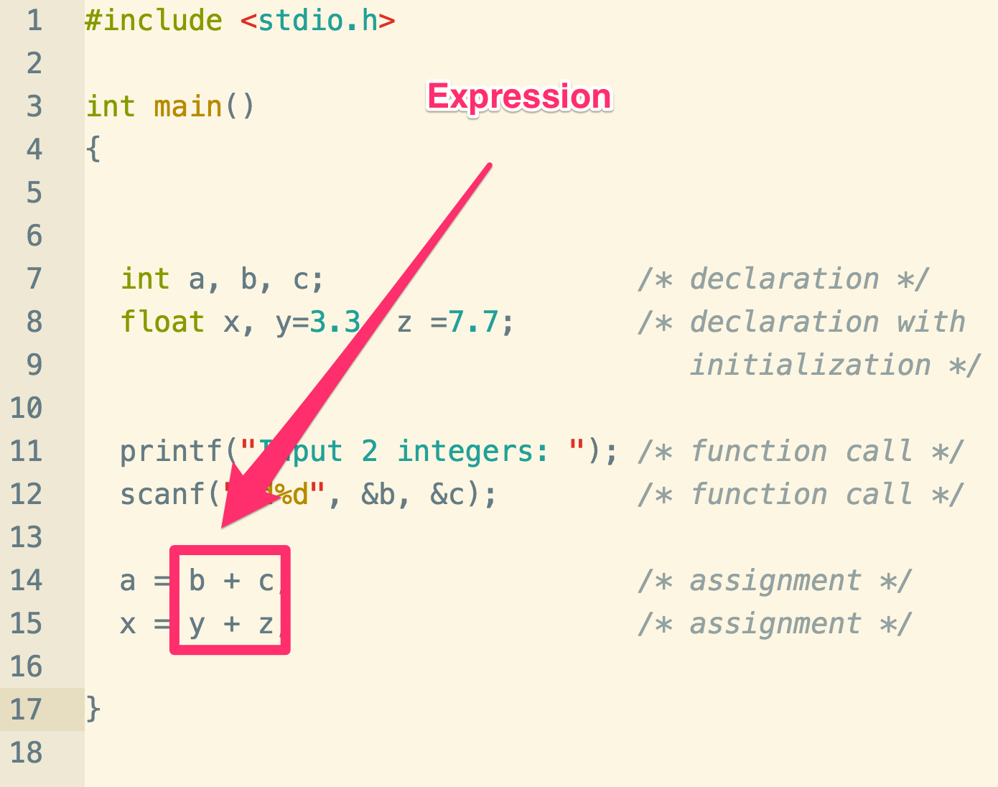
Expressions
Meaningful combinations of constants, variables, operators and function calls.
A constant, variable or function call can be considered an expression
Examples:
A + B
rand()
5.0 * x – 3.14

Slide 17
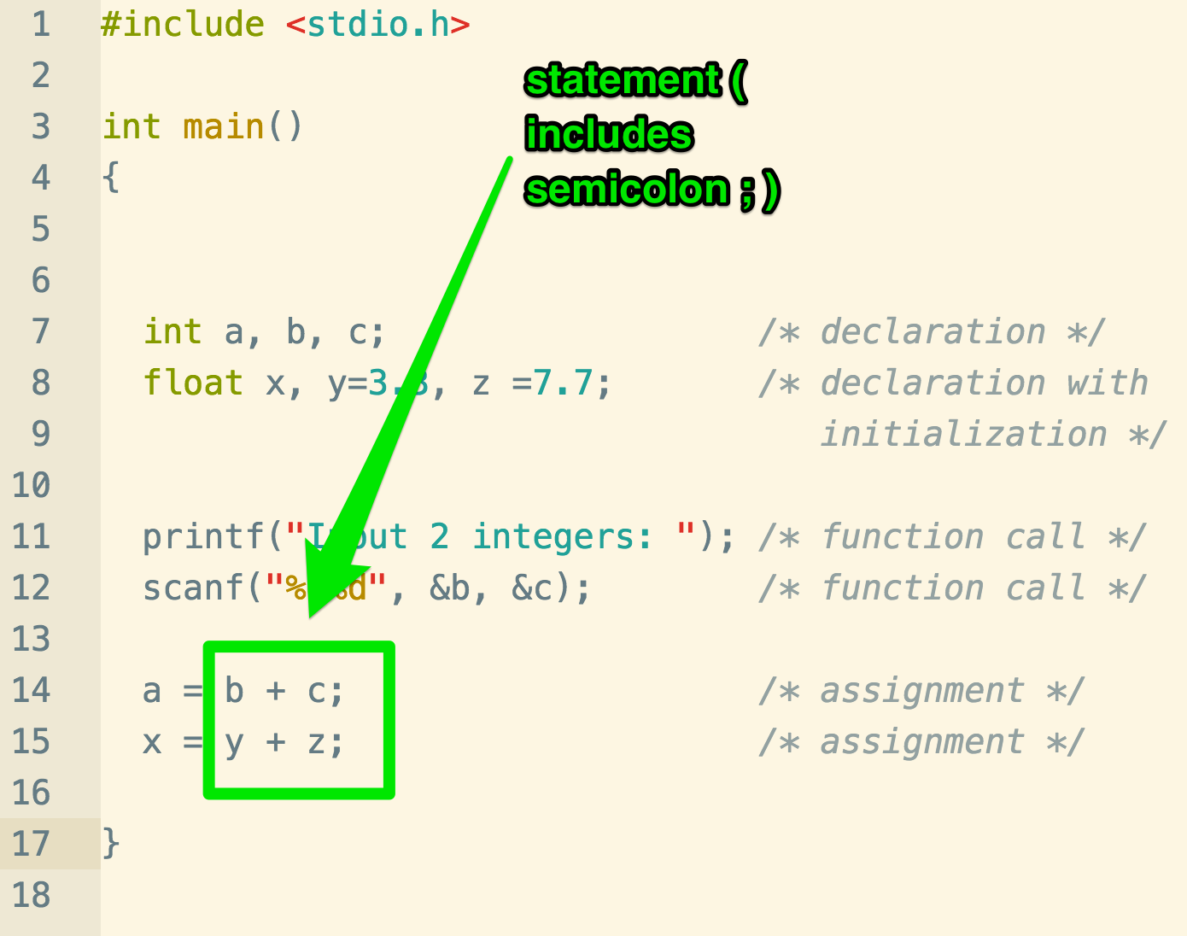
Statements
Expression + semicolon = statement
Examples:
K = 7;
Printf(“here we go again”);
These are legal but not useful and will generate warnings:
3.14159;
a + b;

Slide 18
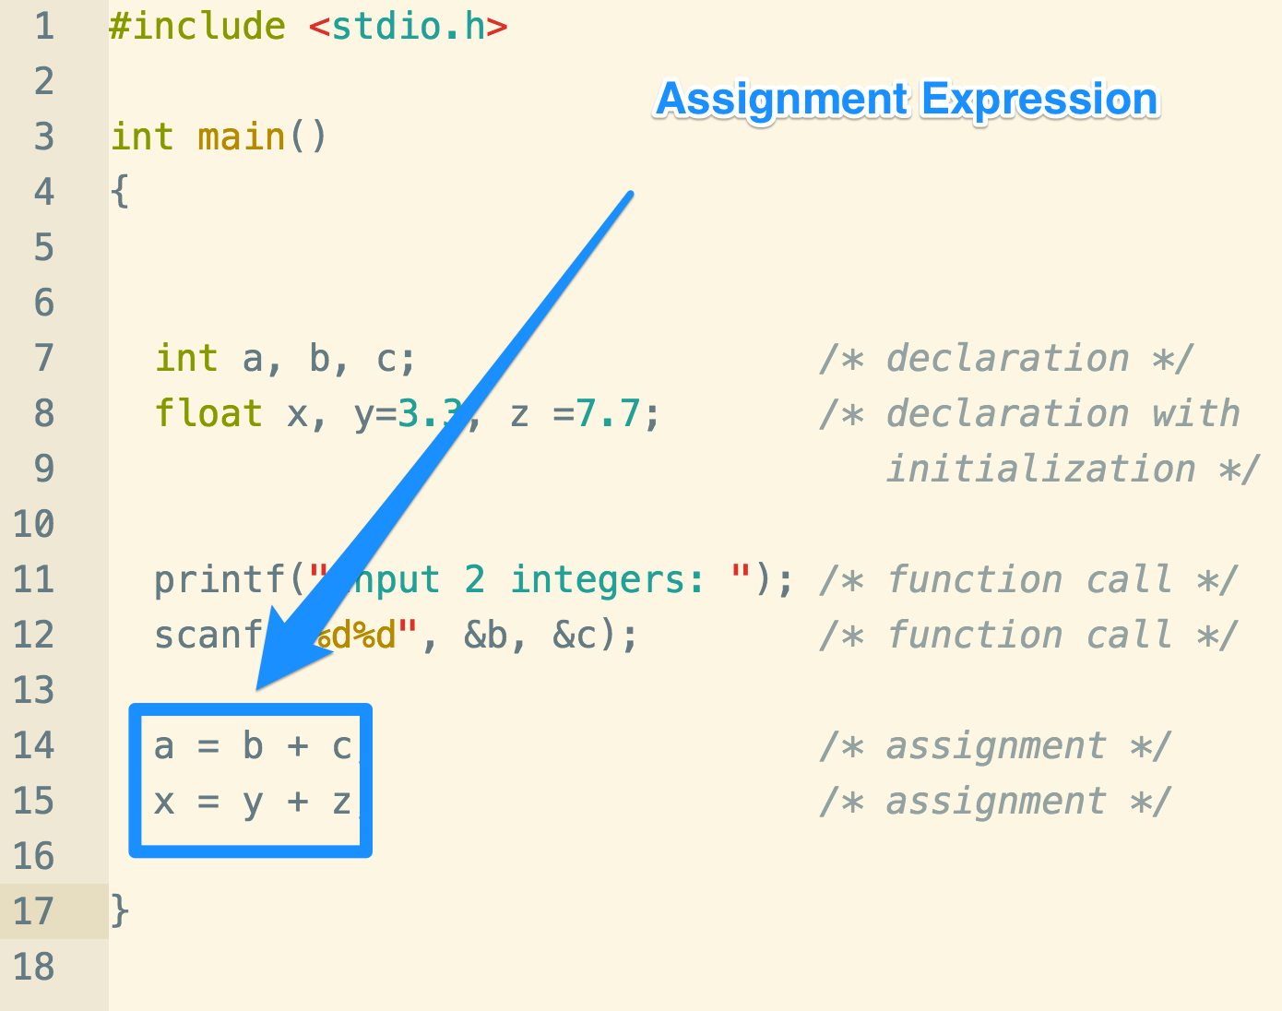
Assignment Expression
It’s of the form:
Variable = expr
Note that it’s not the same as in Math class:
A = A + 1; YES
A + 1 = A; NO

Slide 19
Fundamental Data Types
Type | Size | usage
char | 1 byte | Capable on holding one character on the local char set
int | OS/Architecture dependent. Usually 4 bytes. In the old days it was 2 for 16 bit machines. | integer
long | OS/Machine dependent. Usually 8 bytes. (Except in Windows where it’s 4) | Long integer
float | 4 | Single precision floating point
double | 8 | Double precision floating point

Slide 20
Fundamental Types Long form
char | signed char | unsigned char
short int | int | long int
unsigned short int | unsigned int | Unsigned long int
float | double | long double

Slide 21
Let’s try it out
Sizeof.c

Slide 22
Ranges:
Type | size | Min | Max
Unsigned char | 1 | 0 | 2^8 -1 (count starts at 0)
Signed char | 1 | -2^7 | 2^7 - 1
Unsigned int | 4 | 0 | 2^32 – 1 (or 4,294,967,295 or @4bn)
int | 4 | -2^31 | 2^31 – 1 (or @2bn)
Unsigned long | 8 | 0 | 2^64 – 1 (or @1.8 e 19)
long | 8 | -2^63 | 2^63 - 1

Slide 23
Some examples
Big.c

Slide 24
Characters
Let’s look at characters.c
Why does it one time print a and another 97 ?

Slide 25
Data Type char
In addition to representing characters a variable of type char can be used to hold small integer values (up to 256 distinct values)
Only a subset are actually printable.
Lower and upper case letters
Digits
Punctuation
Special characters such as % and +
Most machines use ASCII character codes

Slide 26
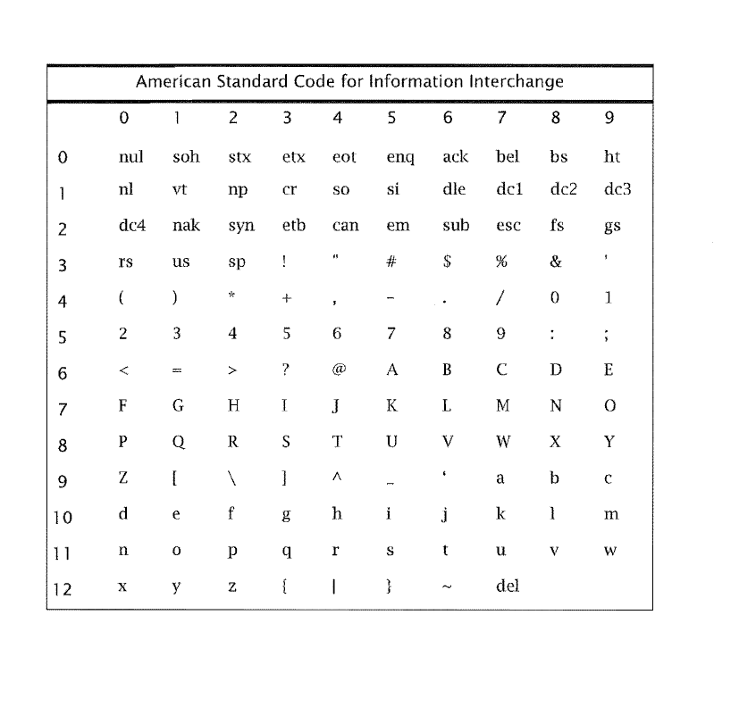
ASCII Table

Slide 27
Exercise
Write a program that print:
All the letters from ‘a’ to ‘z’
All the letters from A to Z
All the numbers from 0 - 9

