Slide 1
CS2164 Lab 2
Intro to programming using C
Instructor: Gustavo Sandoval
gustavo.sandoval@nyu.edu

Slide 2
Objectives
Let’s exercise our:
Edit, compile, execute cycle
Download Github
Learn about Github
Commit code to your github
Write a couple of simple Programs

Slide 3
Git
The version control problem:
How to maintain different versions of your work
Synchronize work with peers working on the same projects
Resolve conflicts
Example:
Wikipedia
Google Docs

Slide 4
Options for version Control
Centralized (SCCS, RCS):
Systems have a copy of the project hosted on a centralized server
Everyone connects to the server to make changes
Everyone gets access and can make changes
First come – first served
Distributed (CVS, Subversion, Git):
Every developer has a copy of the entire project
Developers can make changes to their copy without affecting the master copy or other devs
Later changes can be synchronized
“owner” can choose which changes to accept

Slide 5
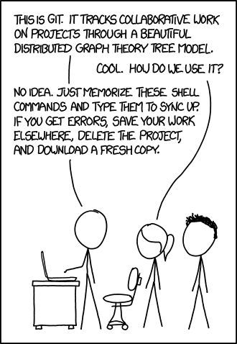
git

Slide 6
Git & Github
Git:
Is a distributed version control system
Tracks your project history
Created by Linus Torvalds (also created Linux)
Github:
One of the providers that allow users to put repositories in the cloud.
Allows git operations through a web interface, desktop and mobile apps

Slide 7
Install Git
OS X:
http://git-scm.com/download/mac or
Sudo brew install Git
You probably have it installed

Slide 8
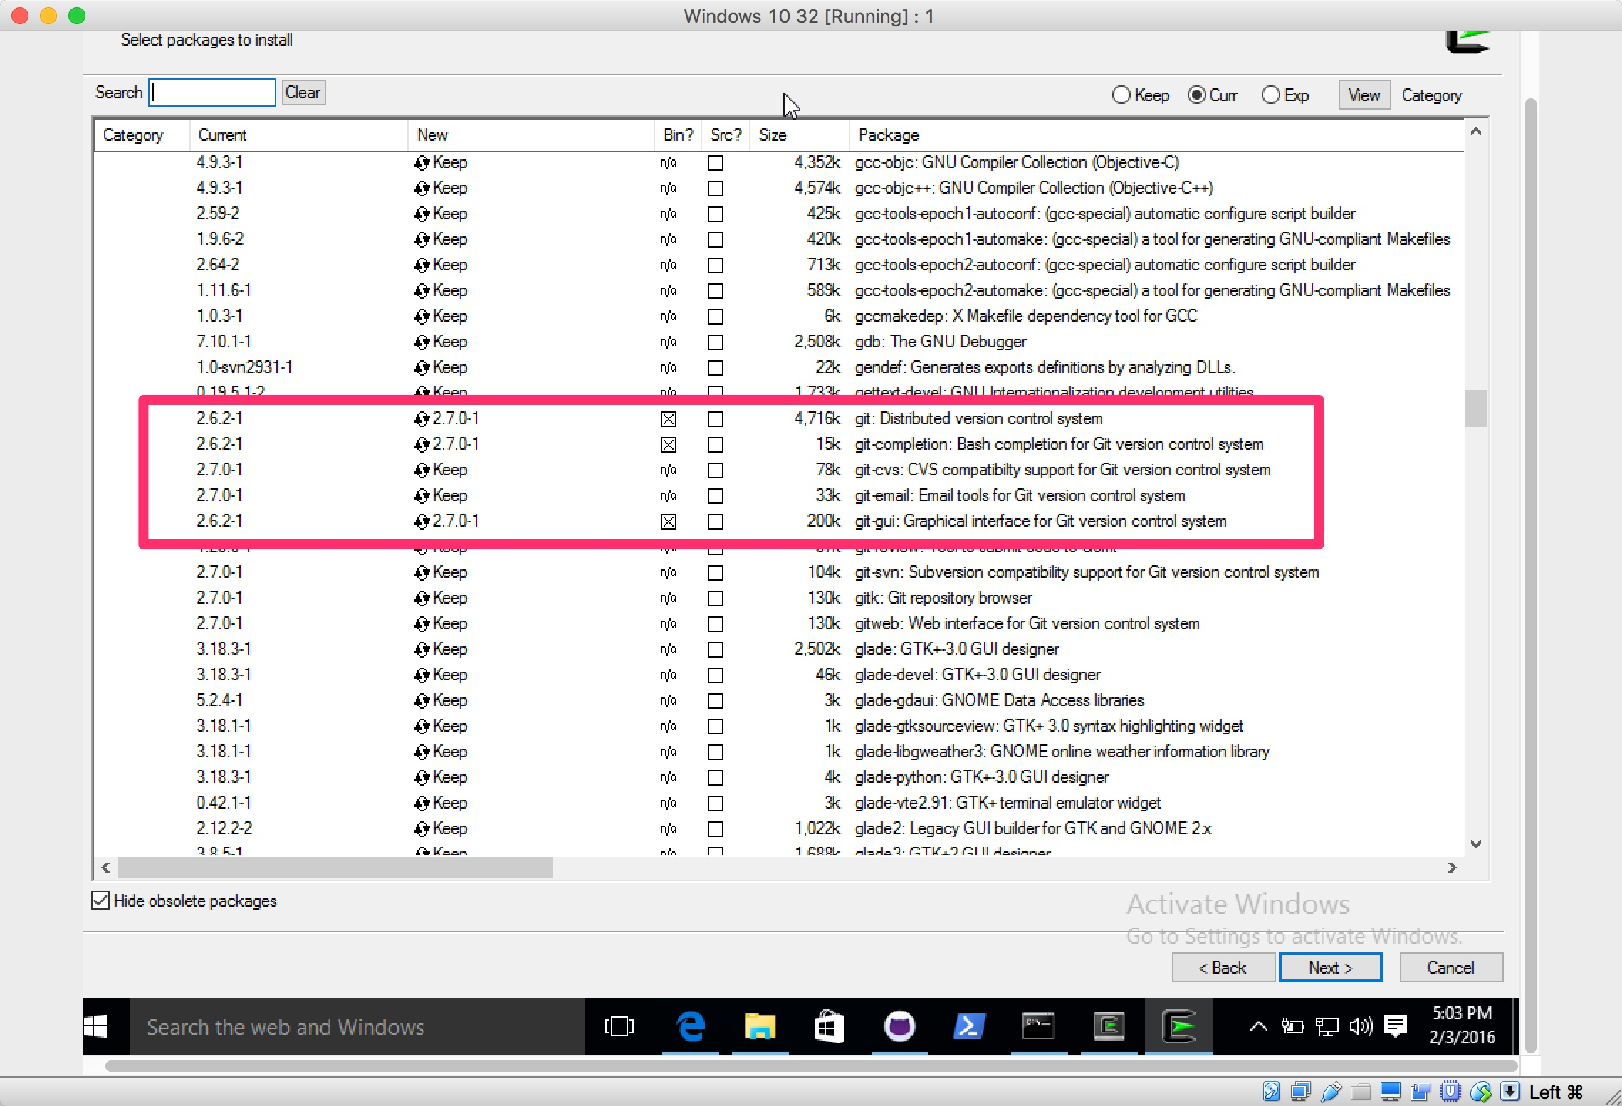
Windows

Slide 9
Git Workflow
Basic operations:
Initialize:
Tell git this directory is a repo.
Track:
Tell git which files you will be working with.
Commit:
“check in” the changes to the files on your local repo.
Push:
Publish your changes to the remote server

Slide 10
Git Commands
Initialize:
git init
Track:
git add <filename>
Commit:
git commit –m “message” <filename>
Push:
git push origin master

Slide 11
Remember the practice in class:
Write a program that computes the length of a string.
See the skeleton in strlen2.c

Slide 12
Let’s add this directory to your repo
git init
git add .
Create the repo on github
Follow instructions…
Let’s edit it...

Slide 13
Collaborating via Github
Cloning a repository (video)
Forking a repository (video)
Contributing via pull requests (video)

Slide 14
More reading on git
https://guides.github.com/activities/hello-world/
https://guides.github.com/activities/forking/index.html
Git videos:
http://git-scm.com/videos
https://www.youtube.com/watch?v=0fKg7e37bQE

Slide 15
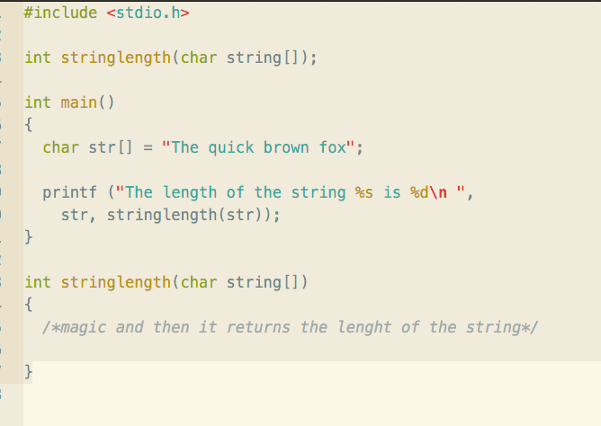
Homework Stringlength :

Slide 16
Homework: Fahrenheit to Celsius
Write a program that prints out the Fahrenheit temperatures from 0 – 300 and their corresponding Celsius equivalents.
The formula is: C = 5/9(F-32).
Print them in 10 F degrees increments
Push the program and your changes to your git repo.
Due by next wed@ 2:00pm

Slide 17
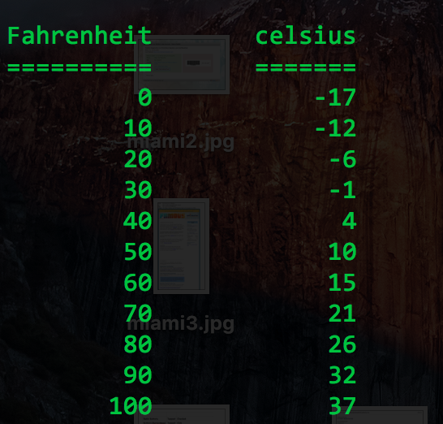
Output should look like…

