Slide 1
CS2164 Lesson 5 Feb 8, 2016
Intro to programming using C
Instructor: Gustavo Sandoval
gustavo.sandoval@nyu.edu

Slide 2
Some things to help in the lab…
Let’s review what we are using:
Editor: to write our programs (sublime, atom, emacs)
Compiler: to create an executable program
Terminal (cygwin): access to the compiler
Git/Github: Version control and submission of our programs.
You write your program in a directory (folder) called Lab2.
Your program will be called: stringlen.c or Temperatureconversion.c.
You will save in in a folder or directory that both your terminal and your editor have access to.
If you can’t call the editor form the terminal it’s ok. You can still open the file !!

Slide 3
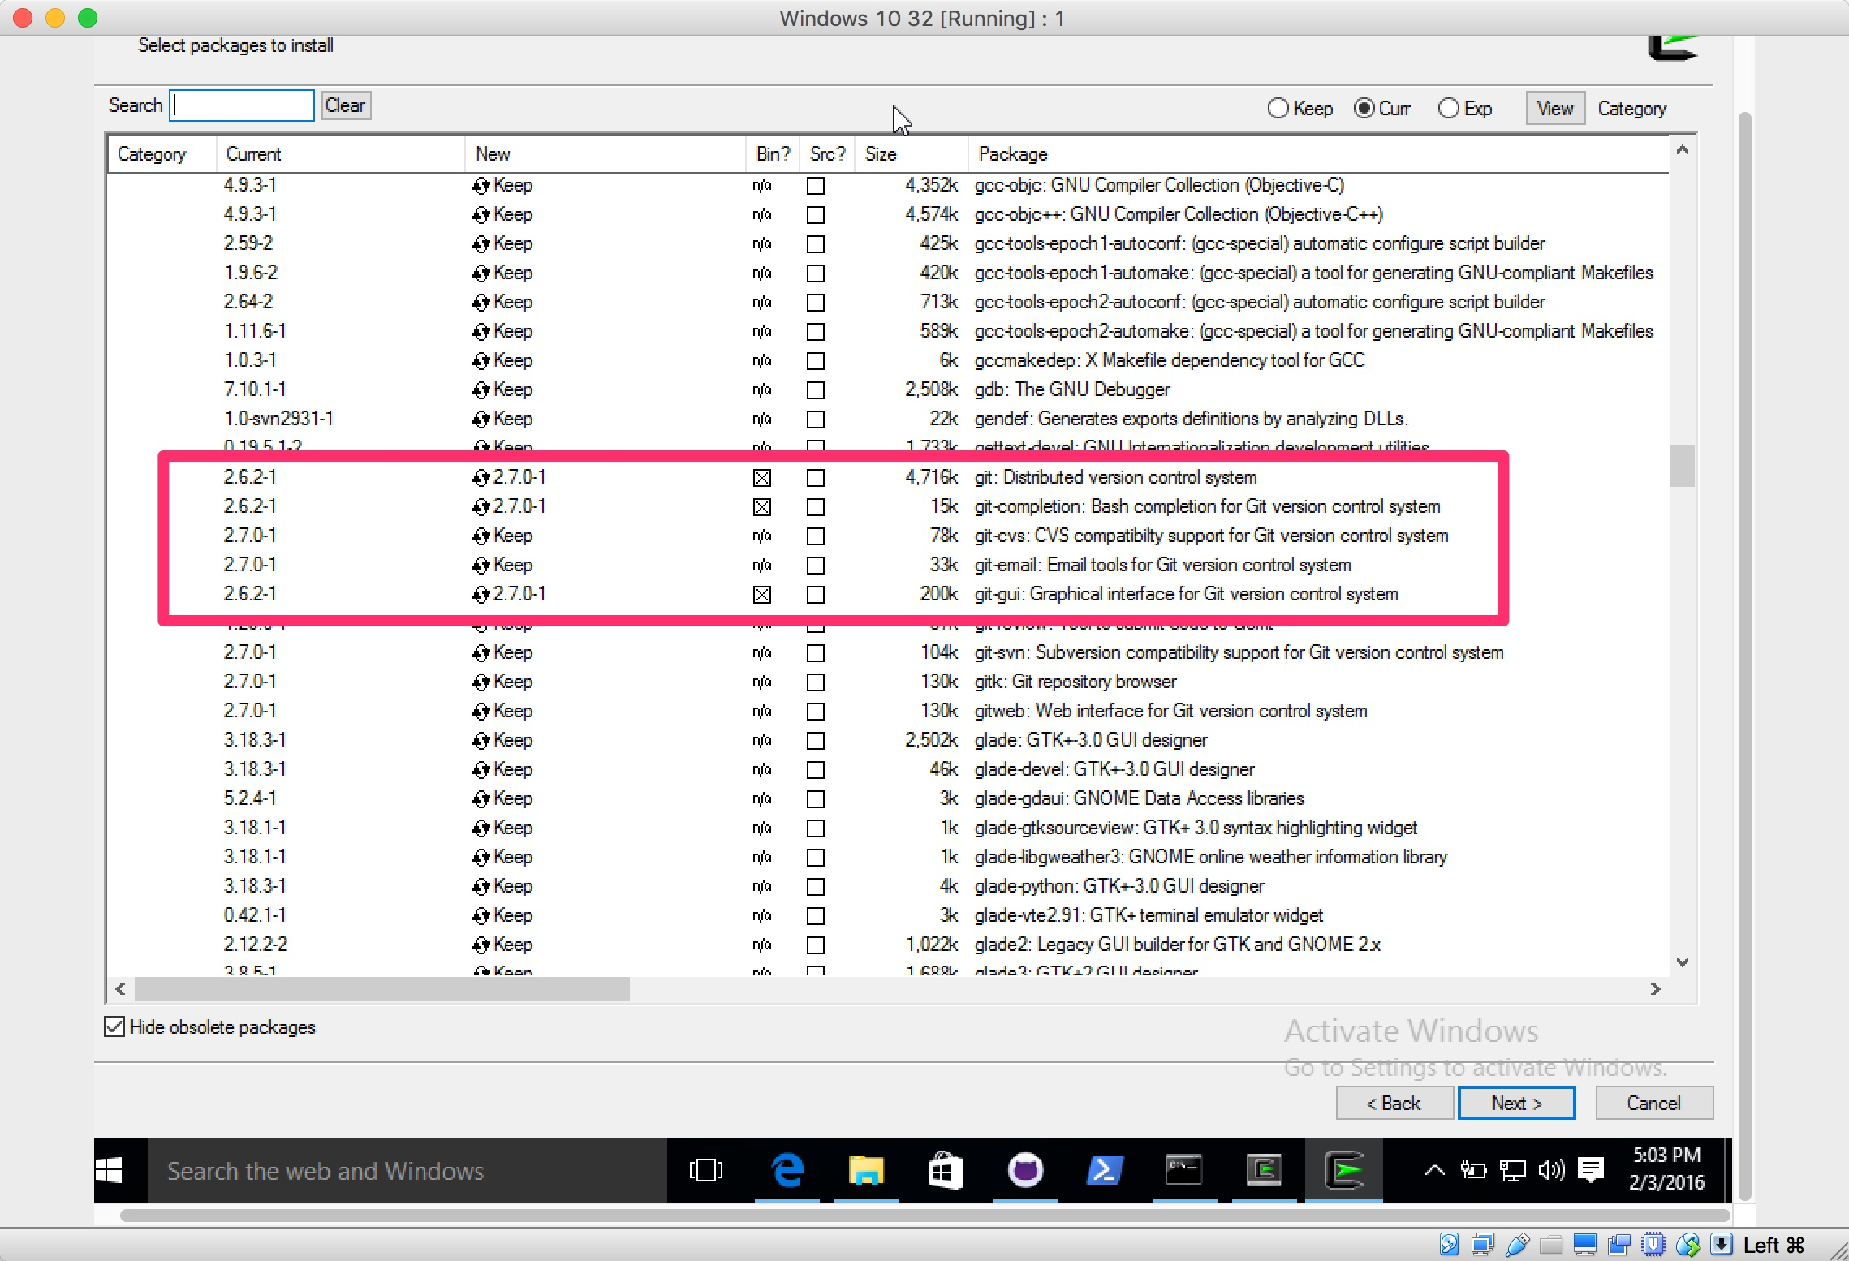
Windows Github on Cygwin

Slide 4
Lexical Elements of C
The vocabulary of C

Slide 5
How does a C Program get compiled
C Like any language It has a vocabulary
A C program consists of 1 or more files
It is translated in several phases:
Translate directives introduced by lines that start with # (#include, #define)
Perform macro definition and expansion
The result is a set of TOKENS
The compiler uses this token to create an executable

Slide 6
6 kinds of tokens for the compiler
Identifiers
Keyword
Constants
String literals
Operators
Punctuators (Other separators)
Note: Blanks, Horizontal and vertical tabs, newlines and comments are ignored

Slide 7
Token Type 1: Identifiers
Is a sequence of letters and digits
It’s a good practice to choose ones that have mnemonic significance
The first character must be a letter or underscore (_)
Upper and Lowercase are different (Main vs main vs _main)
Not recommended to use the _ as the first letter because internal functions use that.
In ANSI C, the first 31 letters are significant
Examples:
K
_id
Iamanidentifier
so_am_i

Slide 8
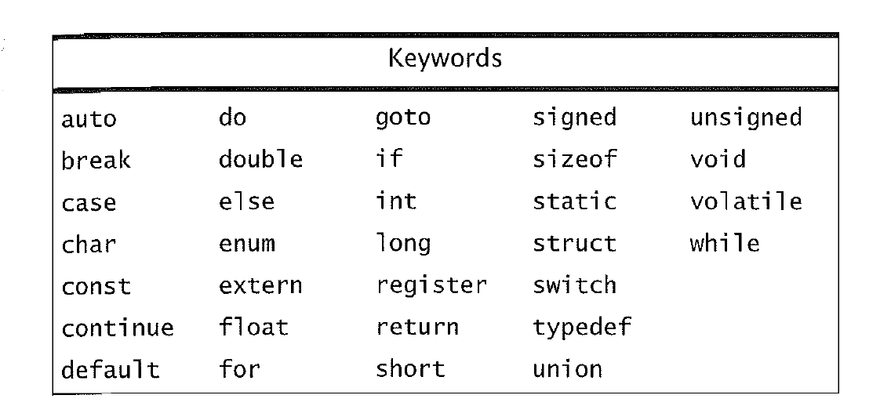
Token Type 2: Keywords
Explicitly reserved words that have a strict meaning.
Cannot be redefined or used in other context.
C has 32

Slide 9
Token Type 3: Constants
We have 4 different types:
Integer constant
Character constant
Floating point constant
Enumeration constant

Slide 10
Integer Constants
Examples:
0, 34
If they start with 0 (zero) it’s assumed Octal. Don’t contain the 8 or 9
056, 023
If they start wit 0x (zero and x) it’s Hex:
0x23, 0xFF

Slide 11
Character constants
Written between single ‘ ‘ (quotes)
Some are special such as:
\n – new line
\t - tab
\\ - backslash

Slide 12
Floating point constants
Consists of 3 parts:
Integer part
A decimal point
Fraction part
Examples:
3.14159
2.71828

Slide 13
Token Type 4: String Constants
Sequence of Characters surrounded by double quotes (“”)
Stored as array of characters with a null terminator at the end
They are different than character Constants:
“a” NOT THE SAME as ‘a’. Why ?
Examples:
“hello world” - normale string we know
“” - the null string
“a = b + c” - another string

Slide 14
Token Type 5: Punctuators
Along with white space help the compiler separate language elements
Examples include:
Parentheses
Braces
Commas
Semicolons

Slide 15
Token Type 6: Operators
In C there are many special characters with particular meanings. Examples include the arithmetic operators:
Operator | meaning
+ | addition
- | subtraction
* | multiplication
/ | Division
% | Modulus. Remember modulus is the value of the remainder after performing a division. Example: 5 % 3 is 2

Slide 16
Notice that tokens have meaning depending on context
Modulus:
A = B % 2;
Conversion Specification:
Printf(“%d”, a)

Slide 17
Precedence and Associativitiy of Operators
Operators have rules or precedence and associativity
However the compiler has some “leeway” to make changes
Expressions inside parentheses are evaluated first
When in doubt use parenthesis !

Slide 18
Examples
Expression | Result
1 + 2 * 3
1 + (2 * 3)
(1 + 2 ) * 3
1 + 2 – 3 + 4 – 5
(((1 + 2 ) – 3) + 4) - 5

Slide 19
Increment and Decrement Operators
Prefix:
--a
Postfix:
a++
Int a, b, c =0;
a = ++c
b = c++
Printf(“%d, %d, %d\n”, a, b, ++c);

Slide 20
Assignment Operators
We already know it:
A = B + C
C treats = as an operator just like + or –
It’s precedence is lower than any of the other operators we have seen
Associativity is Right to left

Slide 21
Examples
b = 2
C = 3
A = B + C
Equivalent to:
A = (B = 2) + (C = 3)
A = 0;
B = 0;
C = 0;
Equivalent to:
A = B = C = 0;
A = (B = (C = 0))

Slide 22
Other assignment operators
Operator | meaning
A = B | A = B
A += B | A = A + B
A -= B | A = A - B
A *= B | A = A * B
A /= B | A = A /B
A %= B | A = A % B
A >> = B | A = A >> B
A << = B | A = A << B
A &= B | A = A & B
A ^= B | A = A ^ B
A |= B | A = A | B
Variable op = expression | Variable = variable op (expression)

Slide 23
Relational and Logical Operators
> | Greater than
>= | Greater than or equal to
< | Less than
<= | Less than or equal to

Slide 24
Equality operators
Equality:
==
Inequality:
!=
Example:
A = 3
If (a == 3)
Printf (“it’s three”);
Else
Pritnf (“it’s not three”);

Slide 25
Example
Powers.c

Slide 26
Preprocessor Directives
Lines that begin with #
One of the uses is to include header files
Examples:
#include <stdio.h>
#include “myfile.h”
With <> it looks in all directories but the current one
With “” it looks on the current one

Slide 27
Standard library
Contains many useful functions that add power and flexibility to C.
Many are used extensively other only ocassionaly
You can browse them all here:
https://en.wikipedia.org/wiki/C_standard_library#Header_files

Slide 28
Example with all the tokens seen today
Printrandom.c

