Slide 1
CS2164 Lesson 11: Arrays, Pointers and Strings
Intro to programming using C
Instructorcl: Gustavo Sandoval
gustavo.sandoval@nyu.edu

Slide 2
HOMework

Slide 3
Assignment 5
Implement a GetToken function that given a line of text, returns each word in the text. If the function is called with NULL it will return the next token on the line. So this means that it can be used with a while loop. The separators are spaces " ". See the sample usage and output below:

Slide 4
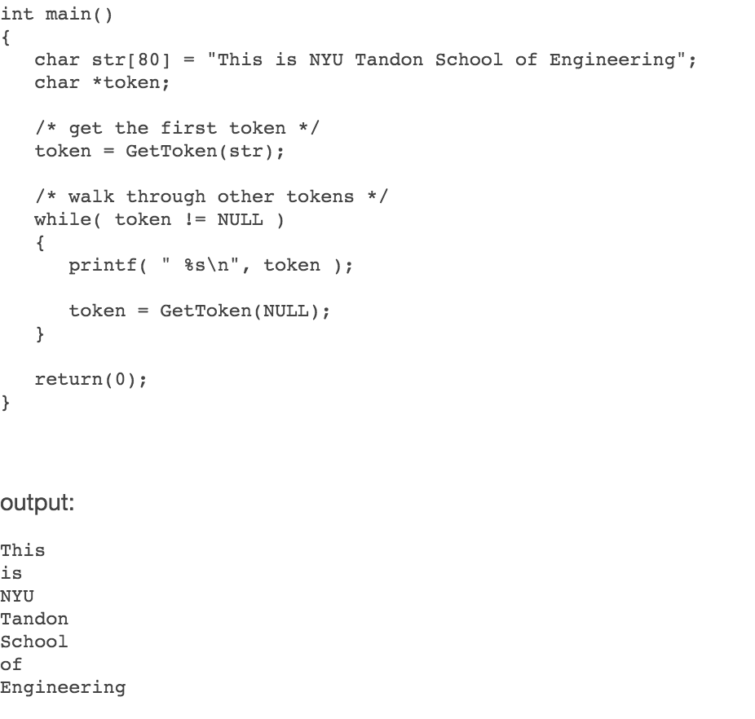

Slide 5
Solution
Board and Tokenizer.c

Slide 6
From last class

Slide 7
Arrays Summary
Brackets tell the compiler that an identifier is an array
The constant inside the brackets specifies the size of the array
For example:
Int a[100]
Causes the compiler to allocate contiguous space in memory for 100 ints
The elements are numbered from 0 – 99
Example:
Arrays1.c

Slide 8
Another example
Let’s see what happens here:
int n = 1;
int *pointer = &n;
n++;
(*pointer)++;
What’s the value of n at the end of these lines ?

Slide 9
New stuff

Slide 10
Dynamic Memory Allocation
What if you are reading a large file that you don’t know the size at compile time ?
What if you want to merge two arrays and you don’t know the size at compile time ?
What if you want to allocate a large object (> 2MB) ? Object on the stack can only be 2MB.
??

Slide 11
Dynamic memory allocation/deallocation
You need to use: Dynamic memory allocation.
The two functions are:
malloc() and calloc().
The memory allocated by these functions needs to be deallocated with free()
They do the same thing except that calloc() initializes the memory to 0
WARNING:
REMEMBER TO ALWAYS USE free() when using malloc() or calloc.

Slide 12
malloc
To allocate a block of memory, call malloc.
The prototype for this function is in stdlib.h.
definition:
void * malloc (size_t size)
Note size_t is another name for an unsigned integer.
Notes:
http://www.gnu.org/software/libc/manual/html_node/Allocating-Cleared-Space.html#Allocating-Cleared-Space

Slide 13
Calloc
The function calloc allocates memory and clears it to zero.
It is declared in stdlib.h.
Definition:
void * calloc (size_t count,size_t element_size)
Note the extra element_size in relationship to malloc.
Why do you think it needs it ?

Slide 14
free
When you no longer need a block that you got with malloc, use the function free to make the block available to be allocated again.
The prototype for this function is in stdlib.h.
Definition:
void free (void *ptr)
The free function deallocates the block of memory pointed at by ptr.
Notes:
http://www.gnu.org/software/libc/manual/html_node/Freeing-after-Malloc.html#Freeing-after-Malloc

Slide 15
Side note
Remember our friend sizeof() ?
Returns the sizeof of an int, char, float,etc ?
Works with arrays !!
Except: it returns the total size of the array.
Example:
Sizeofarrays.c

Slide 16
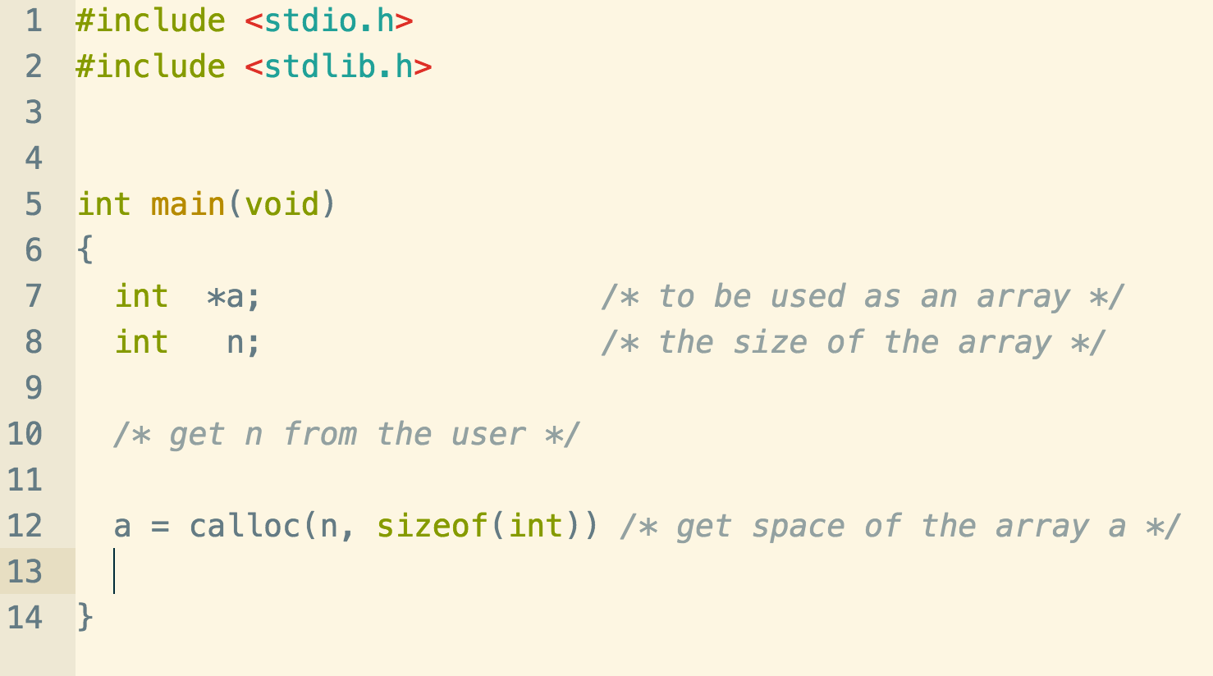
Malloc/calloc usage

Slide 17
Example
Problem:
We have two arrays of grades:
LabA = {90, 78, 45, 89, 65 }
LabB = {34, 67, 89}
Create a third array that contains all the grades.
Assume you don’t know the size of the arrays at the beginning of the program.
Appendarrays.c
Notes:
int size_a = sizeof(lab_a)/sizeof(int); int size_b = sizeof(lab_b)/sizeof(int); int total_size = size_a + size_b; printf("total size to allocate: %d\n", total_size); /* allocate enough memory */ int* p_grades = calloc(total_size, sizeof(int)); for (int ii=0; ii < size_a; ii++) p_grades[ii] = lab_a[ii]; for (int j=0; j < size_b; j++) p_grades[size_a + j] = lab_b[j]; printf ("The total array is: \n"); for (int k=0; k < total_size; k++) printf("%d, ", p_grades[k]); printf("\n"); /* remember to free */ free(p_grades); p_grades = NULL; /* good practive */

Slide 18
The 3 rules of pointers
Summary of pointers in a video:
https://www.youtube.com/watch?v=6pmWojisM_E

