Slide 1
CS2164 Lesson 7 Feb 17, 2016
Intro to programming using C
Instructor: Gustavo Sandoval
gustavo.sandoval@nyu.edu

Slide 2
homework

Slide 3
Recap from last class…

Slide 4
Fundamental Types Long form
char | signed char | unsigned char
short int | int | long int
unsigned short int | unsigned int | Unsigned long int
float | double | long double

Slide 5
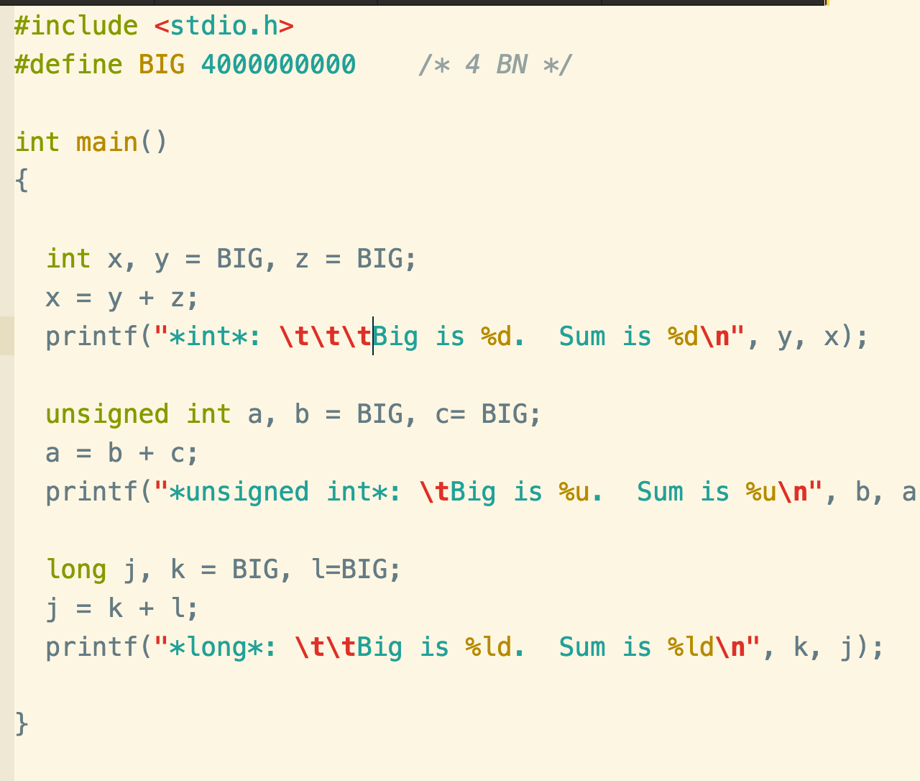
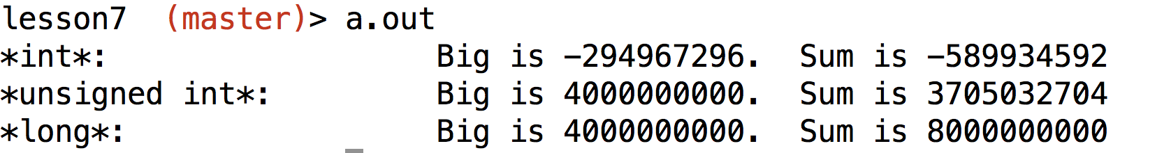
Example: Big.c

Slide 6
The Floating Types
They can hold real values such as 0.001, 2.0 and 3.14159
3 types: float, double, double float
Typically storage:
Float < double < double float
In my system, they are 4, 8 and 16 (sizeof.c)
Represent numbers to different accuracies
Example:

Slide 7
Mathematical Functions
No built-in functions in C
Math functions are part of the math library
Need to include <math.h>
Example of functions available:
double sqrt(double param)
pow()
exp()
log()
sin()
cos()
tan()

Slide 8
Full list here: https://en.wikipedia.org/wiki/C_mathematical_functions
Most take a double type and return a double
Prototype:
double sqrt(double arg);

Slide 9
Conversions
Arithmetic expressions have value and type:
X + y
Automatic conversions can occur when the operands are of different types
If both x & y are ints => expression is of type int
If x and y are int and float => expression is float
You can think of it as getting converted to the “bigger” type
For example:
celsius = 5/9 * (fahr - 32);

Slide 10
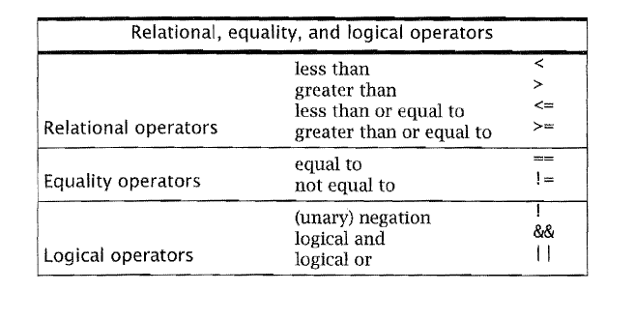
Relational, equality and logical operators

Slide 11
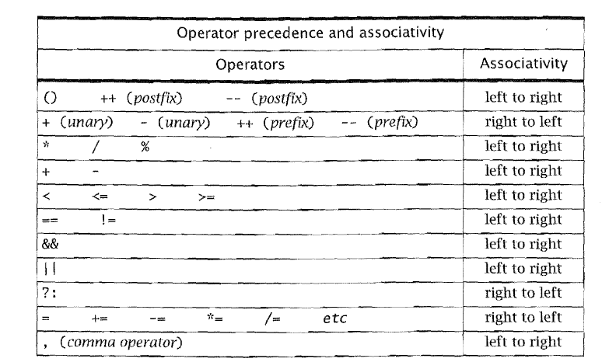
Operator precedence

Slide 12
The do statement
One variant of the while statement we hadn’t seen.
Instead of making the test at the top, makes it at the bottom:
Do
{
statemnet
} while (expression );
example

Slide 13
Fibonacci numbers
F0 = 0,
F1 = 1,
In general
F (i + 1) = F(i) + F(i – 1) for I = 1, 2…
One property is that the Fibonnaci quotients defined by:
Q(i) = {F (i) / F(i – 1)} for i = 1, 2, 3
Converges to the golden mean, which is (1 + sqrt(5))/2

Slide 14
Write Fibonacci.c
Up to N = 46.

