Slide 1
CS2164 Lesson 14: structs & unions
Intro to programming using C
Instructor: Gustavo Sandoval
gustavo.sandoval@nyu.edu

Slide 2
Sometimes you need to handle a lot of data
Example:
We are asked to create a stuffed animal catalog program. For each animal we will record:
Name
Species
Numbe of Teeth
Age
It has 2 functions:
catalog()
print()
Code:
Catalog1.c

Slide 3
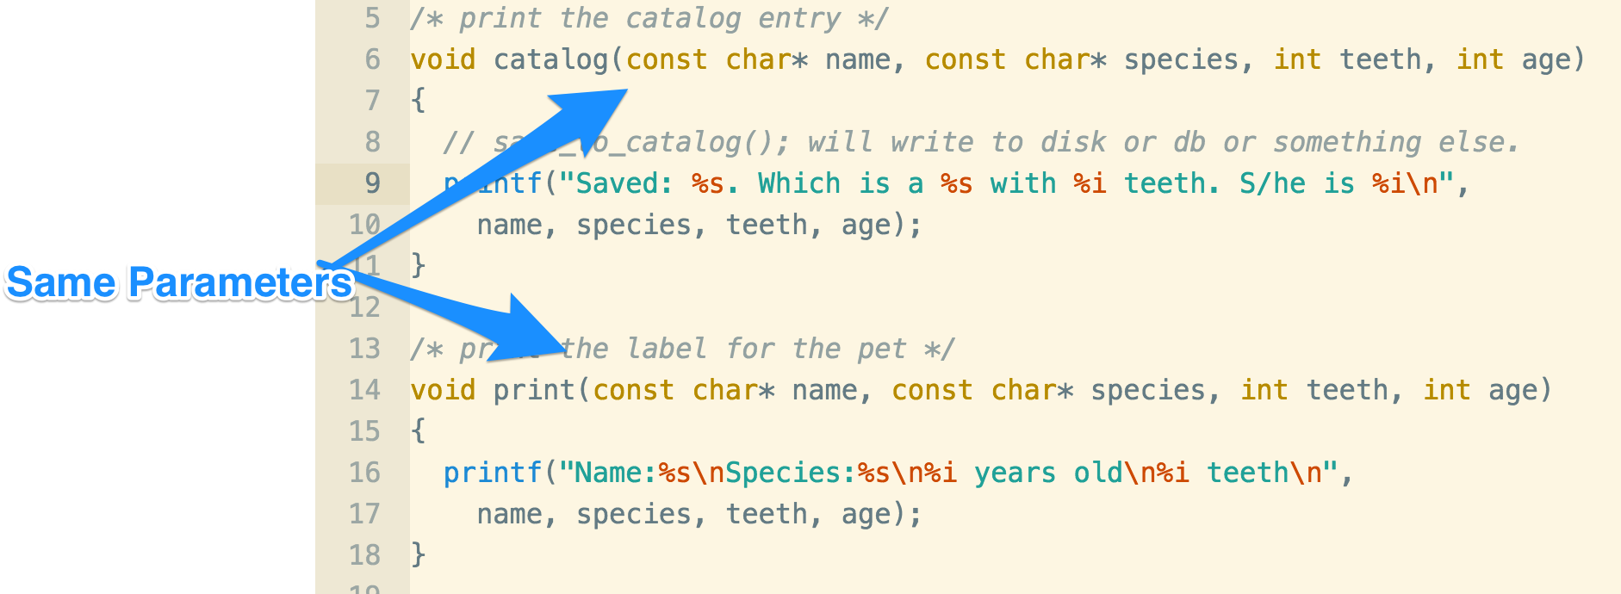
Problems

Slide 4
What if it was 10 functions ?
What if in the requirements we needed to add one more parameter like: owner ?
We would have to change all different functions…
It’s tedius
It’s error prone.

Slide 5
Structs: Your own data types
In C you can create your own data types.
If you need to model something in the real world that has many attributes you can use a struct.
struct is short for structure data type.
A struct will let you collect all those data types and wrap them into one large new data type like:
struct pet {
const char *name;
const char *species;
int teeth;
int age;
}

Slide 6
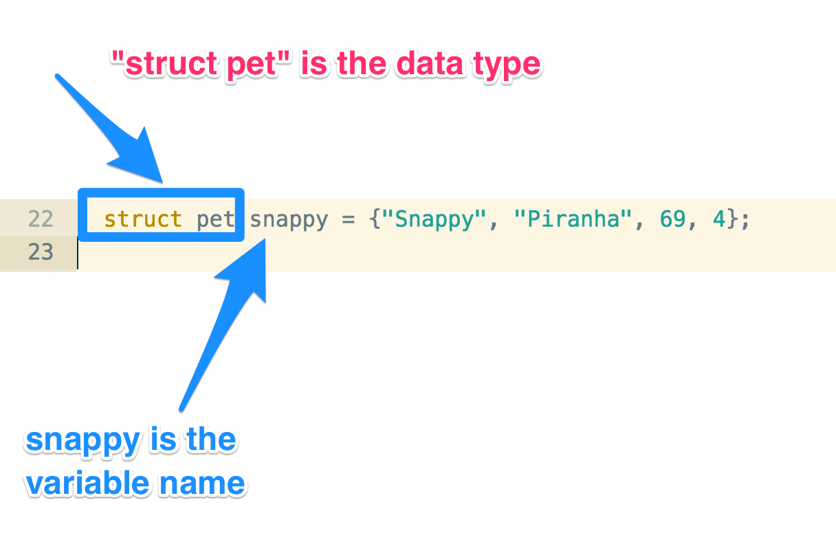
How does this look in code:

Slide 7
Note:
There are a few things:
1. Creating the custom data type:
struct pet {
const char *name;
const char *species;
int teeth;
int age;
}
2. declaring the instance variable:
struct pet snappy = {"Snappy", "Piranha", 69, 4};

Slide 8
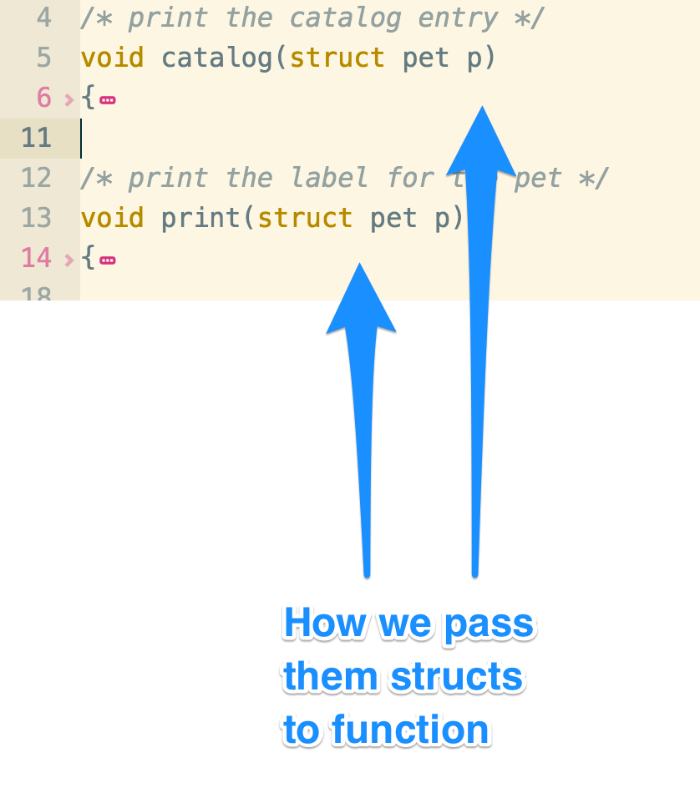
3. How we pass it to the function

Slide 9
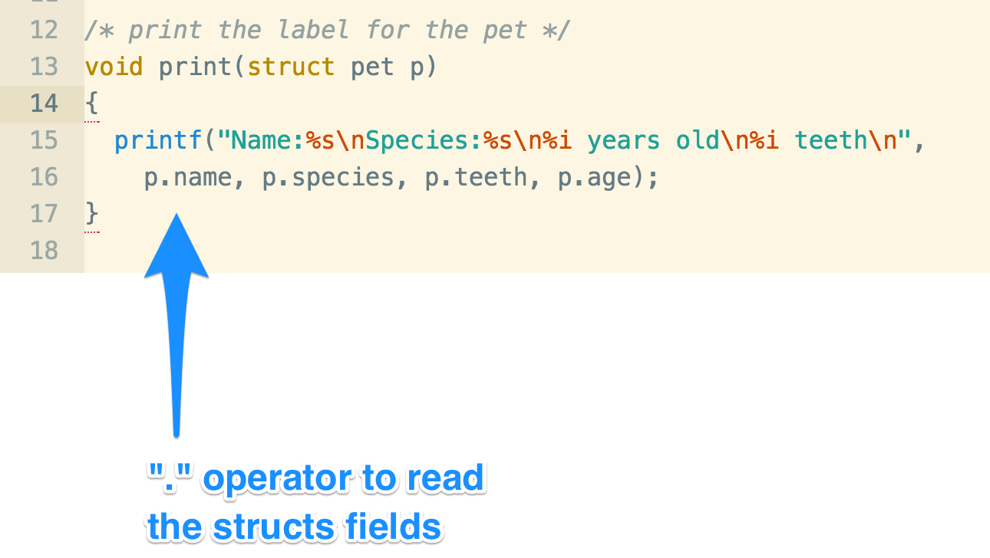
4. How we use it inside the function

Slide 10
Example
Catalog2.c

Slide 11
Q & A
Are structs just like arrays ?
Not but like an array it groups a number of pieces of data together
An array variable is just a pointer to the array. Is a struct variable a pointer to a struct ?
No. A struct variable is a name for the struct itself
What’s the const char thing again ?
Const char is used for strings you don’t want to change. That means it’s often used to record string literals
Does the struct store the string ?
In this case no. The struct just stores a pointer to the string. That means it’s just recording an address, and the string lives somewhere in memory.
But can you store the whole string ?
Yes, if you define a char array array like name[20];
Your questions ? ….

Slide 12
Structs in memory up close
When you define a struct you don’t reserve any memory for it. You are just telling the computer how the new data type will look like.
struct pet {
const char *name;
const char *species;
int teeth;
int age;
}
When you define a new variable the computer will need to create some space in memory for an instance of the struct.
struct pet snappy = {"Snappy", "Piranha", 69, 4};

Slide 13
So what happens in assignment…
struct pet snappy = {"Snappy", "Piranha", 69, 4};
struct pet gnasher = snappy;

Slide 14
What if we need to add …
A few other related parameters like type of care for our pet:
Say type of food
And
Number of exercise hours…
How could we do it ?

Slide 15
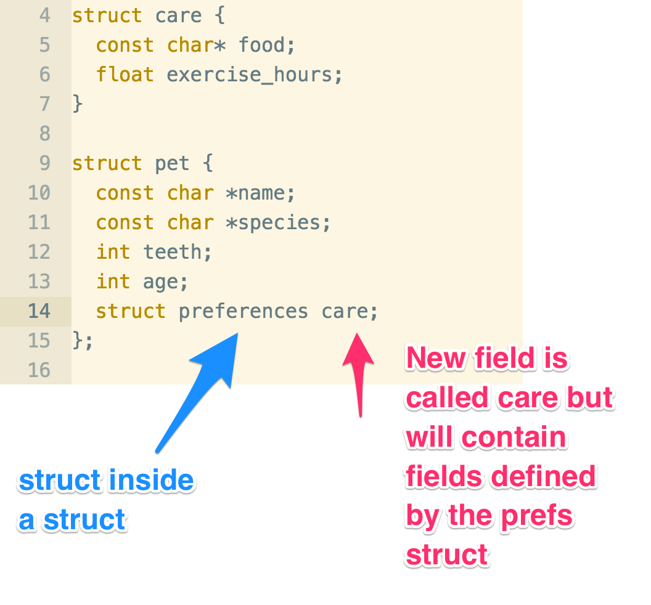
structs inside structs?

Slide 16
Example:
Catalog3.c

Slide 17
Try it:
We want to record:
Exercise:
Description
Duration
Meal:
Ingredients
Weight
Preferences:
Food
Exercise
In addition to the Pet data

Slide 18
Typedef
You can give your structure a proper name using typedef
struct cell_phone
{
int cell_no;
float minutes;
}
Struct cell_phone p = {5551212, 1.35”
Typedef struct cell_phone
{
int cell_no;
float minutes;
} phone;
Phone becomes an alias
phone p = { 5551212, 1.35}

Slide 19
typedef
You can usually skip the first name !
Typedef struct {
int cell_no;
float minutes;
} phone;
phone p = { 5551212, 1.35}

Slide 20
Updating structs
Example:
Petbirthday.c

Slide 21
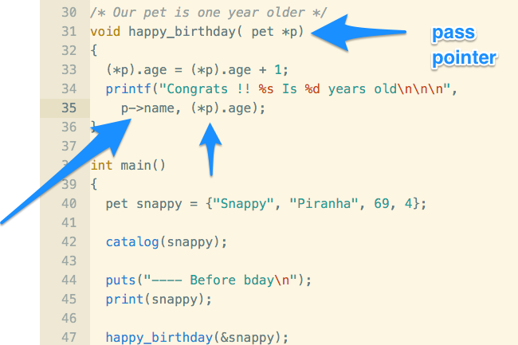
To update

Slide 22
Note
(*t).age != *t.age
(*t).age == t->age

Slide 23
Unions
Sometime you want to record different types of data.
For example:
Let’s say we need a recipe program you might need count, weight or volume for ingredients.
You could use a struct like:
Typedef struct
{
Short count;
Float weight;
Float volume;
} fruit;

Slide 24
Problems
Will take more space in memory
Users might set more than one value
Nothing called quantity

Slide 25
Unions let you reuse memory
A union will use just the space for just one of the fields on the definition.
If you have a union called quantity with fields called count, weight and volume the computer will just save enough space for its largest element;
How does it look:
typedef union{
short count;
float weight;
float volume;
} quantity;

Slide 26
example
Unions1.c

