Slide 1

Building Financial Scorecards for credit risk assessment
Deterministic and non-Deterministic approaches
Kinsuk Ghatak
MBA , IIT Kanpur
BE , Jadavpur University
kinsukghatak@gmail.com
https://www.linkedin.com/in/kinsukghatak/

Slide 2


Objectives and outline:
General intro to credit risk assessment
Credit Lending Process
PD,LGD,EAD
Estimation of PD → Techniques
Probabilistic approaches for credit assessment
Model main variables and categories
Definition of default
Model development techniques and steps
Champion vs challenger models under regulatory framework
Implementation in python for an ML challenger model
Deterministic approach of credit risk assessment
A heuristic based on decision tree
Prepared by : Kinsuk Ghatak , April , 2021

Slide 3

General process of credit lending ,risk & capital assessment :
Application by customer for specific type of loan
Credit assessment of the customer by bank (using scorecards / external rating like CIBIL )
Generation of PD and CRR for the specific customer by the RM
Pricing of the loan (fixing percentage of interest , limit , duration etc)
Approval of loan disbursement by the RM
Periodic review , CRM , Loan Management
LGD
PD
EAD
RWA → Capital Estimation
Credit Risk Assessment
(Prob. of Def)
Internally built PD model (AIRB) (Probabilistic)
Using Externally obtained ratings
Using Frameworks
[Foundation approach] (Deterministic)
** Capital Adequacy Ratio = (Tier 1 Capital + Tier 2 Capital) / Risk-Weighted Assets)
Prepared by : Kinsuk Ghatak , April , 2021

Slide 4
Probabilistic approach for credit assessment

Slide 5


Scorecard modelling approach : Variables
For building a credit risk scorecard which can estimate the probability of default of a loan applicant Generally 4 categories of variables are required along with the default status or external rating as dependent variable.
Defn of default as per BASEL : Payment delay of at least of 90 days / Unlikeliness to Pay.
Variable classes
Financials / capital
Qualitative / character
Condition
- Mthly Income
- Existing Loans (Debts)
- Assets under possession
- Bank Deposits & investments
Dependent : Default status (0/1) or External Rating from agency
Collateral
-Reputation
-Honesty
-Age
-Social media footprints
-Collateral value to be used in case of default and security backed loan
- Market condition
-Seasonality
- Macroeconomics
Prepared by : Kinsuk Ghatak , April , 2021

Slide 6
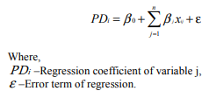
Scorecard modelling approach : Major steps and methodologies
Following are the major steps and methods followed for building a probabilistic credit scoring model.
Data collection & Preprocessing (EDA , MVI, Exclusion)
Single Factor analysis (Correlation, VIF , Variable importance)
Required Variable Transformations (standardization, Rank-ordering, peer ranking, WoE etc)
Multi Factor Analysis (Variable Reduction, Multi-colinearity analysis, PCA , IV etc)
Shortlisting final sets of variables by Forward , stepwise , backward regressions/ ML models
Selection of final variables based on sign , significance ,contribution
Building the final sets of models based on different approaches and for different segments
Implement the model(s) in IT system for users (RMs)
Periodic review / monitoring of the model(s)
Comparison of models on accuracy , fit etc
Selection of the final model(s) [probably for each segment]
Segmentation of customers based on geo , demo ,behave factors
Final model is documented
Model to be sent for regulatory approval
Model validation activity takes place
Modelling Techniques
Logistic Regression
(for 0/1 default)
Linear Regression
(for credit score mapped to PD)
ML Regression & classification techniques
Prepared by : Kinsuk Ghatak , April , 2021
** The two other major modelling techniques used are : Ridge Regression & Lasso Regression

Slide 7

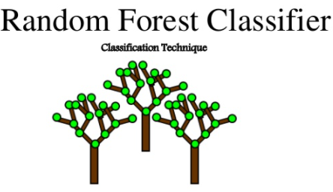

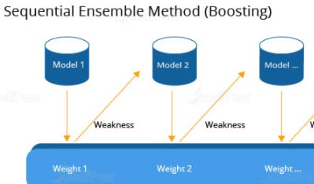
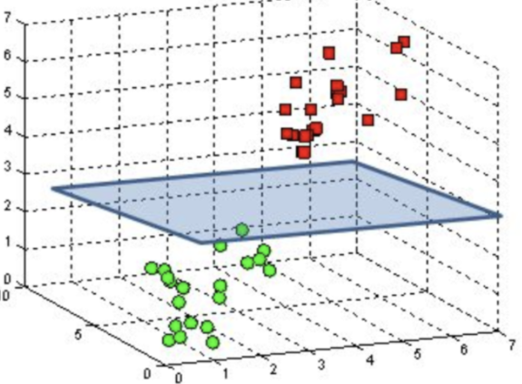
Scorecard modelling approach : Champion vs challenger models
Champion model :
Classic statistic model
Linear / logistic regression
Variable selection using forward, back ward , stepwise elimination methods
Check VIF, Sign , significance at each step and proceed to the next loop
Final set of filtered variables
Fit of the model using R^2, AIC
Output is PD , which is then mapped to a CRR
Final model is selected → Documented → sent for reviews → Regulatory approval → Implementation
Challenger model:
Normally under regulatory set up a challenger model is built using ML techniques
The most used methods are :
Random Forest
Naïve Bayes Classifier
Boosting techniques for unbalanced population with low defaults
Support Vector Machine
Models are to be tested and shortlisted based on their accuracy score on testing set
An implementation of challenger model using ML techniques for a corporate scorecard development can be found at my github repository under the below URL :
https://github.com/kinsukghatak/Python_DS_ML_Notebooks/blob/main/GRAbble_EDA_KG_v4.ipynb
Prepared by : Kinsuk Ghatak , April , 2021

Slide 8
Deterministic approach for credit assessment

Slide 9
A deterministic approach using decision tree heuristic:
Gather data for the applicant
(Geog , Segment, Income , Education, Work)
Income > X
Age > y
Start
Assessment of the application
Yes
NA
No
No
NA
Yes
Existing loans , liabilities & assets
Profession & Years of Exp
Check Education level
Macroeconomics , GDP , Inflation. Job mkt, market cycle etc
Loan Mgt
Post Graduate ?
Graduate
No
No
NA
Yes
Yes
Take Reference of External Ratings
Determine Loan limits , pricing ,tenure
Approval
End
Prepared by : Kinsuk Ghatak , April , 2021

Slide 10
Thank You

