Slide 1



Exploratory analysis and visualization of California Restaurants data set
-By
Kinsuk Ghatak
MBA, IIT Kanpur
BE , Jadavpur University
https://www.linkedin.com/in/kinsukghatak/

Slide 2
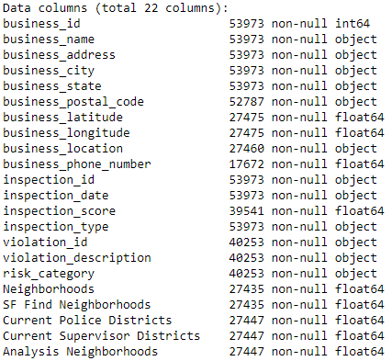
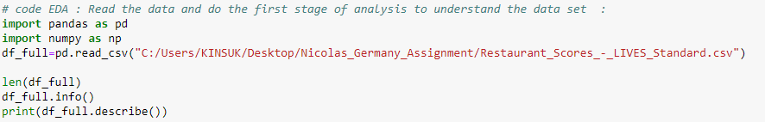







Quick understanding of the data set and tools used :
Different fields of the data
Code Snippet
Tool used for analysis :
Python
Packages used :
Pandas
Matplotlib
Numpy
Seaborn
Datetime
Follium
** The entire notebook has been uploaded to my github for quick reference :
https://github.com/kinsukghatak/Python_DS_ML_Notebooks/blob/main/Dashboard%20and%20analysis%20of%20Restaurants.ipynb
Prepared by : Kinsuk Ghatak , April , 2021

Slide 3
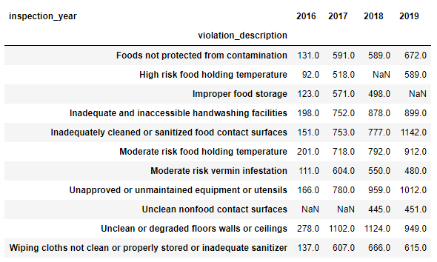
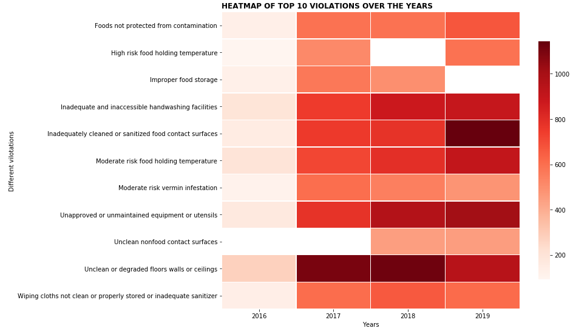
Top 10 violations observed per year:
Top 10 violation description per year
Heatmap representation :
There are total 11 unique violations which took place in repeated numbers across the years .
The heatmap representation portrays that
“Cleanliness “ , “inadequate cleaning of utensils “ , “inadequate access to hand wash facilities” and “food holding temperature” are some of the major violations observed over the years
Prepared by : Kinsuk Ghatak , April , 2021

Slide 4
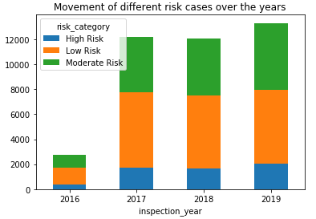
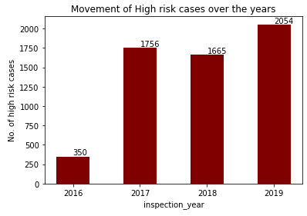
Movement of different risky cases over the years:
Though low risk cases dominate the number of complaints or violations but high risk cases have gradually gone up from 2016 to 2019
Prepared by : Kinsuk Ghatak , April , 2021

Slide 5
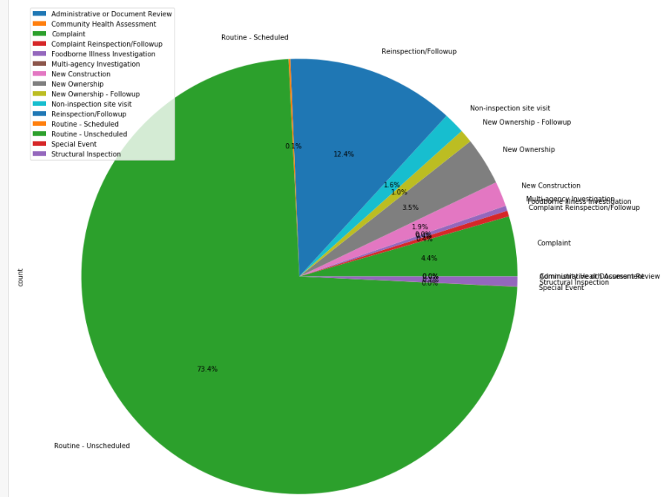
General analysis to understand the inspection type:
We prepared this pie chart to understand which inspection method is of maximum occurrence and the clear winner is Routine-Unscheduled inspection and which definitely helps in maintaining the restaurants across the state to remain vigilant and careful about maintaining their standards continuously.
Prepared by : Kinsuk Ghatak , April , 2021

Slide 6
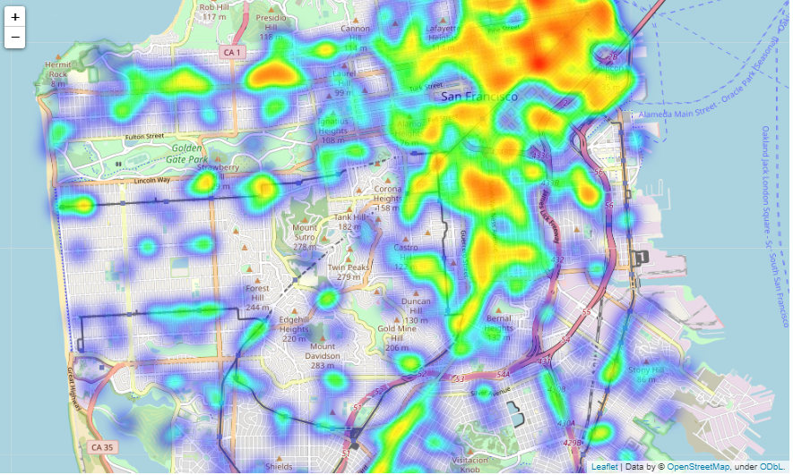
Geographic Heat map to understand most of the inspected areas in the state:
The heat map clearly shows that the areas in and around San Francisco observed most footfalls of the inspectors for the restaurants. Which is in line with business sense considering SA as the biggest city in the state of California most quality restaurants and hangout places are supposed to be clustered here.
Prepared by : Kinsuk Ghatak , April , 2021

Slide 7
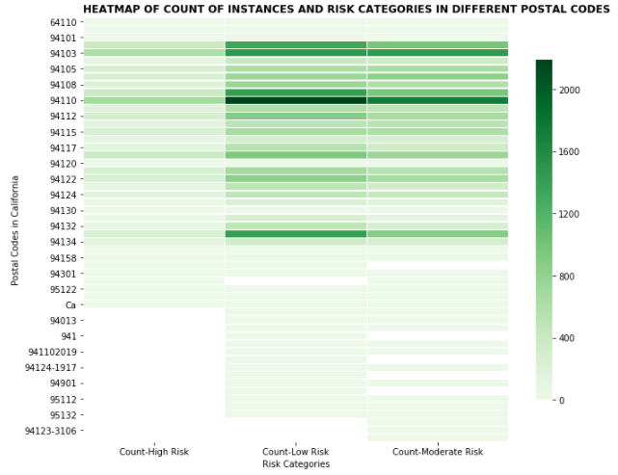
Heatmap analysis between postal codes vs risk categories :
This heat map helps in visualizing the count of instances across various postal codes according to the risk category of inspections. Through this ; the inspectors can judge which are the vulnerable zip codes and where shall one focus as far as the inspection of food and restaurant services are concerned in California.
Prepared by : Kinsuk Ghatak , April , 2021

Slide 8
Thank you

