Slide 1
Development of the Mid market emerging economy (APAC region) IRB PD model
Kinsuk Ghatak
MBA, IIT Kanpur ; BE- Jadavpur University
Ex Nielsen, HSBC, Current - PwC

Slide 2
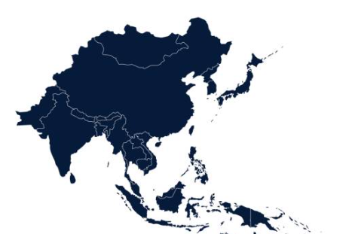
Agenda
Model scope & architecture
The development process of the Qualitative module
Challenges faced

Slide 3
Model scope and architecture
Scope:
To build a regional IRB Probability of Default model to rate corporate clients in APAC region for turnover range of $ 50 mm - $ 650 mm
Countries of origin: India, China, Thailand , Vietnam, Bangladesh, Brunei, Malaysia, Singapore etc. (total 10 countries)
Multi modular Architecture is followed to reach the final PD :
Regression
Financial Module
Financial Score
Internal database
Regression
Regression
Qualitative Module
Qualitative Score
Final score
Fusion
External source (Moody’s)
Macro Economic Module
Regression
MEV Score
PD
CRR
My role:
Lead development of the qualitative module (100%) of the model and part contribution (50%) to the Financial module
Guided junior team member on Macro Economic module in feature engineering, selection of variables, SAS code development

Slide 4
Development of the Qualitative module
Qualitative module development Process overview and feature selection:
Qualitative questions with categorical responses were collected and processed from the internal database across the 10 countries
Questions of nature :
Years in business
Adverse idiosyncratic effect
Recent change in management
Collect questions with responses (95% availability)
Group similar questions across different regions
Group qualitative responses based on monotonicity analysis
Correlation analysis with the dependent variable
WoE Transformation and IV calculation
Missing value imputation (Group by region, industry & impute using Mode)
Multi-colinearity checking with VIF
Stepwise regression for feature selection
Sign intuition analysis & Expert judgement
Data collection & Pre processing
Single Factor Analysis
Multi-Factor Analysis (done at one go)
Internal Default database
Internal database of qualitative questions
# 50
# 40
# 30
# 16
# 8
# 160
Final Qualitative model
** # -> represents the number of variables at each stage

Slide 5
Challenges Faced
Availability of data: Multiple stakeholders have to be managed & communicated (Chased) for collecting data from individual countries
Transformations of variables: Some qualitative questions had uni-modal or bi-modal representations.
Project Mgt
Feature selection
Data Quality
Model performance
Solution / Lessons learned: Conducted periodic meetings with the Onshore project manager. Initiated weekly catch up with data providers from different regions.
Solution / Lessons learned: The variables used in their WoE form after binning w.r.t different categorical responses.
Quality of default: Considering it to be a Corporate portfolio, the dataset was highly unbalanced (Default rate ~ 2.5%)
Model performance: Model fit achieved initially was not satisfactory
Solution / Lessons learned: After the EDA & MFA; linear regression was tested and approved as the final modelling technique. The dependent variable used was log(PD).
- Solution / Lessons learned: Brainstormed with the other teammates. Reengineered feature selection. Rsq increased from 48% to 57%

Slide 6
Thank you

