Slide 1
DevCollab – Developer Collaboration Hub
Team name : KVS
Team members:
K.Karteek-241FA04F15
K.Vishnu Vardhan -241FA04760
G.Sai Manikanta – 241FA04698

Slide 2
Introduction and Problem Statement
Introduction:
Devcollab is a web-based platform designed to help developers connect, communicate, and collaborate on software development activities. It provides a common platform where developers can share knowledge, explore opportunities, and work together.
Problem statement:
Developers often face difficulties finding suitable teammates.
Communication and collaboration are spread across different platforms.
Sharing project ideas and technical knowledge can be challenging.
There is a need for a centralized platform for developer collaboration.

Slide 3
Project Objectives
The main objectives of DevCollab are:
To provide a platform for developers to connect with each other.
To encourage teamwork and knowledge sharing.
To simplify collaboration between developers.
To provide an easy-to-use and interactive user interface.
To develop a secure and scalable web application.
To implement full-stack development using the MERN stack.

Slide 4
Technologies and Tools Used (MERN Stack)
Frontend Technologies:
React.js – Building interactive user interfaces.
HTML – Structuring web pages.
CSS – Styling and designing the application.
JavaScript – Implementing frontend functionality.
Backend Technologies:
Node.js – Server-side JavaScript runtime.
Express.js – Developing RESTful APIs.
Database:
MongoDB – Storing application data.
Development and Deployment Tools:
Visual Studio Code – Code editor.
Git and GitHub – Version control and source code management.
Render – Application deployment.

Slide 5
System Architecture and Workflow
System Architecture:
DevCollab follows a three-layer architecture:
Presentation Layer: React.js provides the user interface.
Application Layer: Node.js and Express.js handle requests and business logic.
Database Layer: MongoDB stores and manages application data.
Workflow:
User opens the DevCollab website.
User interacts with the frontend.
Frontend sends requests to the backend through APIs.
Backend processes the requests.
MongoDB stores or retrieves the required information.
Backend sends the response to the frontend.
React.js displays the result to the user.

Slide 6
Features and Functionalities
DevCollab provides the following functionalities:
User Authentication: Allows users to access the platform through their accounts.
Developer Profiles: Helps developers present their information and skills.
Developer Collaboration: Supports interaction and collaboration among developers.
Project Sharing: Provides opportunities to share and explore project ideas.
Interactive Interface: Offers a user-friendly experience.
Data Management: Manages application information using MongoDB.

Slide 7
Database Design and API Integration
Database Design:
MongoDB is used as the database to store and manage application information.
Possible data collections include:
Users Collection – Stores user details and account information.
Projects Collection – Stores project-related information.
Other application-specific collections based on implemented features.
API Integration:
REST APIs connect the frontend and backend.
Express.js handles incoming API requests.
Node.js processes application logic.
MongoDB performs database operations.
JSON is used for exchanging data between frontend and backend.
HTTP Methods:
GET – Retrieve data.
POST – Create new data.
PUT/PATCH – Update existing data.
DELETE – Remove data.

Slide 8
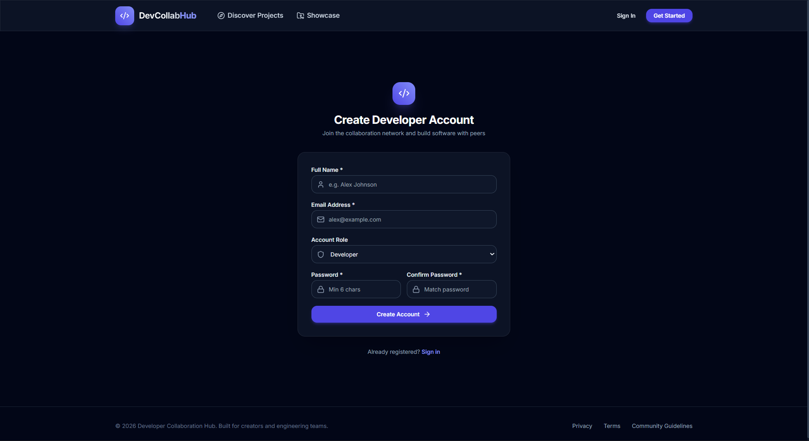
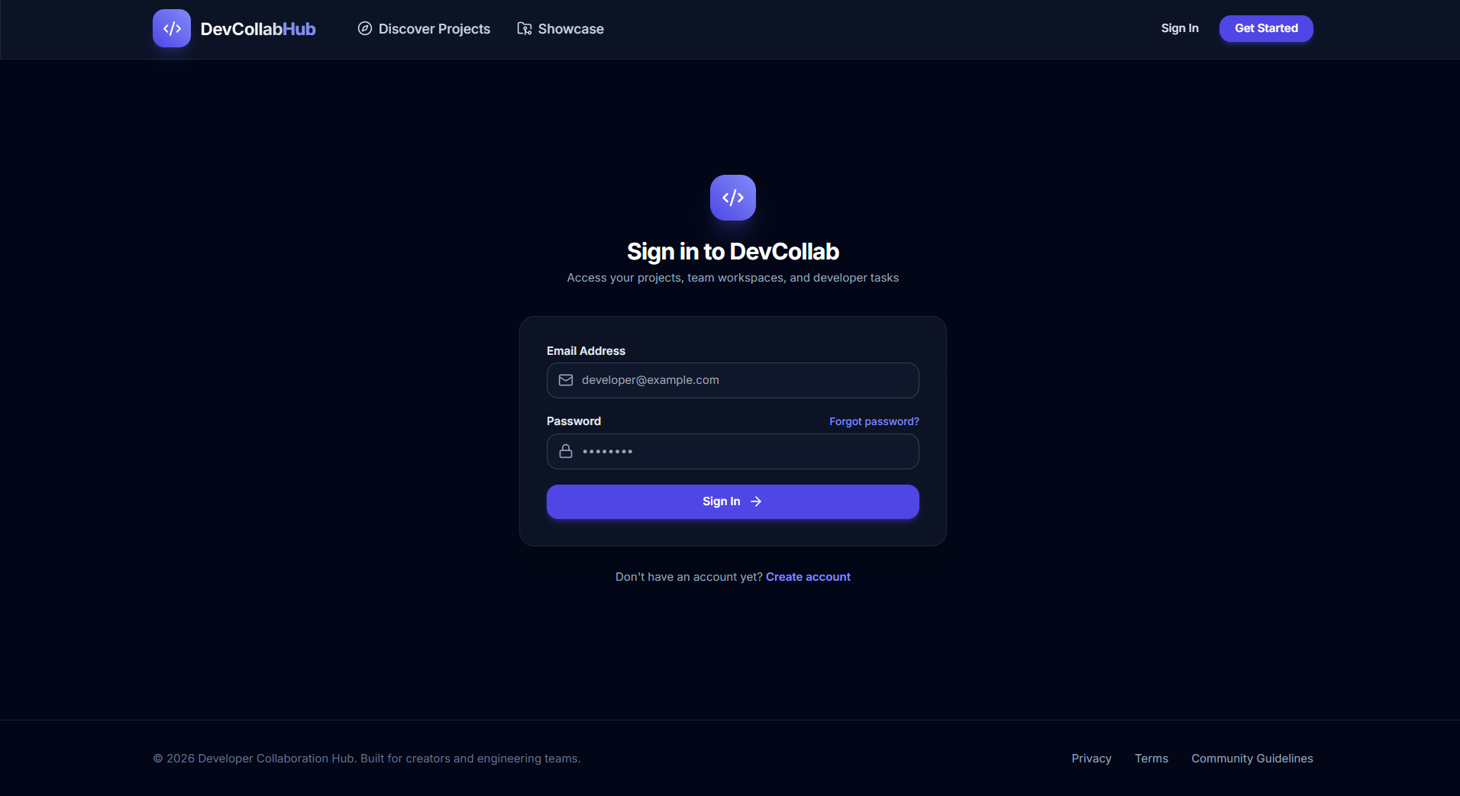
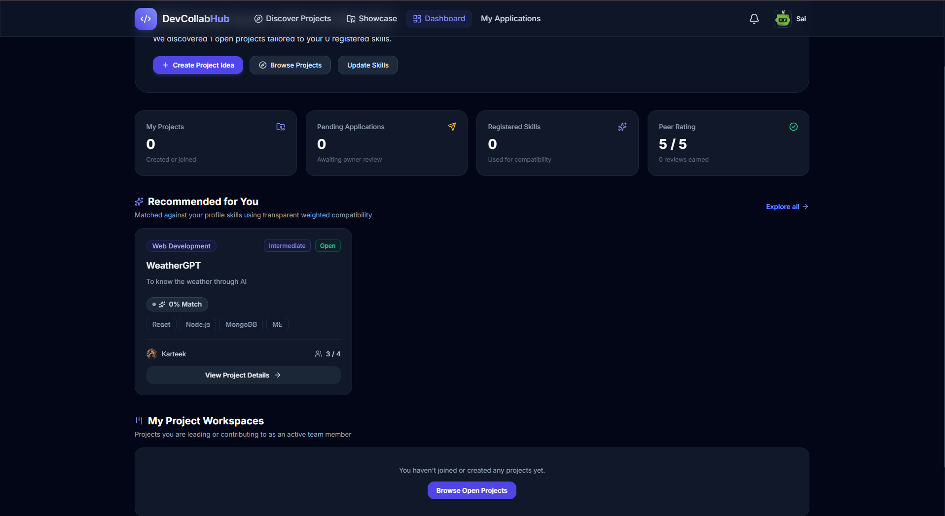
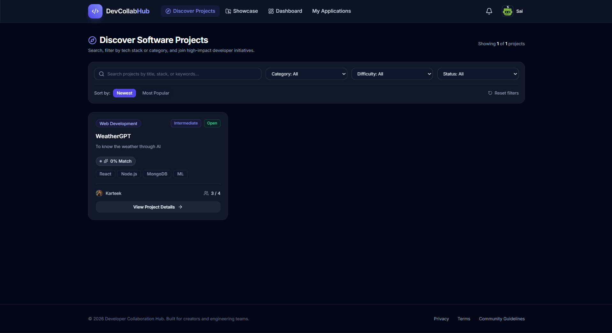
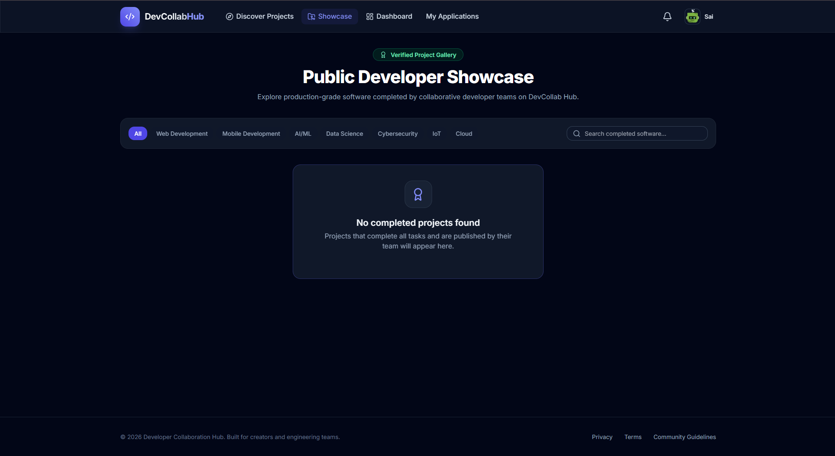
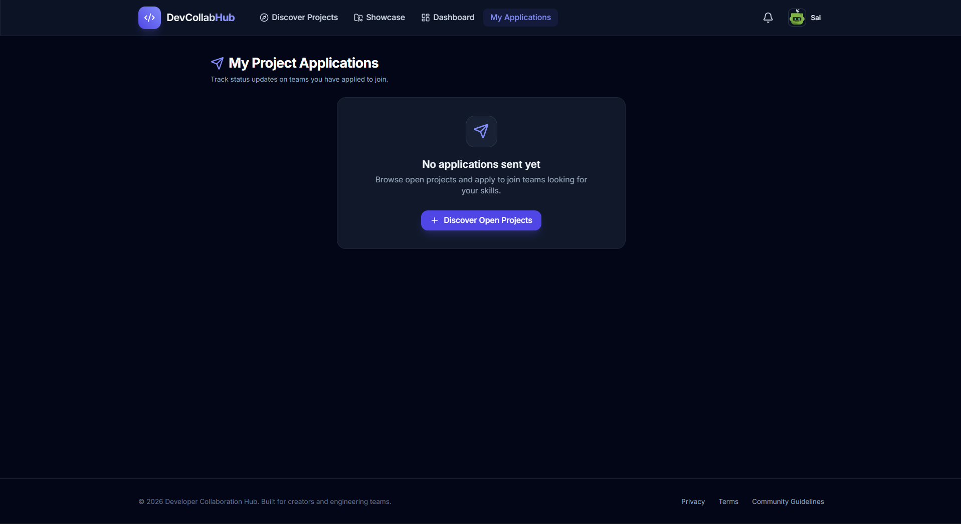
Screenshots of the Project
Website Link: https://devcollab-client-new.onrender.com

Slide 9
Challenges Faced, Future Scope
Challenges Faced:
Connecting frontend and backend components.
Managing data using MongoDB.
Implementing user authentication.
Developing and integrating REST APIs.
Deploying the application successfully.
Future Scope:
Add real-time chat functionality.
Introduce team creation and management.
Add project recommendation features.
Implement notifications and messaging.
Improve security and application performance.
Develop a mobile-friendly application.

Slide 10
Conclusion
DevCollab provides a centralized platform for developer collaboration and knowledge sharing. By using the MERN stack, we developed a full-stack web application that combines frontend interactivity, backend functionality, and database management. This project helped us gain practical experience in modern web development and teamwork.

Slide 11


