Slide 1

CSE-5335: TutorNova Presentation
Dedeepya Chaalika Chukka | Presenter
Vinshnu Darimireddy | Deployment Specialist
Mani Manvith Devineni | Repo Manager
Shravan Kumar Goud Earukala | Manual Author
Sriman Goud Emagouda | AI-Reflection Writer
Section: 5335-XXX
FALL 2025
TUTORING PLANNER: AN INTELLIGENT STUDY ASSISTANT

Slide 2
SEMINAR Demo
How Is It Helpful? Problems Solved
Primary Objectives
Build a web platform to connect students with tutors.
Enable personalized study plans, real-time chat, and progress tracking.
Integrate AI for smart assistance.
Simplifies finding qualified tutors.
Organizes study schedules and plans. Provides instant AI-powered help for students.
Tracks learning progress and achievements.
Reduces manual effort for both students and tutors.

Slide 3

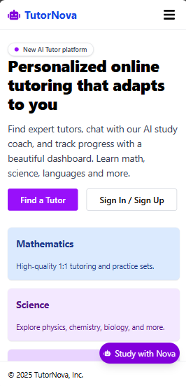
Home Page
Call To Action
Lecture relevance: Landing page design, user flow
Why relevant: First impression, directs users to login/signup
Short explanation: Main entry, feature highlights, CTA buttons
Implementation: React, responsive layout

Slide 4
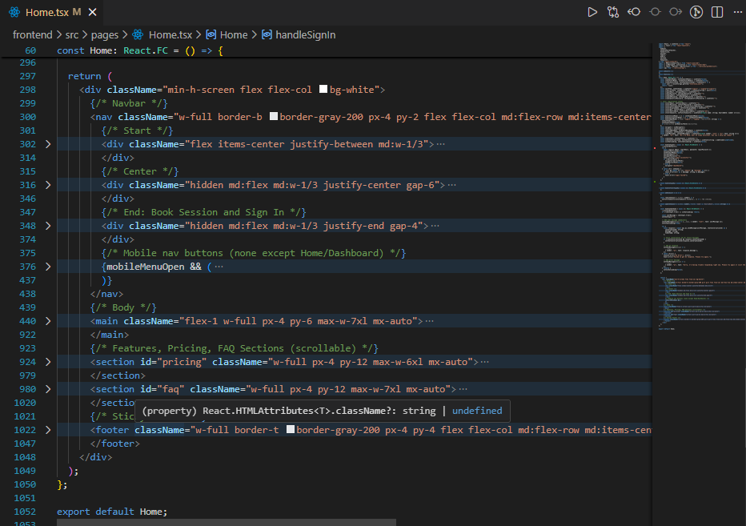
SEMINAR Demo
Page : Home
Home component with different sections

Slide 5

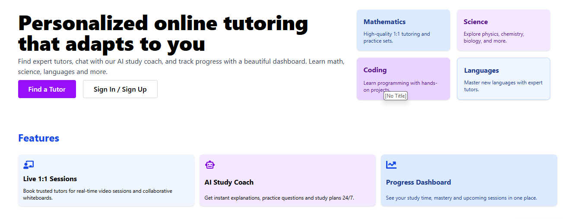
SEMINAR Demo
Page : About Us
Lecture relevance: User onboarding, web navigation
Why relevant: Introduces platform, builds trust to users.
Short explanation: Shows app purpose, features.
Implementation: React component, styled with Tailwind CSS
Application features
React components

Slide 6
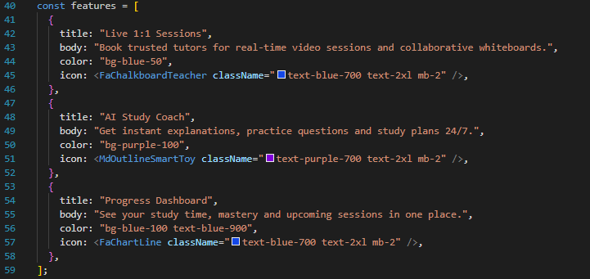
SEMINAR Demo
Page : About Us
About us features

Slide 7
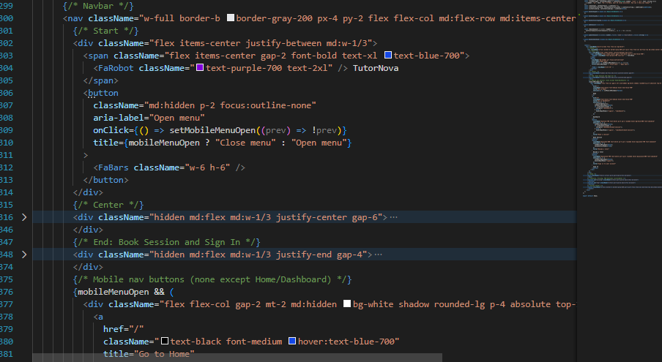
SEMINAR Demo
Page : Home
Navbar links

Slide 8
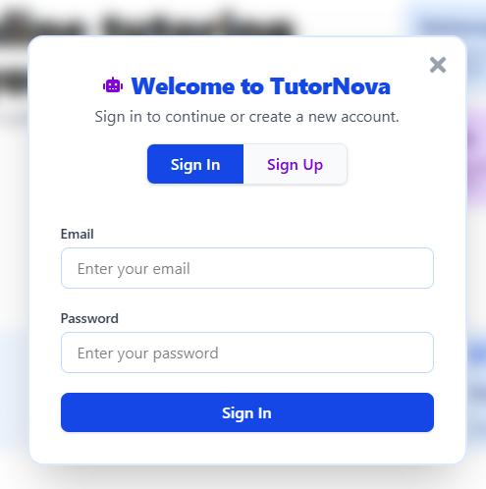
SEMINAR Demo
Login Landing
Lecture relevance: Authentication, form validation
Why relevant: Secure access, user management
Short explanation: Login form, error handling
Implementation: Custom validation, API call
Login and Register

Slide 9
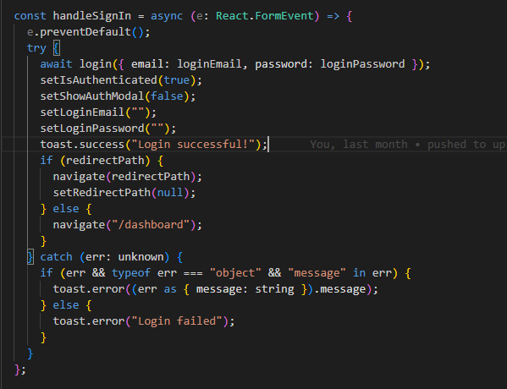
SEMINAR Demo
Page : Login Landing
Api call to the backend
Error handling

Slide 10
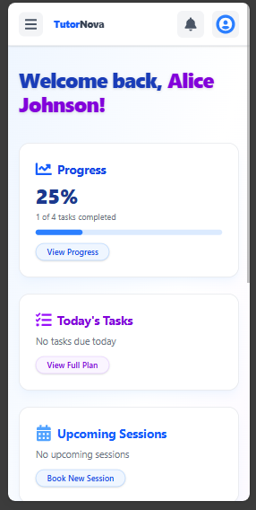
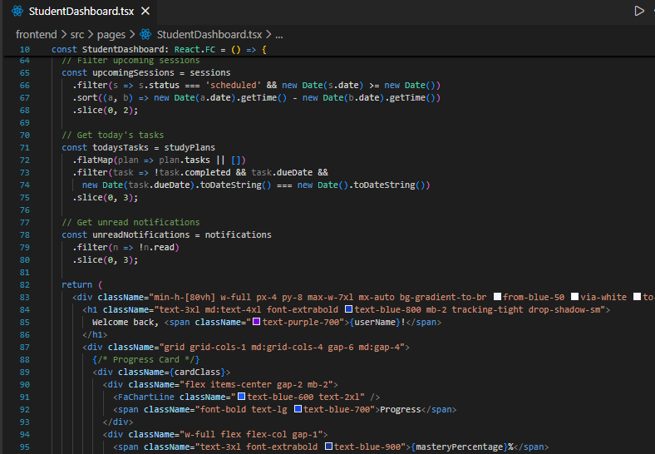
SEMINAR Demo
Dashboard Page
StudentDashboard code
StudentDashboard UI

Slide 11
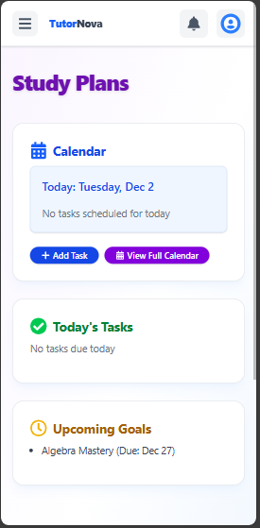
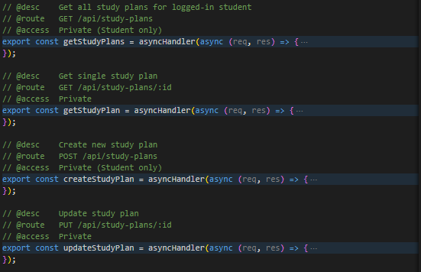
SEMINAR Demo
Page : Study Plans
Lecture relevance: CRUD operations, database integration
Why relevant: Users manage their study plans
Short explanation: Add/edit/delete tasks
Implementation: API calls, state updates
StudyPlan code
StudyPlan UI

Slide 12
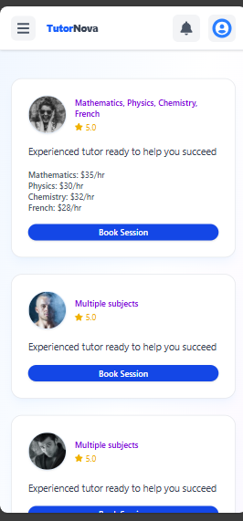
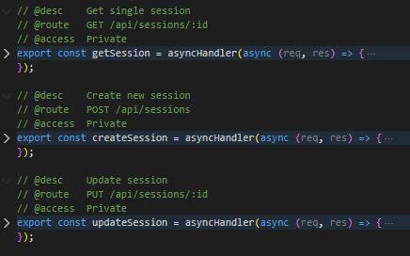
SEMINAR Demo
Page : Book Session
Lecture relevance: Scheduling, backend integration
Why relevant: Students book sessions with tutors
Short explanation: Calendar, time slot selection
Implementation: API call to backend, calendar component
Session crud
Session UI

Slide 13
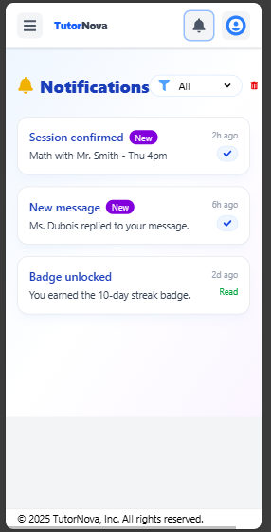
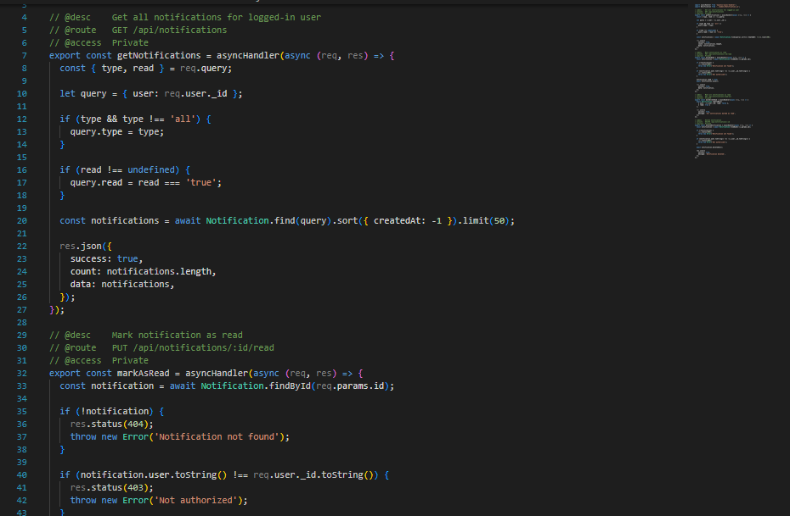
SEMINAR Demo
Page : Notifications
Lecture relevance: Real-time updates, user engagement
Why relevant: Keeps users informed
Short explanation: Notification bell, session reminders
Implementation: Notification crud
Notification crud
Notification UI

Slide 14
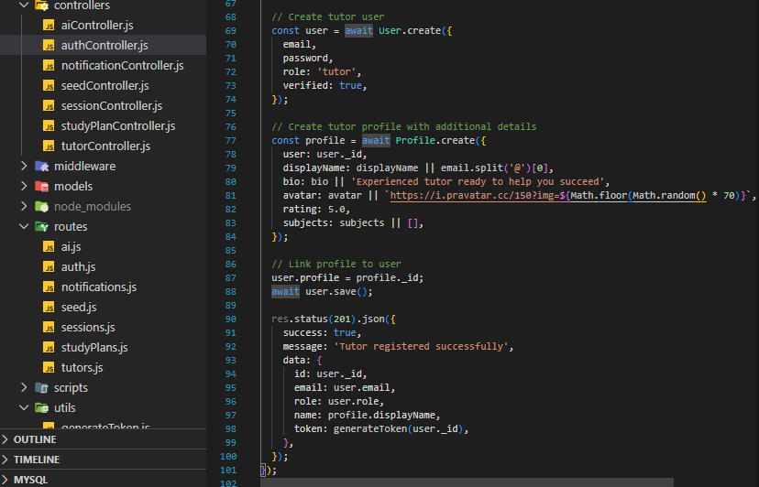
SEMINAR Demo
Page : User Profile
Lecture relevance: User data management
Why relevant: Users update their info
Short explanation: Profile edit, avatar upload
Implementation: Form, file upload, API call
User profile creation

Slide 15
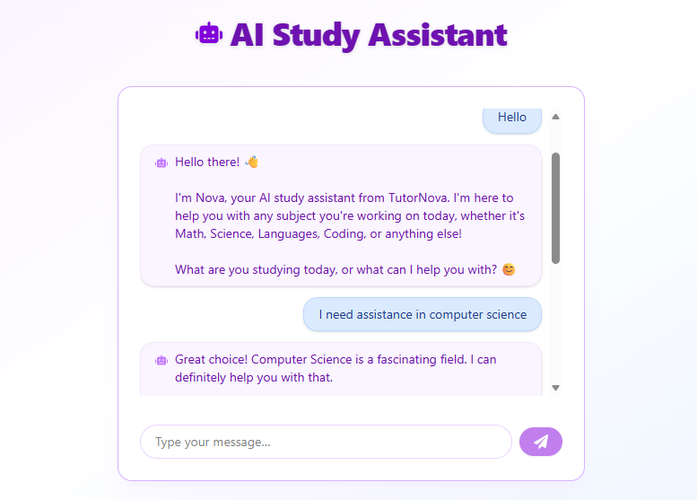
SEMINAR Demo
Chat Assistant
AI assistance in action

Slide 16
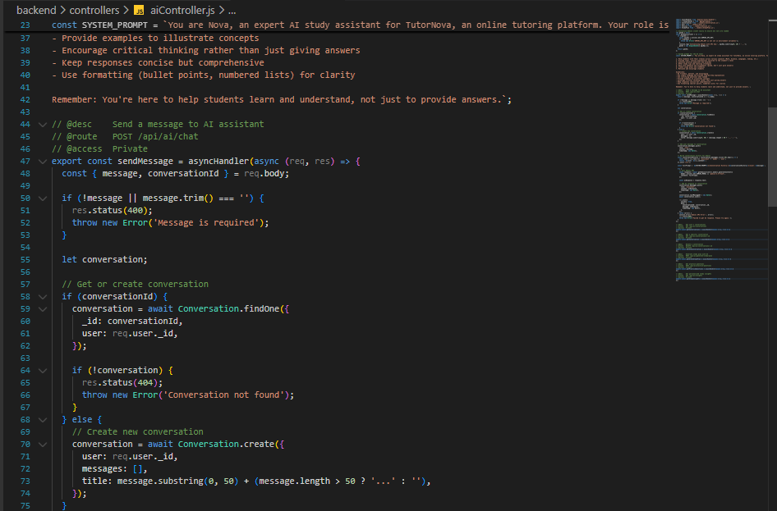
SEMINAR Demo
Page : Chat
Lecture relevance: External API integration
Why relevant: Shows how AI is connected
Short explanation: Code for Gemini API call
Implementation: Show function of sending a message to the model
sendMessage function

Slide 17

SEMINAR Demo
Challenges faced
Integrating Gemini AI and handling API changes
Api rate limits
Managing user authentication and roles
Coordinating team work and merging code
Handling deployment issues and environment variables
Lecture relevance: Problem-solving, debugging
Why relevant: Shows team’s adaptability

Slide 18
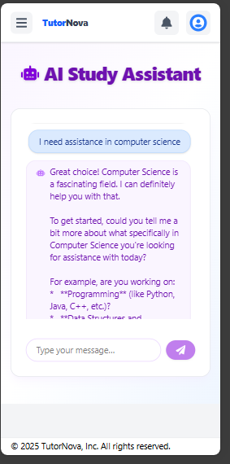
SEMINAR Demo
Creative functionalities
Lecture relevance: Innovation, extra features
Why relevant: Adds value to project
Short explanation: AI study plan generator, responsive UI
Implementation: This AI chat assistance is implanted using the Gemini API.
AI assistance in action

Slide 19
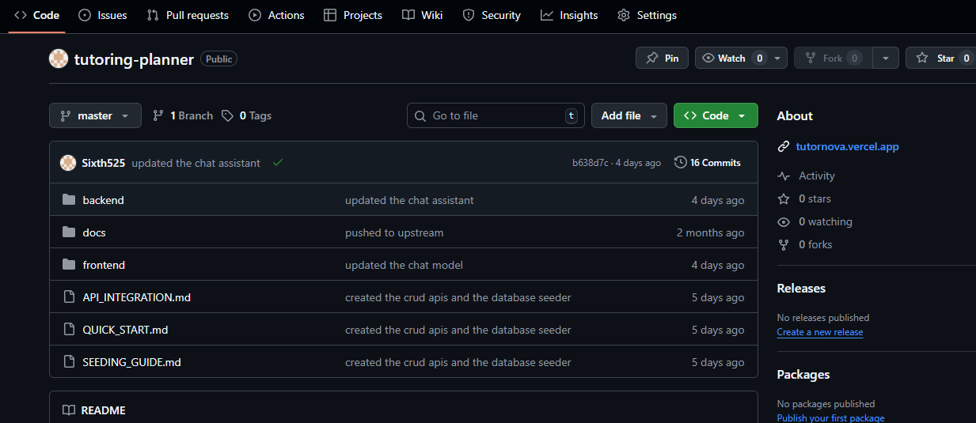
SEMINAR Demo
Future Addition to our Portfolio
This project is very relevant to our career development since it shows real-world skills.
We have learnt full stack application development, collaboration, Deployment and AI integration
Project deployed on GitHub

Slide 20

Thank You

