Slide 1
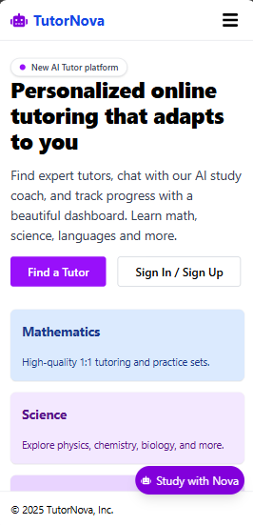

TutorNova
TUTORING PLANNER: AN INTELLIGENT STUDY ASSISTANT
Notes:
Welcome! We are Team Tutoring Planner. Today, we present our intelligent study assistant web platform. Each member will introduce their role and contribution.

Slide 2
TEAM MEMBERS & ROLES
Dedeepya Chaalika Chukka: Presenter
Vinshnu Darimireddy: Deployment Specialist
Mani Manvith Devineni: Repo Manager
Shravan Kumar Goud Earukala: Manual Author
Sriman Goud Emagouda: AI-Reflection Writer

Slide 3


PRIMARY OBJECTIVES
01
Build a web platform to connect students with tutors
02
Enable personalized study plans, real-time chat, and progress tracking
03
Integrate AI for smart assistance
Notes:
Our main goal was to create a platform that helps students find tutors, manage their study plans, and get instant AI-powered help. The system is designed to make learning more organized and effective.

Slide 4

How Is It Helpful? Problems Solved
01
Simplifies finding qualified tutors
02
Organizes study schedules and plans
03
Provides instant AI-powered help for students
04
Tracks learning progress and achievements
05
Reduces manual effort for both students and tutors
Notes:
Tutoring Planner solves key problems: it makes it easy to find tutors, organize study plans, and get help instantly. Students and tutors save time and effort, and everyone can track their progress.

Slide 5
MEMBER CONTRIBUTIONS
01
Presenter: Prepared and led this demo, coordinated team presentation.
02
Deployment Specialist: Set up hosting (Vercel), managed deployment, ensured site availability.
03
Repo Manager: Created and managed the GitHub repository, maintained branches, coordinated code updates
04
Manual Author: Wrote README, user guide, onboarding instructions, documented features
05
AI-Reflection Writer: Integrated Gemini AI, designed prompts, documented AI decisions and challenges
The development of this project was done collaboratively
Notes:
Each member contributed to a specific part of the project. The Deployment Specialist handled hosting and deployment. The Repo Manager created and managed the repository and branches. The Manual Author wrote all documentation. The Presenter organized the demo. The AI-Reflection Writer integrated Gemini AI and documented our decisions and challenges.

Slide 6

CHALLENGES
Integrating Gemini AI and handling API changes
Managing user authentication and roles
Ensuring real-time flow and database updates
Coordinating team work and merging code
Handling deployment issues and environment variables
Notes:
We faced several challenges, including integrating Gemini AI, managing user roles, ensuring real-time features, and coordinating team work. Deployment and environment setup also required careful attention.

Slide 7
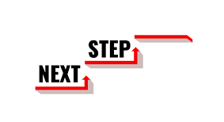
NEXT STEPS
Add more tutor subjects and student features
Improve AI assistant with more advanced prompts
Enhance UI/UX for better accessibility
Expand deployment to additional cloud platforms
Gather user feedback and iterate on features
Notes:
For future work, we plan to add more features for tutors and students, improve the AI assistant, enhance the user interface, expand deployment options, and gather feedback to further improve the platform.

Slide 8

THANK YOU
&
Q&A
- Ready for questions
Notes:
Thank you for your attention! We are ready to answer any questions you may have about our project.

