Slide 1
Telco Customer Churn Prediction
ICT6001C — AI Programme | Week 1 Capstone
Group 3
YEO XIU JUAN (ID: 2570472)
LIM KHOON SENG (ID: 2570459)
LAI KIN WAH (ID: 2570461)
Kaggle Dataset : Predict Customer Churn | Kaggle
Repo : https://github.com/kinwahlai/ICT6001C
Video: https://youtu.be/s6XiefyZ9nQ

Slide 2
Executive Summary
◆ Dataset: 594,194 Telco customers | Churn rate ~22.5% | Class imbalance handled with SMOTE
◆ 3 model families compared via 5-fold stratified CV (ROC-AUC primary, Recall secondary)
◆ Champion: XGBoost (Boosting) — highest CV ROC-AUC
◆ Champion tuned via GridSearchCV (champion-only, ≤50-config budget, 100,000 subsampling); CV ROC-AUC 0.9109±0.0011
◆ Hold-out (evaluated once): ROC-AUC 0.9143 · Recall 0.8083 at threshold 0.61
◆ Threshold 0.61 = highest cut still holding ≥80% recall; FN far costlier than FP
◆ Tier retention offers by predicted churn probability — concentrate premium spend on highest-risk customers.

Slide 3
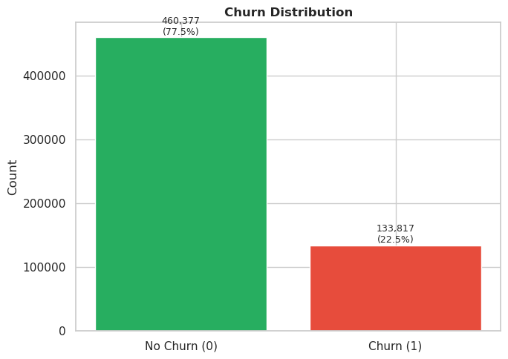
Data Engineering & EDA [Part A (§1)]
CRISP-DM: Data Preparation | 80/20 stratified split | X_test locked until §4
Data Preparation
◆ No missing values; TotalCharges coerced from blank strings.
◆ Churn rate ~22.5% — moderate imbalance addressed by SMOTE inside pipeline.

Slide 4
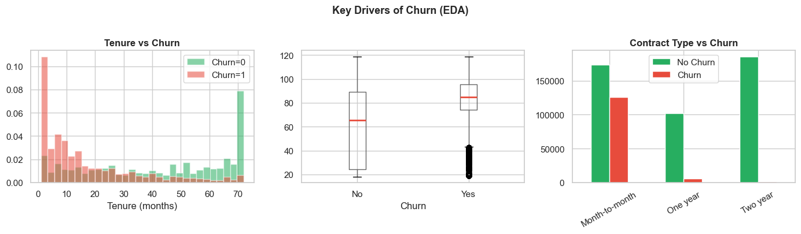
Data Engineering & EDA [Part A (§1)]
CRISP-DM: Data Preparation | 80/20 stratified split | X_test locked until §4
EDA Insights
◆ Tenure: New customers (<12 months) highest churn risk — focus retention on year 1.
◆ MonthlyCharges: Churners pay ~$15–20/month more (pricing sensitivity).
◆ Contract type: Month-to-month churn ~42%; two-year contracts <3%.

Slide 5
Leakage-Safe Pipeline Architecture [Part A (§1)]
CRISP-DM: Data Preparation | All transforms encapsulated inside sklearn Pipeline
BEFORE SPLIT
80 / 20 SPLIT
INSIDE PIPELINE (per CV fold)
• Coerce TotalCharges to numeric
• Map target Churn: Yes → 1, No → 0
• Drop ID column
• Stratified by Churn
• Seed = 42
• Test set locked until §4
Numeric → StandardScaler
Categorical → OneHotEncoder → χ² top-50%
↓ SMOTE (training fold only)
↓ XGBoost champion
→
→
Design Decisions
◆ Explicitly converting string labels for target Churn to define the positive and negative classes.
◆ Feature Scaling for Numeric features using StandardScaler to ensure larger ranges (e.g. TotalCharges) do not dominate smaller ones (e.g. Tenure)
◆ Dimensionality reduction using chi-squard (χ²) feature selection to keep the top-50% of encoded categories most associated with churn.
◆ Handle imbalanced classes using SMOTE which runs inside the pipeline — oversampling touches training folds only, never validation/test.
◆ Using Pipeline ensures that every transform is fit on the training fold only — the test set is untouched until §4.

Slide 6
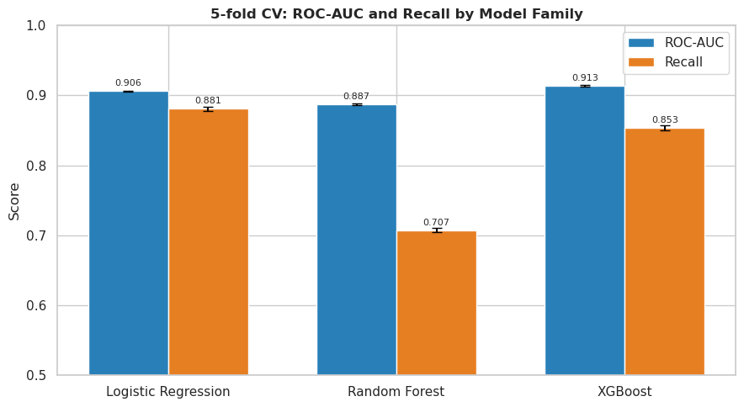
Champion Model Selection [Part B (§2)]
5-fold stratified CV at representative defaults | ROC-AUC primary, Recall secondary
Family | Model | Rationale | ROC-AUC (mean±std) | Recall (mean±std)
Linear | Logistic Regression | Interpretable baseline; linear decision boundary | 0.9059±0.0011 | 0.8808±0.0027
Bagging | Random Forest | Variance reduction; built-in feature importance | 0.8872±0.0013 | 0.7072±0.0024
Boosting | XGBoost | Sequentially corrects errors; strong on tabular data | 0.9134±0.0012 | 0.8534±0.0038
◆ Primary Metric [ROC-AUC]: threshold-independent ranking quality — fair comparison across all families.
◆ Secondary Metric [Recall]: tracks business cost of missed churners (False Negative). threshold is set in §4.

Slide 7
Champion Justification: XGBoost [Part B (§2)]
Selected by highest 5-fold CV ROC-AUC at default params
Family | Model | Rationale | ROC-AUC (mean±std) | Recall (mean±std)
Linear | Logistic Regression | Interpretable baseline; linear decision boundary | 0.9059±0.0011 | 0.8808±0.0027
Bagging | Random Forest | Variance reduction; built-in feature importance | 0.8872±0.0013 | 0.7072±0.0024
Boosting | XGBoost | Sequentially corrects errors; strong on tabular data | 0.9134±0.0012 | 0.8534±0.0038
Champion Model: XGBoost (Boosting family)
CV ROC-AUC: 0.9134±0.0012 CV Recall: 0.8534±0.0038
Why this champion?
◆ XGBoost achieved the highest mean CV ROC-AUC across all 3 families.
◆ Low standard deviation across folds → consistent performance, low overfitting risk.
◆ ROC-AUC is threshold-independent — a fair selection criterion before §4 threshold shift.
◆ Boosting family: sequentially corrects errors — strongest on tabular, imbalanced data.
◆ Provides strong baseline for GridSearchCV tuning in §3 (champion-only grid search).

Slide 8
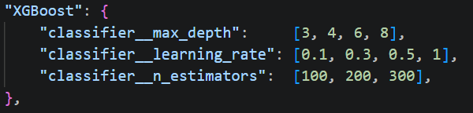
Hyperparameter Tuning for Champion Model XGBoost [Part C (§3)]
GridSearchCV on champion only | ≤50 candidate-config cap
Decision | Choice | Rationale
Search method | GridSearchCV | Exhaustive over small grids; reproducible
Scope | Champion only | One champion declared in §2; tune alone
Iterations cap | ≤50 candidate configs | Champion grid with 48 configs (well within cap)
CV folds | 5-fold stratified | Validation repeats, not search iterations
Tune dataset | 100,000 subsample | 4–5× faster; refit on full 475,000 rows
refit metric | roc_auc | Threshold-independent; recall tuned in §4
Tuning Parameters
Tuning Outcome
Champion: XGBoost
Best params: learning_rate=0.1, max_depth=3, n_estimators=300
CV ROC-AUC: 0.9109±0.0011
CV Recall: 0.8535±0.0019
Refit best config on full 475,000 rows train set

Slide 9
Final Model Stability [Part B (§2)] → [Part D (§4)]
CV cross-validated scores (train) + Hold-out evaluation (test, accessed once)
5-fold CV Scores for XGBoost
Model Test | ROC-AUC | Recall | Dataset Size
Before Tuning | 0.9134±0.0012 | 0.8534±0.0038 | 475,000
Before Tuning | 0.9078±0.0008 | 0.8236±0.0053 | 100,000
After Tuning | Unable to converge due to huge dataset (475,000 rows) with GridSearchCV (48 candidate configs) 48 candidate configs X 5-fold CV = 240 fits |  | 475,000
After Tuning | 0.9109±0.0011 | 0.8535±0.0019 | 100,000

Slide 10
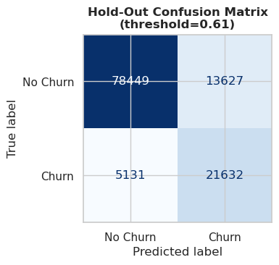
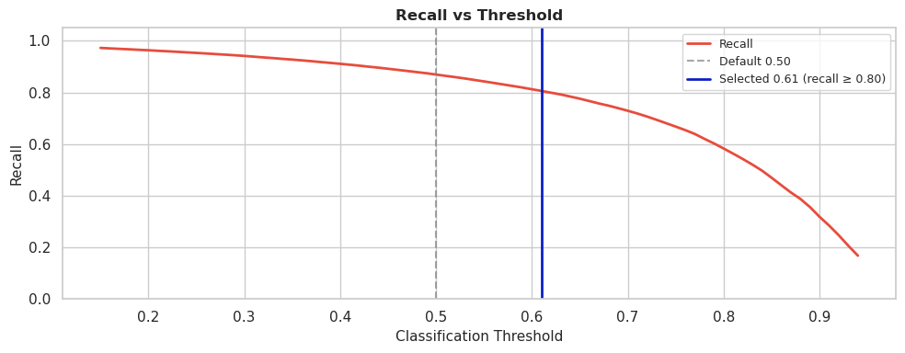
Final Model Stability [Part B (§2)] → [Part D (§4)]
CV cross-validated scores (train) + Hold-out evaluation (test, accessed once)
Hold-Out Test Metrics (threshold = 0.61)
Metric | Value
ROC-AUC | 0.9143
Recall | 0.8083

Slide 11
Business Decision Reasoning [Part D (§4)]
CRISP-DM: Deployment | Asymmetric error costs | Threshold shift
Asymmetric Error Costs
Error Type | Consequence | Severity
False Negative — miss a churner | Customer leaves uncontacted → lost lifetime value | CRITICAL
False Positive — flag loyal customer | Wasted retention offer — comparatively cheap, recoverable | Moderate
Threshold Decision
◆ FN far costlier than FP → prioritise recall; require recall ≥ 80%.
◆ Among thresholds meeting the floor, 0.61 is the highest — limits false positives.
◆ At threshold 0.61: Recall 0.8083 on hold-out — 81% of real churners flagged for intervention.
◆ Tier retention offers by predicted churn probability — concentrate premium spend on highest-risk customers.

Slide 12
Individual Contributions
Name | Student ID
YEO XIU JUAN | 2570472
LIM KHOON SENG | 2570459
LAI KIN WAH | 2570461
Work Area | Primary Owner | Secondary Support
Part A: EDA & Data Quality | LAI KIN WAH | YEO XIU JUAN
Part A: Pipeline Engineering | YEO XIU JUAN | LIM KHOON SENG
Part B: Model Selection | YEO XIU JUAN | LIM KHOON SENG
Part C: Hyperparameter Tuning | LIM KHOON SENG | LAI KIN WAH
Part D: Business Decision | LIM KHOON SENG | LAI KIN WAH
Report & Slides | LAI KIN WAH | LIM KHOON SENG

