Slide 1
SMS GATEWAY INTERFACE
Data Flow Control
January 2008

Slide 2
Purpose
This document illustrates how the SMS shall control the outgoing SMS command messages sent into the SMS-gateway interface.
The goal of this data control is to prevent the input buffer of the SAS (RTM) to be overflow

Slide 3
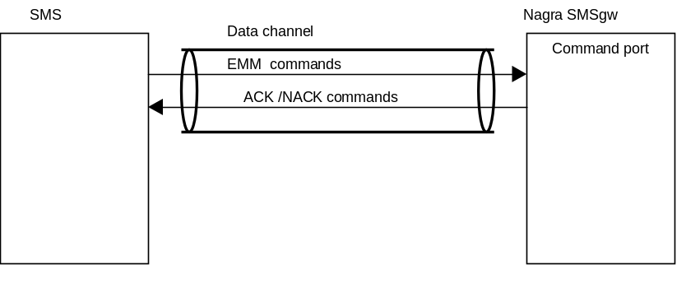
Interface overview
The picture below shows the SMS-gateway interface. The SMS opens a data channel (TCP/IP link) with the Nagra SMSgw server.
In this data channel the SMS sends EMM commands and receives ACK/NACK responses.

Slide 4
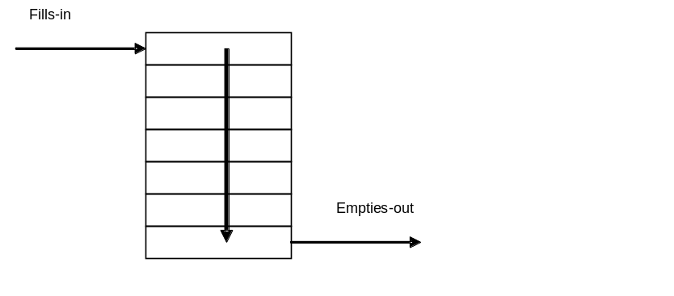
FIFO background
The FIFO acts as a queue.
A process push data in the input.
Another process extract data.
The sequence of data IN vs. OUT is preserved

Slide 5
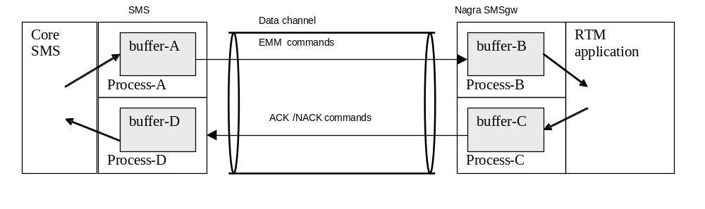
Data Flow Overview
The picture below shows the data flow (end-to-end).
The core SMS fills-in commands to buffer-A.
Buffer-A is a FIFO queue (First In First Out)
The process A empties the data presents in buffer-A. This means that data is now in buffer-B.
RTM extracts data from buffer-B and proceed. When it is done RTM fills-in buffer-C with ACK or NACK responses.
The process-C empties the ACK/NACK and the data is now in buffer-D.
Core SMS extracts ACK/NACK from buffer-D.

Slide 6
Data Flow Control
The Data Flow Control is based on the management of a global counter in the SMS.
When SMS application starts, the counter is set to input buffer size of SAS (typically 1000).
Process-A
  (1) SMS process-A checks if counter value > 0.
    If this condition is OK, then process-A decrements the counter.
    If this condition is not OK, then process-A go to (1)
  Then process-A extracts next command in line (i.e. in the buffer-A) and sends the command to SAS buffer-B.
  Go to (1)
Process-D
  Any time the SMS process-D receives a command (ACK/NACK), it increments the counter.

Slide 7
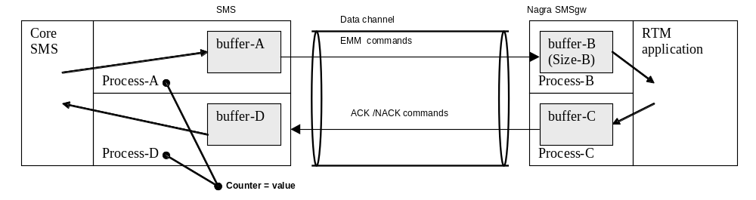
Data Flow Control
The picture below shows the shared counter in the SMS system.

