Slide 1
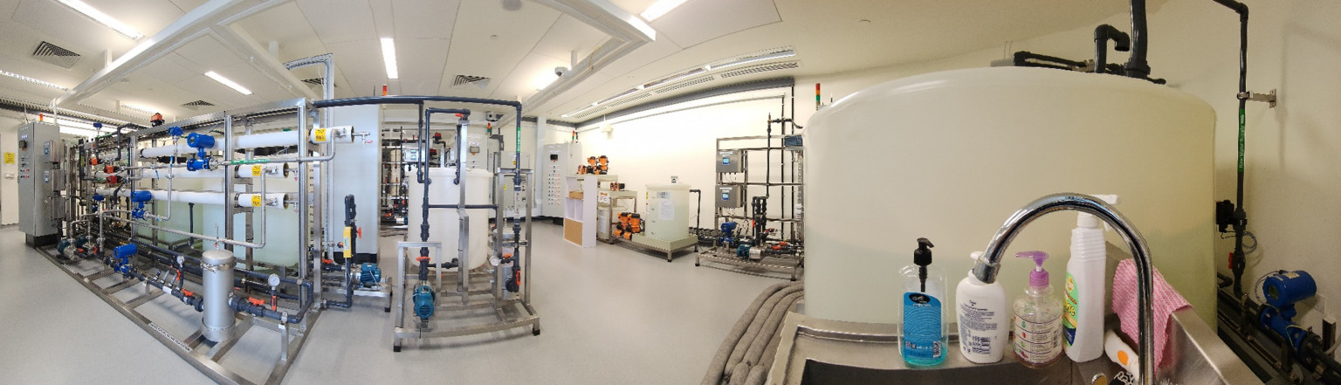
Stealthy Attack & Resilient
Defense on the SWaT Testbed
51.508 Secure Cyber Physical Systems | Project Proposal
Modbus False Command Injection
Constrained Concealment Evasion
Invariant-Based Recovery
iTrust Lab | SWaT Testbed | AY2025/26 Term 2
SWaT Testbed — iTrust Centre for Research in Cyber Security, SUTD Singapore

Slide 2
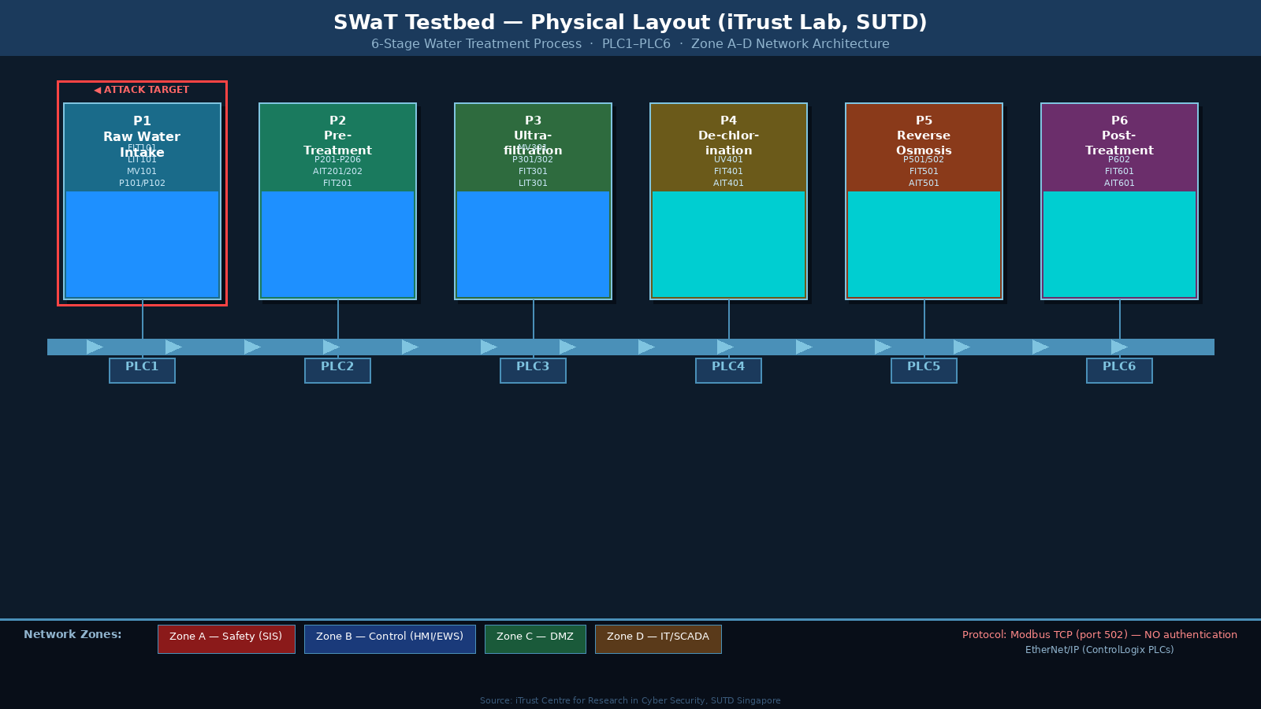
Project Overview
01
02
03
04
Motivation
Attack
Defense
Recovery
SWaT uses Modbus/EtherNet-IP with no auth. Existing ML detectors are vulnerable to adversarial evasion.
Stealthy false CIP tag injection injection targeting pumps & valves with sensor spoofing to evade anomaly detection.
Hybrid detector: process invariants (physics-based) combined with a reconstruction-based ML autoencoder.
Automated safe-state transition + hot-standby PLC failover + invariant-guided sensor reconstruction.
Research Contribution: First end-to-end demonstration on SWaT combining adversarial evasion attacks with a hybrid physics+ML defense and automated recovery.
SWaT Testbed — 6-stage water treatment process, PLC1–PLC6, iTrust Lab SUTD
SWaT Testbed — 6-stage water treatment process, PLC1–PLC6, iTrust Lab SUTD
SWaT Testbed — 6-stage water treatment process, PLC1–PLC6, iTrust Lab SUTD

Slide 3
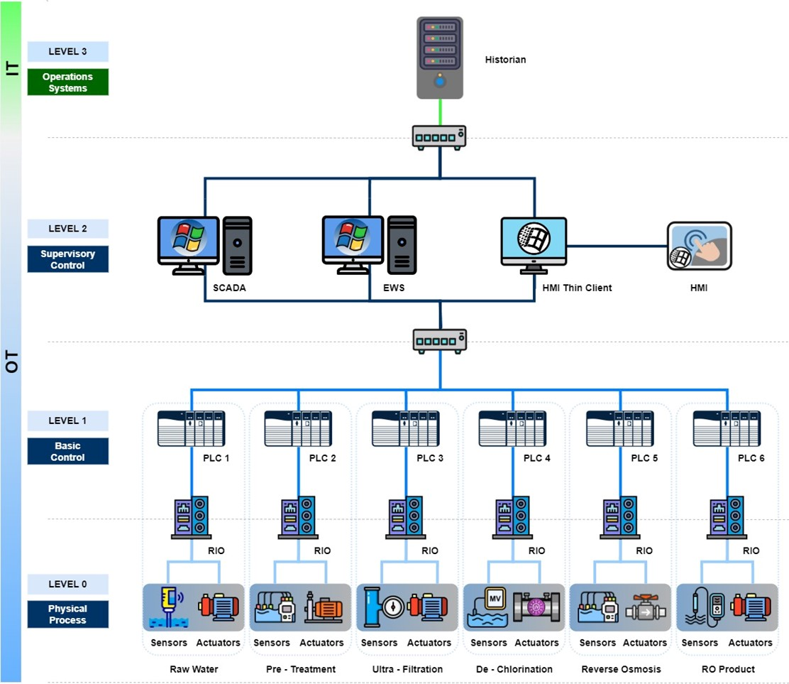
Threat Model & Assumptions
Attacker Profile
SWaT Attack Surface
Access:
Network-level access to Level 1/2 OT network (e.g. via compromised engineering workstation or rogue laptop on switch)
Zone D (IT)
HMI workstation — compromised via phishing/USB (university policy: code runs on HMI)
Knowledge:
Knows Modbus register map (obtainable via passive sniffing). Black-box knowledge of anomaly detector.
Firewall
Traversal possible if SCADA talks to OT — common misconfiguration
Capability:
Can intercept, inject, and spoof EtherNet/IP frames. Can manipulate sensor readings reported to SCADA HMI.
Zone B (OT)
Modbus/TCP to PLC1–PLC6, no authentication — direct command injection
Goal:
Cause physical damage (tank overflow / pump cavitation) without triggering alarms for as long as possible.
Zone A (SIS)
Safety Instrumented System — target is to stay below SIS thresholds
SWaT network architecture: IT (Level 2-3) + OT (Level 0-1), PLC1–PLC6

Slide 4
Attack Design
Papers #9 (Modbus FCI) + #31 (Constrained Concealment)
Phase 0
Reconnaissance
Phase 1
False Command
Phase 2
Sensor Spoofing
Passive Wireshark sniff on
EtherNet/IP port 44818.
Map PLC IPs, register
addresses, I/O tags.
Inject crafted Modbus
write-coil/register frames
e.g. close MV101, force
P101 pump OFF.
Replay captured legitimate
responses to SCADA HMI (Paper #9 Algorithm 1).
Additionally spoof sensor values
via adversarial AE to evade ML detectors (Paper #31).
▶
▶
Target: SWaT P1 (raw water intake) → force MV101 closed + P101 OFF while LIT101 shows normal level → starvation of downstream stages P2–P6

Slide 5
Why Existing Detectors Fail
ML-Only Anomaly Detector
Invariant-Only Detector
(e.g. reconstruction autoencoder)
(e.g. SWaT DAD / Adepu & Mathur)
✗ Learns normal sensor correlations from training data
✗ Encodes physics-based rules from P&ID (e.g. if P101 ON → FIT101 > threshold)
✗ Paper #31 adversarial autoencoder crafts sensor perturbations that minimise MSE reconstruction error
✗ Catches gross physical violations but misses low-rate stealthy changes
✗ Black-box attack — no need to know model internals
✗ AICrit only detected 24/36 attacks in SWaT dataset (Adepu et al.)
✗ Operates in milliseconds — meets real-time Modbus constraints
✗ Attacker can stay within invariant bounds by manipulating slowly
✗ Detection rate drops to near-zero under constrained concealment
✗ No ML component means blind to novel multi-sensor coordinated spoofing

Slide 6
Defense Design
Hybrid Invariant + ML Anomaly Detection
Sensor &
Actuator Readings
Process Invariant
Checker (Physics)
▶
▼
Reconstruction
Autoencoder (ML)
Decision Fusion
(AND / weighted vote)
ALERT
→ Trigger Recovery
▶
▶
Example Invariants for P1:
IF MV101=OPEN AND P101=ON THEN FIT101 > 0.4 m³/h within 10s
IF LIT101 < LOW_THRESHOLD THEN P101=OFF (tank protection invariant)
IF P101=OFF AND MV101=CLOSED THEN LIT101_rate_of_change ≈ 0 (no spurious flow)

Slide 7
Recovery Design
1
2
3
4
5
Detect
Contain
Safe State
Failover
Verify & Resume
Hybrid detector raises alert. Affected P-stage and compromised sensors identified.
Block malicious Modbus frames at network layer. Isolate compromised PLC channel.
Transition affected stage to pre-defined safe config. Fail-safe valve/pump positions per P&ID.
Hot-standby PLC takes over. Switches to local sensor reads, bypasses compromised network path.
Cross-validate sensors via invariant model. Gradually restore normal operation stage-by-stage.
▶
▶
▶
▶
SWaT Safe State Configuration (per stage):
Stage | Safe Valve State | Safe Pump State
P1 – Raw Water | MV101: CLOSED | P101: OFF
P2 – Pre-Treatment | P201–P206: ALL OFF | P102: OFF (P1 backup pump)
P3 – Ultrafiltration | MV301: CLOSED | P301/302: OFF
P4 – De-chlorination / P6 – RO | UV401: OFF / P602: OFF | Hold / RO pump OFF

Slide 8
Implementation Plan
Week 9–10
-> Deploy Wireshark on SWaT Level 1/2 switch mirror port
Phase 1: Setup & Attack
-> Map Modbus register addresses for P1 actuators (MV101, P101)
-> Implement Python-based Modbus injection script (port 44818)
-> Verify false commands reach PLC — confirm physical effect on SWaT
-> Capture baseline sensor timeseries for autoencoder training
Week 11
-> Train reconstruction autoencoder on SWaT normal operation data
Phase 2: Evasion & Defense
-> Implement adversarial perturbation (Paper #31 learning-based method)
-> Verify attack evades standalone ML detector
-> Derive process invariants for P1–P3 from SWaT P&ID
-> Implement invariant checker + combine with autoencoder (decision fusion)
Week 12–13
-> Implement safe-state transition logic for P1 (trigger on alert)
Phase 3: Recovery & Demo
-> Configure hot-standby PLC failover (using SWaT dual-PLC architecture)
-> Implement sensor cross-validation using invariant reconstruction model
-> Run full end-to-end demo: attack → evade → detect → recover
-> Measure recovery time (KPI: time from alert to normal operation)
Tools: Python (Scapy/pylogix) · Wireshark · PyTorch (autoencoder) · Studio 5000 (PLC) · SWaT SCADA HMI

Slide 9
Evaluation Metrics
Attack Effectiveness
▸ Time-to-impact: how quickly does tank level deviate from normal?
▸ Evasion rate: % of attack cycles that pass through standalone ML detector undetected
▸ Stealth duration: time elapsed before any alert is raised
Detection Performance
▸ Detection rate (DR): % of attack scenarios detected by hybrid detector
▸ False positive rate (FPR): % of normal operation flagged as anomalous
▸ Comparison: invariant-only vs ML-only vs hybrid (DR & FPR)
Recovery Performance
▸ Recovery time (RT): seconds from alert to restored normal operation
▸ Sensor trust accuracy: % of spoofed sensors correctly identified via invariant cross-validation
▸ Physical integrity: no unsafe state (overflow/underflow) during recovery window
Bonus Evaluation: Apply our defense against another group's attack (cross-group exercise as per course rubric)

Slide 10
References
[1]
W. Alsabbagh, S. Amogbonjaye, D. Urrego, and P. Langendörfer
[6]
A. Carcano, A. Coletta, M. Guglielmi, M. Masera, I. N. Fovino, and A. Trombetta
"A Stealthy False Command Injection Attack on Modbus based SCADA Systems"
"A Multidimensional Critical State Analysis for Detecting Intrusions in SCADA Systems"
IEEE CCNC, Las Vegas, USA, Jan. 2023.
IEEE Trans. Industrial Informatics, vol. 7, no. 2, pp. 179–186, May 2011. DOI: 10.1109/TII.2010.2098415
[2]
J. H. Castellanos, M. Ochoa, A. A. Cardenas, O. Arden, and J. Zhou
[7]
D. I. Buzhinsky and V. Vyatkin
"Constrained Concealment Attacks against Reconstruction-based Anomaly Detectors in ICS"
"Automatic Inference of Finite-State Plant Models from Traces and Temporal Properties"
ACM ACSAC, Austin, USA, Dec. 2020. | github.com/scy-phy/ICS-Evasion-Attacks
IEEE Trans. Industrial Informatics, vol. 13, no. 4, pp. 1521–1530, Aug. 2017. DOI: 10.1109/TII.2017.2670001
[3]
S. Adepu and A. Mathur
[8]
A. Humayed, J. Lin, F. Li, and B. Luo
"Using Process Invariants to Detect Cyber Attacks on a Water Treatment System"
"Cyber-Physical Systems Security: A Survey"
IFIP SEC, Ghent, Belgium, May 2016.
IEEE Internet of Things Journal, vol. 4, no. 6, pp. 1802–1831, Dec. 2017. DOI: 10.1109/JIOT.2017.2703172
[4]
S. Adepu and A. Mathur
[9]
iTrust, Centre for Research in Cyber Security, SUTD
"Distributed Detection of Single-Stage Multipoint Cyber Attacks in a Water Treatment Plant"
"SWaT: Secure Water Treatment Testbed"
ACM AsiaCCS, Xi'an, China, May 2016.
Singapore University of Technology and Design. https://itrust.sutd.edu.sg/testbeds/secure-water-treatment-swat/
[5]
C. M. Ahmed, J. Zhou, and A. P. Mathur
"Attacking Fieldbus Communications in ICS: Applications to the SWaT Testbed"
Singapore Cyber Security R&D Conference (SG-CRC), Singapore, 2016.
51.508 Secure Cyber Physical Systems | References

Slide 11
SWaT P1 Attack
Scripts
False Command Injection via HMI-based injection
phase0_recon.py
Based on Alsabbagh et al., IEEE CCNC 2023 (Paper #9)
phase1_inject.py
Phase 0: Recon
Phase 1: Inject
Phase 2: Conceal
phase2_spoof.py
Target: PLC1 (P1 stage) — Force MV101 CLOSED + P101 OFF via unauthenticated Modbus writes
Python / Scapy
pylogix / PyTorch
51.508 Secure CPS · SWaT Attack Implementation · Overview

Slide 12
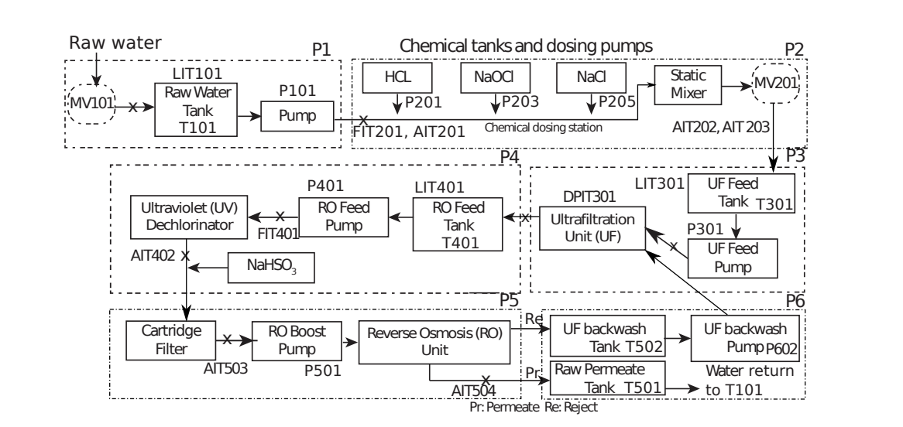
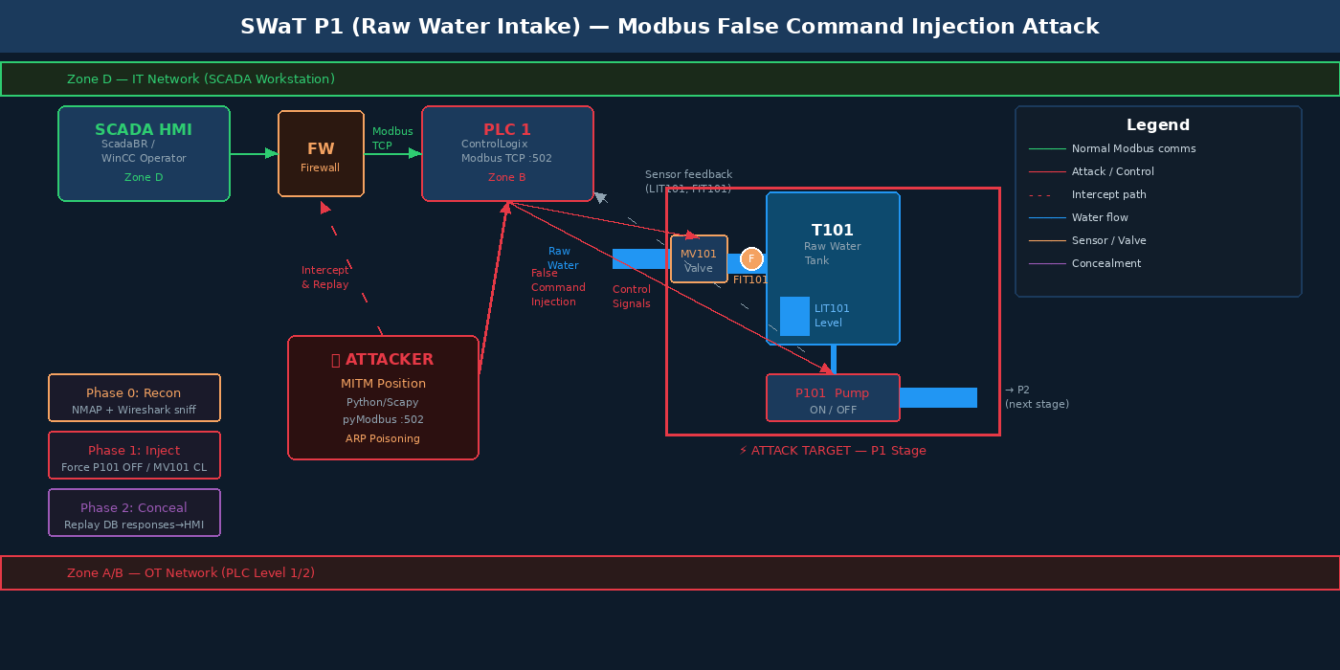
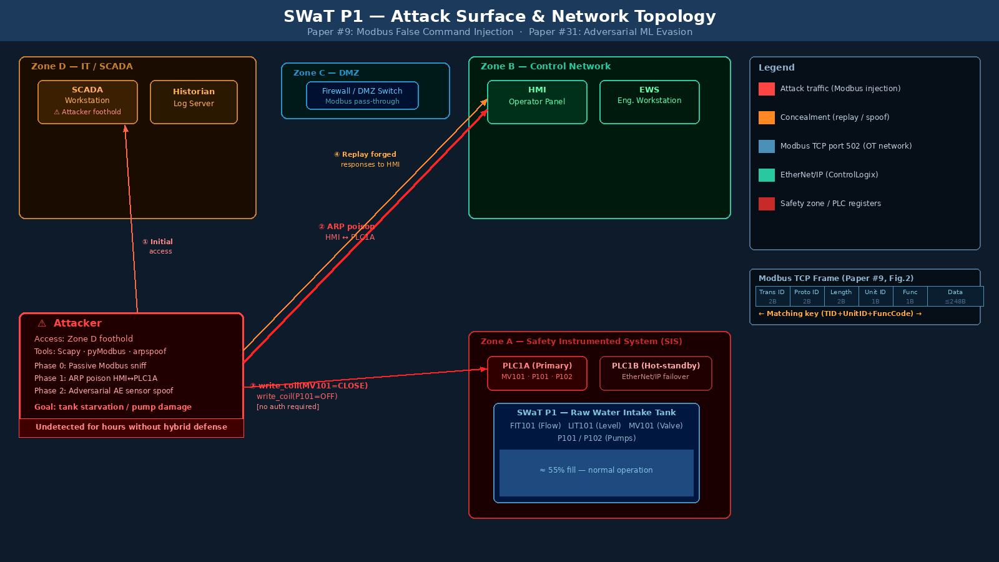
SWaT P1 — What We Are Attacking
Raw Water Intake Stage · PLC1 · EtherNet/IP port 44818
SWaT P&ID — P1 raw water intake with MV101, T101, P101/P102, FIT101, LIT101
Physical SWaT testbed at iTrust Lab
51.508 Secure CPS · SWaT Attack Implementation · Slide 12/18 — Architecture
Attack surface: Compromised HMI → direct CIP writes to PLC1 → false CIP tag injection injection

Slide 13
Threat Model & Attack Surface
Attacker Profile
Why Modbus Has No Defence
Access level
HMI workstation — compromised via phishing/USB drop (Stuxnet, Ukraine 2015, Oldsmar 2021)
No Auth
Any device on the network can write coils/registers to any PLC
Goal
Disrupt P1 water intake; starve downstream P2–P6 stages
Plaintext
Frames transferred in clear — Wireshark reveals everything
Tools
Scapy, pylogix, arpspoof — all standard Python
No timestamp
Devices cannot tell if a response is current or a replay
Knowledge
Modbus spec is public; no PLC vendor credentials needed
No integrity
Frame contents can be altered; PLC cannot detect manipulation
Stealth
HMI operator sees nothing — fake responses replayed from pre-built DB
Open spec
Modbus protocol reference is freely downloadable — attacker has full spec
Network topology showing attacker path from Zone D → Zone B (OT) via EtherNet/IP
SWaT network zones: attacker enters Zone D (IT), targets Zone A (OT/PLC1) via EtherNet/IP
51.508 Secure CPS · SWaT Attack Implementation · Slide 13/18 — Threat Model

Slide 14
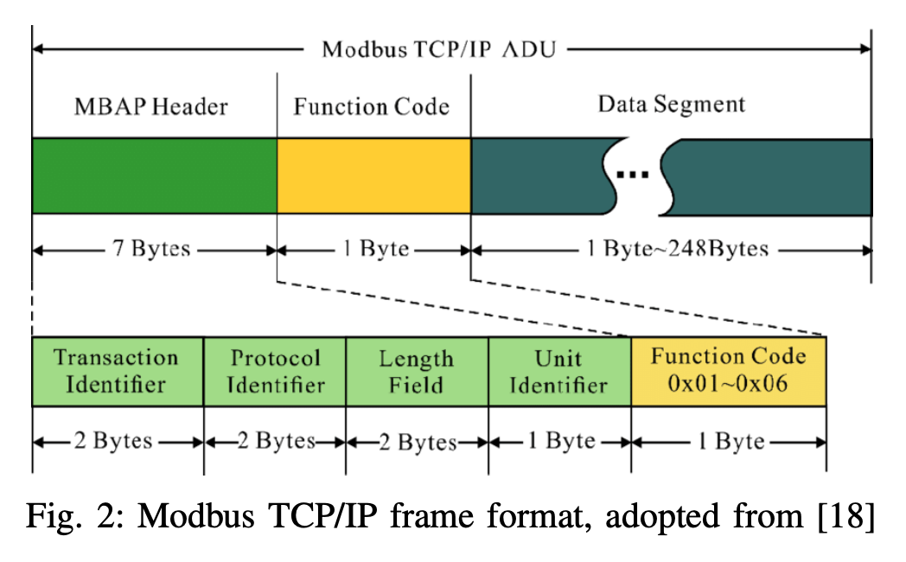
Phase 0
Reconnaissance & Database Building
phase0_recon.py · NMAP SYN scan + Wireshark-style Modbus capture (~30 min)
Step 1 — NMAP SYN Scan
Step 2 — Capture & Pair Modbus Frames
nmap -sS -p 502 192.168.1.0/24
Match by: TID + Unit ID + Func Code
SYN (half-open) scan — does not complete TCP handshake.
Harder to detect by default firewall rules.
Finds all PLCs with port 44818 open.
Sniff for ~30 min. Each HMI→PLC request is paired with its PLC→HMI response using 3 shared fields (Paper #9 Fig.5). Duplicates removed. Result: dict of request-response pairs.
EtherNet/IP Frame (Paper #9 Fig. 2)
Trans ID
Proto ID
Length
Unit ID
Func Code
Data
2B
2B
2B
1B
1B
≤248B
Fig. 2 from Paper #9 — EtherNet/IP/IP ADU frame format (Alsabbagh et al., IEEE CCNC 2023)
← Matching key for DB pairing →
51.508 Secure CPS · SWaT Attack Implementation · Slide 14/18 — Phase 0: Recon

Slide 15
Phase 1
Direct CIP Tag Injection from HMI
phase1_inject.py · Scapy ARP spoof + pylogix write to PLC1:502
HMI Compromise — Attacker Access
False Command Injection
Tell HMI: "PLC1's IP → my MAC"
Tell PLC:
"HMI's IP → my MAC"
client.write_coil(MV101_CLOSE, True)
client.write_coil(P101_STOP, True)
All traffic now routes through attacker.
Re-broadcast every 1.5s to maintain MITM.
IP forwarding enabled on attacker machine.
Python pylogix sends crafted Modbus frames to PLC1:502. No authentication required — PLC accepts any write from any device on the network.
Algorithm 1 — Concealment (Paper #9) · Replay DB responses to HMI while injecting PLC
for each packet sniffed from network:
if src==HMI and dst==PLC and port==502:
drop original request # do not forward to PLC
Replay key: (TransactionID + UnitID + FunctionCode) — Paper #9 Algorithm 1
response = db.lookup(unit_id, func_code) # O(1) hash lookup
send forged_response → HMI # operator sees nothing
send false_command → PLC # PLC obeys attacker
51.508 Secure CPS · SWaT Attack Implementation · Slide 15/18 — Phase 1: Inject

Slide 16
Phase 2
Adversarial Sensor Spoofing — Evading ML Detectors
phase2_spoof.py · Castellanos et al., ACSAC 2020 (Paper #31) · github.com/scy-phy/ICS-Evasion-Attacks
Problem: Naive Replay
Solution: Adv. Autoencoder
Training Loss
✗ Phase 1 replays static stored values
Learning-based (black-box):
L = α · MSE_detector(x+δ)
+ β · ||δ||₂
Train adversarial net to output perturbation δ such that:
AE_detector(x + δ)
has low reconstruction error
→ looks normal to detector
✗ Physical correlations break: LIT101 stays flat while P101 is OFF
α·MSE → fool detector β·||δ|| → keep perturbation small Result: spoofed sensor values that reconstruct normally through any AE detector
✗ Reconstruction AE detects increasing MSE error over time
Constraint: ||δ||∞ ≤ ε
Runs in milliseconds
— meets Modbus timing window
✗ Paper #31: triggers alarms when <95% sensors are manipulated
51.508 Secure CPS · SWaT Attack Implementation · Slide 16/18 — Phase 2: Evade

Slide 17
Implementation Scripts — Usage Reference
phase0_recon.py
NMAP SYN scan + Modbus packet sniffer + request-response DB builder
sudo python3 phase0_recon.py \
--subnet 192.168.1.0/24 \
--iface eth0 --duration 1800 \
--db modbus_db.pkl
deps: scapy python-nmap
out: modbus_db.pkl swat_capture.pcap recon_results.json
phase1_inject.py
HMI-based CIP injection + false CIP tag writes + Algorithm 1 concealment replay
sudo python3 phase1_inject.py \
--plc-ip 192.168.1.10 \
--hmi-ip 192.168.1.20 \
--db modbus_db.pkl --duration 120
deps: scapy pymodbus
out: Console: injection count + concealment events
phase2_spoof.py
Adversarial autoencoder: train detector + adv model, then spoof sensor readings at attack time
python3 phase2_spoof.py train \
--data swat_normal.csv --epochs 100
python3 phase2_spoof.py attack \
--plc-ip 192.168.1.10 --adv-model adv_model.pt
deps: torch numpy pandas scapy pymodbus scikit-learn
out: detector.pt adv_model.pt
51.508 Secure CPS · SWaT Attack Implementation · Slide 17/18 — Scripts

Slide 18
Before You Run — Practical Notes for SWaT
Pre-Run Checklist
P1 Register Map (fill from Phase 0)
Confirm EtherNet/IP is enabled on SWaT PLC1 (ask lab engineer)
MV101_CLOSE
0x????
Coil — close motorised valve
P101_STOP
0x????
Coil — stop pump P101
Get register addresses for MV101 + P101 from Phase 0 sniff — do NOT guess
LIT101
0x????
Holding reg — tank level
Get iTrust lab engineer sign-off before running attack scripts
FIT101
0x????
Holding reg — flow sensor
TA must be physically present during all experiments
Race Condition (Paper #9 §IV-B)
Your forged HMI response must arrive before the real PLC response. Pre-key the database as dict keyed on (unit_id, func_code) for O(1) lookup. SWaT polling cycle ≈ 1–2s — you have margin.
Run Phase 0 first — never inject without the pre-built DB
Test injection on digital twin before live SWaT
Dual PLC Note
Document clean-exit: restore_plc_state() runs automatically on stop
SWaT has primary + hot-standby PLCs per stage. Target primary; standby takeover is your recovery trigger.
51.508 Secure CPS · SWaT Attack Implementation · Slide 18/18 — Notes

Slide 19
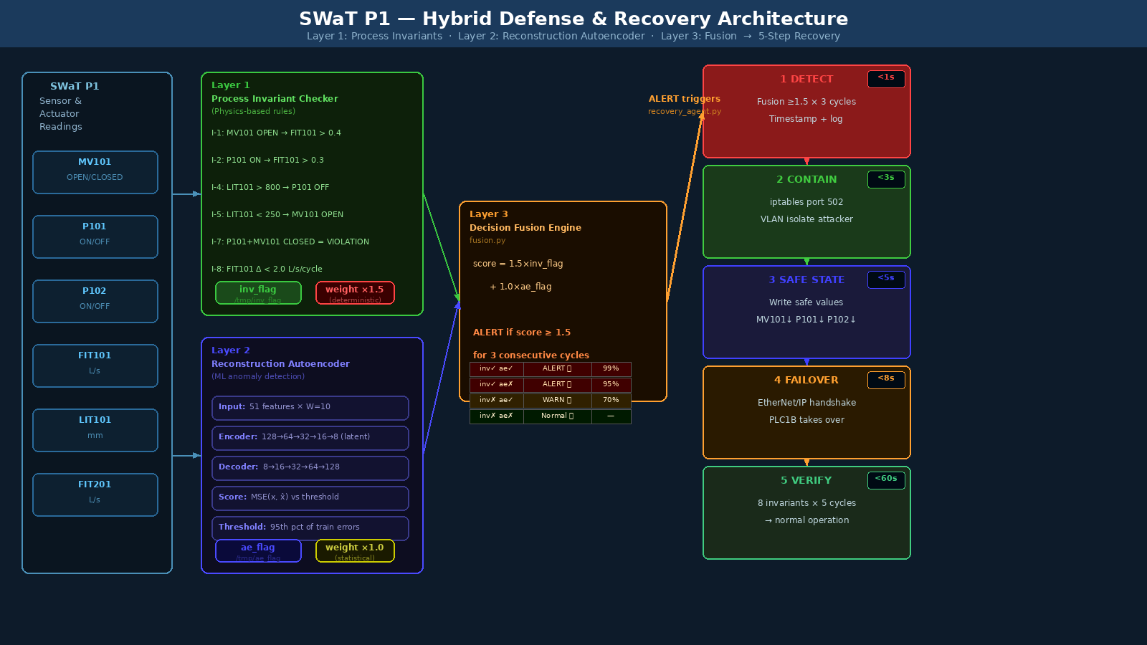
Defending SWaT
Against Stealthy Modbus False Command Injection
Layer 1
Layer 2
Layer 3
Process Invariant Checker
Reconstruction Autoencoder
Decision Fusion + Alert
Recovery: Detect → Contain → Safe State → PLC Failover → Invariant-Verified Resume
51.508 Secure Cyber Physical Systems | iTrust Lab, SUTD | AY2025/26 Term 2
51.508 Secure CPS · SWaT Defense Architecture
Hybrid defense pipeline: invariant checker + autoencoder → fusion → 5-step automated recovery

Slide 20
Why Single-Layer Defenses Fail
Each defense alone is evaded by our attack — which is exactly why the hybrid exists
ML-Only Anomaly Detector
Invariant-Only Detector
e.g. Reconstruction Autoencoder (BATADAL baseline)
e.g. Adepu & Mathur, IFIP SEC 2016 (Papers #88)
✗
Learns normal correlations from training data only
✗
Physics rules encode P&ID constraints (e.g. MV101 open → FIT101 > 0)
✗
Paper #31 adversarial AE crafts δ minimising MSE recon error
✗
Paper #9 Phase 2 replay sends stale-but-valid sensor readings
✗
With |δ|∞ ≤ ε = 0.1, evasion rate ~94% on SWaT
✗
Only 24 of 36 SWaT attacks detected by invariant alone [Adepu 2016]
✗
Sensor spoof looks normal to the ML model's latent space
✗
No timing anomaly flagged if replay matches polling frequency
✗
Blind to actuator state — only sees sensor timeseries
✗
Cannot detect gradual drift if attacker moves slowly within bounds
Conclusion: Neither layer alone is sufficient. The hybrid forces the attacker to simultaneously satisfy physics constraints AND fool the ML detector — a much harder constraint.

Slide 21
Hybrid Defense Architecture
Three cooperative layers — each compensates for the other's blind spots
Layer 1
Layer 2
Layer 3
SWaT
Sensor &
Actuator
Readings
Process Invariant
Checker
Reconstruction
Autoencoder
Decision
Fusion
→
→
→
Physics-based rules
from SWaT P&ID
(Adepu & Mathur 2016)
ML anomaly score
vs learned normal
distribution
Weighted vote +
alert + trigger
recovery pipeline
↓ ALERT + RECOVERY TRIGGER
Layer 1 — What it checks
Layer 2 — Autoencoder
Layer 3 — Fusion logic
▸ MV101 OPEN → FIT101 > 0.5 m³/h
▸ Trained on 7 days normal SWaT data
▸ ALERT if inv_flag fires (score ≥1.5) or both fire together
▸ P101 ON → LIT101 rising or stable
▸ Encoder: 50→32→16→8 (latent dim)
▸ WARN if AE alone fires (score=1.0 < threshold) — investigate
▸ LIT101 < HIGH_LIMIT → P101 ON
▸ Anomaly score = MSE(x, x̂)
▸ Invariant flag weighted ×1.5 (physics > stats)
Full hybrid pipeline with recovery
▸ P101 OFF → LIT101 falling (drain only)
▸ Threshold = 95th pctile of train errors
▸ 3-cycle confirmation window (anti-flap)
▸ MV101 CLOSED + P101 ON = invariant violation
▸ Raises flag if score > threshold
▸ Trigger recovery if ALERT confirmed
51.508 Secure CPS · SWaT Defense · Architecture

Slide 22
Layer 1 — Process Invariant Checker
Physics-based rules derived from the SWaT P&ID — cannot be fooled by ML evasion
#
Condition
Invariant Rule
Physical Reason
I-1
MV101 OPEN
FIT101 > 0.4 m³/h
Water flows when valve open
I-2
P101 ON
FIT101 > 0.3 m³/h
Pump drives positive flow
I-3
P101 ON
LIT101 not falling rapidly
Pump fills or holds tank
I-4
LIT101 > HIGH (800mm)
P101 OFF within 2 cycles
Overflow protection
I-5
LIT101 < LOW (250mm)
MV101 OPEN + P101 ON
Dry-run protection
I-6
MV101 CLOSED
FIT101 < 0.05 m³/h
No flow when valve shut
I-7
P101 ON + MV101 CLOSED
→ VIOLATION (attack signature)
Impossible physics state
I-8
P101 OFF
LIT101 non-increasing
Tank drains only if pump off
Key insight: I-7 fires immediately when Paper #9 forces P101 ON + MV101 CLOSED simultaneously — the invariant flags the attack before any physical damage occurs.
51.508 Secure CPS · SWaT Defense · Layer 1 — Invariants

Slide 23
Layer 2 — Reconstruction Autoencoder
Trained on normal SWaT sensor timeseries — flags deviations from learned correlations
Autoencoder Architecture
Training
Input
▸ 7-day SWaT normal operation dataset (iTrust)
▸ Sliding window: 10 timesteps, step=1
51 features
(all SWaT sensors, window=10)
▸ Batch size 128, Adam optimiser, lr=1×10⁻³
↓
▸ 100 epochs, MSE loss on reconstruction
Encoder L1
▸ Threshold = 95th percentile of training MSE
128 units ReLU
↓
Detection Logic
Encoder L2
Decoder L1
▸ At inference: compute MSE(x_t, x̂_t) per timestep
64 units ReLU
64 units ReLU
▸ Flag if score > threshold for 3 consecutive steps
↓
↓
▸ Rate of score increase also tracked (gradient check)
Latent z
Decoder L2
▸ Separates genuine anomaly from sensor noise
16 units (bottleneck)
128 units ReLU
Why AE Alone Fails (Paper #31)
↓
Output x̂
▸ Adversarial AE trained to minimise our detector's MSE
51 features reconstruction
▸ Perturbation δ constrained to ‖δ‖∞ ≤ 0.1 (imperceptible)
▸ Bypasses AE alone in ~94% of cycles (Paper #31 result)
MSE(x, x̂) = Anomaly Score
▸ → Layer 1 invariant catches what AE misses
51.508 Secure CPS · SWaT Defense · Layer 2 — Autoencoder

Slide 24
Layer 3 — Decision Fusion & Alert
Combines both detection signals — minimises false positives while maximising detection coverage
Invariant Flag
Invariant Flag
AE Flag
AE Flag
Output
Output
Confidence
Confidence
Action
Action
✓ TRIGGERED
✓ TRIGGERED
🔴 ALERT
HIGH (99%)
Initiate full recovery pipeline
✓ TRIGGERED
✗ Clean
🟠 ALERT
HIGH (95%)
Alert + log + verify invariant
✗ Clean
✓ TRIGGERED
🟡 WARN
MEDIUM (70%)
Investigate — possible drift
✗ Clean
✗ Clean
🟢 NORMAL
N/A
Continue normal operation
Weighted Fusion Formula
Timing Constraints (SWaT)
score_fusion = 1.5 × inv_flag + 1.0 × ae_flag
▸ PLC polling cycle: 1–2 seconds
ALERT if score_fusion ≥ 1.5 (3-cycle window)
▸ Invariant check: <1 ms (rule lookup)
▸ AE inference: ~8 ms (GPU) / ~45 ms (CPU)
Invariant weighted ×1.5 because physics violations are deterministic, not probabilistic.
▸ Total detection latency: <50 ms per cycle
▸ 3-cycle confirmation: 3–6 seconds to alert
51.508 Secure CPS · SWaT Defense · Layer 3 — Fusion

Slide 25
Why the Hybrid Defeats Paper #31's Evasion
The adversarial autoencoder can fool the ML layer — but it cannot satisfy physics simultaneously
The Attacker's Dilemma
Attack Timeline Under Hybrid Defense
Paper #31 trains a perturbation network δ(x) such that:
t=0s
Phase 0
HMI compromised, direct PLC access
MSE_detector( x + δ ) ≈ 0
‖δ‖∞ ≤ ε = 0.1
t=5s
Phase 1
False write: P101 OFF, MV101 CLOSED injected to PLC1
This successfully evades the AE (Layer 2). But:
t=6s
L1 FIRES
Invariant I-7 triggers: P101=ON coil state + MV101=CLOSED
✗
δ on sensor readings ≠
δ on physical state
t=7s
Phase 2
The real P101 is still OFF. The real MV101 is still CLOSED. Perturbing sensor readings reported to HMI does not change what the PLC actually commands.
Adversarial sensor spoof begins — δ injected into Modbus replies
✗
Invariant I-7 checks
actuator register state
t=8s
L2 evaded
AE reconstruction error stays below threshold (Paper #31 works)
Layer 1 reads directly from PLC coil registers — not from Modbus responses replayed to HMI. The attack cannot spoof both simultaneously.
t=10s
ALERT
✗
Constraint violation is
deterministic, not probabilistic
Fusion: L1 weight=1.5 → threshold crossed → ALERT triggered
P101 ON + MV101 CLOSED is physically impossible regardless of what the sensor timeseries says. Physics does not average over distributions.
t=11s
Recovery
Modbus blocked, safe state set, standby PLC activated
51.508 Secure CPS · SWaT Defense · Defeating Paper #31

Slide 26
Recovery Pipeline
Five deterministic steps — from detection to verified normal operation
1
2
3
4
5
Detect
→
Contain
→
Safe State
→
PLC Failover
→
Verify & Resume
▸ Fusion score ≥ 1.5 for 3 consecutive cycles
▸ Drop all EtherNet/IP frames on port 44818 (iptables rule)
▸ Write safe-state actuator values to PLC1 (see Slide 9)
▸ Signal hot-standby PLC1B to take control
▸ Run all 8 P1 invariants against PLC1B readings
▸ Timestamp, sensor snapshot, and alert logged
▸ Isolate HMI session at L2 switch (VLAN), terminate attacker process
▸ MV101 → CLOSED, P101 → OFF (P1 safe idle)
▸ EtherNet/IP handshake confirms PLC1B is primary
▸ Check LIT101 within [250, 800] mm safe range
▸ Operator notified via SCADA HMI alarm
▸ Freeze current PLC output register state
▸ Wait 2 polling cycles to confirm registers held
▸ HMI re-mapped to PLC1B IP (automatic switchover)
▸ Resume only if all invariants pass for 5+ cycles
Total recovery time target: < 15 seconds from alert to verified safe state | PLC1B failover < 3 seconds | No unsafe state (overflow/underflow) during window

Slide 27
Safe State Table & PLC Failover
Exact actuator targets per stage — written to PLC registers before failover handshake
Stage
Actuator
Safe State Value
Physical Reason
SWaT Risk if Wrong
P1
MV101
CLOSED
Stop raw water intake
Tank overflows if left open
P1
P101
OFF
No pump without intake
Dry-run damage to pump
P1
P102
OFF
Backup pump also idle
Redundant — must match P101
P2
P201–206
ALL OFF
No dosing without P1 feed
Chemical overdose to tank
P3
MV301
CLOSED
Isolate UF feed
Overflow in UF vessel
P3
P301/302
OFF
UF pumps off
Membrane pressure spike
P4
UV401
OFF
UV off — no water to treat
UV element overheating
P6
P602
OFF
RO pump off
Reverse osmosis membrane damage
Hot-Standby PLC Failover: SWaT runs dual PLCs per stage (primary + standby). After safe state is written, the standby PLC (PLC1B) takes control via EtherNet/IP primary/secondary handshake. PLC1B has an identical copy of the ladder logic and resumes from the last known safe register state. The compromised PLC1A is isolated from the network until it is re-imaged and verified.
51.508 Secure CPS · SWaT Defense · Safe State & Failover

Slide 28
Defense Implementation & Evaluation
Concrete code artifacts and metrics for the course project demo at iTrust Lab
Implementation Artifacts
Evaluation Metrics
invariant_checker.py
Detection Rate (DR)
8 P1 invariants, reads PLC1 coil registers via pylogix
% attack scenarios caught by hybrid detector
autoencoder.py
False Positive Rate (FPR)
Reconstruction AE, train on SWaT CSV, inference + threshold
% normal operation incorrectly flagged
fusion.py
Evasion Rate (ER)
Weighted voting, 3-cycle window, alert + log output
% attack cycles that pass both layers simultaneously
recovery_agent.py
Time-to-Detect (TTD)
iptables block, safe-state write, PLC1B failover trigger
Seconds from injection to confirmed ALERT
autoencoder_detector.py
Recovery Time (RT)
Live MSE anomaly scoring; outputs /tmp/ae_flag for fusion engine
Seconds from ALERT to invariant-verified safe state
Layer Attribution
Baseline Comparison
Which layer fired first — L1 vs L2 vs both
Invariant alone
AE alone
Hybrid (expected)
DR ~67% FPR <1% Evasion ~33%
DR ~72% FPR ~5% Evasion ~28%
DR >95% FPR <3% Evasion <5%
51.508 Secure CPS · SWaT Defense · Implementation & Evaluation

Slide 29
References
[1]
S. Adepu and A. Mathur
"Using Process Invariants to Detect Cyber Attacks on a Water Treatment System"
IFIP SEC, Ghent, Belgium, 2016. (Paper #88 — SWaT invariant baseline)
[2]
S. Adepu and A. Mathur
"Distributed Detection of Single-Stage Multipoint Cyber Attacks in a Water Treatment Plant"
ACM AsiaCCS, Xi'an, China, 2016. (DAD invariant design)
[3]
J. H. Castellanos, M. Ochoa, A. A. Cardenas, O. Arden, and J. Zhou
"Constrained Concealment Attacks against Reconstruction-based Anomaly Detectors in ICS"
ACM ACSAC, Austin, USA, 2020. (Paper #31 — adversarial AE evasion) github.com/scy-phy/ICS-Evasion-Attacks
[4]
W. Alsabbagh, S. Amogbonjaye, D. Urrego, and P. Langendörfer
"A Stealthy False Command Injection Attack on Modbus based SCADA Systems"
IEEE CCNC, Las Vegas, USA, 2023. (Paper #9 — Modbus FCI attack)
[5]
A. Carcano, A. Coletta, M. Guglielmi, M. Masera, I. N. Fovino, and A. Trombetta
"A Multidimensional Critical State Analysis for Detecting Intrusions in SCADA Systems"
IEEE Trans. Industrial Informatics, vol. 7, no. 2, pp. 179–186, May 2011. DOI: 10.1109/TII.2010.2098415
[6]
D. I. Buzhinsky and V. Vyatkin
"Automatic Inference of Finite-State Plant Models from Traces and Temporal Properties"
IEEE Trans. Industrial Informatics, vol. 13, no. 4, pp. 1521–1530, Aug. 2017. DOI: 10.1109/TII.2017.2670001
[7]
iTrust, Centre for Research in Cyber Security, SUTD
"SWaT: Secure Water Treatment Testbed"
Singapore University of Technology and Design. https://itrust.sutd.edu.sg/testbeds/secure-water-treatment-swat/
51.508 Secure Cyber Physical Systems | SWaT Defense | References

Slide 30
CPS Cyber Attack Recovery
Methods, Taxonomy & Application to SWaT
Shallow Recovery
Deep Recovery
State Estimation
NIST SP 800-82r3
Safe-state + failover
Dedicated recovery controller
Kalman / Luenberger observers
OT incident response framework
Key finding (ACM Survey 2024): Most CPS security research focuses on detection — recovery is the least studied phase. Shallow recovery (safe state + PLC failover) is deployable in SWaT immediately; deep recovery via secure state estimation is the research frontier.
51.508 Secure Cyber Physical Systems | iTrust Lab, SUTD | AY2025/26 Term 2
51.508 Secure CPS · SWaT Recovery Research
SWaT testbed: 6-stage water treatment system targeted in this research — iTrust Lab, SUTD
SWaT testbed: 6-stage water treatment system targeted in this research

Slide 31
Recovery Taxonomy: Shallow vs Deep
ACM Computing Surveys (2024) surveyed 30 CPS recovery papers — two fundamental strategies identified
Shallow Recovery
Deep Recovery
Does NOT require a dedicated recovery controller.
Uses pre-designed safe states & redundancy.
Requires a dedicated recovery controller that
runs in parallel and actively restores the system.
1
Safe-State Transition
1
Secure State Estimation (SSE)
Pre-defined fail-safe actuator values per stage written to PLC registers immediately on alert. No computation required — purely deterministic lookup.
Luenberger / Kalman observers reconstruct true plant state from uncorrupted sensor subsets during the attack window. Bridges the gap between alert and verified safe state.
2
Hot-Standby PLC Failover
2
Model Predictive Control (MPC) Recovery
Primary PLC1A isolated; EtherNet/IP handshake activates PLC1B (mirror image of ladder logic + last safe register state). <3 s switchover.
He et al. (2021): resilient self-triggered MPC adjusts update frequency and reconstructs input signals during FDI attacks. Proven input-to-state stability.
3
Network Isolation (Containment)
3
Sliding Mode Observer (SMO)
iptables rules drop all EtherNet/IP port 44818 traffic from attacker MAC. VLAN isolation enforced at L2 switch within seconds of alert.
Adaptive-gain SMO reconstructs sensor and actuator attacks online in real time; cleans corrupted measurements before feeding back to controller.
4
Checkpoint & Restore
4
Learn-to-Respond (RL-based)
Kong et al. (ICCPS 2018): periodic system state snapshots to trusted storage; rollback to last valid checkpoint post-attack. Applicable to SWaT HMI + historian.
Liu et al. (RTSS 2023): sequence-predictive recovery uses RL to learn optimal recovery sequences from attack scenarios. Suited for novel/unseen attack patterns.
5
Manual Operator Override
5
Invariant-Guided Reconstruction
Physical bypass of all digital commands; local operator restores process using P&ID reference. Last resort — used if PLC1B failover also compromised.
After safe state confirmed, re-enable sensors one at a time; accept reading only if all P1 invariants are satisfied with new value. Physics-constrained re-entry.
51.508 Secure CPS · SWaT Recovery Research · Recovery Taxonomy

Slide 32
Secure State Estimation (SSE) Methods
Core academic methods for reconstructing plant state when sensors are under attack
Luenberger Observer
Kalman-based Secure Estimator
Sliding Mode Observer (SMO)
Lu & Yang, Info. Sci. 2017
Chang, Hu & Tomlin, ArXiv 2015
IntechOpen 2019; AdaptiveCPS 2016
Augments system state with attack signals as extra states. Switched observer selects attack-free sensor subsets per cycle. Guarantees exponential convergence to true state under sparse attacks.
Combines classical error-correction (decoding from corrupted codewords) with Kalman filter. Treats attack as sparse coding error; recovers true state if system is 2s-sparse observable.
Finite-time convergent observer using sliding mode theory. Reconstructs both sensor and actuator attacks online. Super-twisting variant handles time-varying attacks without a priori knowledge of attack waveform.
✓ Strengths
✓ Strengths
✓ Strengths
▸ Provably stable (LMI conditions)
▸ Handles Gaussian noise naturally
▸ Reconstructs attack signal explicitly
▸ Handles time-varying attack locations
▸ Optimal for stochastic systems
▸ No system model of attack required
▸ Low computation — suitable for PLC timing
▸ Extended Kalman generalises to nonlinear
▸ Fast — finite-time convergence
✗ Limitations
✗ Limitations
✗ Limitations
▸ Requires linear system model of SWaT P1 hydraulics
▸ Computationally heavier than Luenberger
▸ Chattering effect needs damping
▸ Degrades if > p/2 sensors attacked
▸ Requires accurate noise covariance matrices
▸ Requires continuous sensor availability
SWaT applicability
SWaT applicability
SWaT applicability
SWaT P1 linearises well around operating point. FIT101, LIT101 are the key sensors — SSE can reconstruct from pressure/flow cross-readings.
Extended Kalman filter applicable to nonlinear SWaT tank dynamics (LIT101 ODE). Well-suited for Paper #31 sensor spoofing scenario.
Directly estimates the δ injected by Paper #31's adversarial AE. Reconstructed δ can be subtracted from readings to recover clean sensor values.
51.508 Secure CPS · SWaT Recovery Research · SSE Methods

Slide 33
Fundamental Limit: 2s-Sparse Observability
How many sensors can be corrupted before state reconstruction becomes impossible?
Theorem (Shoukry & Tabuada, IEEE TAC 2016)
The true state of a CPS can be uniquely recovered despite sensor attacks on at most s sensors IF AND ONLY IF the system remains observable after removing any 2s sensor rows from the output matrix C. This is called 2s-sparse observability.
SWaT P1 Sensors — Sparse Observability Analysis
Sensor
Physical Role
Criticality
Standalone?
Recovery Approach
FIT101
Raw water flow rate
HIGH
Derivable from P101 state + LIT101 Δ
LIT101
Tank level
HIGH
No direct redundancy — physics model needed
MV101
Motorised inlet valve (coil)
MEDIUM
PLC register directly readable (not only sensor)
P101
Primary pump (coil)
MEDIUM
PLC register directly readable (not only sensor)
P102
Backup pump (coil)
LOW
Mirrors P101 state — 1-1 redundancy
SWaT P1 conclusion: P1 has 5 sensors/actuators. For SSE to work under Paper #9's attack (which targets MV101 + P101 coils), we need the system to be 2×1 = 2-sparse observable — i.e. state recoverable after removing any 2 sensor rows. SWaT P1 satisfies this since FIT101 and LIT101 together with the process ODE fully determine the tank state even without actuator coil readings.
51.508 Secure CPS · SWaT Recovery Research · 2s-Sparse Observability

Slide 34
Proposed: Invariant-Guided Sensor Reconstruction
A SWaT-specific deep recovery method — physics-constrained re-entry after safe state is reached
Algorithm: Invariant-Guided Re-entry
P1 Tank ODE Model
1
Reach Safe State
dL/dt = (Q_in - Q_out) / A_tank Q_in = MV101_state × FIT101_reading Q_out = P101_state × rated_flow A_tank ≈ 1.5 m² (SWaT P1 spec)
All P1 actuators driven to known-safe values (MV101 CLOSED, P101/102 OFF). Wait 2 PLC cycles for register confirmation.
2
Isolate Attack Channel
EtherNet/IP blocked. PLC1B is now primary. All Modbus traffic to PLC1A dropped at iptables.
In safe state: MV101=0, P101=0 → dL/dt = 0
LIT101 is constant → predictable, verifiable.
3
Reconstruct LIT101 from ODE
Use process model: dL/dt = Q_in - Q_out. Since pumps are OFF, Q_in=Q_out=0, so LIT101 = last_valid_LIT101. Cross-check with historical trend.
4
Re-enable sensors sequentially
Why Physics-Constrained Re-entry Matters
Enable FIT101 first (reads 0 — valve closed). Accept if consistent with I-6. Then enable MV101 coil read. Accept if FIT101 responds correctly on valve open.
▸ Attacker may still have HMI-based injection active — naively trusting sensor replies on resume would re-expose the system
5
Invariant-gated acceptance
▸ Invariant-gated acceptance means a compromised sensor reading is rejected before it reaches the PLC control loop
Each sensor reading accepted only if ALL 8 invariants remain satisfied for 5 consecutive cycles. Any violation → reject + hold last valid.
▸ Sequential re-enablement limits blast radius: if FIT101 alone is still spoofed, only FIT101 is rejected — P1 resumes partially
6
Resume normal control
▸ No external trusted sensor needed — the process ODE itself provides ground truth during the safe-state window
Transfer control back to full PLC1B ladder logic. Log full incident timeline. Notify security team for forensics.
▸ Matches ICS/OT incident response principle: 'verify before restore' (NIST SP 800-82r3 §6.3)
51.508 Secure CPS · SWaT Recovery Research · Invariant-Guided Reconstruction

Slide 35
Industry Framework: NIST SP 800-82r3
Guide to OT Security (Sep 2023) — our recovery design maps directly to its 5 recovery principles
NIST SP 800-82r3 Principle
Our SWaT Recovery Implementation
RC.RP-1: Recovery plan executed during/after incident
Pre-coded recovery_agent.py executes automatically on ALERT — no human in the loop required for Phase 1 containment
RC.IM-1: Recovery strategies incorporate lessons learned
Full incident log written to tamper-evident WORM storage (historian); each attack-recovery cycle updates threshold for future detection
RS.CO-3: Information shared consistently with response plans
SCADA HMI alarm triggers email + SMS to iTrust lab engineer; PLC1B takeover reflected in all monitoring dashboards within 1 cycle
RS.AN-1: Notifications from detection systems investigated
Fusion engine logs: which layer fired, sensor snapshot at T=alert, process state — sufficient for post-incident forensic root cause analysis
RC.CO-3: Recovery communicated to stakeholders/authorities
iTrust lab security coordinator notified automatically; full recovery event written to SWaT incident registry for research analysis
ICS/OT-specific principle (SANS 2024): Unlike IT incident response, OT recovery must be engineering-led and safety-first. Isolating a PLC at the wrong moment can cause immediate physical harm. Our recovery sequence respects this — containment is network-level first, PLC-level second, only after safe state is verified.
51.508 Secure CPS · SWaT Recovery Research · NIST SP 800-82r3 Alignment

Slide 36
Real-World Recovery Case Studies
What actually happened in water/ICS attacks — and what recovery looked like
💧 Oldsmar, Florida Water Plant
Feb 2021
Attack
Recovery
Lesson for SWaT
Attacker remotely modified NaOH level in SCADA to 111× normal via TeamViewer remote access.
Operator noticed HMI cursor moving unexpectedly — manually reverted setpoint within minutes. No physical damage. Highlights value of operator monitoring alongside automated systems.
Human-in-the-loop recovery can be faster than automated if operator is trained and monitoring. But reliance on human observation alone is insufficient — automated alert would have fired before cursor movement.
🏭 Texas Water Utilities
Apr 2024
Attack
Recovery
Lesson for SWaT
Russian-linked hackers targeted Unitronics PLCs (exposed SCADA). One plant tank overflowed; SCADA systems disrupted.
Manual override to local control. Physical inspection of all actuator states. Took days to verify system integrity before resuming automated control. No cryptographic verification of PLC firmware.
No hot-standby PLC, no automated safe-state — recovery took days vs our target of <15s. Firmware integrity checking post-incident critical. Our design adds cryptographic PLC1B verification step.
⚛️ Stuxnet (Natanz, Iran)
2009–2010
Attack
Recovery
Lesson for SWaT
Centrifuge speed manipulation while spoofing normal readings to HMI. Classic Paper #9 + #31 combined in practice.
Operators unaware of attack for months — no process invariant checker existed. Physical centrifuge damage discovered only after fact. Forensic reconstruction of attack timeline took years.
Invariant-based detection would have caught actuator/sensor inconsistency immediately. Our I-7 equivalent (pump ON + valve state mismatch) fires in <3 cycles. Recovery plan must pre-exist attack — post-hoc is too late.
51.508 Secure CPS · SWaT Recovery Research · Case Studies

Slide 37
Recovery Methods — Comparison Matrix for SWaT
Evaluating each method against SWaT's specific constraints: real-time PLC timing, Modbus attack, sensor spoofing
Method
Recovery
Time
Requires
Model
Handles
Spoofed Sensors
Deployable
in SWaT
Paper #9
Coverage
Paper #31
Coverage
Safe State + Failover
(Shallow — Ours)
< 15s
No
Partial ⚠️
✓ Yes
✓ Full
Partial ⚠️
Checkpoint & Restore
(Kong et al. 2018)
Minutes
No
No ✗
✓ HMI only
✓ Full
No ✗
Luenberger SSE
(Lu & Yang 2017)
1–3 cycles
Linear
✓ Yes
Feasible
✓ Full
✓ Full
Kalman Secure Est.
(Chang et al. 2015)
1–3 cycles
Stochastic
✓ Yes
Feasible
✓ Full
✓ Full
Sliding Mode Obs.
(Adaptive 2016)
< 1 cycle
Partial
✓ Explicit
Feasible
✓ Full
✓ Best
MPC Recovery
(He et al. 2021)
Multi-cycle
Full MPC
✓ Yes
Complex
Partial
✓ Full
Inv-Guided Re-entry
(Proposed — Ours)
< 30s
ODE only
✓ Yes
✓ Yes
✓ Full
✓ Full
Recommended for SWaT: Deploy Shallow (Safe State + Failover) immediately — zero model requirements. Layer in Invariant-Guided Re-entry (proposed) for sensor-level recovery. Luenberger SSE is the academic stretch goal for full deep recovery.
51.508 Secure CPS · SWaT Recovery Research · Comparison Matrix

Slide 38
Integrated Recovery Architecture — SWaT
Combining shallow + deep recovery in a single automated pipeline triggered by the hybrid detector
DETECT
→
CONTAIN
→
SAFE STATE
→
FAILOVER
→
RECONSTRUCT
→
RESUME
Hybrid detector
fusion score ≥ 1.5
iptables block
VLAN isolation
Actuator reset
PLC registers
PLC1B takes
control (EIP)
SSE + invariant-
guided re-entry
All invariants
pass 5+ cycles
0s
<3s
<5s
<8s
<30s
<60s
Path A — Shallow Recovery (Immediate)
Path B — Deep Recovery (Research Extension)
Deployed in SWaT today — no additional development needed
Extends shallow — adds sensor-level reconstruction
▸ recovery_agent.py runs automatically on ALERT
▸ Luenberger SSE runs on parallel thread during attack
▸ iptables: drop port 44818 from attacker MAC
▸ Reconstructs LIT101/FIT101 from uncorrupted subset
▸ Write safe-state dict to PLC1 coil registers via pylogix
▸ Invariant-guided re-entry gates each sensor re-acceptance
▸ EtherNet/IP handshake activates PLC1B as primary
▸ ODE-predicted LIT101 compared with SSE estimate
▸ Human engineer verifies physically before final resume
▸ Accept sensor only if ODE, SSE, and invariant agree
▸ Total time target: < 15 seconds
▸ Full automated resume — no human required
51.508 Secure CPS · SWaT Recovery Research · Integrated Architecture

Slide 39
Implementation Plan & Open Research Challenges
What we can build now vs what remains as open problems worth studying
Buildable Now — Project Deliverables
Open Research Challenges
READY
recovery_agent.py
?
System identification for SWaT P1
Automated safe-state writer + iptables containment + PLC1B handshake trigger. Uses pylogix + pyEthernetIP.
Luenberger SSE requires state-space matrices (A, B, C). SWaT uses nonlinear hydraulics — linearisation around operating point needed. Requires access to SWaT normal data + PLC ladder logic.
READY
ode_estimator.py
?
Multi-stage cascading recovery
Discrete ODE integrator for LIT101 using PLC1B register reads during recovery window. Predicts expected tank level.
Paper #9 can attack all 6 stages simultaneously. Our design recovers P1 only. Multi-stage parallel recovery with cross-stage invariant checking is an open problem.
LAB NEEDED
sse_observer.py
?
Adversarial recovery evasion
Luenberger observer for P1 linearised around operating point. Requires P1 A, B, C matrices from system ID.
An advanced attacker could time their attack to coincide with the recovery window, spoofing the ODE-predicted values during invariant-guided re-entry. Counter: authenticated sensor channels.
READY
reentry_gate.py
?
Recovery time guarantees
Invariant-gated sensor acceptance on recovery. Reads each sensor, validates against all 8 invariants × 5 cycles before accepting.
Academic papers on CPS recovery rarely provide hard real-time guarantees for embedded PLC environments. Formal verification of recovery timing is open (RTAS/RTSS venue).
DEMO
Full integration test
?
Post-attack forensics
Run simulated Paper #9+#31 attack → trigger detector → execute recovery pipeline → measure TTR on SWaT testbed.
After recovery, how do we determine the full attack timeline for legal/attribution purposes? Tamper-evident Modbus traffic logging and PLC register versioning needed.
51.508 Secure CPS · SWaT Recovery Research · Implementation & Challenges

Slide 40
Recovery Research References
[R1]
ACM Computing Surveys 2024 — Recovery from Adversarial Attacks in CPS: Shallow, Deep and Exploratory Works. doi:10.1145/3653974
[R7]
F. Kong et al. — Cyber-Physical System Checkpointing and Recovery. ICCPS 2018. IEEE.
[R2]
A. Y. Lu & G. H. Yang — Secure State Estimation for CPS under Sparse Sensor Attacks via Switched Luenberger Observer. Information Sciences 417, 2017.
[R8]
M. Liu et al. — Learn-to-Respond: Sequence-Predictive Recovery from Sensor Attacks in CPS. RTSS 2023. IEEE.
[R3]
A. Y. Lu & G. H. Yang — Secure Luenberger-like Observers for CPS under Sparse Actuator and Sensor Attacks. Automatica 98, 2018.
[R9]
A. Staves et al. — A Cyber Incident Response and Recovery Framework for ICS Operators. Int. J. Critical Infrastructure Protection 37, 2022.
[R4]
Y. Shoukry & P. Tabuada — Event-triggered State Observers for Sparse Sensor Noise/Attacks. IEEE TAC 61(8), 2016. (2s-sparse observability theorem)
[R10]
SANS Institute — 2024 State of ICS/OT Cybersecurity. SANS Institute, May 2024. https://www.sans.org/blog/the-2024-state-of-ics-ot-cybersecurity
[R5]
Y. H. Chang, Q. Hu & C. Tomlin — Secure Estimation based Kalman Filter for CPS against Adversarial Attacks. ArXiv 2015.
[R11]
ScienceDirect 2024 — Attack Isolation in a Water Treatment Plant (SWaT). IFAC-PapersOnLine. doi:10.1016/j.ifacol.2024.07...
[R6]
NIST SP 800-82 Revision 3 — Guide to Operational Technology (OT) Security. NIST, September 2023. https://csrc.nist.gov/pubs/sp/800/82/r3/final
51.508 Secure CPS · SWaT Recovery Research · References

