Slide 1
Virtual Art Gallery Project Proposal Kirinyaga University
Team Members:
- Samwel Kinyanjui: PA101/G/6932/19
Victor Kinyua: CT100/G/12681/21
- Denis Waithaka: CT102/G/13810/21
- Harrison Gitau: CT100/G/7206/19
- Victor Lang’at: CT100/G/14101/21

Slide 2
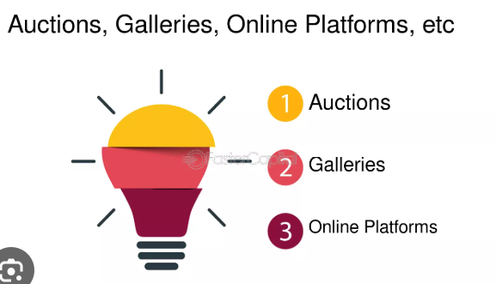
Abstract
A web-based platform combining exhibition, education, and commerce formanagement, advanced search, and real-time bidding. artworks. Includes artist profiles, portfolio

Slide 3
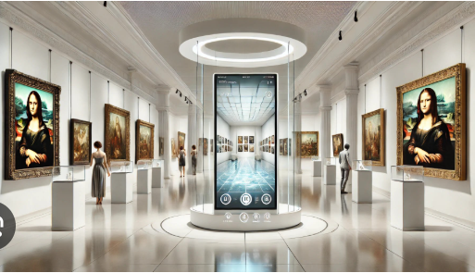
Introduction
Purpose: To connect artists and customers globally through a seamless digital platform. Background: Existing systems lack integration of features.

Slide 4
Problem Statement
Current platforms focus on narrow purposes (e.g., education, sales) and lack interactivity and comprehensive user experiences.

Slide 5
Objectives
Main Objective: Create an interactive Virtual Art Gallery.
Specific Objectives:
- User registration and authentication
- Artist collaboration
- Integrated bidding system
- Profile and portfolio management for artists.

Slide 6
Key Features
Core Functionalities:
- User-friendly interface
- Artist profile creation
- Real-time bidding
- Advanced search and filtering.

Slide 7
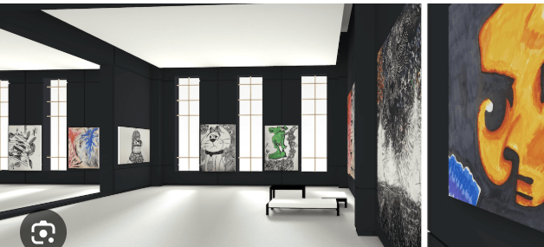
Proposed System
An integrated platform offering:
- Interactive features
- Educational resources
- Seamless transactions for art enthusiasts.

Slide 8
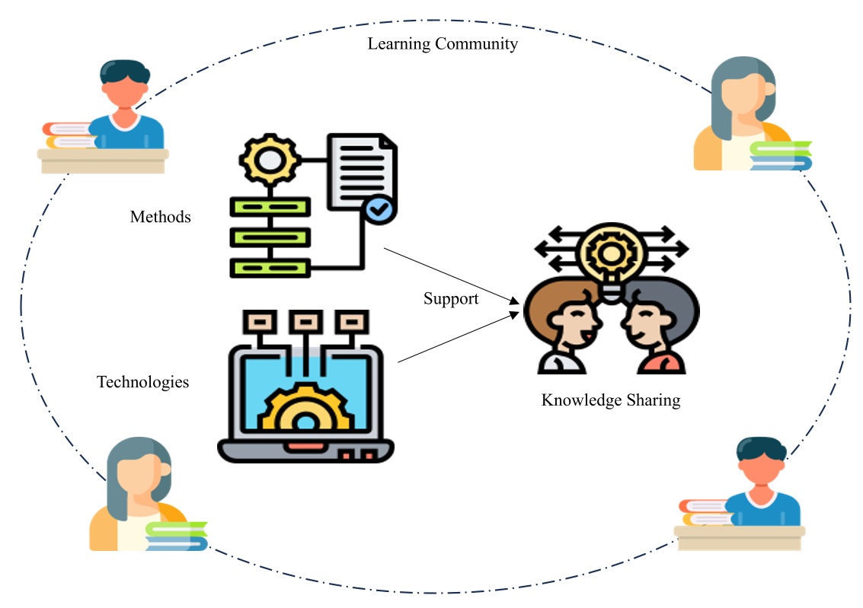
Conceptual Framework
Framework:
- Art as cultural expression
- Technology as enabler
- Commerce as business model
- Inclusivity and community-building.

Slide 9

Methodology
Research Design: Mixed-method approach (qualitative and quantitative).
Tools: React, Django, MySQL.
Prototyping Model: Iterative development based on user feedback.

Slide 10
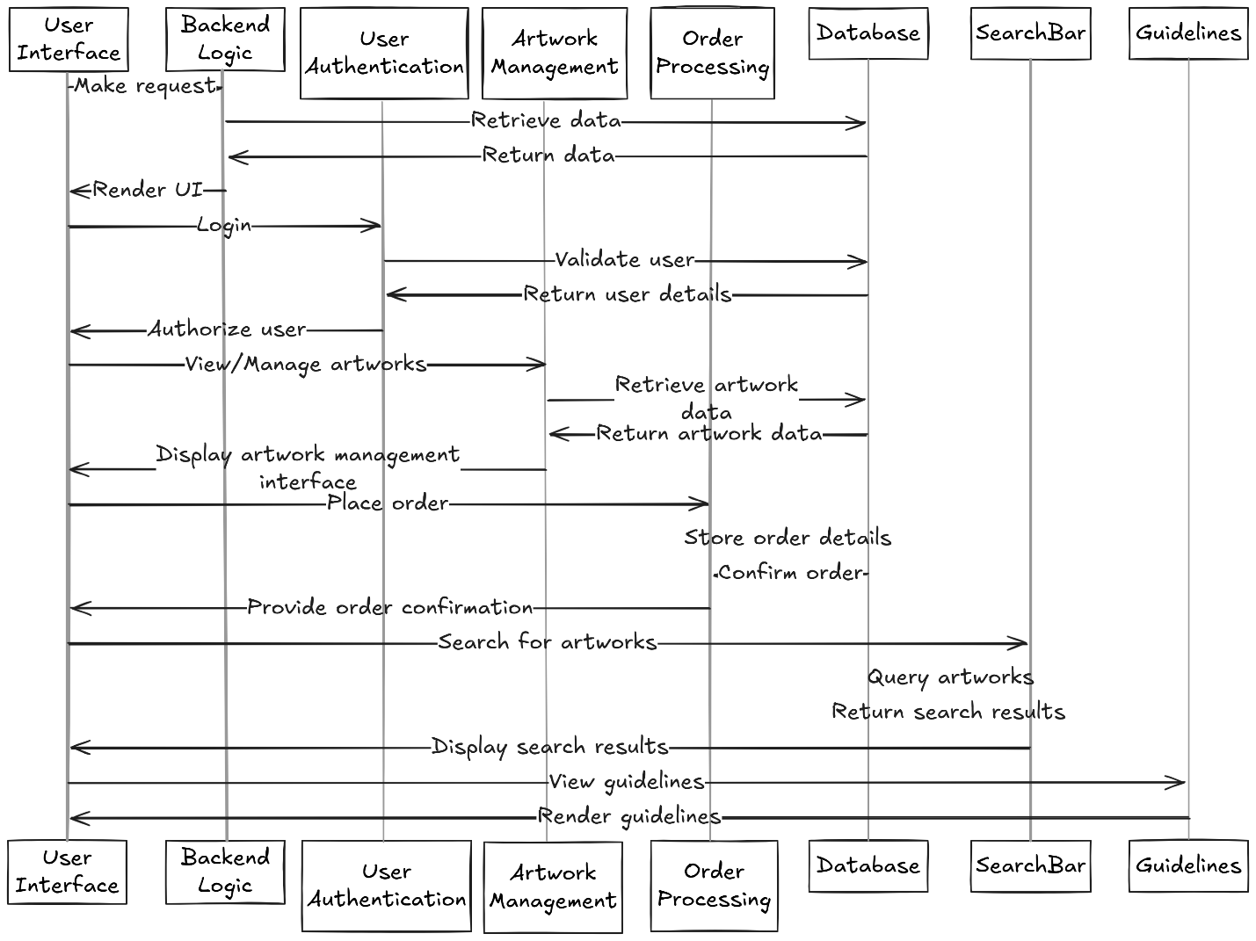
System Design
Architecture:
- Presentation Layer: React, TypeScript
- Application Layer: Django
- Database Layer: MySQL
Includes sequence, use case, and data flow diagrams.

Slide 11
Data Management
Strategies:
- Secure data storage and encryption
- Efficient metadata tagging
- Analytics for user behavior and sales trends.

Slide 12
Future Trends
Integration of:
- AI for personalized recommendations
- Blockchain for security
- Virtual Reality for immersive experiences.

Slide 13
References
Allal-Chérif, O., Simón-Moya, V., & Ballester, A. C. C. (2021). Intelligent purchasing: How artificial intelligence can redefine the purchasing function. Chong, H. Y., & Diamantopoulos, A. (2020). Integrating advanced technologies to uphold security of payment: Data flow diagram.
Habelsberger, B. E., & Bhansing, P. V. (2021). Art galleries in transformation: is COVID-19 driving digitization?.
Lucidchart. (n.d.). Types of UML diagrams. Retrieved November 27, 2024.
Martins, N., Brandão, D., Alvelos, H., & Silva, S. (2020). E-marketplace as a tool for the revitalization of Portuguese craft industry.
Oham, C., & Ejike, O. G. (2024). Customer interaction and engagement: A theoretical exploration of live promotional tactics in the arts.
Rodriguez, R. M. (2024). The Psychology of Virtual Art Gallery Experiences.
TheDataProtectionAct__No24of2019 (2019).
TingaTinga African Art. Exploring the splendor of Tingatinga African paintings.

