Slide 1
Virtual Functions

Slide 2
Late Binding
Also know as Dynamic binding.
When type of the object is determined at the run-time.
Function call is made at execution (runtime).

Slide 3
Virtual Function
A member function.
Declared in Parent class.
Re-define in Child Class (Override).
CALLED USING A POINTER.
We can call the function using a pointer of a class to its refer.

Slide 4
Virtual Function
It ensure correct function is called. Regardless of the type of reference.
Functions are declared with a virtual keyword (in base class).
The resolving of the function is done at runtime.
It is used to achieve Runtime polymorphism.

Slide 5
Rules of VF
Cannot be static.
Can be a friend function of another class.
Should be accessed using pointer or reference of base class type to achieve RTP.
Same signature in both base and derived classes.
Must be overridden by the child class.
We can have virtual destructor but not a virtual constructor.

Slide 6
class base {
public:
virtual void print()
{
cout << "print base class\n";
}
void show()
{
cout << "show base class\n";
}
};
class derived : public base {
public:
void print()
{
cout << "print derived class\n";
}
void show()
{
cout << "show derived class\n";
}
};
int main()
{
base *bptr;
derived d;
bptr = &d;
bptr->print();
bptr->show();
return 0;
}

Slide 7
If object of that class is created then a virtual pointer (VPTR) is inserted as a data member of the class to point to VTABLE of that class.
For each new object created, a new virtual pointer is inserted as a data member of that class.
Irrespective of object is created or not, class contains as a member a static array of function pointers called VTABLE.
Cells of this table store the address of each virtual function contained in that class.

Slide 8
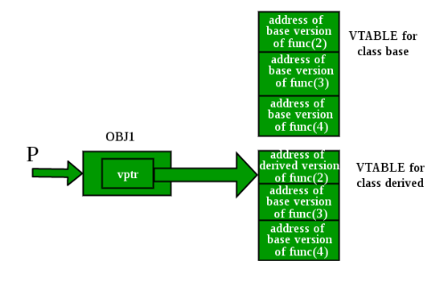

Slide 9
Base Class
class base {
public:
void fun_1() {
cout << "base-1\n";
}
virtual void fun_2() {
cout << "base-2\n";
}
virtual void fun_3() {
cout << "base-3\n";
}
virtual void fun_4() {
cout << "base-4\n";
}
};

Slide 10
Derived class
class derived : public base {
public:
void fun_1() {
cout << "derived-1\n";
}
void fun_2() {
cout << "derived-2\n";
}
void fun_4(int x) {
cout << "derived-4\n";
}
};

Slide 11
int main()
{
base *p;
derived obj1;
p = &obj1;
p->fun_1();
p->fun_2();
p->fun_3();
p->fun_4();
return 0;
}

