Slide 1


Ensemble Learning Methods
Tushar B. Kute,
http://tusharkute.com

Slide 2
Ensemble Learning
An ensemble is a composite model, combines a series of low performing classifiers with the aim of creating an improved classifier.
Here, individual classifier vote and final prediction label returned that performs majority voting.
Ensembles offer more accuracy than individual or base classifier.
Ensemble methods can parallelize by allocating each base learner to different-different machines.
Finally, you can say Ensemble learning methods are meta-algorithms that combine several machine learning methods into a single predictive model to increase performance.
Ensemble methods can decrease variance using bagging approach, bias using a boosting approach, or improve predictions using stacking approach.

Slide 3
Real life examples
Let's take a real example to build the intuition.
Suppose, you want to invest in a company XYZ. You are not sure about its performance though.
So, you look for advice on whether the stock price will increase by more than 6% per annum or not?
You decide to approach various experts having diverse domain experience:

Slide 4
The survey prediction
Employee of Company XYZ:
In the past, he has been right 70% times.
Financial Advisor of Company XYZ:
In the past, he has been right 75% times.
Stock Market Trader:
In the past, he has been right 70% times.
Employee of a competitor:
In the past, he has been right 60% times.
Market Research team in the same segment:
In the past, he has been right 75% times.
Social Media Expert:
In the past, he has been right 65% times.

Slide 5
Conclusion
Given the broad spectrum of access you have, you can probably combine all the information and make an informed decision.
In a scenario when all the 6 experts/teams verify that it’s a good decision(assuming all the predictions are independent of each other), you will get a combined accuracy rate of 1 - (30% . 25% . 30% . 40% . 25% . 35%) = 1 - 0.07875 = 99.92125%
The assumption used here that all the predictions are completely independent is slightly extreme as they are expected to be correlated. However, you can see how we can be so sure by combining various forecasts together.
Well, Ensemble learning is no different.

Slide 6
Ensembling
An ensemble is the art of combining a diverse set of learners (individual models) together to improvise on the stability and predictive power of the model.
In our example, the way we combine all the predictions collectively will be termed as Ensemble learning.
Moreover, Ensemble-based models can be incorporated in both of the two scenarios, i.e., when data is of large volume and when data is too little.

Slide 7
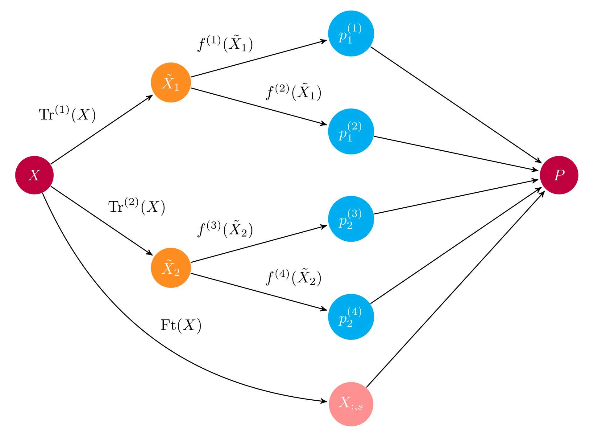
Ensemble Schematic

Slide 8
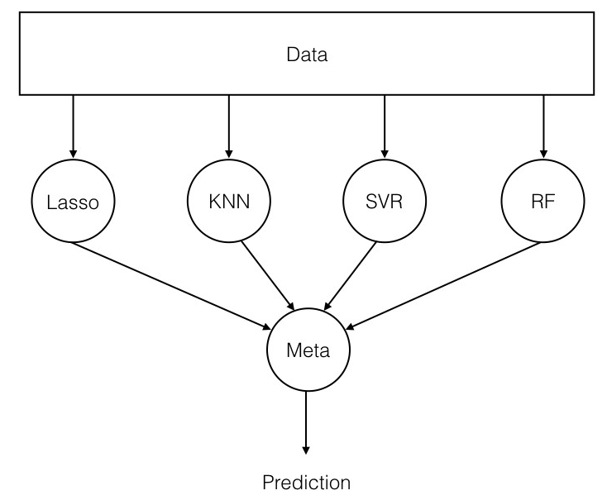
Basic Ensemble Structure

Slide 9
Summary
•
•
•
•
•
Use multiple learning algorithms (classifiers) Combine the decisions
Can be more accurate than the individual classifiers
Generate a group of base-learners Different learners use different
Algorithms
Hyperparameters
Representations (Modalities)
Training sets

Slide 10
How models are different?
•
•
•
•
Difference in population Difference in hypothesis Difference in modeling technique Difference in initial seed

Slide 11
Why ensembles ?
•
There are two main reasons to use an ensemble over a single model, and they are related; they are:
Performance: An ensemble can make better predictions and achieve better performance than any single contributing model.
Robustness: An ensemble reduces the spread or dispersion of the predictions and model performance.

Slide 12
Ensemble Creation Approaches
Unweighted Voting (e.g. Bagging)
Weighted voting – based on accuracy (e.g. Boosting), Expertise, etc.
Stacking - Learn the combination function

Slide 13
Ensemble Learning Methods
Bagging
Boosting
Stacking

Slide 14
Bootstrap
The bootstrap is a powerful statistical method for estimating a quantity from a data sample. This is easiest to understand if the quantity is a descriptive statistic such as a mean or a standard deviation.
Let’s assume we have a sample of 100 values (x) and we’d like to get an estimate of the mean of the sample.
We can calculate the mean directly from the sample as:
mean(x) = 1/100 * sum(x)

Slide 15
Bootstrap
We know that our sample is small and that our mean has error in it. We can improve the estimate of our mean using the bootstrap procedure:
Create many (e.g. 1000) random sub-samples of our dataset with replacement (meaning we can select the same value multiple times).
Calculate the mean of each sub-sample.
Calculate the average of all of our collected means and use that as our estimated mean for the data.

Slide 16
Bootstrap
For example, let’s say we used 3 resamples and got the mean values 2.3, 4.5 and 3.3.
Taking the average of these we could take the estimated mean of the data to be 3.367.
This process can be used to estimate other quantities like the standard deviation and even quantities used in machine learning algorithms, like learned coefficients.

Slide 17
Bagging
Bagging stands for bootstrap aggregation.
It combines multiple learners in a way to reduce the variance of estimates.
For example, random forest trains M Decision Tree, you can train M different trees on different random subsets of the data and perform voting for final prediction.
Example:
Random Forest
Extra Trees.

Slide 18
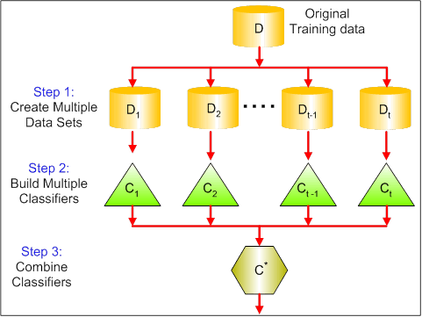
Bagging

Slide 19
Random Forest
Random forest is a type of supervised machine learning algorithm based on ensemble learning.
Ensemble learning is a type of learning where you join different types of algorithms or same algorithm multiple times to form a more powerful prediction model.
The random forest algorithm combines multiple algorithm of the same type i.e. multiple decision trees, resulting in a forest of trees, hence the name "Random Forest".
The random forest algorithm can be used for both regression and classification tasks.

Slide 20
How it works ?
Pick N random records from the dataset.
Build a decision tree based on these N records.
Choose the number of trees you want in your algorithm and repeat steps 1 and 2.
In case of a regression problem, for a new record, each tree in the forest predicts a value for Y (output). The final value can be calculated by taking the average of all the values predicted by all the trees in forest. Or, in case of a classification problem, each tree in the forest predicts the category to which the new record belongs. Finally, the new record is assigned to the category that wins the majority vote.
•

Slide 21
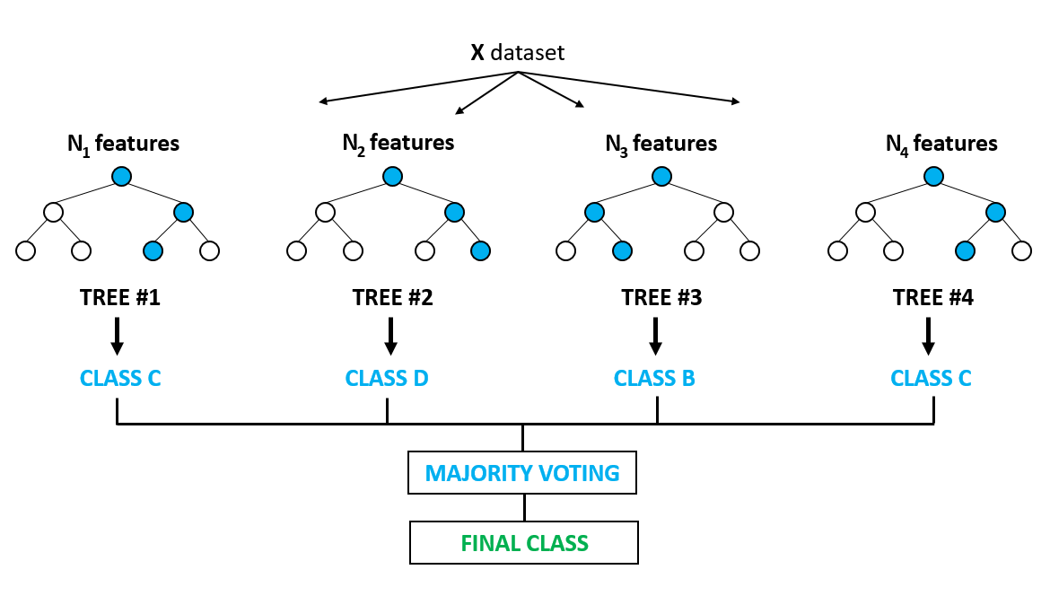
Majority Voting
Source: medium.com

Slide 22
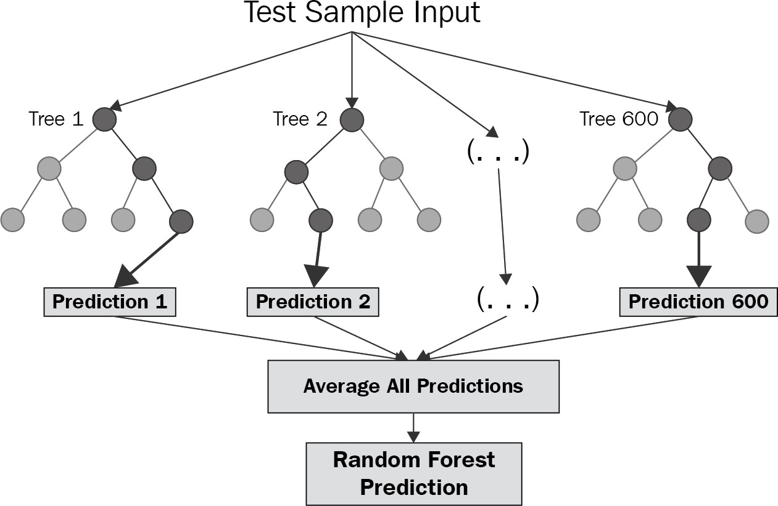
Regressor Output
Source: medium.com

Slide 23
Boosting
Boosting algorithms are a set of the low accurate classifier to create a highly accurate classifier.
Low accuracy classifier (or weak classifier) offers the accuracy better than the flipping of a coin.
This is done by building a model from the training data, then creating a second model that attempts to correct the errors from the first model. Models are added until the training set is predicted perfectly or a maximum number of models are added.
Highly accurate classifier( or strong classifier) offer error rate close to 0. Boosting algorithm can track the model who failed the accurate prediction.
Boosting algorithms are less affected by the overfitting problem.

Slide 24
Boosting Models
Models that are typically used in Boosting technique are:
XGBoost (Extreme Gradient Boosting)
GBM (Gradient Boosting Machine)
ADABoost (Adaptive Boosting)

Slide 25
Adaboost Summary
Initially, Adaboost selects a training subset randomly.
It iteratively trains the AdaBoost machine learning model by selecting the training set based on the accurate prediction of the last training.
It assigns the higher weight to wrong classified observations so that in the next iteration these observations will get the high probability for classification.
Also, It assigns the weight to the trained classifier in each iteration according to the accuracy of the classifier. The more accurate classifier will get high weight.
This process iterate until the complete training data fits without any error or until reached to the specified maximum number of estimators.
To classify, perform a "vote" across all of the learning algorithms you built.

Slide 26
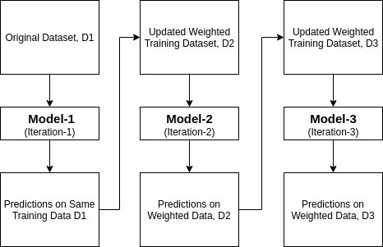
How Adaboost Works?

Slide 27
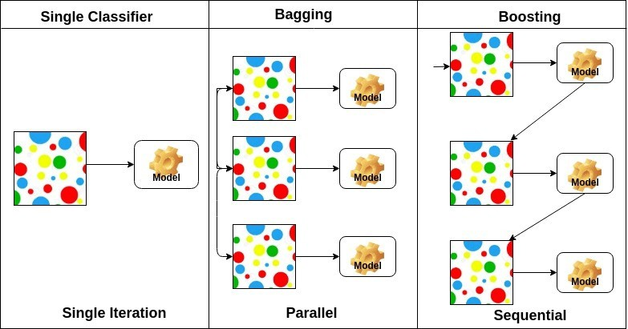
Comparison

Slide 28
Stacking
Stacked Generalization or “Stacking” for short is an ensemble machine learning algorithm.
It involves combining the predictions from multiple machine learning models on the same dataset, like bagging and boosting.
Stacking addresses the question:
– Given multiple machine learning models that are skillful on a problem, but in different ways, how do you choose which model to use (trust)?

Slide 29
Stacking
The approach to this question is to use another machine learning model that learns when to use or trust each model in the ensemble.
Unlike bagging, in stacking, the models are typically different (e.g. not all decision trees) and fit on the same dataset (e.g. instead of samples of the training dataset).
Unlike boosting, in stacking, a single model is used to learn how to best combine the predictions from the contributing models (e.g. instead of a sequence of models that correct the predictions of prior models).

Slide 30
Stacking
The architecture of a stacking model involves two or more base models, often referred to as level-0 models, and a meta-model that combines the predictions of the base models, referred to as a level-1 model.
Level-0 Models (Base-Models): Models fit on the training data and whose predictions are compiled.
Level-1 Model (Meta-Model): Model that learns how to best combine the predictions of the base models.

Slide 31
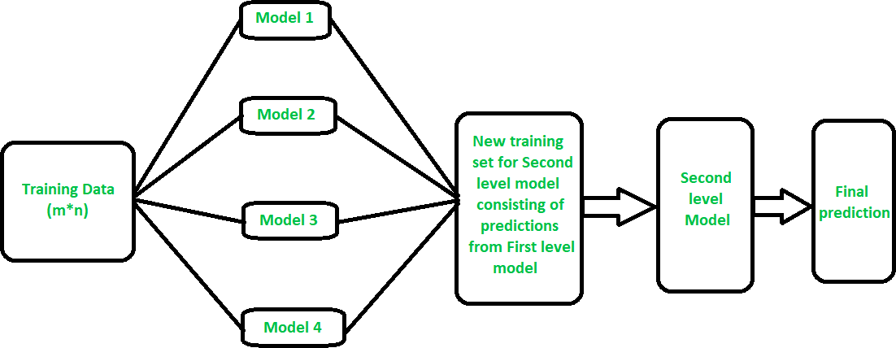
Stacking

Slide 32
Stacking
The meta-model is trained on the predictions made by base models on out-of-sample data.
That is, data not used to train the base models is fed to the base models, predictions are made, and these predictions, along with the expected outputs, provide the input and output pairs of the training dataset used to fit the meta-model.
The outputs from the base models used as input to the meta-model may be real value in the case of regression, and probability values, probability like values, or class labels in the case of classification.

Slide 33
Voting
Voting is an ensemble machine learning algorithm.
For regression, a voting ensemble involves making a prediction that is the average of multiple other regression models.
In classification, a hard voting ensemble involves summing the votes for crisp class labels from other models and predicting the class with the most votes.
A soft voting ensemble involves summing the predicted probabilities for class labels and predicting the class label with the largest sum probability.

Slide 34
Voting
A voting ensemble (or a “majority voting ensemble“) is an ensemble machine learning model that combines the predictions from multiple other models.
It is a technique that may be used to improve model performance, ideally achieving better performance than any single model used in the ensemble.
A voting ensemble works by combining the predictions from multiple models.
It can be used for classification or regression.

Slide 35
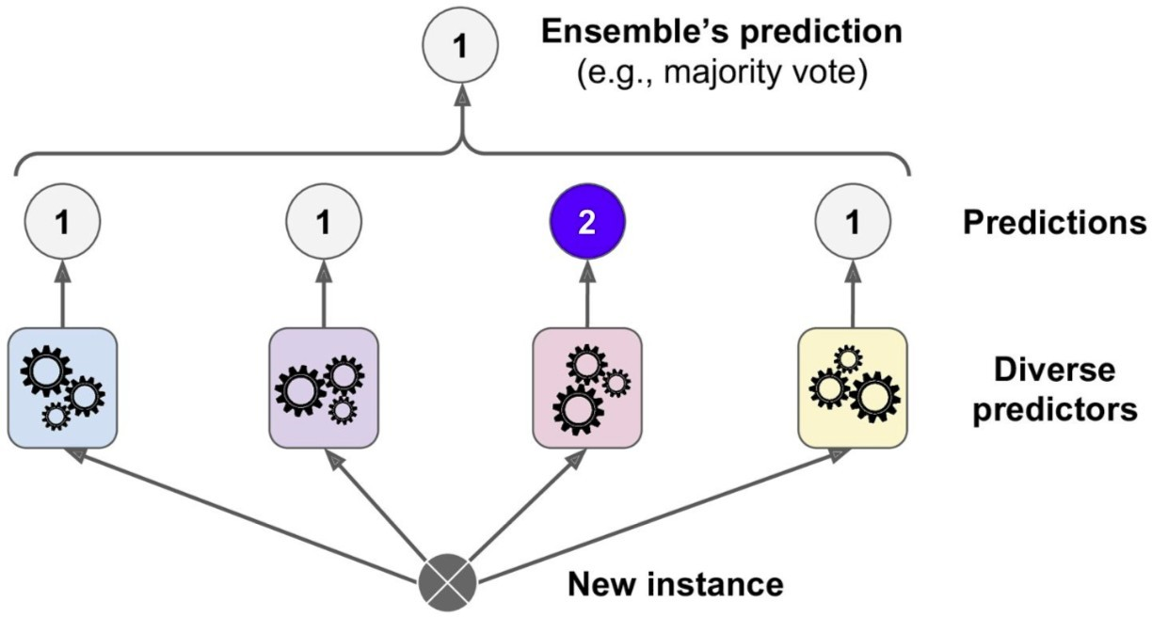
Voting

Slide 36
Voting
In the case of regression, this involves calculating the average of the predictions from the models.
In the case of classification, the predictions for each label are summed and the label with the majority vote is predicted.
Regression Voting Ensemble: Predictions are the average of contributing models.
Classification Voting Ensemble: Predictions are the majority vote of contributing models.

Slide 37
Voting
There are two approaches to the majority vote prediction for classification; they are hard voting and soft voting.
Hard voting involves summing the predictions for each class label and predicting the class label with the most votes. Soft voting involves summing the predicted probabilities (or probability-like scores) for each class label and predicting the class label with the largest probability.
Hard Voting. Predict the class with the largest sum of votes from models
Soft Voting. Predict the class with the largest summed probability from models.

Slide 38
Voting
Use voting ensembles when:
All models in the ensemble have generally the same good performance.
All models in the ensemble mostly already agree.
Hard voting is appropriate when the models used in the voting ensemble predict crisp class labels. Soft voting is appropriate when the models used in the voting ensemble predict the probability of class membership.

Slide 39
Voting
Soft voting can be used for models that do not natively predict a class membership probability, although may require calibration of their probability-like scores prior to being used in the ensemble (e.g. support vector machine, k-nearest neighbors, and decision trees).
Hard voting is for models that predict class labels.
Soft voting is for models that predict class membership probabilities.
The voting ensemble is not guaranteed to provide better performance than any single model used in the ensemble.

Slide 40
Voting
Use a voting ensemble if:
It results in better performance than any model used in the ensemble.
It results in a lower variance than any model used in the ensemble.
A voting ensemble is particularly useful for machine learning models that use a stochastic learning algorithm and result in a different final model each time it is trained on the same dataset.
One example is neural networks that are fit using stochastic gradient descent.

Slide 41
Useful resources
•
•
•
•
•
•
•
•
•
www.mitu.co.in www.pythonprogramminglanguage.com www.scikit-learn.org www.towardsdatascience.com www.medium.com www.analyticsvidhya.com www.kaggle.com
www.stephacking.com www.github.com

