Slide 1
Machine Learning
BS/MS (Computer Science)
Lecture-09
Fall-2025

Slide 2
Revision
Machine Learning Dr. S. Nadeem Ahsan, IU

Slide 3
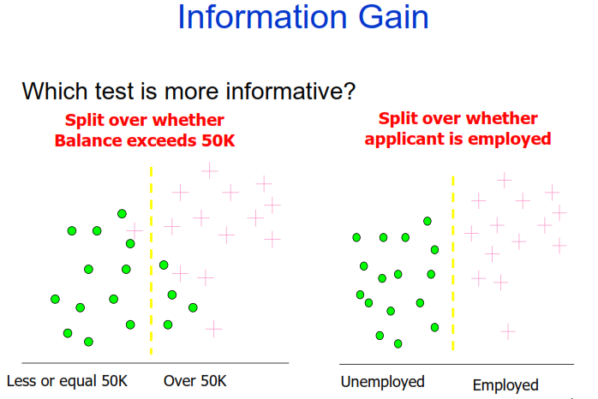
Machine Learning Dr. S. Nadeem Ahsan, IU

Slide 4
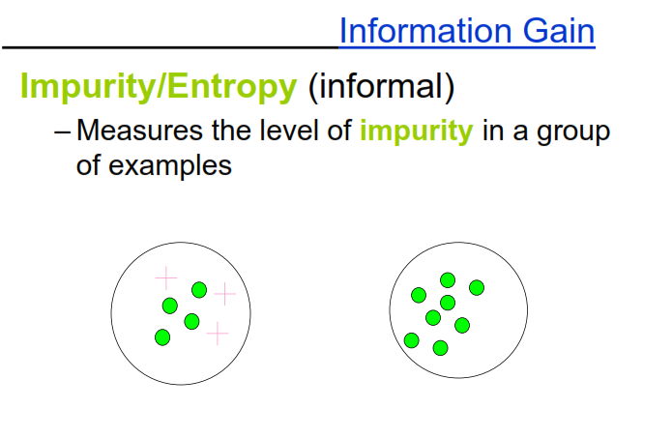
Machine Learning Dr. S. Nadeem Ahsan, IU

Slide 5
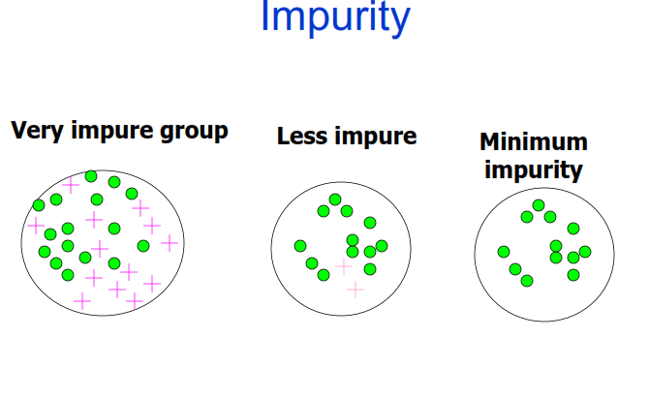
Machine Learning Dr. S. Nadeem Ahsan, IU

Slide 6
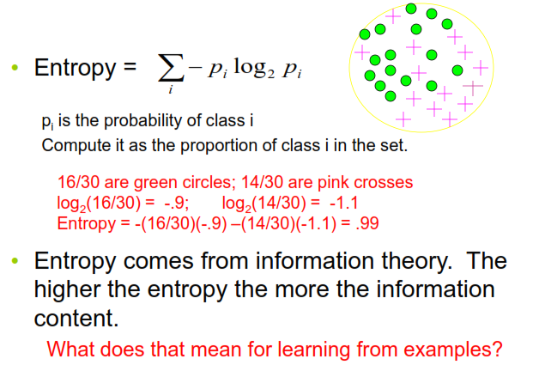
Entropy, a common way to measure impurity
Machine Learning Dr. S. Nadeem Ahsan, IU

Slide 7
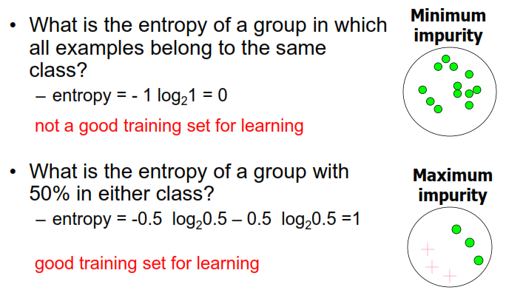
2- Class Cases
Machine Learning Dr. S. Nadeem Ahsan, IU

Slide 8
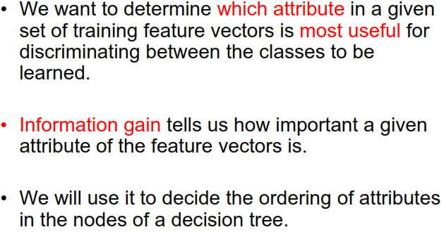
Information Gain
Machine Learning Dr. S. Nadeem Ahsan, IU

Slide 9
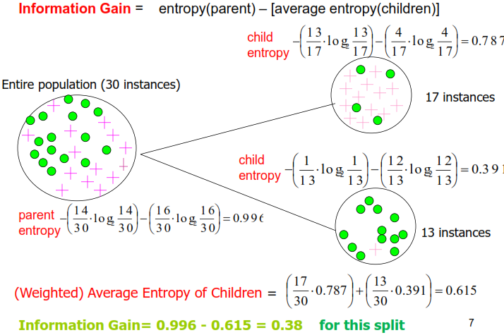
Calculating Information Gain
Machine Learning Dr. S. Nadeem Ahsan, IU

Slide 10
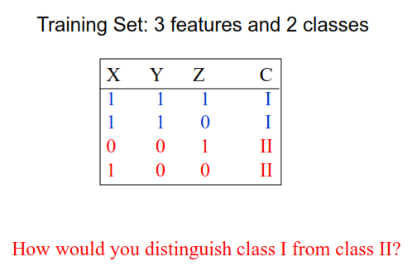
Simple Example
Machine Learning Dr. S. Nadeem Ahsan, IU

Slide 11
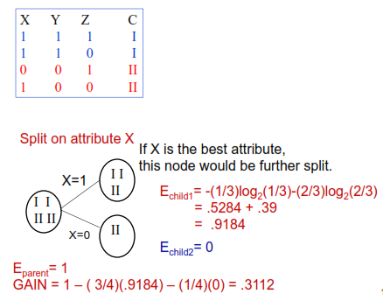
Simple Example
Machine Learning Dr. S. Nadeem Ahsan, IU

Slide 12
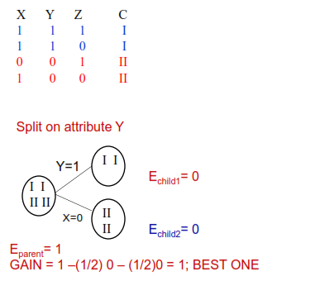
Simple Example
Machine Learning Dr. S. Nadeem Ahsan, IU

Slide 13
Decision Tree Learning
Decision tree learning is a method for approximating discrete-valued target functions, in which the learned function is represented by a decision tree.
Learned trees can also be re-represented as set of IF-THEN rules to improve human readability

Slide 14
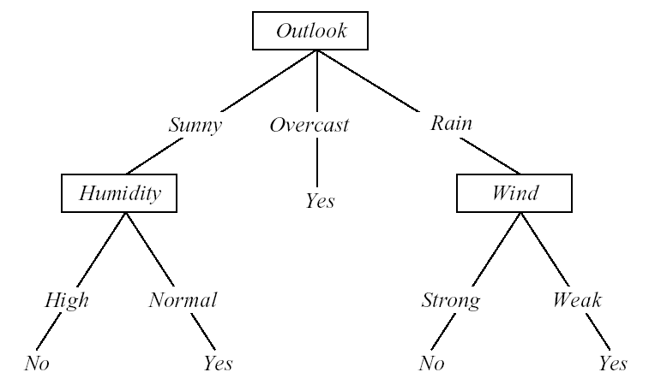
Converting A Tree to Rules
IF (Outlook = Sunny) ∧ (Humidity = High)
THEN PlayTennis = No
IF (Outlook = Sunny) ∧ (Humidity = Normal)
THEN PlayTennis = Yes
….

Slide 15
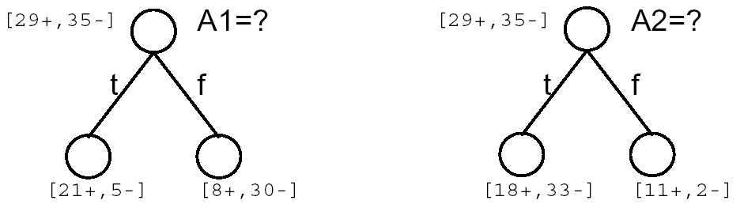
Top-Down Induction of Decision Trees (Approach)
Main loop:
  1. A ← the “best” decision attribute for next node
  2. Assign A as decision attribute for node
  3. For each value of A, create new descendant of node
  4. Sort training examples to leaf nodes
  5. If training examples perfectly classified, Then STOP, Else iterate over new leaf nodes
Which attribute is best?

Slide 16
Entropy(2/2)
Entropy(S) = expected number of bits needed to encode class (⊕ or ⊖) of randomly drawn member of S (under the optimal, shortest-length code)
Why?
Information theory: optimal length code assigns
  log₂p bits to message having probability p.
So, expected number of bits to encode ⊕ or ⊖ of random
member of S:
p⊕(-log₂ p⊕) + p⊖(-log₂ p⊖)
Entropy(S) ≡ - p⊕log₂ p⊕ - p⊖log₂ p⊖

Slide 17
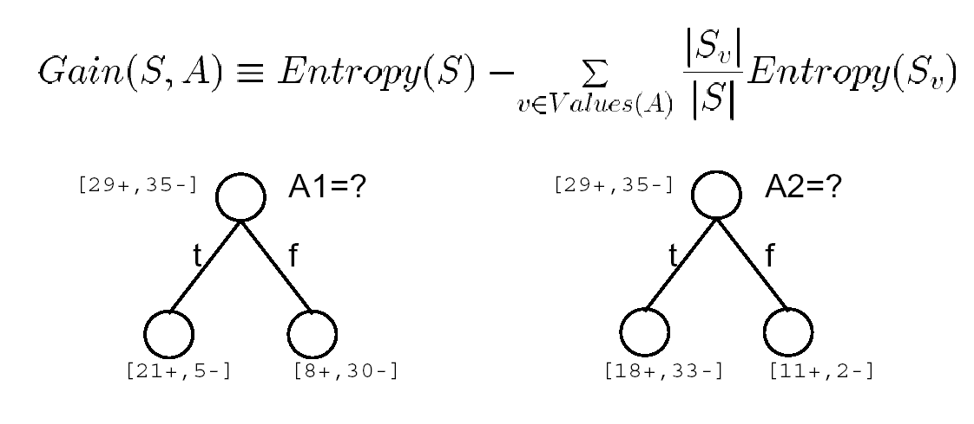
Information Gain
Gain(S, A) = expected reduction in entropy due to sorting on A

