Slide 1
Machine Learning BS/MS (Computer Science)
Lecture-07
M.Minhal.Raza
Ph.D. (Computer Science) Scholar
FAST-NUCES, KHI

Slide 2
Outline
Theory Session:
Revision
Tree Classification
Lab/Project Session:
Lab Assignments

Slide 3
Decision Tree Classification

Slide 4
Classification: Definition
Given a collection of records (training set )
Each record contains a set of attributes, one of the attributes is the class.
Find a model for class attribute as a function of the values of other attributes.
Goal: previously unseen records should be assigned a class as accurately as possible.
A test set is used to determine the accuracy of the model. Usually, the given data set is divided into training and test sets, with training set used to build the model and test set used to validate it.

Slide 5
Illustrating Classification Task

Slide 6
Classification Techniques
Decision Tree based Methods
Neural Networks
Naïve Bayes and Bayesian Belief Networks
Support Vector Machines, etc.

Slide 7
Example of a Decision Tree
categorical
categorical
continuous
class
Splitting Attributes
Refund
Yes
No
NO
MarSt
Single, Divorced
Married
TaxInc
NO
< 80K
> 80K
NO
YES
Training Data
Model: Decision Tree

Slide 8
Another Example of Decision Tree
categorical
categorical
continuous
class
MarSt
Single, Divorced
Married
NO
Refund
Yes
No
NO
TaxInc
< 80K
> 80K
NO
YES
There could be more than one tree that fits the same data!

Slide 9
Decision Tree Classification Task
Decision Tree

Slide 10
Apply Model to Test Data
Test Data
Start from the root of tree.
Refund
Yes
No
NO
MarSt
Single, Divorced
Married
TaxInc
NO
< 80K
> 80K
NO
YES

Slide 11
Apply Model to Test Data
Test Data
Refund
Yes
No
NO
MarSt
Single, Divorced
Married
TaxInc
NO
< 80K
> 80K
NO
YES

Slide 12
Apply Model to Test Data
Test Data
Refund
Yes
No
NO
MarSt
Single, Divorced
Married
TaxInc
NO
< 80K
> 80K
NO
YES

Slide 13
Apply Model to Test Data
Test Data
Refund
Yes
No
NO
MarSt
Single, Divorced
Married
TaxInc
NO
< 80K
> 80K
NO
YES

Slide 14
Apply Model to Test Data
Test Data
Refund
Yes
No
NO
MarSt
Single, Divorced
Married
TaxInc
NO
< 80K
> 80K
NO
YES

Slide 15
Apply Model to Test Data
Test Data
Refund
Yes
No
NO
MarSt
Single, Divorced
Married
Assign Cheat to “No”
TaxInc
NO
< 80K
> 80K
NO
YES

Slide 16
Decision Tree Classification Task
Decision Tree

Slide 17
Decision Tree Induction
Many Algorithms:
1R
Hunt’s Algorithm (one of the earliest)
CART
ID3, C4.5
SLIQ,SPRINT

Slide 18
Tree Induction
Greedy Strategy.
Split the records based on an attribute test that optimizes certain criterion.
ISSUES:
Determine how to split the records
How to specify the attribute test condition?
How to determine the best split?
Determine when to stop splitting

Slide 19
How to Specify Test Condition?
Depends on attribute types
Nominal
Ordinal
Continuous
Depends on number of ways to split
2-way split
Multi-way split

Slide 20
Splitting Based on Nominal Attributes
Multi-way split: Use as many partitions as distinct values.
Binary split: Divides values into two subsets. Need to find optimal partitioning.
CarType
Family
Luxury
Sports
CarType
OR
CarType
{Sports, Luxury}
{Family, Luxury}
{Family}
{Sports}

Slide 21
Splitting Based on Ordinal Attributes
Multi-way split: Use as many partitions as distinct values.
Binary split: Divides values into two subsets. Need to find optimal partitioning.
What about this split?
Size
Small
Large
Medium
Size
Size
{Small, Medium}
OR
{Medium, Large}
{Large}
{Small}
Size
{Small, Large}
{Medium}

Slide 22
Splitting Based on Continuous Attributes
Different ways of handling
Discretization to form an ordinal categorical attribute
Static – discretize once at the beginning
Dynamic – ranges can be found by equal interval bucketing, equal frequency bucketing (percentiles), or clustering.
Binary Decision: (A < v) or (A ≥ v)
consider all possible splits and finds the best cut
can be more compute intensive

Slide 23
Splitting Based on Continuous Attributes

Slide 24
Inferring Rudimentary Rules
1R: learns a 1-level decision tree
In other words, generates a set of rules that all test on one particular attribute
For example:
Outlook = sunny → play = yes
Basic version (assuming nominal attributes)
One branch for each of the attribute’s values
Each branch assigns most frequent class
Error rate: proportion of instances that don’t belong to the majority class of their corresponding branch
Choose attribute with lowest error rate

Slide 25
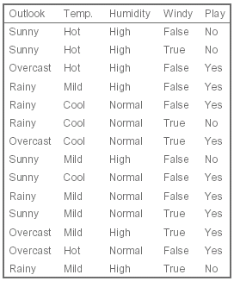
Inferring Rudimentary Rules
Goal: to classify on the
column ‘Play’
Outlook=sunny → play = no
Outlook=overcast → play = yes
Outlook=rainy → play = yes

Slide 27
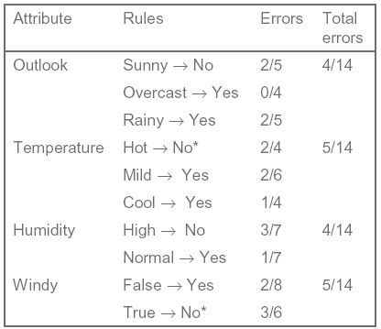
Inferring Rudimentary Rules

Slide 28
Numeric Attributes
Temperature

Slide 29
Numeric Attributes
Temperature
66.5
72
80.5
64.5
70.5
77.5
84
temperature <= 64.5 → play = yes
temperature > 66.5 & temperature <= 70.5 → play = yes
temperature > 70.5 & temperature <= 72 → play = no
…

Slide 30
Numeric Attributes
66.5
72
80.5
64.5
70.5
77.5
84
…
temperature > 70.5 & temperature <= 72 → play = no
temperature > 72 & temperature <= 77.5 → play = yes
…

Slide 31
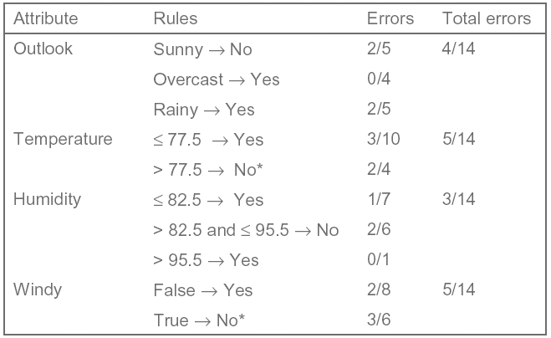
Numeric Attributes

Slide 32
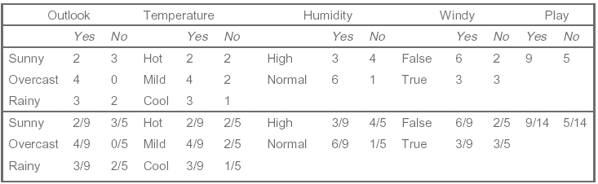
Statistical Modeling
Yes = 2/9*3/9*3/9*3/9*9/14=0.0053
No = 3/5*1/5*4/5*3/5*5/14=0.0206

Slide 33
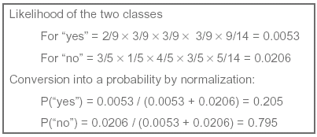
Statistical Modeling
Bayes’s rules
Yes = 2/9*3/9*3/9*3/9*9/14=0.0053
No = 3/5*1/5*4/5*3/5*5/14=0.0206

Slide 34
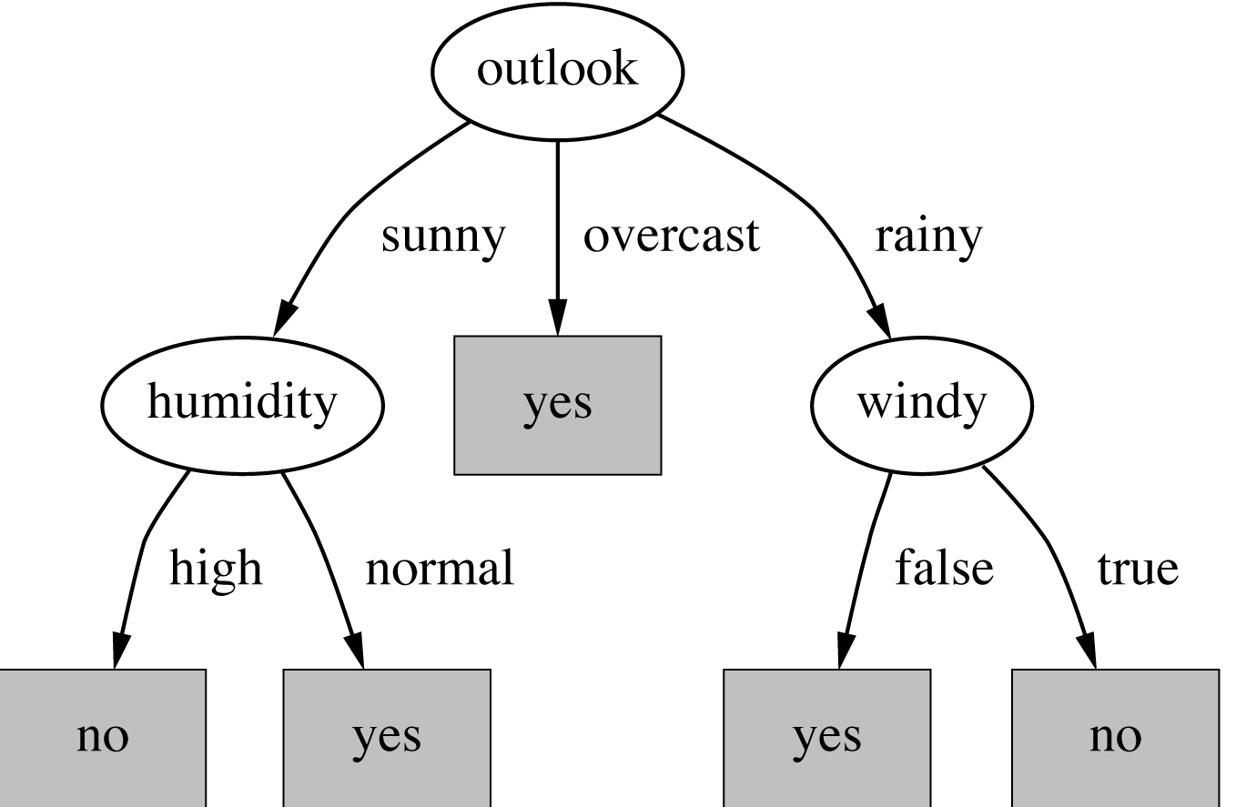
Divide and Conquer: Constructing Decision Trees
Which attribute to select ?

Slide 35
Divide and Conquer: Constructing Decision Trees
Which is the best attribute?
The one which will result in the smallest tree
Popular impurity criterion: information gain
Information gain increases with the average purity of the subsets that an attribute produces
Strategy: choose attribute that results in greatest information gain

Slide 36
Divide and Conquer: Constructing Decision Trees
Information is measured in bits
Given a probability distribution, the info required to predict an event is the distribution’s entropy
Entropy gives the information required in bits (this can involve fractions of bits!)
Formula for computing the entropy:

Slide 37
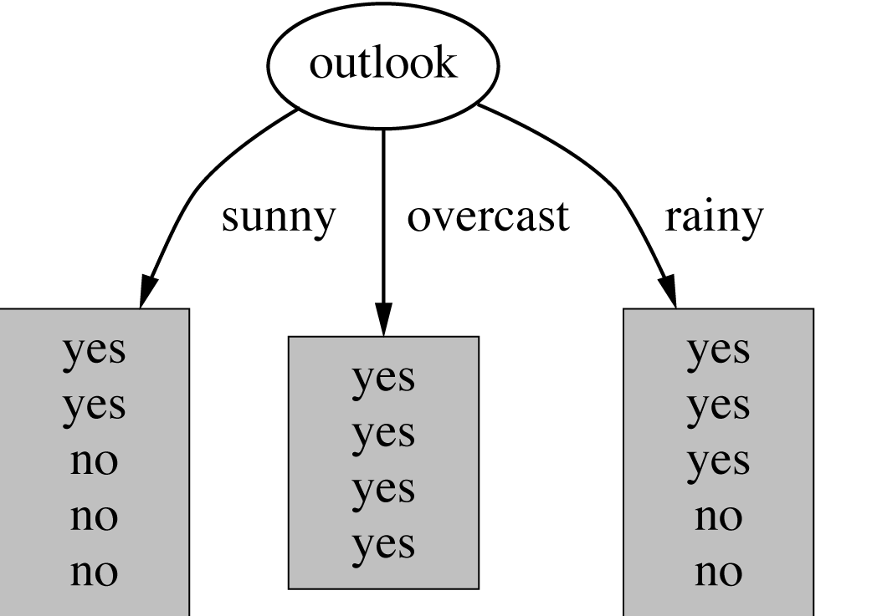
Divide and Conquer: Constructing Decision Trees
[2,3]
[4,0]
[3,2]

Slide 38
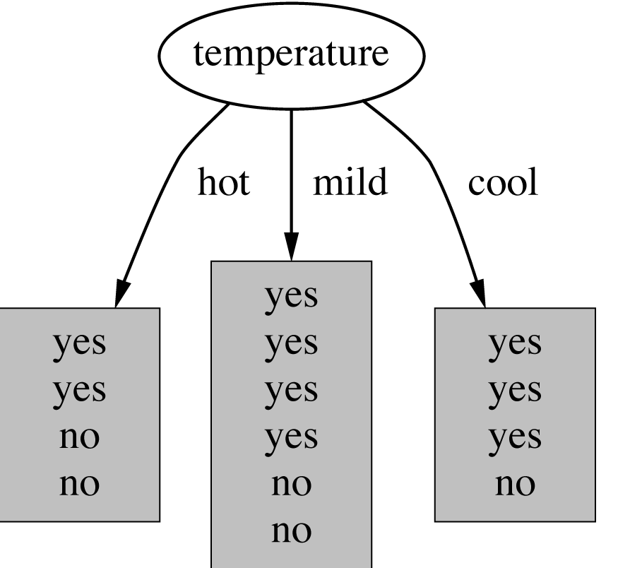
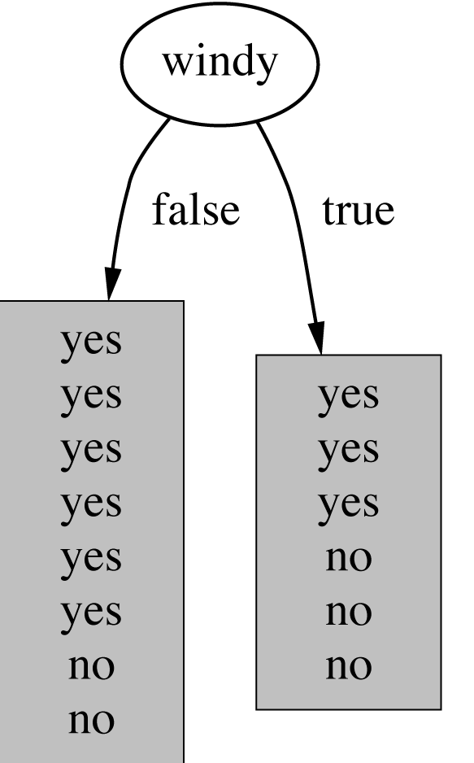
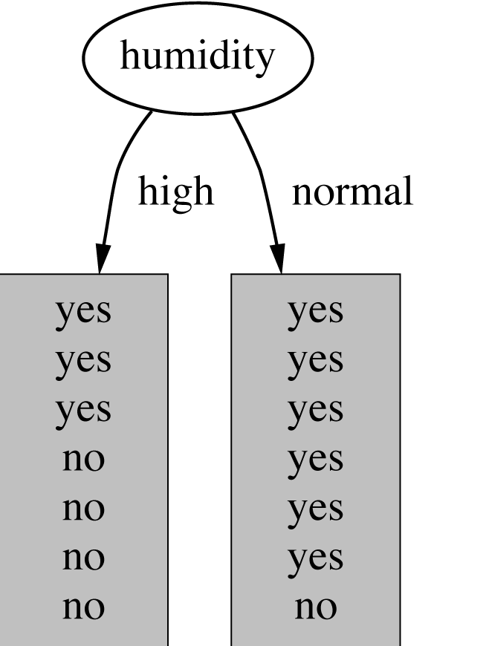
[2,3]
[4,0]
[3,2]
[2,2]
[4,2]
[3,1]
[3,4]
[6,1]
[6,2]
[3,3]

Slide 39
Divide and Conquer: Constructing Decision Trees
The number of either yeses or nos is zero, the information is zero
The number of yeses and nos is equal, the information reaches a maximum

Slide 40
Divide and Conquer: Constructing Decision Trees
[2,3]
[4,0]
[3,2]
Info ([2,3]) = -2/5 * log 2/5 – 3/5 * log 3/5 =0.971
Info ([4,0]) = -4/4 * log 4/4 – 0/4 * log 0/4 =0
Info ([3,2]) = -3/5 * log 3/5 – 2/5 * log 2/5 =0.971
Info ([2,3],[4,0],[3,2])
= 5/14 *0.971 + 4/14 *0 + 5/14 *0.971 = 0.673 bits

Slide 41
Divide and Conquer: Constructing Decision Trees
play
[9,5]
Play: Info ([9,5]) = -9/14 * log 9/14 – 5/14 * log 5/14
= 0.94 bits
Gain (outlook) = Info ([9,5]) - Info ([2,3],[4,0],[3,2])
= 0.94 - 0.673 = 0.247 bits
Gain (temperature) = 0.029 bits
Gain (humidity) = 0.029 bits
Gain (windy) = 0.048 bits

Slide 42
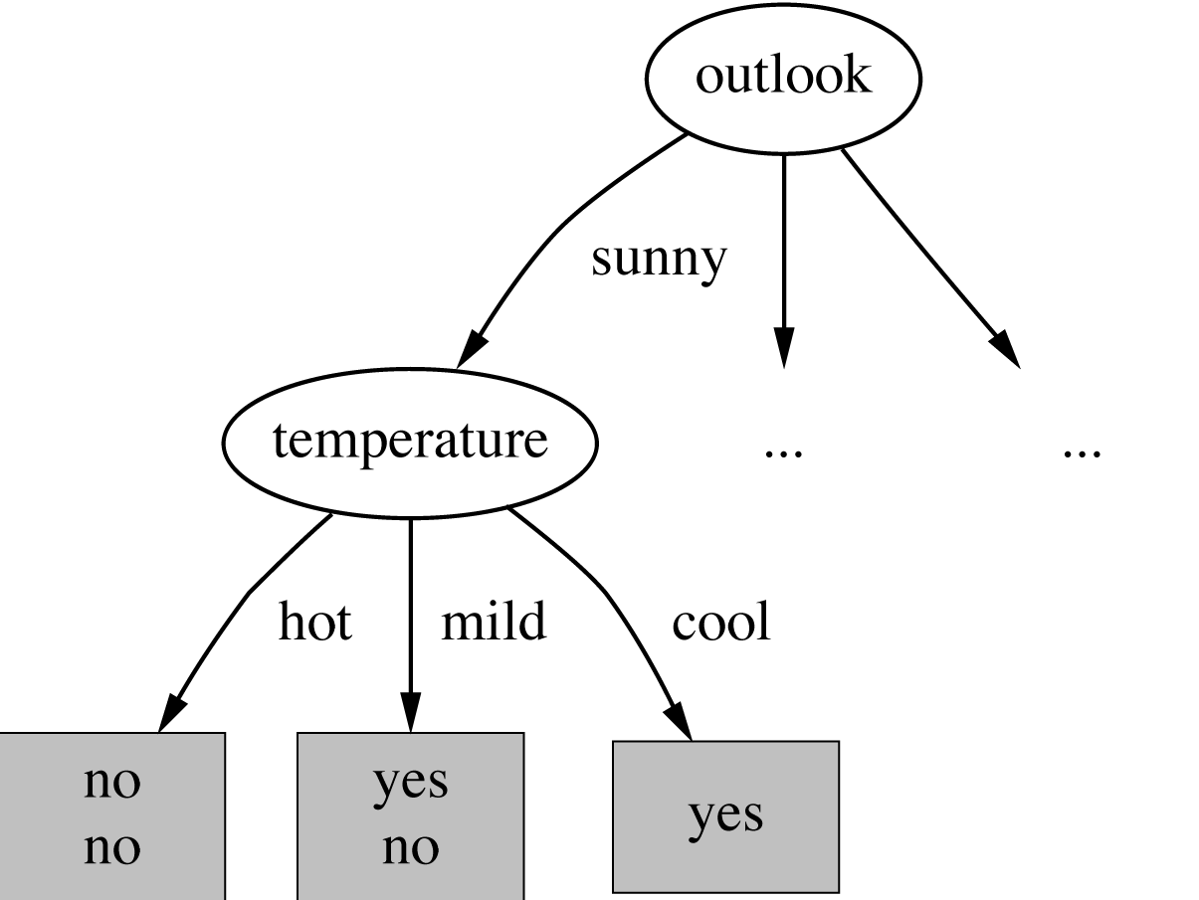
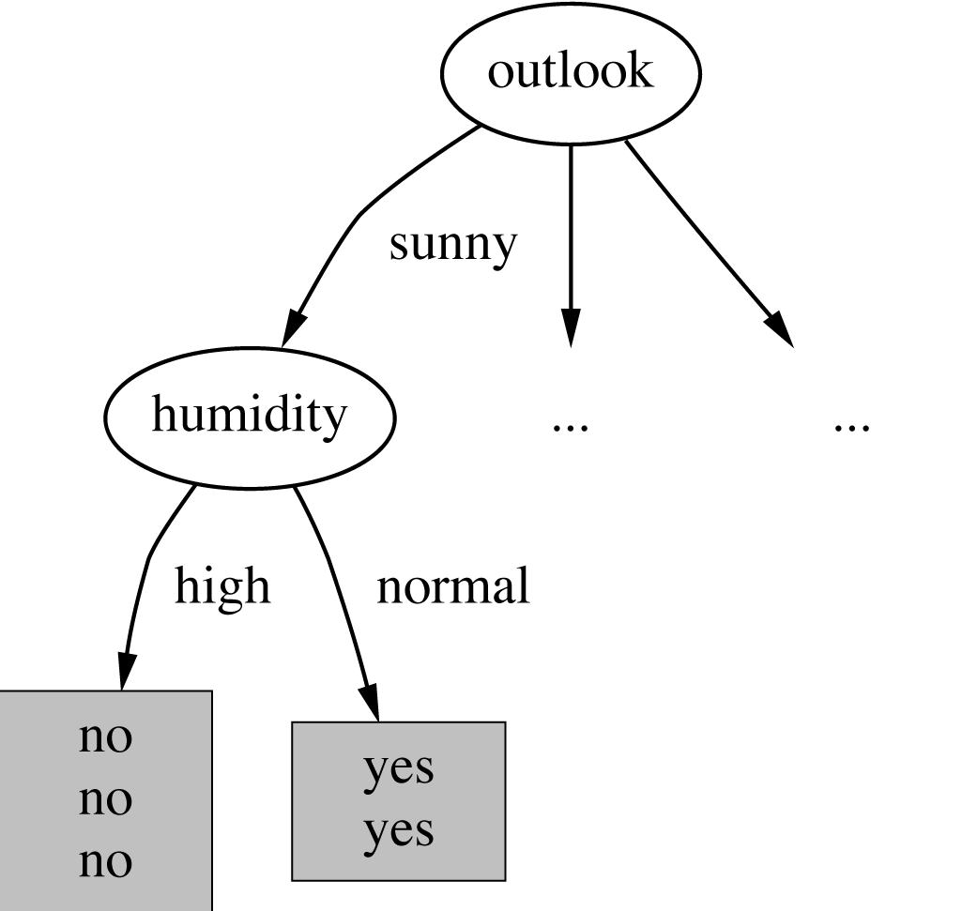
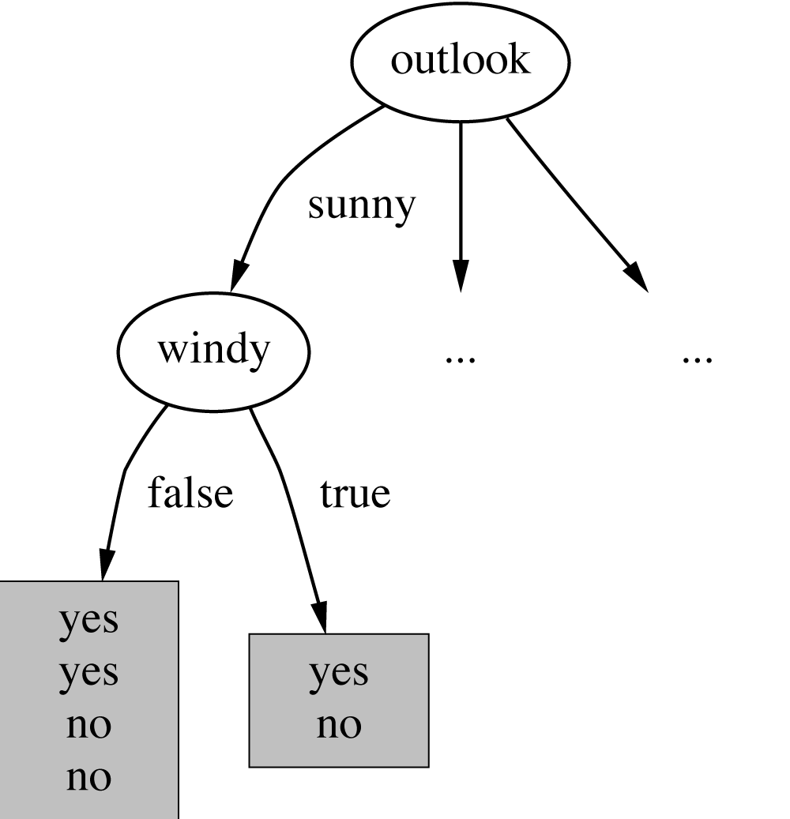
?

Slide 43
Info ([2,3]) = 0.971
[0,2]
[1,1]
[1,0]
Info ([0,2]) = 0
Info ([1,1]) = -1/1 * log 1/1 – 1/1 * log 1/1
Info ([1,0]) = 0
Info ([0,2], [1,1], [1,0]) = 0.4 bits
Gain (temperature) = 0.971 – 0.4 = 0.571 bits

Slide 44
Divide and Conquer: Constructing Decision Trees
Gain (temperature) = 0.571 bits
Gain (humidity) = 0.971 bits
Gain (windy) = 0.020 bits

Slide 45
Divide and Conquer: Constructing Decision Trees
Algorithm for top-down induction of decision trees (“ID3”) was developed by Ross Quinlan
Gain ratio just one modification of this basic algorithm
Led to development of C4.5, which can deal with numeric attributes, missing values, and noisy data
Similar approach: CART
There are many other attribute selection criteria! (But almost no difference in accuracy of result.)

Slide 46
Constructing Rules
b
a
y
b
b
b
a
b
b
a
a
a
b
b
b
b
a
b
b
b
b
x
1.2
b
a
y
b
b
b
a
b
b
a
a
a
2.6
b
b
b
a
b
b
b
b
b
x
1.2

Slide 47
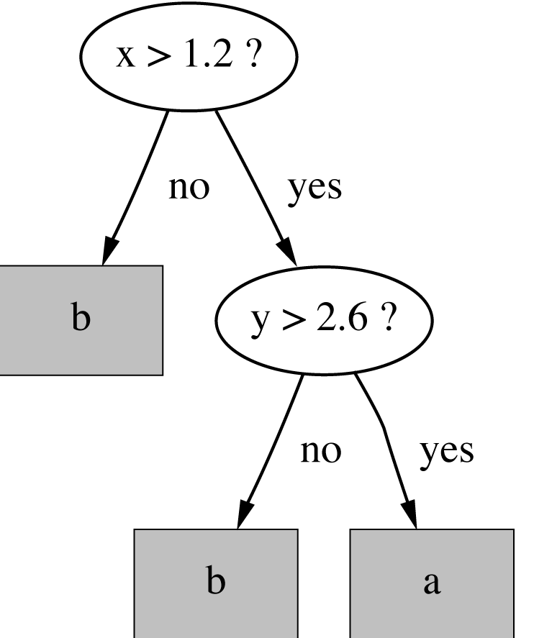
Constructing Rules
b
a
y
b
b
b
a
b
b
a
a
a
2.6
b
b
b
b
a
b
b
b
b
x
1.2
If x ≤ 1.2 then class = b
If x > 1.2 then class = a
If x > 1.2 and y ≤ 2.6 then class = b

Slide 48
How to Determine the Best Split
Greedy approach:
Nodes with homogeneous class distribution are preferred
Need a measure of node impurity:
Non-homogeneous,
High degree of impurity
Homogeneous,
Low degree of impurity

